Slide 1
Microsoft online Forms and Quizzes

Slide 2
Open this Presentation in Slide Show for special visual effects added to text or objects
On the Slide Show tab, in the Start Slide Show group, click From Beginning

Slide 3
When to use a Form and when to use a Quiz
Use FORMS to collect feedback, conduct surveys, collect contact details, etc.
Use QUIZ if you want to assess learning and provide instant results and feedback

Slide 4
Suggestion
Download the videos to solve your problems with Internet connectivity
Shorten your links with https://bitly.com

Slide 5
Microsoft Forms is generally available to:
Microsoft 365 Education customers
https://forms.office.com
Users with a personal Microsoft Account (Hotmail, Live, or Outlook.com)
https://office.com

Slide 6
If you have a valid Office 365 account, go to https://forms.office.com

Slide 7
If you use a personal Microsoft Account, go to https://office.com > All apps > Forms

Slide 8
To create a Form/Quiz, always start from this page

Slide 9
You should always add fields to collect learners’ names and class groups
If you do not, then each response will be labelled Responder 1, Responder 2 etc. with no names associated

Slide 10
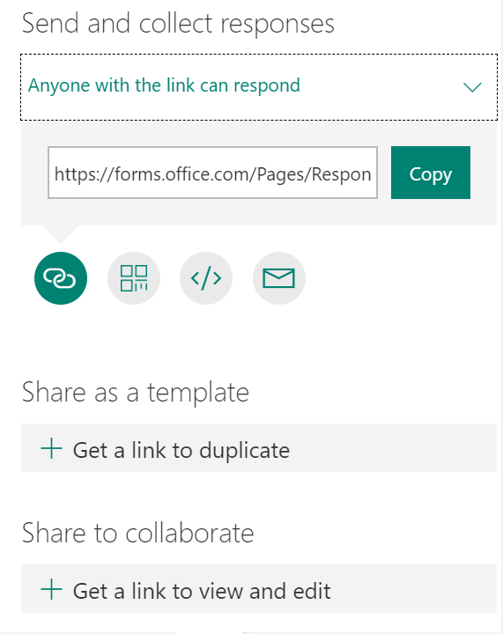
Share your Form/Quiz
With the Form/Quiz visible, click the Share button
Make sure ANYONE WITH THE LINK CAN RESPOND
Copy the Form/Quiz link and paste it into your preferred medium to distribute
You have 4 buttons which provide options for sharing your Form/Quiz: Link, QR Code, Embed, or Email

Slide 11
To WhatsApp your Form / Quiz
With the Form/Quiz visible, click the Share button
To generate a link for the Form/Quiz , click Copy next to the link box
Go to https://bitly.com to shorten the link
Copy and Paste the shortened link in your WhatsApp group (download WhatsApp onto your PC/Laptop) and send to your participants

Slide 12
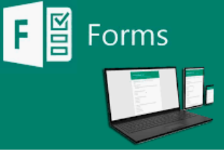
To create a Form or a Quiz, watch the video’s by clicking on the links on the next 2 slides

Slide 13
For an overview on Working with Forms, go to https://www.youtube.com/watch?v=TvWQXYl_aV0

Slide 14
For an overview on How to create a Quiz, go to https://www.youtube.com/watch?v=J-JpiMTHlEY&feature=youtu.be

