Slide 1
Accounting grade 10
2020
SOLE TRADERS analysis of adjustments and post adjustment trial balance

Slide 2
Characteristics of Financial statements
information is available to decision-makers in time to be capable of influencing their decisions
Timeliness
Understandability
presenting information clearly and concisely
Faithful representation
completeness, neutrality and freedom from error
Relevance
must have both a predictive value and confirmatory value
can be compared with a similar information about other entities and with similar information about the same entity for another period or another date
Comparability
Verifiability
observers looking at the data will reach have the same consensus

Slide 3
PRINCIPLES OF GAAP
Business entity
principle
Business and owner
separate entities
Historical cost
principle
Assets valued at
original cost
Going-concern
principle
Business to continue
for foreseeable future

Slide 4
Matching
principle
Income and expenses
allocated to correct
time period
Prudence
Principle
Financial results
Reflected on
Conservative bases
Materiality
Principle
Irrelevant information
not highlighted

Slide 5
You are provided with the pre-adjustment trial balance and list of individually worked and explained adjustments you are required to familiarize yourself with the adjustments and workings
Instructions

Slide 6
The following information has been taken from Nodada Traders for the year ended 28 February 2019.
PRE- ADJUSTED TRIAL BALANCE ON 28 FEBRUARY 2019
Balance Sheet account section |  | Debit | Credit
Capital | B1 |  | 963 000
Drawings | B2 | 19 600
Land and Building | B3 | 1 006 000
Vehicles (at cost) | B4 | 240 000
Accumulated depreciation on vehicles | B5 |  | 80 000
Equipment | B | 60 000
Accumulated depreciation on equipment | B7 |  | 36 000
Fixed Deposit: E.C. Bank | B8 | 50 000
Trading stock | B9 | 29 900
Debtors control | B10 | 18 000
Bank | B11 | 235 000
Loan: E.C. Bank | B12 |  | ?
Creditors control | B13 |  | 26 000
Nominal accounts section
Sales | N1 |  | 880 000
Cost of sales | N2 | 440 000
Debtors Allowances | N3 | 2 000
Discount allowed | N4 | 600
Bad debts | N5 | 1 200
Discount received | N6 |  | 900
Telephone | N7 | 2 800
Interest on fixed deposit | N8 |  | 3 000
Insurance | N9 | 3 400
Rent Income | N10 |  | 110 500
Salaries | N11 | 72 000
Stationery | N12 | 1 400
Bank charges | N13 | 2 500
 |  | 2 184 400 | 2 184 400

Slide 7
ADJUSTMENTS 1
Trading stock Deficit
The physical stocktaking of trading stock on 28 February 2019 is R28 500
R29 900 – R28 500 = R1 400
Amount to be calculated:
TB + Purchases – Returns to Creditors + Returns from Debtors (cost price)
Amount from Trial Balance
OR
ACCOUNT DEBIT | ACCOUNT CREDIT
Trading Stock Deficit
Trading Stock

Slide 8
GENERAL JOURNAL OF Nodada TRADERS FOR FEBRUARY 2019 GJ
Doc | D | Details | Fol | Debit | Credit
1 | 28 | Trading stock deficit | N14 | 1 400
 |  | Trading stock | B9 |  | 1 400
 |  | Trading stock deficit taken into account
GENERAL LEDGER OF Nodada TRADERS
BALANCE SHEET ACCOUNTS SECTION
 | TRADING STOCK |  |  |  |  | B9
2019 Feb 28 | Balance | b/d | 29 900 | 2019 Feb 28 | Trading stock deficit | GJ | 1 400
 |  |  |  |  | Balance | c/d | 28 500
 |  |  | 29 900 |  |  |  | 29 900
2019 Mar 1 | Balance | b/d | 28 500

Slide 9
GENERAL JOURNAL OF Nodada TRADERS FOR FEBRUARY 2019 GJ
NOMINAL ACCOUNTS SECTION
 | TRADING ACCOUNT DEFICIT |  |  |  |  | N14
2019 Feb 28 | Trading stock | GJ | 1 400 | 2019 Feb 28 | Profit and loss | GJ | 1 400
2 |  | Profit and loss account | F2 | 1 400
 |  | Trading stock deficit | N14 |  | 1 400
 |  | Closing transfer
EFFECT ON ACCOUNTING EQUATION
Journal | Source Document | Account debit | Account credit | A = | E + | L
GJ | Journal voucher | Trading stock deficit | Trading stock | - | - | 0

Slide 10
ADJUSTMENTS 2
Consumable stores on hand
The physical stocktaking of stationery on 28 February 2019 is R500
R500
ACCOUNT DEBIT | ACCOUNT CREDIT
Consumable Stores on hand
Stationery

Slide 11
GENERAL JOURNAL OF Nodada TRADERS FOR FEBRUARY 2019 GJ
Doc | D | Details | Fol | Debit | Credit
3 | 28 | Consumable stores on hand | B14 | 500
 |  | Stationery | N12 |  | 500
 |  | Stationery on hand
GENERAL LEDGER OF Nodada TRADERS
BALANCE SHEET ACCOUNTS SECTION
 | CONSUMABLE STORES ON HAND |  |  |  |  | B14
2019 Feb 28 | Stationery | GJ | 500

Slide 12
NOMINAL ACCOUNTS SECTION
 | STATIONERY |  |  |  |  | N12
2019 Feb 28 | Total | b/d | 1 400 | 2019 Feb 28 | Consumable stores on Hand | GJ | 500
 |  |  |  |  | Profit and loss | GJ | 900
 |  |  | 1 400 |  |  |  | 1400
GENERAL JOURNAL OF Nodada TRADERS FOR FEBRUARY 2019 GJ
4 |  | Profit and loss | F2 | 900
 |  | Stationery | N12 |  | 900
 |  | Closing transfer
EFFECT ON ACCOUNTING EQUATION
Journal | Source Document | Account debit | Account credit | A = | E + | L
GJ | Journal voucher | Consumable stores on hand | Stationery | + | + | 0

Slide 13
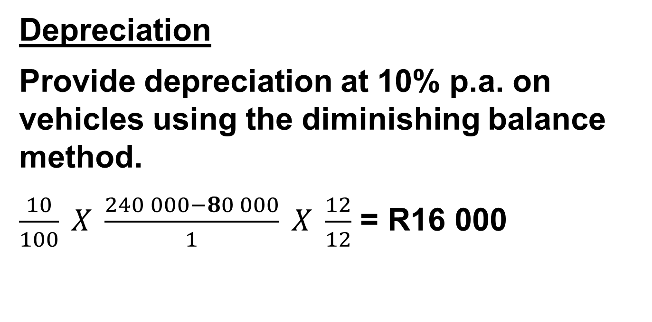
ADJUSTMENTS 3
Depreciation
Provide depreciation at 10% p.a. on vehicles using the diminishing balance method.
$\frac{10}{100} X \frac{240 000−80 000}{1} X \frac{12}{12}$ = R16 000
ACCOUNT DEBIT | ACCOUNT CREDIT
Accumulated Depreciation on vehicles
Depreciation

Slide 14
ADJUSTMENTS 3 CONTINUED
Depreciation
Provide depreciation at 20% p.a. on equipment on cost price.
$\frac{20}{100} X \frac{60 000}{1} X \frac{12}{12}$ = R12 000
ACCOUNT DEBIT | ACCOUNT CREDIT
Accumulated depreciation on Equipment
Depreciation

Slide 15
GENERAL JOURNAL OF Nodada TRADERS FOR FEBRUARY 2019 GJ
Doc | D | Details | Fol | Debit | Credit
5 | 28 | Depreciation | N15 | 28 000
 |  | Accumulated depreciation on vehicles | B5 |  | 16 000
 |  | Accumulated depreciation on equipment | B7 |  | 12 000
 |  | Depreciation on vehicles at 10% p.a. diminishing balance method Depreciation on equipment at 20% p.a. on cost
GENERAL LEDGER OF Nodada TRADERS
BALANCE SHEET ACCOUNTS SECTION
 |  | ACCUMULATED DEPRECIATION ON VEHICLE |  |  |  |  | B5
 |  |  |  |  | 2019 Feb 28 | Balance | b/d | 80 000
 |  |  |  |  |  | Depreciation | GJ | 16 000
 |  |  |  |  |  |  |  | 96 000

Slide 16
 | ACCUMULATED DEPRECIATION ON EQUIPMENT |  |  |  |  | B7
 |  |  |  | 2019 Feb 28 | Balance | b/d | 36 000
 |  |  |  |  | Depreciation | GJ | 12 000
 |  |  |  |  |  |  | 48 000
NOMINAL ACCOUNTS SECTION
 | DEPRECIATION |  |  |  |  | N156
2019 Feb 28 | Accumulated depreciation on vehicles | GJ | 16 000 | 2019 Feb 28 | Profit and loss | GJ | 28 000
 | Accumulated depreciation on equipment | GJ | 12 000
 |  |  | 28 000 |  |  |  | 28 000
GENERAL JOURNAL OF Nodada TRADERS FOR FEBRUARY 2019 GJ
6 |  | Profit and loss | F2 | 28 000
 |  | Depreciation | N15 |  | 28 000
 |  | Closing transfer

Slide 17
EFFECT ON ACCOUNTING EQUATION
Journal | Source Document | Account debit | Account credit | A = | E + | L
GJ | Journal voucher | Depreciation | Accumulated depreciation on vehicles | - | - | 0
GJ | Journal voucher | Depreciation | Accumulated depreciation on equipment | - | - | 0

Slide 18
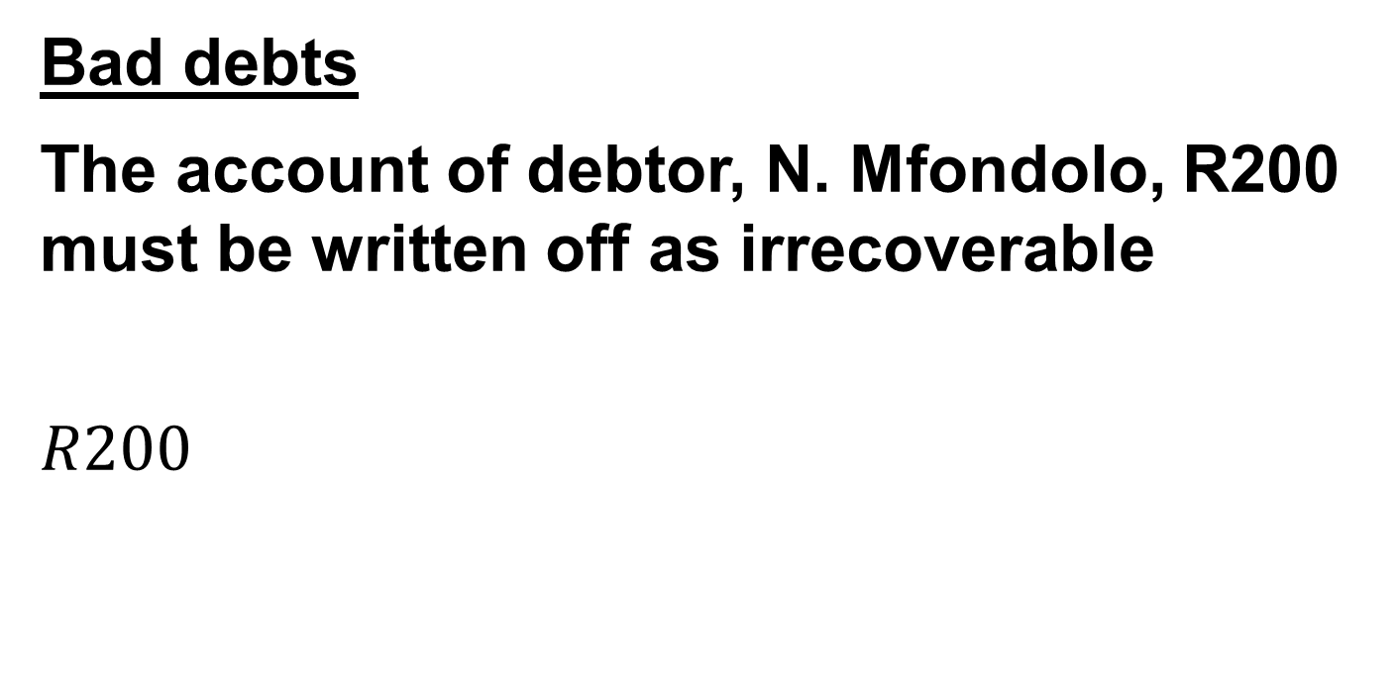
ADJUSTMENTS 4
Bad debts
The account of debtor, N. Mfondolo, R200 must be written off as irrecoverable
$$R200$$
ACCOUNT DEBIT | ACCOUNT CREDIT
Bad Debts
Debtors Control

Slide 19
GENERAL JOURNAL OF Nodada TRADERS FOR FEBRUARY 2019 GJ
Doc | D | Details | Fol | Debit | Credit | Debtors Control
 |  |  |  |  |  | Debit | Credit
7 | 28 | Bad debts | N5 | 200
 |  | N. Mfondolo | D7 |  | 200 |  | 200
 |  | Write off debts as irrecoverable
GENERAL LEDGER OF Nodada TRADERS
BALANCE SHEET ACCOUNTS SECTION
 | DEBTORS CONTROL |  |  |  |  | B10
2019 Feb 28 | Balance | b/d | 18 000 | 2019 Feb 28 | Journal Credits | GJ | 200
 |  |  |  |  | Balance | c/d | 17 800
 |  |  | 18 000 |  |  |  | 18 000
2019 Mar 1 | Balance | b/d | 17 800

Slide 20
NOMINAL ACCOUNTS SECTION
 | BAD DEBTS |  |  |  |  | N5
2019 Feb 28 | Total | b/d | 1 200 | 2019 Feb 28 | Profit and loss | GJ | 1 400
 | Debtors Control / N. Mfondolo | GJ | 200
 |  |  | 1 400 |  |  |  | 1 400
GENERAL JOURNAL OF Nodada TRADERS FOR FEBRUARY 2019 GJ
8 |  | Profit and loss | F2 | 1 400
 |  | Bad debts | N5 |  | 1 400
 |  | Closing transfer
EFFECT ON ACCOUNTING EQUATION
Journal | Source Document | Account debit | Account credit | A = | E + | L
GJ | Journal voucher | Bad debts | Debtors Control | - | - | 0

Slide 21
ADJUSTMENTS 5
Bad debts recovered
Debtor, T. Integrity, deposited R600 directly into bank account. It was discovered that his account was written off as bad debts. Receipt 650 was issued.
R600
ACCOUNT DEBIT | ACCOUNT CREDIT
Bank
Bad Debts Recovered

Slide 22
CASH RECEIPTS JOURNAL OF Nodada TRADERS FOR FEBRUARY 2019 CRJ
Doc | D | Details | Fol. | Bank | Sundry accounts
 |  |  |  |  | Amount | Fol. | Details
650 | 28 | T. Integrity |  | 600 | 600 | N16 | Bad debts recovered
GENERAL LEDGER OF Nodada TRADERS
BALANCE SHEET ACCOUNTS SECTION
 | BANK |  |  |  |  | B11
2019 Feb 28 | Balance | b/d | 269 600
 | Total Receipts | CRJ | 600
 |  |  | 270 200

Slide 23
NOMINAL ACCOUNTS SECTION
 | BAD DEBTS RECOVERED |  |  |  |  | N16
2019 Feb 28 | Profit and loss | GJ | 600 | 2019 Feb 28 | Bank | CRJ | 600
GENERAL JOURNAL OF Nodada TRADERS FOR FEBRUARY 2019 GJ
Doc | D | Details | Fol | Debit | Credit
9 |  | Bad debts recovered | N16 | 600
 |  | Profit and loss | F2 |  | 600
 |  | Closing transfer
EFFECT ON ACCOUNTING EQUATION
Journal | Source Document | Account debit | Account credit | A = | E + | L
CRJ | Receipt | Bank | Bad debts recovered | + | + | 0

Slide 24
ADJUSTMENTS 6
Correction of error
Repairs to the building, R6 000 was erroneously debited to the land and building account.
R6 000
ACCOUNT DEBIT | ACCOUNT CREDIT
Repairs to building
Land and Building

Slide 25
GENERAL JOURNAL OF Nodada TRADERS FOR FEBRUARY 2019 GJ
Doc | D | Details | Fol | Debit | Credit
10 | 28 | Repairs to building | N17 | 6 000
 |  | Land and Building | B3 |  | 6 000
 |  | Correction of error
GENERAL LEDGER OF Nodada TRADERS
BALANCE SHEET ACCOUNTS SECTION
 | LAND AND BUILDINGS |  |  |  |  | B3
2019 Feb 28 | Balance | b/d | 1 006 000 | 2019 Feb 28 | Repairs to building | GJ | 6 000
 |  |  |  |  | Balance | c/d | 1 000 000
 |  |  | 1 006 000 |  |  |  | 1 006 000
2019 Mar 1 | Balance | b/d | 1 000 000

Slide 26
NOMINAL ACCOUNTS SECTION
 | REPAIRS TO BUILDING |  |  |  |  | N17
2019 Feb 28 | Land and building | GJ | 6 000 | 2019 Feb 28 | Profit and loss | GJ | 6 000
GENERAL JOURNAL OF Nodada TRADERS FOR FEBRUARY 2019 GJ
11 |  | Profit and loss | F2 | 6 000
 |  | Repairs to building | N17 |  | 6 000
 |  | Closing transfer
EFFECT ON ACCOUNTING EQUATION
Journal | Source Document | Account debit | Account credit | A = | E + | L
GJ | Journal voucher | Repairs to building | Land and building | - | - | 0

Slide 27
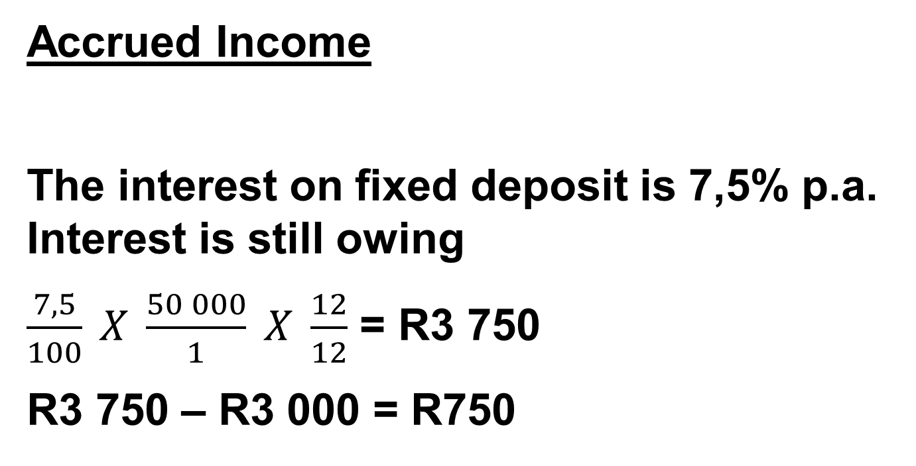
ADJUSTMENTS 7
Accrued Income
The interest on fixed deposit is 7,5% p.a. Interest is still owing
$\frac{7,5}{100} X \frac{50 000}{1} X \frac{12}{12}$ = R3 750
R3 750 – R3 000 = R750
Amount from Trial Balance
ACCOUNT DEBIT | ACCOUNT CREDIT
Accrued Income
Interest on Fixed Deposit

Slide 28
GENERAL JOURNAL OF Nodada TRADERS FOR FEBRUARY 2019 GJ
Doc | D | Details | Fol | Debit | Credit
10 | 28 | Accrued Income | B15 | 750
 |  | Interest on fixed deposit | N8 |  | 750
 |  | Interest on fixed deposit is still receivable
GENERAL LEDGER OF Nodada TRADERS
BALANCE SHEET ACCOUNTS SECTION
 | Accrued Income |  |  |  |  | B15
2019 Feb 28 | Interest on fixed deposit | GJ | 750

Slide 29
NOMINAL ACCOUNTS SECTION
 | INTEREST ON FIXED DEPOSIT |  |  |  |  | N8
2019 Feb 28 | Profit and loss | GJ | 3 750 | 2019 Feb 28 | Total | b/d | 3 000
 |  |  |  |  | Accrued Income | GJ | 750
 |  |  | 3 750 |  |  |  | 3 750
GENERAL JOURNAL OF Nodada TRADERS FOR FEBRUARY 2019 GJ
11 |  | Interest on fixed deposit | N8 | 3 750
 |  | Profit and loss | F2 |  | 3 750
 |  | Closing transfer
EFFECT ON ACCOUNTING EQUATION
Journal | Source Document | Account debit | Account credit | A = | E + | L
GJ | Journal voucher | Accrued Income | Interest on fixed deposit | + | + | 0

Slide 30
ADJUSTMENTS 8
Income received in advance
The rent income was received for March 2019
R110 500 ÷ 13 = R8 500
ACCOUNT DEBIT | ACCOUNT CREDIT
Income Received in Advance
Rent Income

Slide 31
GENERAL JOURNAL OF Nodada TRADERS FOR FEBRUARY 2019 GJ
Doc | D | Details | Fol | Debit | Credit
10 | 28 | Rent Income | N10 | 8 500
 |  | Income received in advance | B16 |  | 8 500
 |  | Rent income received for March 2019
GENERAL LEDGER OF Nodada TRADERS
BALANCE SHEET ACCOUNTS SECTION
 | INCOME RECEIVED IN ADVANCE |  |  |  |  | B18
 |  |  |  | 2019 Feb 28 | Rent income | GJ | 8 500

Slide 32
NOMINAL ACCOUNTS SECTION
 | RENT INCOME |  |  |  |  | N10
2019 Feb 28 | Income received in advance | GJ | 8 500 | 2019 Feb 28 | Total | b/d | 110 500
 | Profit and loss |  | 102 000
 |  |  | 110 500 |  |  |  | 110 500
GENERAL JOURNAL OF Nodada TRADERS FOR FEBRUARY 2019 GJ
11 |  | Rent Income | N10 | 102 000
 |  | Profit and loss | F2 |  | 102 000
 |  | Closing transfer
EFFECT ON ACCOUNTING EQUATION
Journal | Source Document | Account debit | Account credit | A = | E + | L
GJ | Journal voucher | Rent Income | Income Received in advance | 0 | - | +

Slide 33
ADJUSTMENTS 9
Prepaid Expense
Included in the Insurance is an amount of R1 440 paid for the period 1 June 2018 to 31 May 2019.
R1 440 ÷ 12 = R120 X 3 = R360
ACCOUNT DEBIT | ACCOUNT CREDIT
Expenses Prepared
Insurance

Slide 34
GENERAL JOURNAL OF Nodada TRADERS FOR FEBRUARY 2019 GJ
Doc | D | Details | Fol | Debit | Credit
12 | 28 | Prepaid Expense | B17 | 360
 |  | Insurance | N9 |  | 360
 |  | Insurance paid in advance
GENERAL LEDGER OF Nodada Traders
BALANCE SHEET ACCOUNTS SECTION
 | Prepaid Expense |  |  |  |  | B17
2019 Feb 28 | Insurance | GJ | 360

Slide 35
NOMINAL ACCOUNTS SECTION
 | INSURANCE |  |  |  |  | N9
2019 Feb 28 | Total | b/d | 3 400 | 2019 Feb 28 | Prepaid Expense | GJ | 360
 |  |  |  |  | Profit and loss | GJ | 3 040
 |  |  | 3 400 |  |  |  | 3 400
GENERAL JOURNAL OF Nodada TRADERS FOR FEBRUARY 2019 GJ
13 |  | Profit and loss | F2 | 3 040
 |  | Insurance | N9 |  | 3 040
 |  | Closing transfer
EFFECT ON ACCOUNTING EQUATION
Journal | Source Document | Account debit | Account credit | A = | E + | L
GJ | Journal voucher | Prepaid Expense | Insurance | + | + | 0

Slide 36
ADJUSTMENTS 10
Accrued Expense
The telephone account, R400, for February is still outstanding
R400
ACCOUNT DEBIT | ACCOUNT CREDIT
Telephone
Accrued Expense

Slide 37
GENERAL JOURNAL OF Nodada TRADERS FOR FEBRUARY 2019 GJ
Doc | D | Details | Fol | Debit | Credit
10 | 28 | Telephone | N6 | 400
 |  | Accrued Expense | B18 |  | 400
 |  | Rent income received for March 2019
GENERAL LEDGER OF Nodada TRADERS
BALANCE SHEET ACCOUNTS SECTION
 | Accrued Expense |  |  |  |  | B18
 |  |  |  | 2019 Feb 28 | Telephone | GJ | 400

Slide 38
NOMINAL ACCOUNTS SECTION
 | TELEPHONE |  |  |  |  | N6
2019 Feb 28 | Total | b/d | 2 800 | 2019 Feb 28 | Profit and loss | GJ | 3 200
 | Accrued Expense | GJ | 400
 |  |  | 3 200 |  |  |  | 3 200
GENERAL JOURNAL OF Nodada TRADERS FOR FEBRUARY 2019 GJ
11 |  | Profit and loss | F2 | 3 200
 |  | Telephone | N7 |  | 3 200
 |  | Closing transfer
EFFECT ON ACCOUNTING EQUATION
Journal | Source Document | Account debit | Account credit | A = | E + | L
GJ | Journal voucher | Telephone | Expense Accrued | 0 | - | +

Slide 39
ADJUSTMENTS 11
Loan and Interest on loan
Loan statement received from E.C. Bank reflected the following:
Calculate the interest on loan.
The business is expected to pay R18 000 of the loan the following year
 | R
Balance at beginning of financial year | 112 000
Repayments during the year, including interest | 27 000
Interest at 15% per year capitalised | ?
Balance at end of financial year | 000

Slide 40
ADJUSTMENTS 11 - Continued
DR |  | LOAN: E.C. Bank |  |  |  |  |  |  | CR
DATE |  | DETAILS | F | AMOUNT | DATE |  | DETAILS | F | AMOUNT
2019Feb
2018
Mar
28
Bank
27 000
01
Balance
112 000
2009
Feb
Interest on loan
Balance
c/d
100 000
28
15 000
127 000
127 000
2019
Mar
R127 000 – R112 000 = R15 000
01
Balance
b/d
100 000
ACCOUNT DEBIT | ACCOUNT CREDIT
Interest on loan
Loan: E.C. Bank

Slide 41
GENERAL JOURNAL OF Nodada Traders FOR FEBRUARY 2019 GJ
Doc | Day | Details | Fol. | Debit | Credit
12 | 28 | Interest on Loan | N18 | 15 000
 |  | Loan: E.C. Bank | B12 |  | 15 000
 |  | Interest on loan taken into account
NOMINAL ACCOUNTS SECTION
 |  | INTEREST ON LOAN |  |  |  |  |  | N18
2019 Feb | 28 | Loan: E.C. Bank | GJ | 15 000 | 2019 Feb | 28 | Profit and loss | GJ | 15 000
GENERAL JOURNAL OF Nodada Traders FOR FEBRUARY 2019 GJ
13 |  | Profit and loss | F2 | 15 000
 |  | Interest on loan | N18 |  | 15 000
 |  | Closing transfer
EFFECT ON ACCOUNTING EQUATION
Journal | Source Document | Account debit | Account credit | A = | E + | L
GJ | Journal voucher | Interest on loan | Loan: E.C. Bank | 0 | - | +

Slide 42
12 Transfer of Debtors allowances to Sales and closing transfers of sales
and cost of sales
GENERAL JOURNAL OF Nodada TRADERS FOR FEBRUARY 2019 GJ
Doc | D | Details | Fol | Debit | Credit
22 | 28 | Sales | N1 | 2 000
 |  | Debtors Allowances | N3 |  | 2 000
 |  | Closing Transfer
GENERAL LEDGER OF Nodada TRADERS
NOMINAL ACCOUNTS SECTION
 | SALES |  |  |  |  | N1
2019 Feb 28 | Debtors allowances | GJ | 2 000 | 2019 Feb 28 | Total | b/d | 880 000
 | DEBTORS ALLOWANCES |  |  |  |  | N3
2019 |  |  |  | 2019
Feb 28 | Total | b/d | 2 000 | Feb 28 | Sales | GJ | 2 000

Slide 43
GENERAL LEDGER OF Nodada TRADERS
NOMINAL ACCOUNTS SECTION
 | SALES |  |  |  |  | N1
2019 Feb 28 | Debtors allowances | GJ | 2 000 | 2019 Feb 28 | Total | b/d | 880 000
 | Trading Account | GJ | 878 000
 |  |  | 880 000 |  |  |  | 880 000
GENERAL JOURNAL OF Nodada TRADERS FOR FEBRUARY 2019 GJ
Doc | D | Details | Fol | Debit | Credit
23 |  | Sales |  | 878 000
 |  | Trading Account |  |  | 878 000
 |  | Closing Transfer

Slide 44
GENERAL LEDGER OF Nodada TRADERS
NOMINAL ACCOUNTS SECTION
 | COST OF SALES |  |  |  |  | N2
2019 |  |  |  | 2019
Feb 28 | Total | b/d | 440 000 | Feb 28 | Trading Account | GJ | 440 000
GENERAL JOURNAL OF Nodada TRADERS FOR FEBRUARY 2019 GJ
Doc | D | Details | Fol | Debit | Credit
24 |  | Trading Account |  | 440 000
 |  | Cost of Sales |  |  | 440 000
 |  | Closing Transfer

Slide 45
Nodada TRADERS
POST- ADJUSTED TRIAL BALANCE ON 28 FEBRUARY 2019
Balance Sheet account section | Debit | Credit
Capital |  | 963 000
Drawings | 19 600
Land and Building (1 006 000 – 6 000) | 1 000 000
Vehicles (at cost) | 240 000
Accumulated depreciation on vehicles (80 000 + 16 000) |  | 96 000
Equipment | 60 000
Accumulated depreciation on equipment (36 000 + 12 000) |  | 48 000
Fixed Deposit: E.C. Bank | 50 000
Trading stock (29 900 – 1 400) | 28 500
Debtors control (18 000 – 200) | 17 800
Bank (235 000 + 600) | 235 600
Loan: E.C. Bank (112 000 – 27 000 + 15 000) |  | 100 000
Creditors control |  | 26 000
Consumable Stores on hand | 500
Accrued Income | 750
Income received in advance |  | 8 500
Prepaid Expense | 360
Accrued Expense |  | 400

Slide 46
Nominal accounts section
Sales |  | 880 000
Cost of sales | 440 000
Debtors Allowances | 2 000
Discount allowed | 600
Bad debts (1 200 + 200) | 1 400
Discount received |  | 900
Telephone (2 800 + 400) | 3 200
Interest on fixed deposit (3 000 + 750) |  | 3 750
Insurance (3 400 – 360) | 3 040
Rent Income (110 500 – 8 500) |  | 102 000
Salaries | 72 000
Stationery (2 500 – 500) | 900
Bank charges | 2 500
Trading stock deficit | 1 400
Depreciation (16 000 + 12 000) | 28 000
Bad debts recovered |  | 600
Repairs to building | 6 000
Interest on loan | 15 000
 | 2 229 150 | 2 229 150

