Slide 1
THE TEACHING OF DRAMA

Slide 2
The concept drama
Story is presented by enacting rather than by narration
Provides stage directions/ facial expressions/costumes/props/
Each member in the audience brings own interpretation based on background, beliefs and personality

Slide 3
Different dramatic forms
Epic Drama – Embodies ideals of a large group of people
Lyrical romantic – intimate life and feelings of people
Comic – Humorous with a happy ending
Tragedy –People suffer because of the environment/ flaw in character/calamitous event/violent crime

Slide 4
Why teach drama?
Realistic nature of the play when dramatised evokes a personal response
We see ourselves reflected in the actors
Our experiences are mirrored in the action
Personal involvement deepens the awareness of life’s problems
Self-expression – which the acting allows heightens the sense of reality/ relevance to life

Slide 5
The teaching of drama: Concepts
Characterisation – We learn about a character from what he/she says about him/herself and others
Form opinions about characters
What others say about the character
Stage directions on how the characters should look, act and dress

Slide 6
The teaching of drama: Concepts
Climax – peak or physical emotional tension is reached
Conflict – clash of ideas/ personalities or actions of the characters
Dialogue – Conversation carried on by the characters
Plot – story
Setting – location/background

Slide 7
The teaching of drama: Concepts
Structure – underlying pattern of development : Exposition – rising action – climax- falling action – conclusion
Suspense – Building up of tension/ uncertainty
Theme – central idea or main issue of the play

Slide 8
Focus areas (caps) p26
Plot and sub-plot
Characterisation
Role of narrator/persona/ point of view
Background and setting (relation to character and theme)
Dramatic structure: plot/subplot
Mood and tone
Ironic twist/ending
Stage directions
Link between dialogue/monologue/ soliloquy and action
Dramatic irony
Timeline

Slide 9
The presentation of a play
Know something about playwright’s time and background
Watch a worthwhile production/film
Make use of audio-visual aids/technology
Use pair and group work
Be willing to try out new approaches
Use illustrations and cartoons
Acquaint pupils with dramatic conventions they will need for understanding the play/ They need to create the play in their imagination as it is written for the stage

Slide 10
Stages in play presentation
Teacher’s interpretation – read commentaries and criticisms/ have a good grasp
Planning and preparation – meticulous planning – Time spent on the play / Topics and questions must be carefully prepared
Introducing the play- discuss the reasons for studying the play/ Broad outline of the plot – use photographs/posters

Slide 11
Stages in presentation
The play should be read at least twice
The first reading is cursory –plot –events
The second reading should focus on interpretation and analysis
Explain lexical items/ dramatic conventions that are fundamental to understanding the scene
Discuss the structure/ outline of significance of scene

Slide 12
Other procedures
Listening comprehension exercises – skillfully set questions
Group discussions – structured set of questions – self discovery
Play reading by some of the better readers
Other learners could provide sound effects
Pupils could read minor scenes at home
Encourage them to make predictions
Reinforcement – text-based exercises after every reading

Slide 13
Sophiatown by malcolm purkey
Background to the Play
Conceived in 1986 during the state of emergency
It was a workshopped production by the Junction Avenue Theatre Company
In using Sophiatown to oppose the apartheid regime Junction Avenue was using it to look beyond the apartheid regime at the difficulties and promises of a democratic South Africa

Slide 14
sophiatown
The conceptualisation of the play
The group interviewed people who lived in the area – Don Mattera/ Kort Boy –Leader of the American gang/ Jane Dakile – teacher whose home was bulldozed/ Anthony Sampson and Gordimer shared their experiences of intellectual life
They visited the film archives – African Jim (movie) / Magic Garden
Examined copies of Drum magazine from the passed at the archives in Pretoria

Slide 15
SOPHIATOWN
Story from Drum that was the impetus:
Nat Nakasa and Lewis Nkosi set up house together (in Sophiatown) and advertised for a Jewish girl to come and live with them
Questions that they considered: What does the Jewish girl do? Under what conditions is she accepted? How does a 16 year old schoolgirl respond to the call for a school boycott in 1955 when Bantu Education is implemented? What was the role of a journalist from Drum at the height of its popularity?

Slide 16
sophiatown
The Workshop process:
They met 3 times a week for 6 months
They presented their collective vision for the future
This workshop served as a meeting ground for their common life experiences
Spent hours weighing up different beginnings and endings
Plot focused on the destruction of Sophiatown
Purkey was required to shape the material into a working script

Slide 17
SOPHIATOWN
CHARACTERS
Jakes – Drum magazine journalist and intellectual - late 20’s
Mingus – Member of the American gang – late 20’s
Mr Fahfee – Fahfee runner and Congress activist– 40’s
Lulu – 16 year old school girl
Mamariti – Shebeen queen, owner of a house in Sophiatown- mother of Mingus and Lulu
Princess – Lover of Mingus and good time girl- late 20’s
Ruth – Jewish girl from the white suburb of Yeoville 20’s
Charlie – Mingus’s sidekick – Barely articulate – obsessed with shoes

Slide 18
Act 1 – scene 1
Cast sing Kofifi Sophia
Jakes provides a background to Sophiatown
We are introduced to the people who lived there and his own background
Mingus asks Jakes to write him a love letter to his girlfriend because he cannot write
He relates what should be written in the letter to boost his ego
Fahfee informs them about the forced removals and that the Congress called for 5000 volunteers

Slide 19
Act 1 scene 2
Lulu learning her poem ‘I wondered lonely as a cloud ..’
Someone knocks at the door but Princess Mingus’ girlfriend refuses to open
Ruth- the Jewish girl enters stating that she saw an advertisement in the paper for accommodation
Fahfee informs them that they will be forced to sell their houses to the Native Resettlement Board – Luthuli was banned
Ruth is allowed to stay

Slide 20
Act 1 scene 3
Princess is unhappy with Mingus for allowing the Jewish girl to move in
Mingus wants the Jewish girl to stay on
Poem on forced removals (p.42)
Mingus buys the Jewish girl a bath, which she says that she will not be using
Jakes is suspicious of Ruth – He says that a white skin is a fatal attraction

Slide 21
Act 1 scene 4
Issues of identity are examined in this scene (p.46)
Example (Ruth says – What’s Jewish – I don’t know what the hell I am)
Jakes says ( ‘I’m a would be intellectual living in a wasteland with no power to change anything except words – and a fat lot of good they do’)

Slide 22
Act 1 scene 5
Fahfee calls out the numbers and explains what they represent

Slide 23
Act 1 Scene 6
Lulu tells Ruth that she is writing a composition about her mom who is a ‘cheeky old woman’ and her brother who is a thief
Ruth tells her about the different sorts of truths
Mingus and Princess go to watch a movie at the Odin bioscope and enact the scene
Fahfee informs them that they will have to move/ but that they should refuse to move

Slide 24
Act 1 scene 7
Mingus buys Ruth pearls but she refuses to accept them because he stole them

Slide 25
Act 2 scene 1
The company storms onto the stage singing “Koloi e”
The characters talk about the forced removals
Princess informs them that she has a job as a model/ this enrages Mingus
Ruth asks Jakes to look at her properly when he writes so that he gives a balanced perspective of her

Slide 26
Act 2 scene 2
Spotlight is on Ruth as she concentrates intensely and calls out numbers - Fahfee

Slide 27
Act 2 scene 3
A dance sequence – 4 men dressed in white executing dance moves reminiscent of the Manhattans

Slide 28
Act 2 scene 4
Mingus wants Ruth to go out with him, but she refuses and he becomes angry

Slide 29
Act 2 scene 5
Fahfee informs them that his shack has been knocked down
Mingus’s storeroom in Toby street has also been demolished
Mingus accuses Ruth’s Whites for the forced removals and says she should be held responsible
He becomes aggressive towards her and uses vulgar language
Princess informs them that she will be moving to Hillbrow

Slide 30
Act 2 scene 6
Charlie speaks for the first time in this scene
As Mingus’ side-kick he wants to go with him to Meadowlands
Mingus tells him that he won’t be able to come because he is Coloured and Mingus is Black
Ruth regrets that Jake did not decide to have a relationship with her
Character narratives of the final day in Sophiatown and a summary of what transpired thereafter

Slide 31
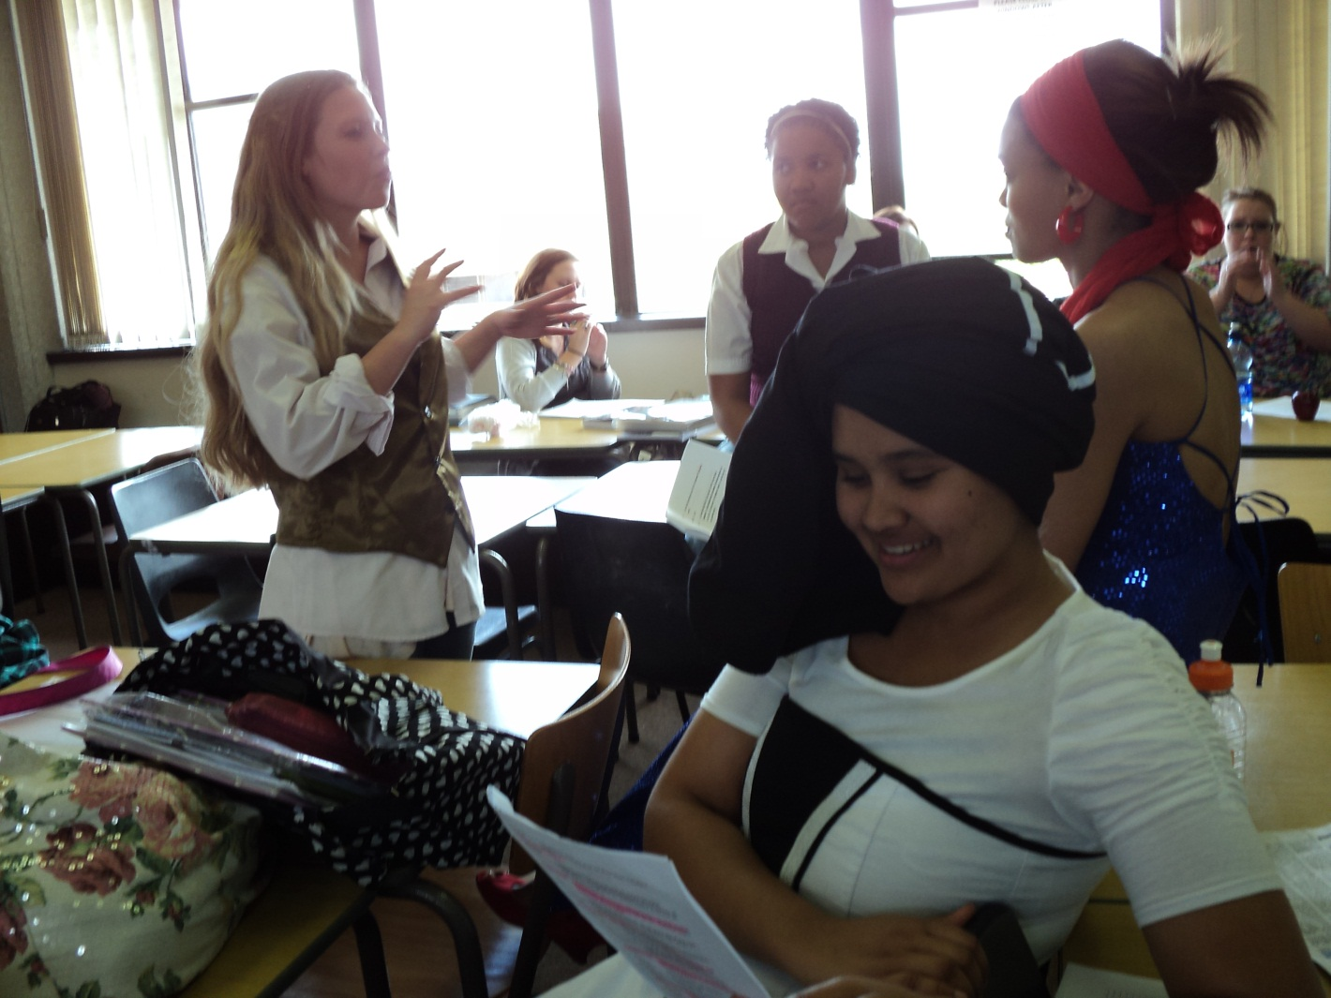
Group preparation

Slide 32
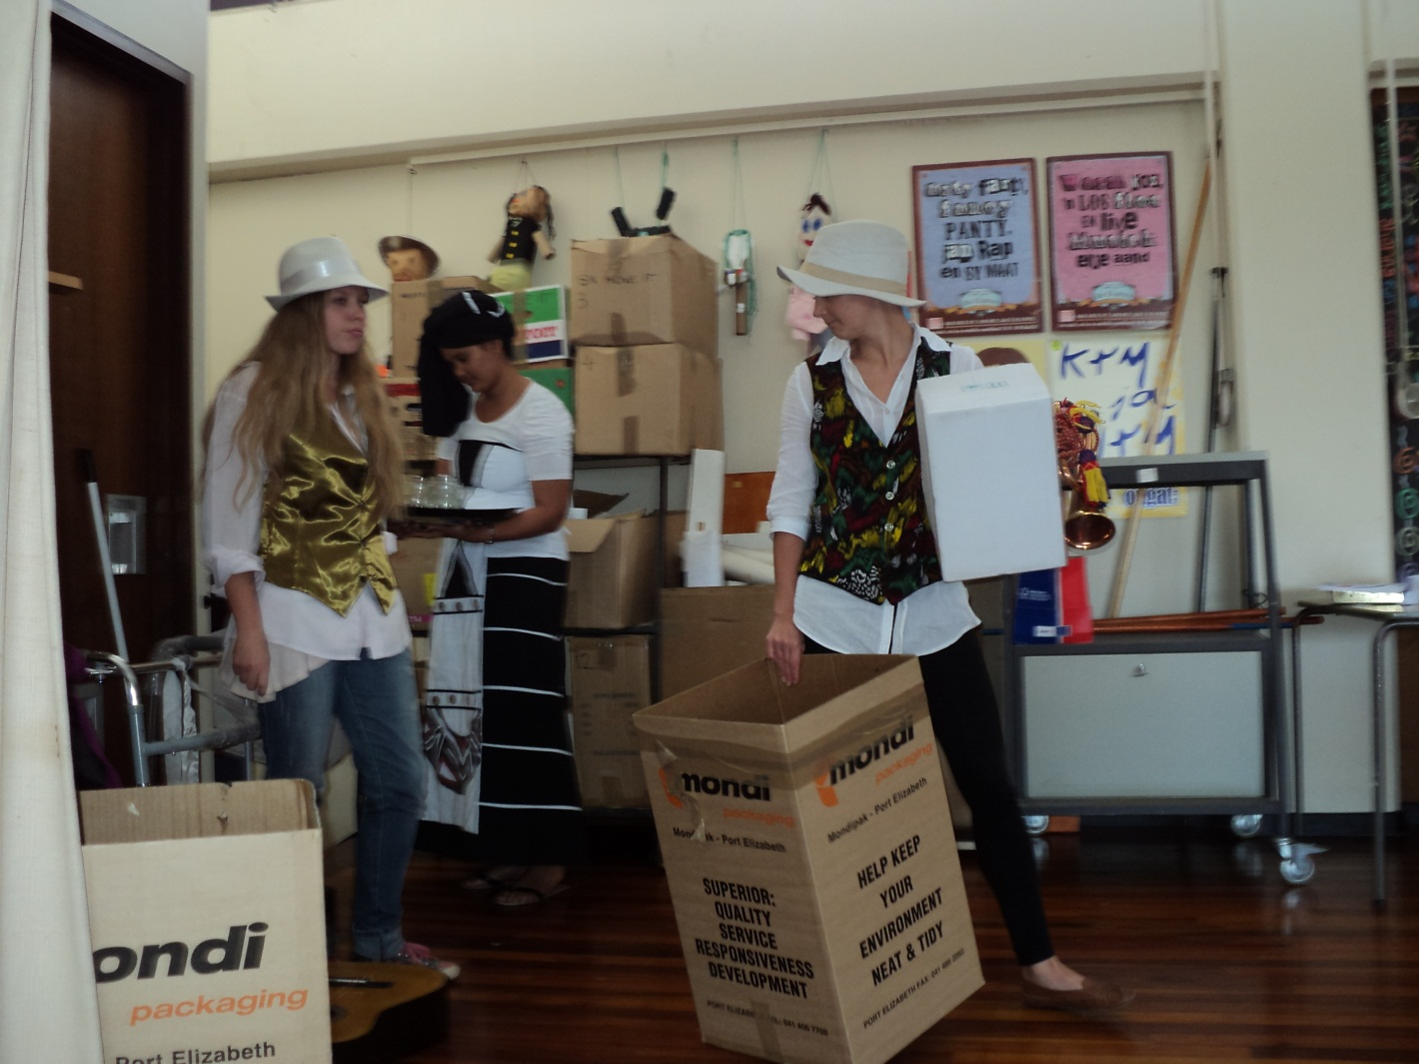
Getting ready to move

Slide 33
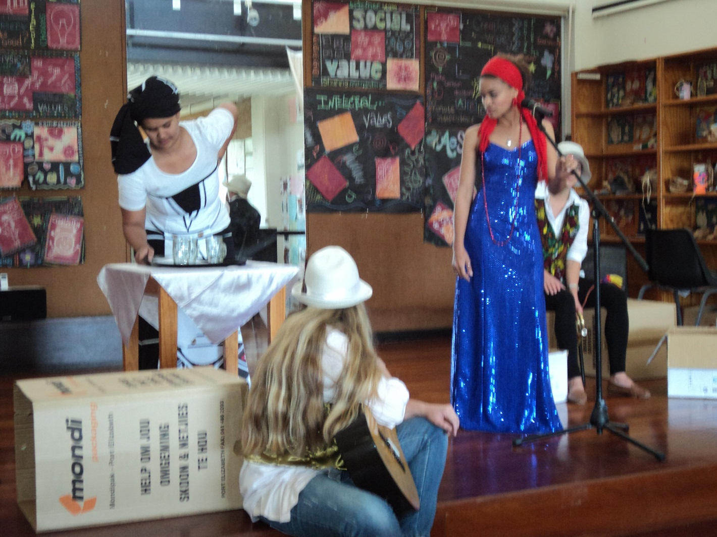
Music at the shebeen

Slide 34
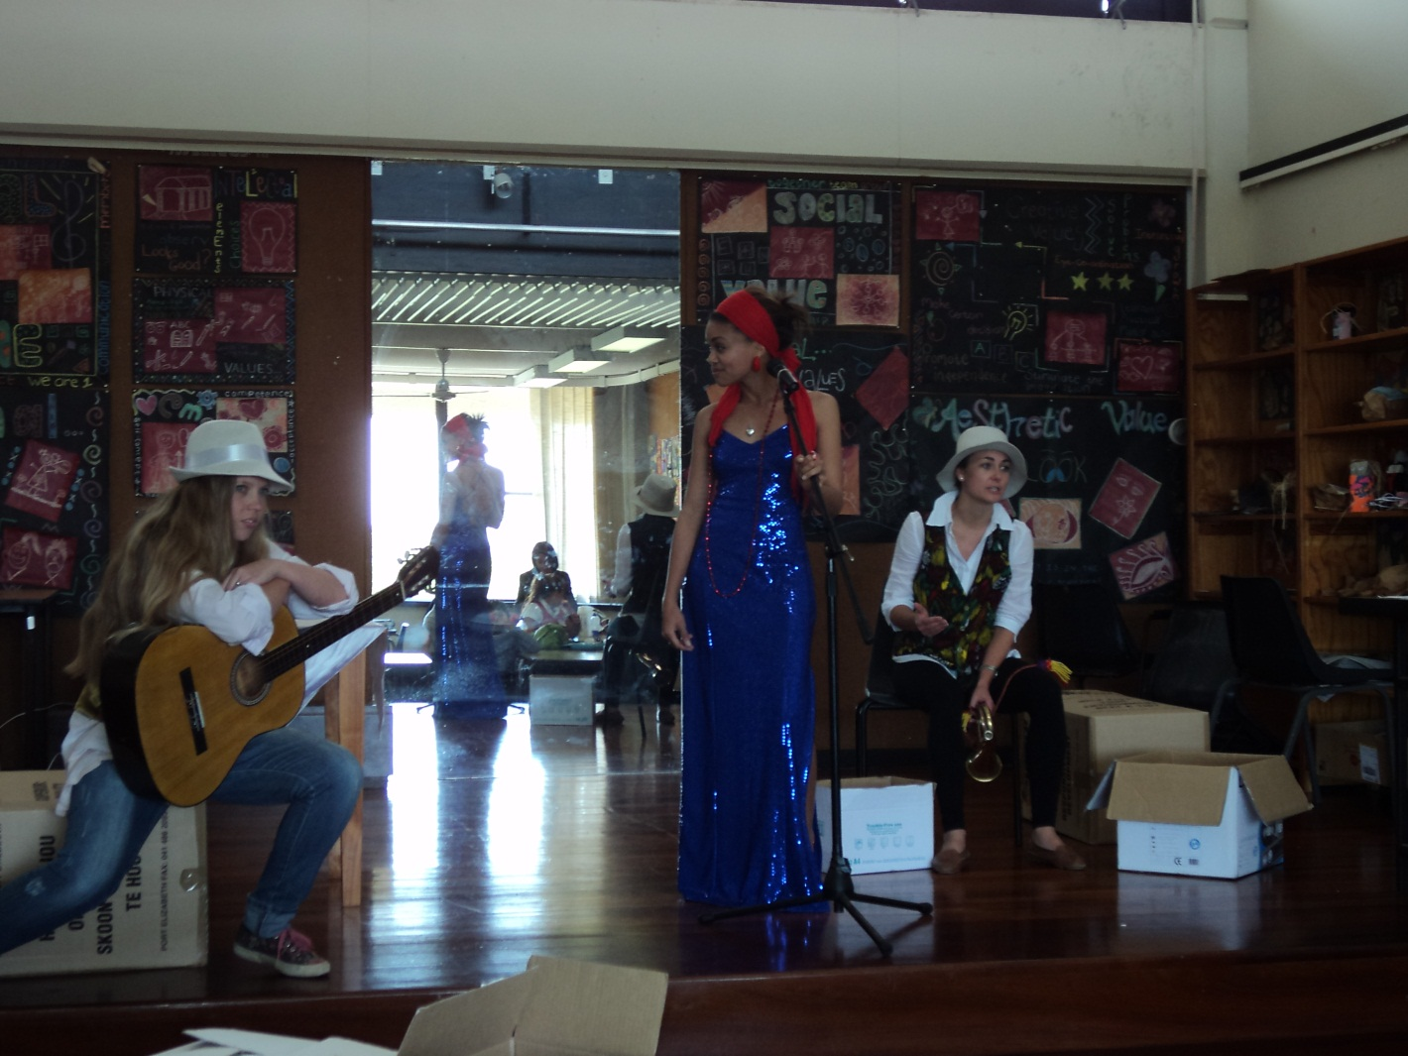
Music at the shebeen

Slide 35
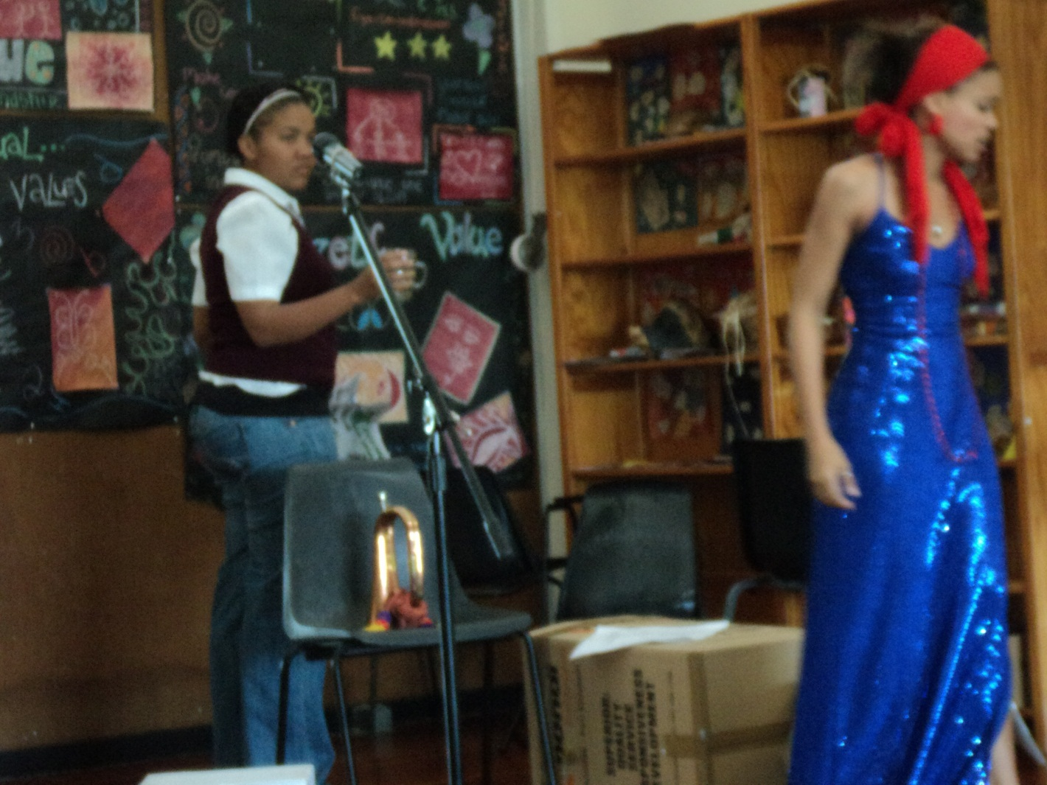
They receive the news

Slide 36
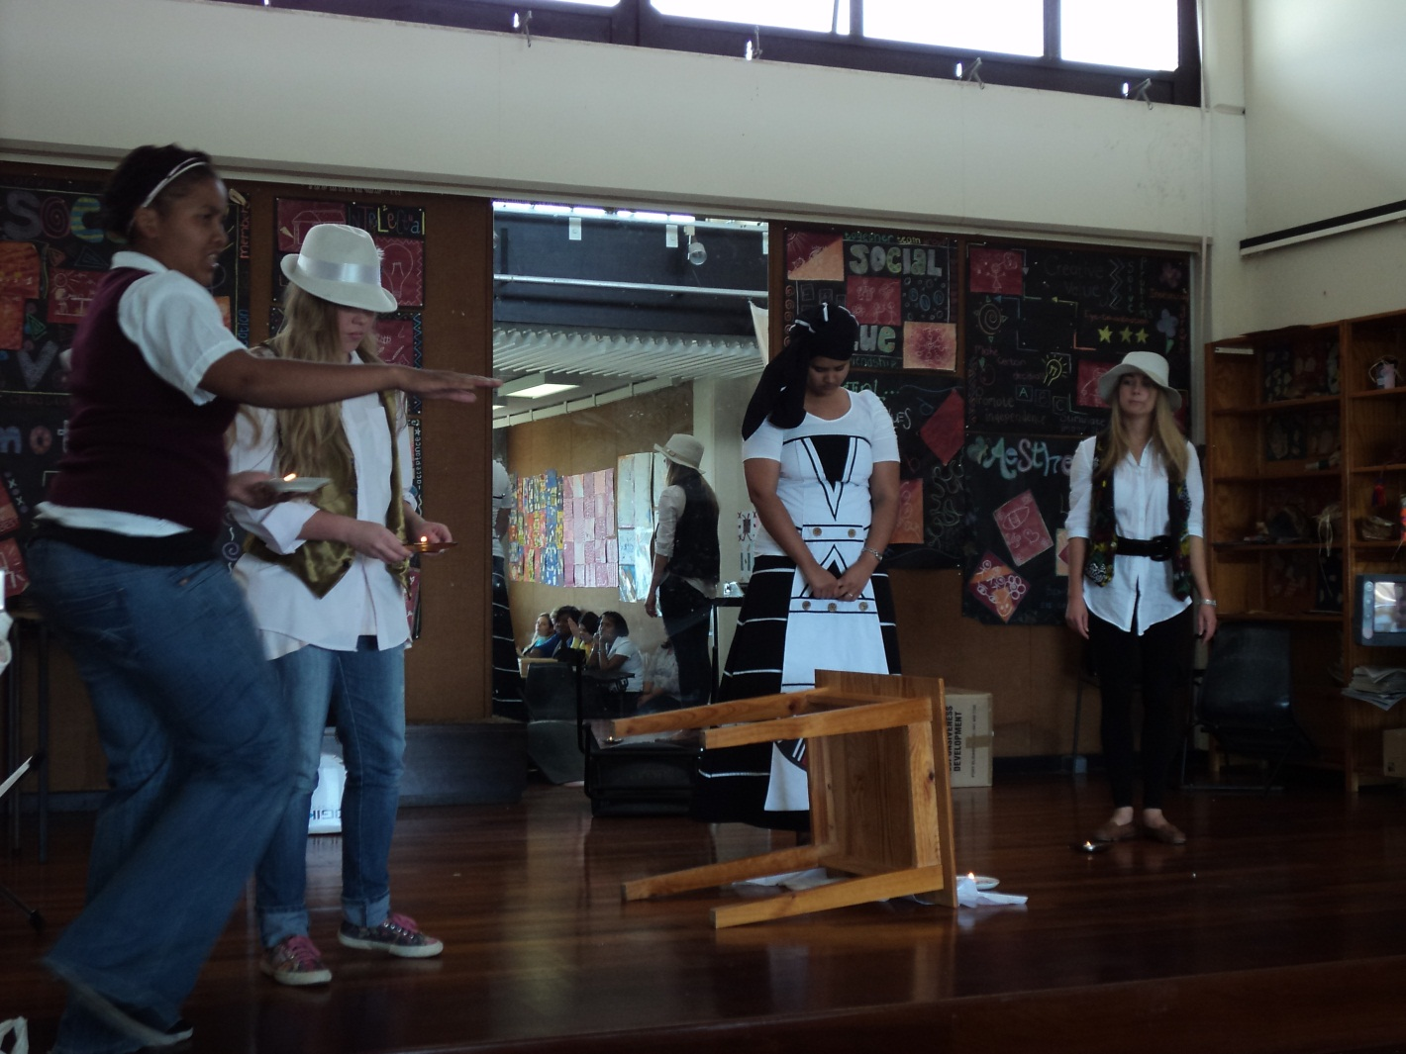
The are forced to move

Slide 37
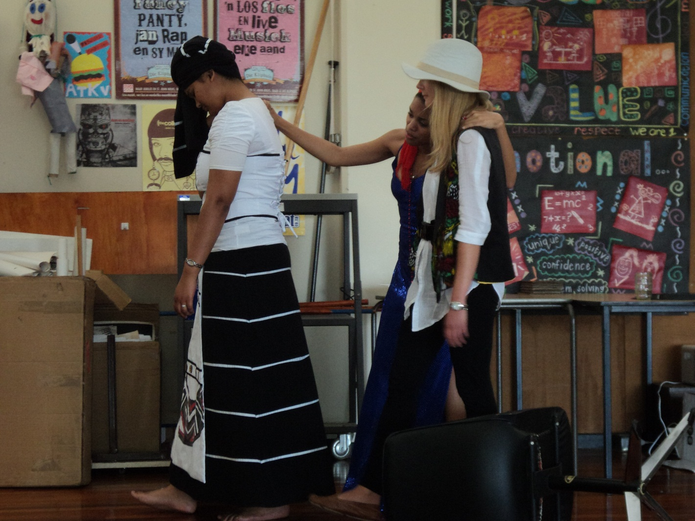
They leave sophiatown

Slide 38
Group work tasks
Task 1: Design a flow diagram/ mind map that represents each of the following aspects
Group 1: Characterisation and stage directions
Group 2: Plot and setting
Group 3: Themes and dialogue (Language)
Group 4: Structure (of play and scenes)
Group 5: Conflict amongst characters

Slide 39
Workshop tasks – per group
TASK
1.Provide a brief outline of the scenes allocated to your group.
2. Construct a set of contextual questions based on any one of the scenes with a memoranda.
3.Present the questions to the class for discussion

Slide 40
GROUP ALLOCATION
Group 1: Act 1 Scenes 1-3
Group 2: Act 2 Scenes 4-5
Group 3: Act 1 Scenes 6-7
Group 4: Act 2 Scenes 1-3
Group 5: Act 2 Scenes 4-6

