Slide 1
Sophia town
South African play

Slide 2
History of sophiatown
On 9 February 1955, the head of the South African state, D F Malan, sent two thousand policemen armed with sten guns and rifles.
They destroyed Sophiatown and removed 60 000 inhabitants.
The removal of the residents of Sophiatown was organised by the Native Resettlement Board, which was the NP’s local board.
People who settled in Sophiatown were moved to Meadowlands, which formed a part of Soweto, where the NP established a housing area based on the population census within the shanty town.
The houses had no toilets, water and electricity.

Slide 3
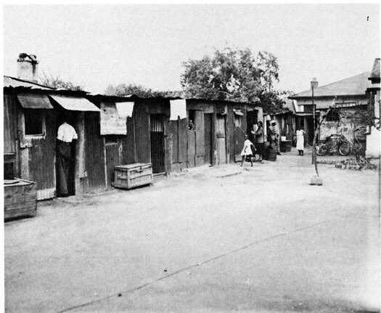
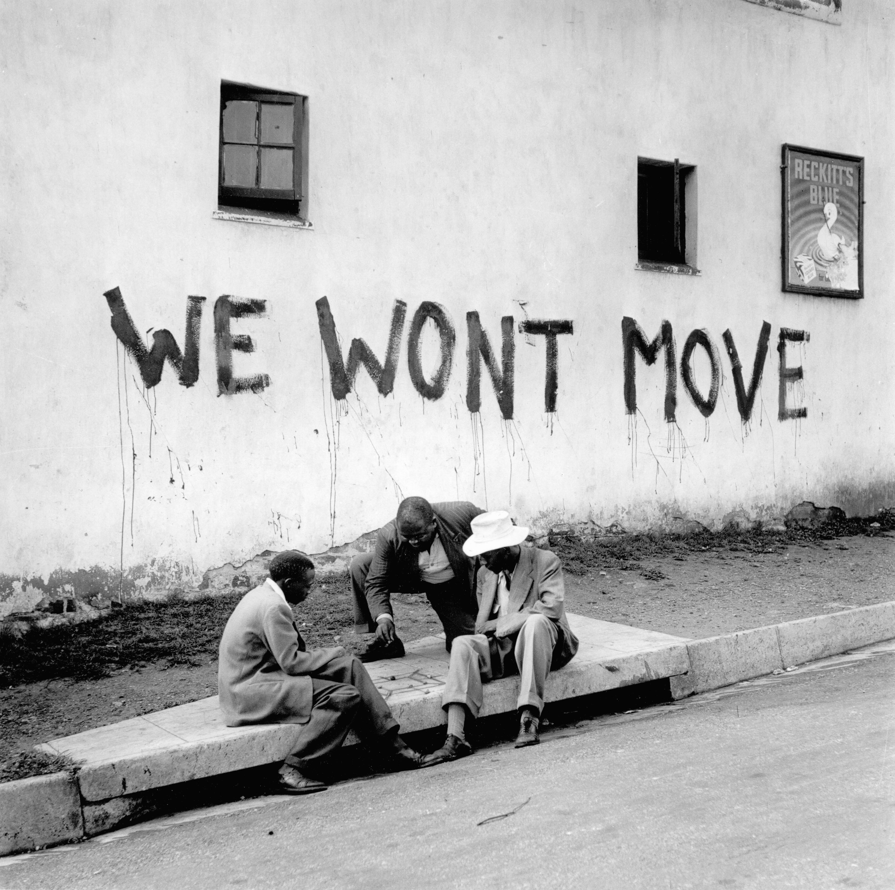
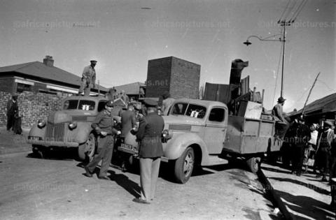
“The bulldozers were just hired killers; they flattened people’s homes in minutes. They destroyed a spirit, a culture, and a rich heritage that had been built up over generations. But they could not remove people’s dignity or their memories. The story of forced removals will be told for many generations to come. The pain cannot be ignored.”
-Don Mattera, poet and author

Slide 4
What is a plot
The term “plot” refers to how the main events in the book or play relate to one another, how one event leads to another. Something happens because of something else, and so on. It is a series of events that make up a story and is specific to each story. A plot structure, also called a dramatic structure is the overall design or structure of a story and how the story elements are arranged.
To help you analyse the plot, it is important to understand what the structural elements of the plot are.
Every story has a beginning or exposition, with something that leads to conflict in the middle, before it is resolved and the story concludes

Slide 5
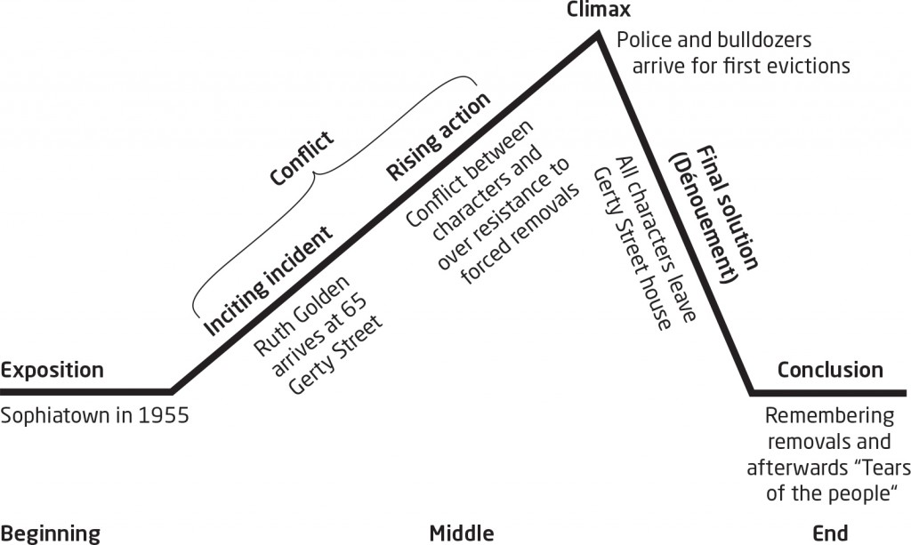
To help you understand the plot structure, here is a graph that illustrates the structural elements of Sophiatown

Slide 6
Now let us look at the definitions of each element to understand what they mean.
Exposition | The exposition is the explanation (usually at the beginning of a story) of the events leading up to the start of the plot.
Inciting incident | The first time we realise that all is not well. Something that sets off the conflict in the story.
Rising action | The building up of conflict in the plot.
Conflict | The struggle between characters, or between individuals and their circumstances.
Climax | The highest point in the development of the conflict, the moment of greatest intensity and tension.
Final solution (dénouement) | The final part of the story where everything is made clear.
Conclusion | The way the story is rounded off.

Slide 7
Exposition and inciting incident of conflict
 | Jakes sets the scene, describing the situation and conflict that the characters in the play are facing, that is, the forced removal from their homes. The incident that triggers the conflict between the characters is the arrival of Ruth. We see the first reactions of the other characters towards her. In terms of the story and plot, Ruth’s arrival sets in motion the struggle that the characters face. This struggle will remove them from the home and lives they know

Slide 8
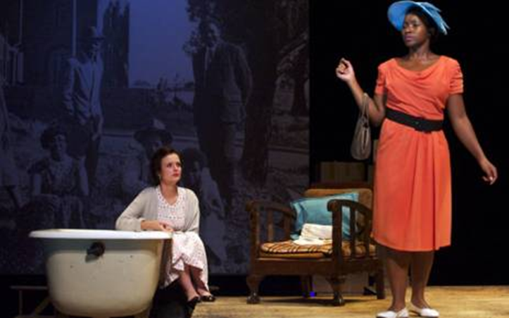
Conflict begins
In the play, Sophiatown, two distinct types of conflict can be identified, namely:
1. Conflict between characters, for example between Mingus and Ruth, or Fahfee and Jakes, or Ruth and Jakes.
2. Conflict between the characters and a situation, for example, the characters in the play face conflict in terms of the forced removals. We can also say that, in this play, the conflict is between the residents of Sophiatown and the apartheid government.

Slide 9
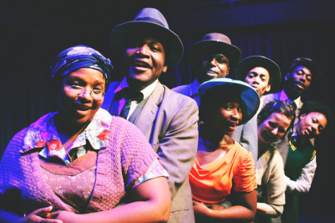
Rising action contributing to conflict and leading to climax
What builds up to the conflict between the main characters is how they, for example Jakes, Mingus and Fahfee, react to Ruth. Ruth also reacts to them and to life in Sophiatown.
The conflict between the characters and their situation also contributes to the rising action. There are glimpses of resistance to the coming eviction through Fahfee. As the play proceeds and the time of the eviction draws closer, the tension rises.

Slide 10
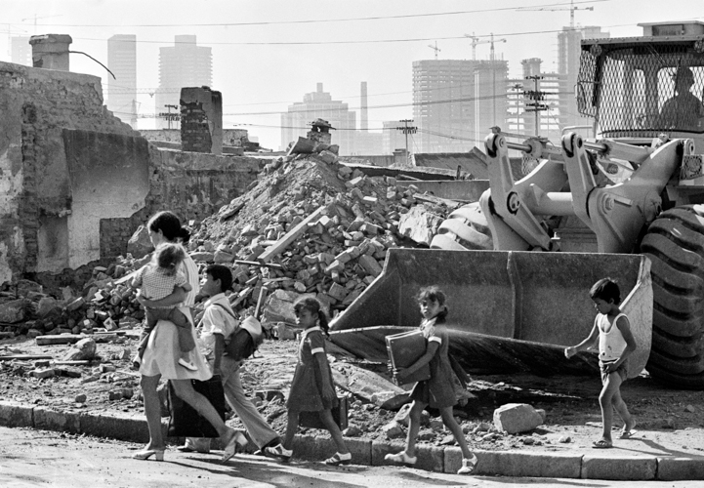
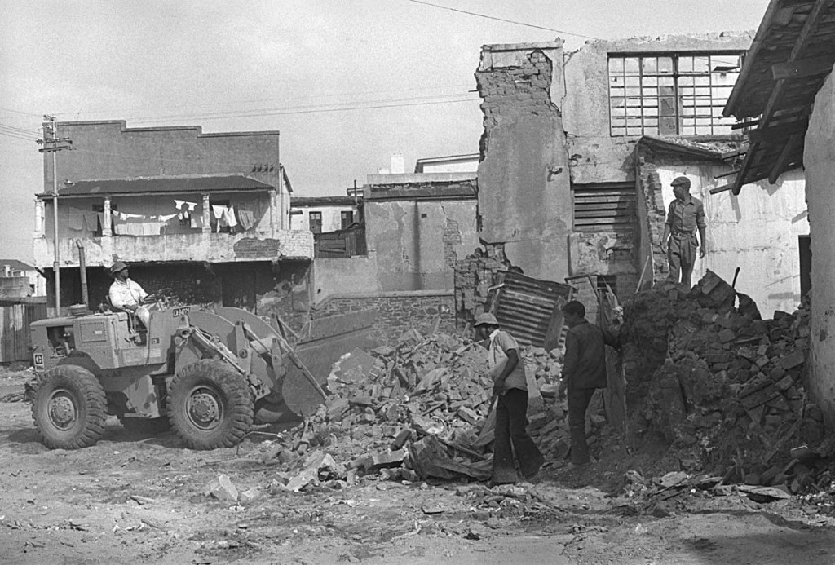
Climax
Act 2, Scene 5 and 6. The first evictions in Sophiatown are shown. The bulldozers have arrived to demolish Toby Street. It is clear the bulldozers will soon come to Gerty Street.

Slide 11
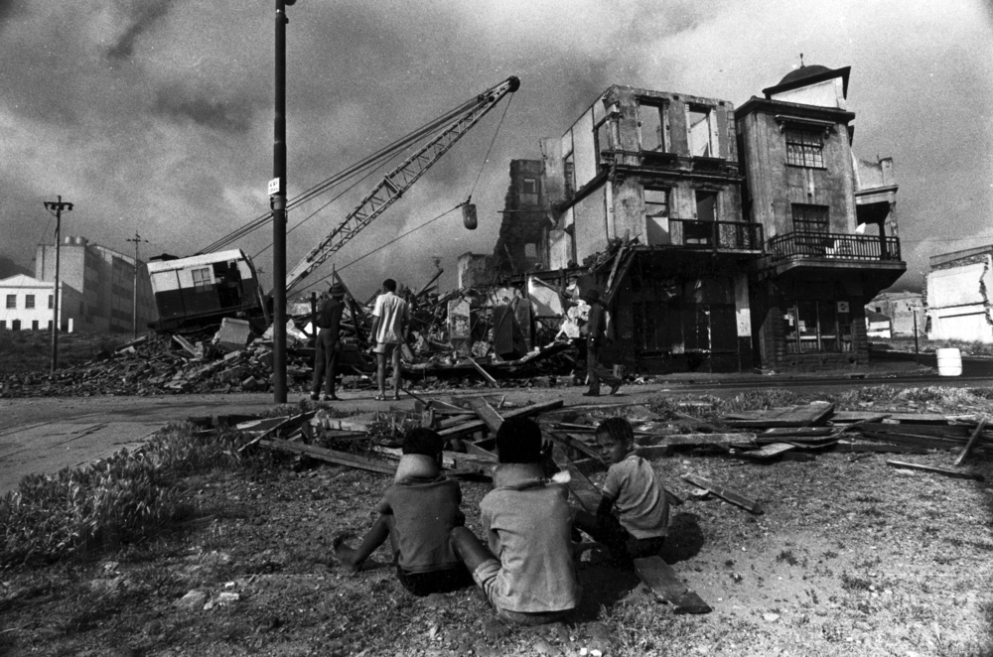
Falling action/ final solution
The police and bulldozers are about to arrive to demolish the house in Gerty Street. The characters are powerless to stop their eviction. Plans to resist this have failed.

Slide 12
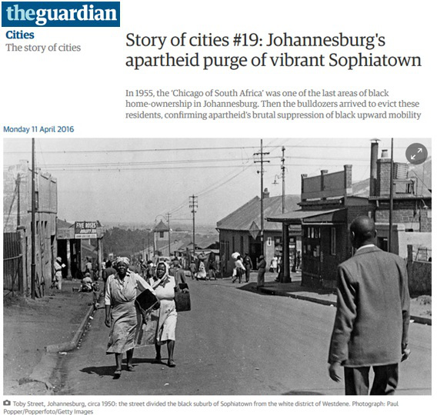
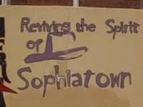
Conclusion
In the last scene, the characters (except for Ruth, Princess and Charlie) remember the day their home was destroyed and they tell about this day from their point of view. Jakes tells us what happened to Ruth, Princess and Charlie. The song at the end conveys a mood of sadness and mourning for what was lost

Slide 13
CAST
JAKES: Drum magazine journalist, smart and in his late 20’s
MINGUS: American gang member, in his late 20’s
MR FAHFEE: Fahfee runner and Congress activist, in his late 40’s
LULU: 16 year old girl
MAMARITI: A shebeen Queen and owner of a house in Sophiatown; the mother of Mingus and Lulu
PRINCESS: Lover of Mingus and good-time girl, in her 20’s
RUTH: Jewish girl from the white suburb of Yeoville, in her 20’s
CHARLIE: Mingus’s sidekick, he is barely articulate (able to read or write or speak clearly) and is obsessed with shoes

Slide 14
Setting
MAMARITI’S: has a comfortable arm chair and side-table covered in photographs
There are chairs in the kitchen
Set in 1960’s
Mamariti’s freehold Sophiatown house
Living area is cramped (small) but comfortable suggesting care/warmth
Each character has their own corner filled with their things
JAKES: has a table, chair, typewriter and books
CHARLIE’S: has a broken car seat and steering wheel
LULU: has school books, pens and pencils

