Slide 1
DIRECTORATE CURRICULUM FET PROGRAMMES
Agricultural sciences
Virtual lessons
Term 2

Slide 2
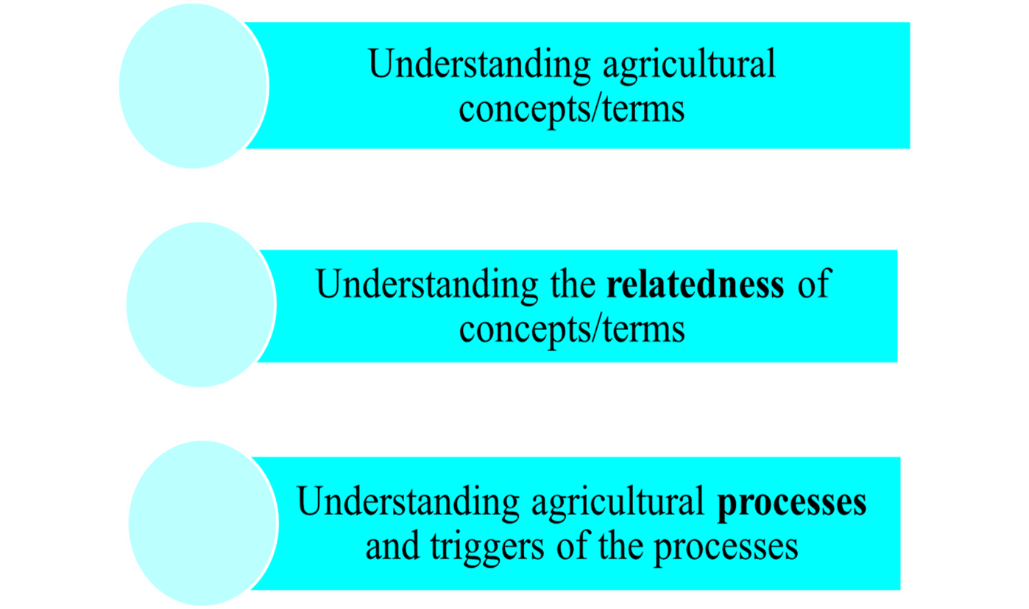
Integrated approach to learning

Slide 3
VOCABULARY DEVELOPMENT AND LANGUAGE USE

Slide 4
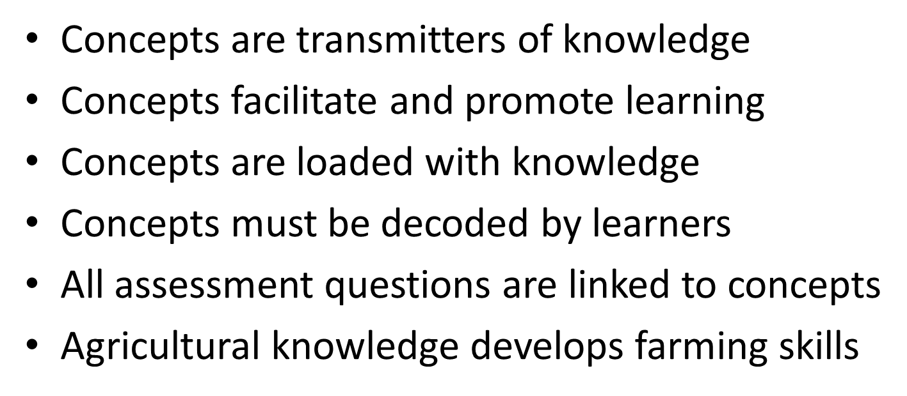
Importance of key concepts

Slide 5
Parturition/birth and dystocia

Slide 6
Key terms
Parturition or calving is the normal ending of a pregnancy. It is the process of ejection of the foetus and the placenta from the uterus of the mother.
Dystocia is the term used to describe a difficult birth.

Slide 7
Conditions that interfere with the parturition process!
Offspring that is too large for the cow.
Multiple births:
Premature or late birth
Induced parturition
Incorrect presentation of the calf
Incomplete cervical dilation
Vaginal tear

Slide 8
Dystocia
The term dystocia is used to describe any situation or reason why a cow is unable to deliver a calf. The cow experiences a difficult parturition process. If the breeder or veterinarian does not intervene in time it may lead to the death of both the cow and the calf. Factors that may cause dystocia include:
Incorrect presentation, position and posture
large foetuses that cannot move through the birth canal
Torsion of the uterus
Uterine inertia
Malformed foetuses.

Slide 9
Signs or characteristics of a cow approaching parturition
The vulva softens and becomes swollen.
The cervix secretes stringy mucus
The cervix dilates.
The cow urinates and defecates frequently due to the pressure exerted by the foetus on the bladder and rectum.
There may be a change in the cow’s body temperature.
‘The allantois ruptures leading to expulsion of the allantois fluid (‘the water breaks’).
The cow’s udder becomes swollen and milk starts dripping from the teats.
The belly droops.
The soft tissues around the tail head look sunken due to the relaxation of the pelvic ligaments.

Slide 10
Behavioural signs of oncoming parturition
The cow isolates herself from the herd.
The cow stops eating.
The cow shows signs of distress and discomfort.
The cow is restless, circles, bites or kicks her flank, bawls and groans

Slide 11
The functions of the layers covering the foetus
Amnion: This is the inner embryonic membrane. It contains a fluid that surrounds the embryo, called the amniotic fluid. The amniotic fluid prevents the embryo from attaching to other tissues and also protects the embryo against shocks, injuries, changes in temperature and dehydration. In addition, it serves as a lubricant in the reproductive tract during parturition.

Slide 12
The functions of the layers covering the foetus
Chorion: The chorion is the outer membrane, which is firmly attached to about 150 caruncles on the uterus wall. The chorion contributes to the development of the embryo by aiding the production of the placenta.

Slide 13
Placenta: The placenta is the area of attachment of the foetus with the cow. The placenta is very rich in blood supply, and consists of maternal and embryonic tissue. The blood of the embryo comes in close contact with the blood of the mother, but never mixes. The embryo receives nutrients and oxygen, and gets rid of waste products and carbon dioxide by means of osmosis and diffusion.

Slide 14
Milk production (lactation)

Slide 15
Milk let-down
The cow starts secreting normal milk three days after parturition.
The lactation curve rises until the maximum production is reached about eight weeks after calving.
This peak is maintained for about two weeks and production then gradually starts dropping until the cow is dried up in preparation for the next parturition.
When milk production reaches its peak, the butterfat content is at its lowest quantity. As milk production decreases, the percentage of butterfat is at its highest.

Slide 16
Process of milk let-down

Slide 17
Revision questions
Identify the process in the picture above.
Milking or lactation
2. Identify three visible stimuli in the picture.
The milking equipment
The calf
Touching of the udder
3. Name the hormone responsible for the above process.
Oxytocin
4. Name the reproductive process which preceeds the above process.
Pregnancy or gestation

Slide 18
Milk let-down process and the hormones involved
When the nerves in a cow’s udder are stimulated, the hormone oxytocin is secreted by hypophysis gland in the brain.
Oxytocin causes contractions inside the udder cavities, which cause the milk to ejected.
Certain nervous stimuli must take place in the udder.
The washing of the udder with luke-warm water
The presence of the calf
The sucking action of the calf
Familiar sounds in the milking stable also lead to the secretion of oxytocin.

Slide 19
Hormones
Oxytocin. The hormone oxytocin is responsible for the release of milk in the udder.
Oxytocin is secreted by the hypophysis gland.
Transported to the udder by the blood.
Cows should be treated calmly before milking, because rough handling could cause the excretion of the hormone adrenalin.
Adrenalin lessens the blood flow to the udder, resulting in less oxytocin and incomplete ejection of the milk.

Slide 20
Importance and function of colostrum
During the first three days after calving, the milk secreted differs from ordinary milk.
We call this first milk colostrum/Beesting.
Colostrum is more yellow than ordinary milk
Colostrum with higher beta carotene content, and antibodies that give the new born calf resistance to diseases.
The rate of absorption of the protein antibodies is greatest during the first six hours after birth.
A calf hould suckle from its mother for at least the first 24 hours of its life and the farmer should make sure that the calf ingests enough colostrum within the first eight hours.

Slide 21
Properties and fuctions of colostrum
High in the mother’s antibodies (immunoglobulin): this strengthens the immunity of the new-born calf
Higher in energy than normal milk
The new-born calf does not have fat reserves yet, so the milk needs to provide all the necessary energy for the calf to stay warm and start initial movements
Serves as a laxative, to clear out the calf’s digestive tract in the first few days of life
Rich in minerals and fat-soluble vitamins.
Colostrum is rich in Vitamin A, which is essential for the development of the lymphatic system and epithelium tissue, which are vital for the young to resist disease.

Slide 22
Normal milk and colostrum

Slide 23
Colostrum vs Whole milk

Slide 24
The amount of milk produced by a cow is influenced by:
Age of the cow, the more pregnancies and lactations a cow has had, the more milk the cow is likely to produce.
Pregnancy inhibits milk yield, especially after the fifth month.
An increase in the levels of oestrogen and progesterone during pregnancy inhibits milk secretion.
Temperature changes can either increase or decrease milk yields.

Slide 25
The normal lactation curve

Slide 26
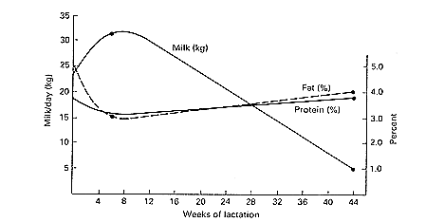
Lactation curve
Peak Lactation
Need to calve
to lactate

Slide 27
Revision questions
1.Give two stimuli initiated by the milker during the milking process.
Washing of udder
Massage of the udder
Appearance and sound of the milker
Milking action
2. What hormone inhibits milk ejection?
Adrenalin
3. State bacterial diseases which affects the udder.
Mastitis /metritis

