Slide 1
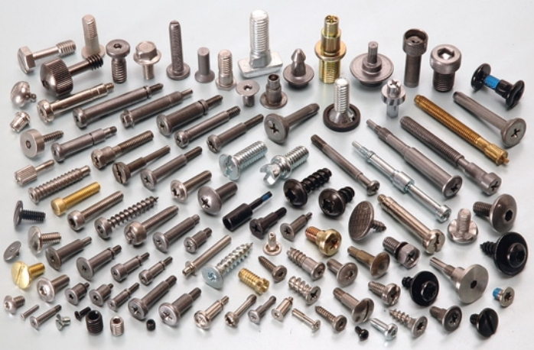
Grade 12 JOINING GENERIC WEEK 1

Slide 2
Joining (Generic)
In this lesson we will be looking at.. Identify and explain the use of:
• Bolts and nuts
• Rawl bolts
• Plastic plugs
• Rawl plugs

Slide 3
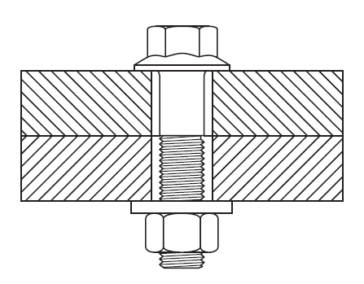
FASTENERS Bolts and Nuts
Bolts and Nuts are classified as fasteners.
Fixed parts together.
Manufactured with different threads.
Have different lengths and sizes.
How to join two pieces of material (Wood / Metal) together with a bolt and nut:
Step 1. - Drill a hole of the required diameter through both pieces of material.
Step 2. - Insert the bolt from one side sliding through both pieces of material.
Step 3. - Add a washer and nut and fasten it from the tread side.

Slide 4
FASTENERS Bolts and Nuts
Questions
1. Identify the fastener in the sketch.
2. Explain in three steps how you will join the material that are being used in the sketch with the fixture mentioned in answer 1.
Answers
1. Bolt and Nut.
2. Drill a hole of the required diameter through both pieces of material.
Insert the bolt from one side sliding through both pieces of material.
Add a washer and nut and fasten it from the tread side.

Slide 5
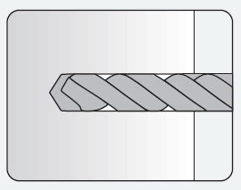
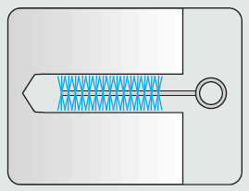
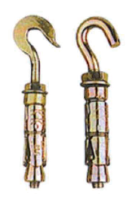
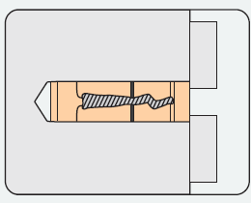
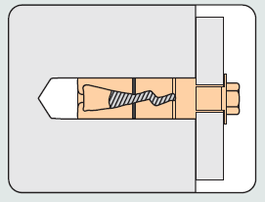
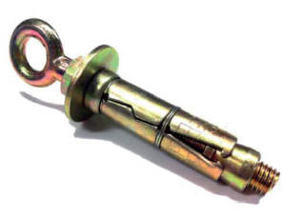
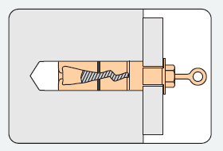
Rawl Bolts
How to use a rawl bolt
Rawl bolt
Drill a hole of the required diameter and depth; avoid
mortar joints when used in brickwork.
Remove debris and thoroughly clean the hole with a
brush or by blowing into it.
Remove the bolt and washer, insert the shield and place
the fixture over the hole.
Insert the bolt with washer through the fixture and
tighten to the recommended torque.
Rawl bolt with hook
When an eye or hook is used, the nut must be tightened,
not the eye or hook.
Rawl bolt with eye

Slide 6
Question
Arrange the images in the correct order from A – E, to insert a rawl bolt into a brick wall.
Answer: E, C, A, B and D
A
B
C
D
E

Slide 7
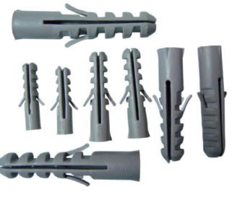
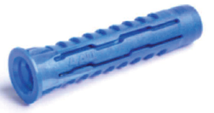
Rawl plug / Plastic plugs
Manufactured of plastic and grey fibre.
Capable of gripping and holding screws when inserted into a wall.
Work especially well in concrete and brick walls.
Consider the weight of the object being secured.
Questions
Of what material is the rawl plug manufactured?
What are the plastic plugs used for?
Answers
Mostly plastic / Grey fibre
Gripping and holding screws when inserted into the wall. Any acceptable answer.

