Slide 1

English HL/FAL Gr 10-12

Slide 2
THE OBITUARY
The art of honouring the deceased.

Slide 3
What is an Obituary?
An obituary is a piece of writing which honours the departed.
Many people still make use of the obituary to inform (just like an informative article) the multiple readers who were unaware of the passing of someone they might have known.

Slide 4
Why do we write obituaries?
Many people lose touch over time with someone who impacted their lives in some way. Such as:
  A teacher or professor who inspired you.
  A film star or role model (someone you looked up to).
The obituary is the ideal means of communication for the masses to read about the life, importance and impact of the person who passed away.
Another reason is to show our respects and honour the deceased.

Slide 5
Where do I begin?
As difficult as it might seem to face the reality of our departed, it is still a great honour to be asked to write about his/her life.
The easiest way to begin is to plan.
  WHO is the person?
    Date of birth and death (Full dates)
  WHERE did his/her life start?
  Where did his/her journey take them?
  What are some of their great ACHIEVEMENTS?
    Remember to place these in a time-line to keep the flow.
  WHO ARE THEY LEAVING BEHIND?
    Children/Wife/Husband/etc.
  WHEN will the memorial service take place?
  WHERE will the service take place?
  WHO will be allowed to attend?
    A “closed service” refers to invite only.

Slide 6
What’s next?
THE FIRST DRAFT. (Rough Draft)
This is where we put our plan into action.
It is very important to number your ideas so that you know when you are going to use it.
Place your ideas in order to create a flow throughout your text.
Remember to use a time-line to indicate how your obituary will progress.
Attempt to write your first draft.
Follow the example on the following slide.

Slide 7
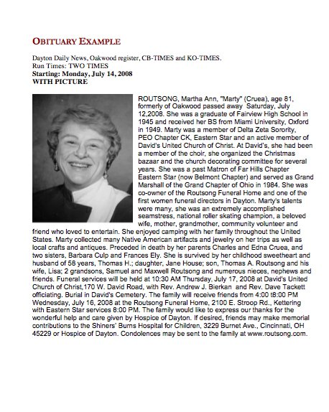

Slide 8
The FINAL step
The final step can only take place after you have edited(check for errors eg.spelling ,
tense and punctuation)
PROOFREAD your rough draft
(Read the entire draft).

