Slide 1
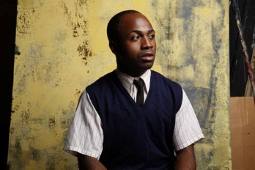
MY CHILDREN!
MY AFRICA!
by Athol Fugard
ACT 1

Slide 2
By the end of this session you should…
be able to identify the elements in a drama
link these elements to THIS drama
have a good understanding of how these elements make up ACT 1

Slide 3
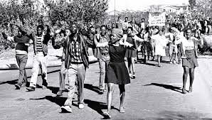
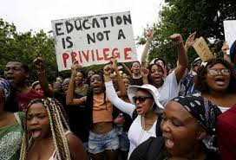
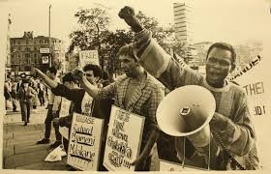
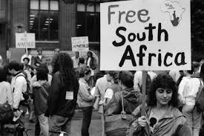
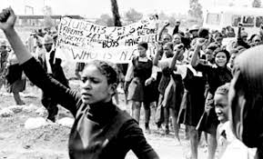
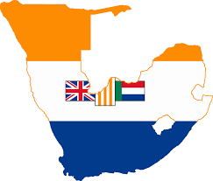
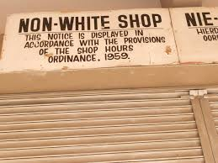
Let’s get started…
SA apartheid 1984/1985
Background and setting

Slide 5
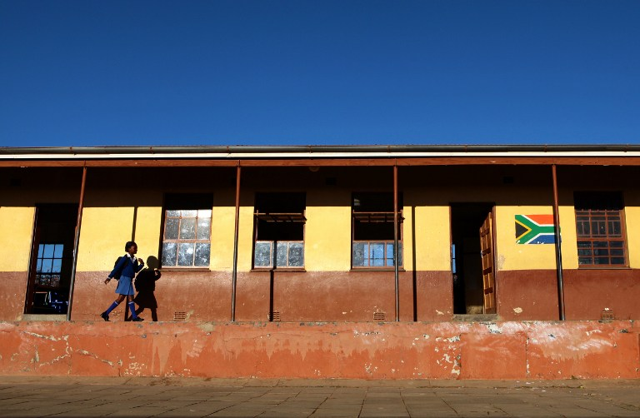

Slide 6
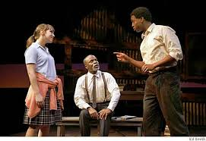
Characters
Mr Myalatya (Mr M)
Isabel Dyson
Thami Mbikwana

Slide 7
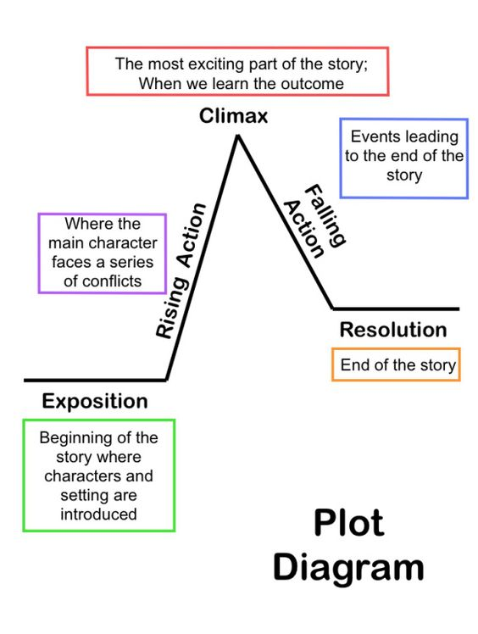
PLOT
The storyline:
exposition (debate)
Rising Action (One character rebels and resigns from quiz competition. Ringleaders of the boycotts are exposed)
climax (Someone is killed)
dénouement (final solution) (Two remaining characters meet.)
Conclusion (The promise)

Slide 8
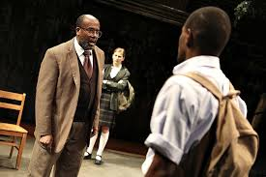
VASTLY DIFFERING OPINIONS or POINTS OF VIEW
CONFLICT

Slide 9
The message: What lessons are conveyed by the characters and the action in the drama?
The value of education
THEMES
The Generation Gap
The effects of an unjust society
Privilege and Poverty
COMMUNICATION VS VIOLENCE
FRIENDSHIP

Slide 10
ACT 1:1
CHARACTERS | PLOT + THEME
Mr M Thami Isabel | DEBATE – Mr M shouts ‘Order’ the FIRST word - an element of a debate. Debate? Structured argument, has rules – in complete opposition to what will take place in the drama. DISORDER during the debate at this stage foreshadows the brewing unrest and violence which will come to light later on.

Slide 11
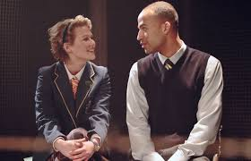
ACT 1:1…
CHARACTERS | PLOT + THEME
Thami Isabel | After the debate – light-hearted conversation – joking and teasing each other – the start of a FRIENDSHIP – forming a bond. Isabel - debate - a ‘riot’ = fun. Thami teases her – a riot = violence Description of their families and lives highlight: INJUSTICE OF THE APARTHEID SYSTEM PRIVILEGE VS POVERTY

Slide 12
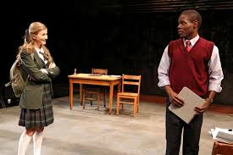
ACT 1:1…the last bit
CHARACTERS | PLOT + THEME
Thami Isabel | THAMI: It’s not as simple as just passing exams, Isabel. School doesn’t mean the same to us that it does to you. … ISABEL: So, what changed? THAMI: I changed. Identify and discuss the theme of the play which is evident in this extract. (3)

Slide 13
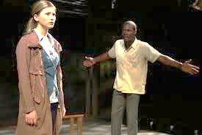
ACT 1:1…seriously the last bit of this scene
CHARACTERS | PLOT + THEME
Thami Isabel | THAMI: [Sharply] What I do with my life has got nothing to do with him. ISABEL: Sorry. THAMI: I don’t listen to what he says and I don’t do what he says. (from page 50) CONFLICT – Between? Why?

Slide 14
What do we learn about her? What does she learn about herself?
What THEMES does she expose?
What do we, as audience know about her character now?
ACT 1:2
A monologue — is a speech given by a character to another character or the audience.
ISABEL’S MONOLOGUE

Slide 15
ISABEL’S MONOLOGUE
CONTRASTS Brakwater (where Zolile High School is) TO Camdeboo
What she ‘was made to believe was out there’ for her – was only a ‘fraction’ ‘of what it could be’
(prejudice- racism – apartheid)
After her visit to Zolile High School – she ‘discovered a new world!’
Discuss what you think Isabel hopes to learn from this ‘new world’ that she has discovered.

Slide 16
ACT 1:3
Mr M’s character revealed. How?
SETTING?
Which characters?
Mr M calls Isabel ‘MS Dyson’ at first.
PLOT: Purpose of visit?
Themes: Reminds audience about apartheid setting.

Slide 17
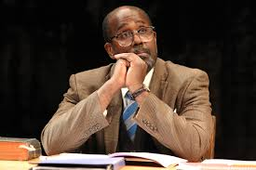
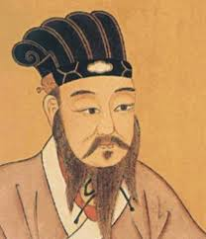
Believes that knowledge and education have the power to bring about change
MR M’S MONOLOGUE
CONFUCIUS
ACT 1:4
was a Chinese philosopher.
He is considered to be the first teacher.
His life = THE CLASSROOM and THE BACK ROOM (of Rev Mbopa’s house, next to Anglican church)

Slide 18
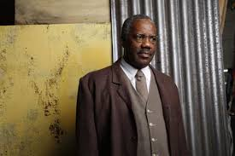
METAPHOR
compares
TO ANIMALS IN A ZOO – ‘a mad zoo of hungry animals’
HIS EMOTIONS
DESPAIR
HATE
HOPE
His emotions need to be satisfied – in the same way animals need to be fed – that’s why he became a teacher. Teaching – hope – better future.

Slide 19
ACT 1:5
IT’S VERY, VERY, VERY, VERY LONG…
and CRUCIAL to plot development, exposing themes, revealing characters…
Practise for the quiz reveals…
THAMI AND ISABEL
Both intelligent = Thami wins test
Isabel’s loyalty tested = friendship

Slide 20
Thami identifies with themes in the poetry of Lord Byron
Byron died while helping the Greeks fight for freedom
“A love of liberty characterises his poems…” (Byron)
“Yet, Freedom! Yet, thy banner, torn,…” (Byron)

Slide 21
Thami identifies with themes in the poetry of Percy Shelley
Ozymandias – Egyptian king - Rameses 2nd = oppressive ruler
There are quite a few Ozymandiases in this country waiting to be toppled. (Shelley)
Explain why Thami is able to relate to the themes in the poetry of these poets.
Hint: Remember SETTING of this drama?

Slide 22
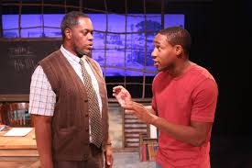
Mr M -regards removal of statues as ‘vandalism’
‘acts of lawlessness’
he has ‘constructive alternatives’ to revolution
Isabel –Thami’s relationship with Mr M
According to Thami –
Mr M blind and deaf to what is going on in reality
Ideas are outdated
CONFLICT:
THAMI VS

Slide 23
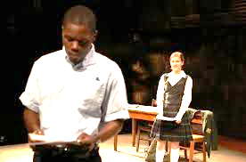
Explain Thami’s reluctance to share his true feelings with Mr M, the way he does with Isabel.
Is it due to the role of tradition and culture or is it the generation gap?

Slide 24
THAMI’S MONOLOGUE
ACT 1:6
Thami, in his own words, EXPLAINS his socio-political development, from young boy to where he is at this point in the drama
Oom Dawie’s influence
The reality of the struggles of daily life
Bantu education traps and enslaves
Historic references

Slide 25
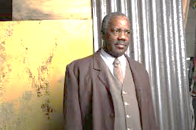
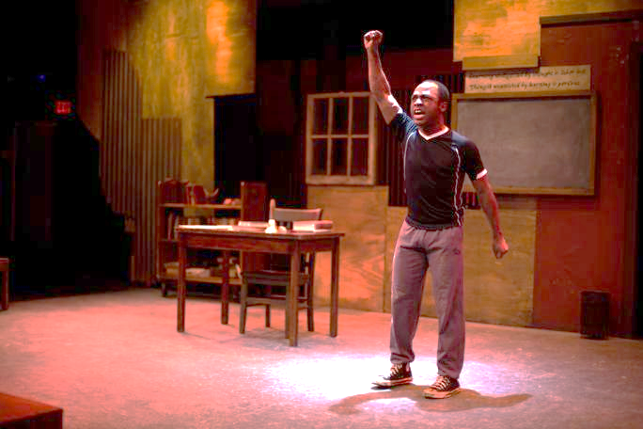
According to Thami:
The answer is REBELLION
Whose opinion, Mr M or Thami, do you share? Give reasons for your choice.

Slide 26
What have you learnt about Act 1?
1. Discuss the importance of having knowledge of the setting to this drama, when one considers what takes place later.
2. Three monologues in Act 1. Explain the purpose.
3. Do you think that these 6 scenes were a good way to introduce the characters? Explain.

Slide 27
Let’s recap:
The elements of the drama work together to form the final product – the drama we read.
THIS drama has THREE characters.
Apartheid setting of the ’80s is vital to understanding the plot.

Slide 28
Differing views of characters give rise to the central conflict.
Themes can be identified by READING BETWEEN THE LINES (what characters say/not say) – it is twisted inside the plot, setting and its characters
Plot is the unfolding of the story – characters, theme, setting come together to form a complete unit.

