Slide 1
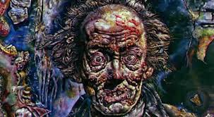
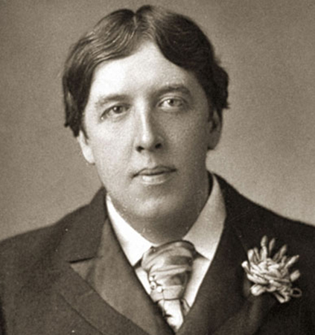
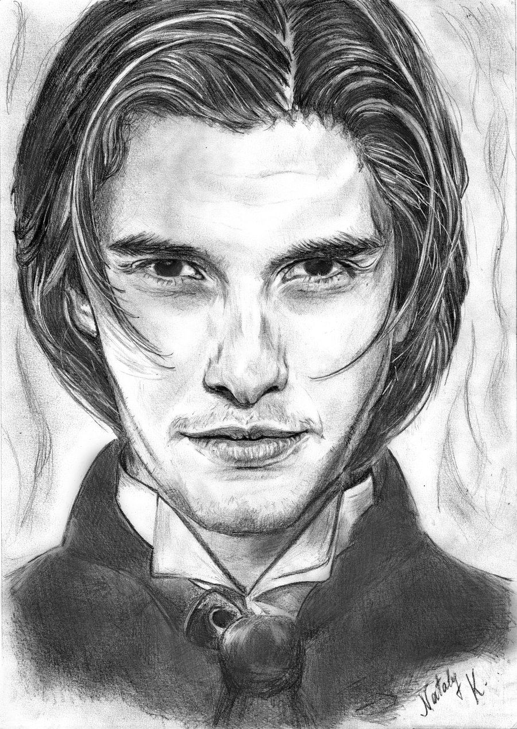
Summary:
Dorian Gray

Slide 2
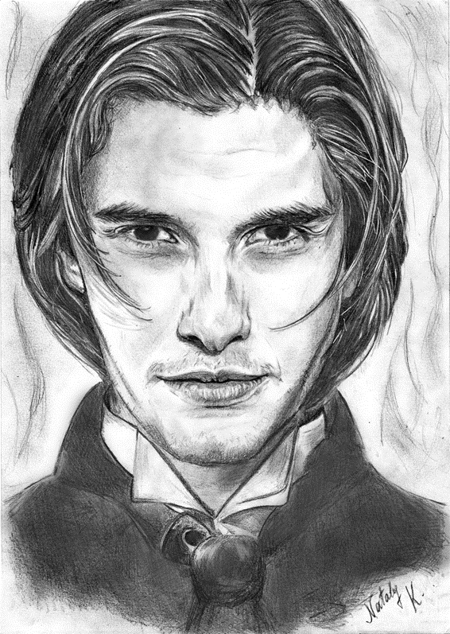
Plot Overview:
Dorian Gray is the subject of a full-length portrait in oil by Basil Hallward, an artist who is impressed and infatuated by Dorian's beauty;
He believes that Dorian’s beauty is responsible for the new mode in his art as a painter.
Through Basil, Dorian meets Lord Henry Wotton, and he soon is enthralled by the aristocrat's hedonistic worldview:
that beauty and sensual fulfilment are the only things worth pursuing in life.
Newly understanding that his beauty will fade, Dorian expresses the desire to sell his soul, to ensure that the picture, rather than he, will age and fade.
The wish is granted, and Dorian pursues a libertine life of varied and amoral experiences, while staying young and beautiful;
all the while his portrait ages and records every sin.

Slide 3
Summary: The Preface
The Preface is a series of epigrams, or concise, witty sayings, that express the major points of Oscar Wilde’s aesthetic philosophy.
In short, the epigrams praise beauty and repudiate the notion that art serves a moral purpose.
The Preface to The Picture of Dorian Gray is a collection of epigrams that aptly sums up the philosophical tenets of the artistic and philosophical movement known as aestheticism.
Aestheticism, which found its footing in Europe in the early nineteenth century, proposed that art need not serve moral, political, or otherwise didactic ends.
Whereas the romantic movement of the early and mid-nineteenth century viewed art as a product of the human creative impulse that could be used to learn more about humankind and the world, the aesthetic movement denied that art must necessarily be an instructive force in order to be valuable.
Instead, the aestheticists’ believed, art should be valuable in and of itself—art for art’s sake.
Near the end of the nineteenth century, Walter Pater, an English essayist and critic, suggested that life itself should be lived in the spirit of art.
His views, especially those presented in a collection of essays called The Renaissance, had a profound impact on the English poets of the 1890s, most notably Oscar Wilde.

Slide 4
Summary: The Preface
Aestheticism flourished partly as a reaction against the materialism of the burgeoning middle class, assumed to be composed of philistines (individuals ignorant of art) who responded to art in a generally unrefined manner.
In this climate, the artist could assert him- or herself as a remarkable and rarefied being, one leading the search for beauty in an age marked by shameful class inequality, social hypocrisy, and bourgeois complacency.
No one latched onto this attitude more boldly, or with more flair, than Oscar Wilde.
His determination to live a life of beauty and to mould his life into a work of art is reflected in the beliefs and actions of several characters in Wilde’s only novel.
The fear of a bad—or good—influence is, in fact, one of the novel’s primary concerns.
As a work that sets forth a philosophy of aestheticism, the novel questions the degree and kind of influence a work of art can have over an individual.
Furthermore, since the novel conceives of art as including a well-lived life, it is also interested in the kind of influence one person can have over another.
The artful Lord Henry himself has as profound an effect upon Dorian’s life as Basil’s painting does.

Slide 5
Summary: Chapter One
The novel begins in the elegantly appointed London home of Basil Hallward, a well-known artist. Basil discusses his latest portrait with his friend, the clever and scandalously amoral Lord Henry Wotton.
Lord Henry admires the painting, the subject of which is a gorgeous, golden-haired young man. Believing it to be Basil’s finest work, he insists that the painter exhibit it.
Basil, however, refuses, claiming that he cannot show the work in public because he has put too much of himself into it.
When Lord Henry presses him for a more satisfying reason, Basil reluctantly describes how he met his young subject, whose name is Dorian Gray, at a party.
He admits that, upon seeing Dorian for the first time, he was terrified; indeed, he was overcome by the feeling that his life was “on the verge of a terrible crisis.” Dorian has become, however, an object of fascination and obsession for Basil, who sees the young man every day and declares him to be his sole inspiration.
Basil admits that he cannot bring himself to exhibit the portrait because the piece betrays the “curious artistic idolatry” that Dorian inspires in him.

Slide 6
Summary: Chapter One
Lord Henry, astonished by this declaration, remembers where he heard the name Dorian Gray before:
his aunt, Lady Agatha, mentioned that the young man promised to help her with charity work in the slums of London.
At that moment, the butler announces that Dorian Gray has arrived, and Lord Henry insists on meeting him.
Basil reluctantly agrees but begs his friend not to try to influence the young man.
According to Basil, Dorian has a “simple and a beautiful nature” that could easily be spoiled by Lord Henry’s cynicism.

Slide 7
Summary: Chapter Two
Dorian Gray proves to be every bit as a handsome as his portrait.
Basil introduces him to Lord Henry, and Dorian begs Lord Henry to stay and talk to him while he sits for Basil.
Basil warns Dorian that Lord Henry is a bad influence, and Dorian seems intrigued by this idea.
Lord Henry agrees to stay and, while Basil puts the finishing touches on the portrait, discusses his personal philosophy, which holds that “the highest of all duties [is] the duty that one owes to one’s self.”
While Basil continues to work, Lord Henry escorts Dorian into the garden, where he praises Dorian’s youth and beauty and warns him how surely and quickly those qualities will fade.
He urges Dorian to live life to its fullest, to spend his time “always searching for new sensations” rather than devoting himself to “common” or “vulgar” pastimes.

Slide 8
Summary: Chapter Two
Basil calls the men inside, and Dorian sits for another quarter of an hour until the portrait is complete.
It is a thing of remarkable beauty—“the finest portrait of modern times,” Lord Henry tells Basil—but looking at it makes Dorian unhappy.
Remembering Lord Henry’s warning about the advance of age, he reflects that his portrait will remain young even as he himself grows old and wrinkled.
He curses this fate and pledges his soul “[i]f it were only the other way.” Basil tries to comfort the young man, but Dorian pushes him away.
Declaring that he will not allow the painting to ruin their friendship, Basil makes a move to destroy it.
Dorian stops him, saying that he loves the painting, and a relieved Basil promises to give it to him as a gift.
Dorian and Lord Henry depart after Dorian promises, despite Basil’s objections, to go to the theatre with Lord Henry later that evening.

Slide 9
Summary: Chapter Three
Shortly after his first meeting with Dorian Gray, Lord Henry visits his uncle, Lord Fermor, a “genial if somewhat rough-mannered” old nobleman.
When Lord Henry asks his uncle about Dorian Gray’s past, the old man tells him that Dorian comes from an unhappy family with a dark, tangled history.
He relates that Dorian’s mother, a noblewoman, eloped with a poor soldier; the woman’s father, a villainous old lord, arranged to have his daughter’s husband killed just before Dorian was born.
The grieving widow died soon thereafter, leaving Dorian to be raised by a loveless tyrant.
With this information, Lord Henry becomes increasingly fascinated with Dorian; he finds the story romantic and delights in the thought that he might influence the young man, making “that wonderful spirit his own.”

Slide 10
Summary: Chapter Three
Lord Henry goes to dine at the home of his aunt, Lady Agatha, where several of London’s elite upper class—Dorian included—have gathered.
Lord Henry scandalizes the group by going on at length about the virtues of hedonism and selfishness and mocking his aunt’s philanthropic efforts. “I can sympathize with everything,” he remarks at one point, “except suffering.”
He insists that one’s life should be spent appreciating beauty and seeking out pleasure rather than searching for ways to alleviate pain and tragedy.
Many of the guests are appalled by his selfishness, but he is so clever and witty that they are charmed in spite of themselves.
Dorian Gray is particularly fascinated, so much so that he leaves with Lord Henry and abandons his earlier plans to visit Basil.

Slide 11
Summary: Chapter Four
One month later, while waiting in Lord Henry’s home for his host to arrive, Dorian discusses music with Lord Henry’s wife, Victoria.
When Lord Henry arrives, Dorian rushes to him, eager to share the news that he has fallen in love.
The girl, he reports, is Sibyl Vane, an actress who plays Shakespeare’s heroines in repertoire in a cheap London theatre.
Dorian admits to discovering her while wandering through the slums: inspired by Lord Henry’s advice to “know everything about life,” he had entered a playhouse.
Despite the tawdriness of the locale and his disdain for the theatre owner, Dorian decided that the star, Sibyl Vane, was the finest actress he had ever seen.

Slide 12
Summary: Chapter Four
After several trips to the theatre, the owner insisted that Dorian meet Ms. Vane, who, awed by the attentions of such a handsome gentleman, declared that she would refer to him as “Prince Charming.”
Lord Henry, amused by this development, agrees to accompany Dorian to see Sibyl Vane play the lead in Romeo and Juliet the following night.
Basil is to join them, and Dorian remarks that Basil sent him his portrait, framed, a few days earlier.
After Dorian leaves, Lord Henry muses on his influence over the young man, reflecting on how fascinating the psychology of another human being can be.
He then dresses and goes out to dinner. He comes home late that night and finds a telegram from Dorian waiting for him.
It states that he is engaged to be married to Sibyl Vane

Slide 13
Summary: Chapter Five
At the Vane household, Sibyl Vane is deliriously happy over her romance with Dorian Gray.
Mrs. Vane, her mother, is less enthusiastic, and she alternately worries over Dorian’s intentions and hopes that her daughter will benefit from his obvious wealth.
Sibyl’s brother, James, is also rather cautious regarding the match.
As a sailor preparing to depart for Australia, James arrives to say his good-byes and warns his mother that she must watch over Sibyl.
Mrs. Vane assures him that admirers such as Dorian Gray are not uncommon to actresses, and that there is no reason not to “contract an alliance” with one so wealthy.
Impatient with his mother’s “affectations,” James takes Sibyl on a walk.
Rather than discuss her Prince Charming, Sibyl chatters on about the adventures James is certain to find in Australia.
She imagines him discovering gold but then, thinking this life too dangerous, states that he will be better off as a quiet sheep farmer.

Slide 14
Summary: Chapter Five
James cannot shake the feeling that he is leaving his sister at an inopportune time.
He doubts both Dorian’s intentions and his mother’s ability to protect Sibyl from them.
Finally, James asks Sibyl about her suitor.
He warns her against Dorian, and Sibyl carries on about the ecstasy of her new love.
As the two sit and watch “the smart people go by,” Sibyl sees Dorian pass in an open carriage.
She points him out, but he is gone before James sees him.
James swears fiercely that if Dorian ever wrongs her, he will track down her “Prince Charming” and kill him.
Sibyl pledges undying devotion to Dorian. Later that night, James confronts his mother, asking her whether she was ever married to his father.
Mrs. Vane answers no, and James begs her not to let Sibyl meet the same fate. Before departing, James again pledges to kill Dorian should Sibyl ever come to harm by him.

Slide 15
Summary: Chapter Six
That evening over dinner, Lord Henry announces to Basil Dorian’s plan to marry Sibyl.
Basil expresses concern that Dorian has decided to marry so far beneath his social position.
Lord Henry claims that he himself cannot pass such judgment and that he is simply interested in observing the boy and his experiences, regardless of the outcome.
Basil doubts that Lord Henry would be so cavalier if Dorian’s life was, in fact, “spoiled,” but Lord Henry insists that “no life is spoiled but one whose growth is arrested.”

Slide 16
Summary: Chapter Six
Dorian enters, and he relates the story of his engagement, which was precipitated by his seeing Sibyl play the Shakespearean heroine Rosalind (in As You Like It).
Dorian, in a state of tremendous excitement, remarks that his love for Sibyl and his desire to live only for her have shown him the falsehood of all of Lord Henry’s seductive theories about the virtues of selfishness.
Lord Henry, by no means discouraged by Dorian’s speech, defends his point of view by claiming that it is nature, not he, who dictates the pursuit of pleasure.
The three men make their way to a theatre in the slums where Sibyl Vane is to perform that night.

Slide 17
Summary: Chapter Seven
Dorian continues to wax eloquent about Sibyl’s beauty, and Basil assures Dorian that he will support the marriage wholeheartedly since Dorian is so obviously in love.
When the play begins, however, Sibyl is terrible, and her acting only worsens as the evening wears on.
Unable to understand the change that has come over his beloved, Dorian is heartbroken.
Basil and Lord Henry leave him, and he makes his way backstage to find Sibyl, who is quite happy despite her dreadful performance.
She explains that before she met Dorian and experienced true love, she was able to inhabit other characters and feel their emotions easily, which made possible her success as an actress.
Now, however, these pretend emotions no longer interest her, since they pale in relation to her real feelings for Dorian.
She realizes that “the words I had to speak were unreal, were not my words, were not what I wanted to say.” As a result, she declares that her career on the stage is over.

Slide 18
Summary: Chapter Seven
Dorian, horrified by this decision, realizes that he was in love not with her but with her acting.
He spurns her cruelly and tells her that he wishes never to see her again.
After a night spent wandering the streets of London, Dorian returns to his home.
There, he looks at Basil’s portrait of him and notices the painting has changed—a faint sneer has appeared at the corner of his likeness’s mouth.
He is astonished. Remembering his wish that the painting would bear the burden and marks of age and lifestyle for him, Dorian is suddenly overcome with shame about his behaviour toward Sibyl.
He pulls a screen in front of the portrait and goes to bed, resolving to make amends with Sibyl in the morning.

Slide 19
Summary: Chapter Eight
Dorian does not awake until well after noon the next day.
When he gets up, he goes to check the painting.
In the light, the change is unmistakable; the face in the portrait has become crueller.
While the stunned Dorian tries to come up with some rational explanation for the change, Lord Henry arrives with terrible news:
Sibyl committed suicide the previous night.
Dorian is stunned, but Lord Henry manages to convince him that he should not go to the police and explain his part in the girl’s death.
Lord Henry urges Dorian not to wallow in guilt but, rather, to regard Sibyl’s suicide as a perfect artistic representation of undying love and appreciate it as such.

Slide 20
Summary: Chapter Eight
Dorian, who feels numb rather than anguished, is convinced by his friend’s seductive words and agrees to go to the opera with him that very night.
When Lord Henry is gone, Dorian reflects that this incident is a turning point in his existence, and he resolves to accept a life of :
“[e]ternal youth, infinite passion, pleasures subtle and secret, wild joy and wilder sins,” in which his portrait, rather than his own body, will bear the marks of age and experience.
Having made this resolution, he joins Lord Henry at the opera.

Slide 21
Summary: Chapter Nine
The next day, Basil comes to offer his condolences to Dorian, but Dorian dismisses the memory of Sibyl lightly and easily, remarking,
“What is done is done. What is past is past.”
Horrified at the change in Dorian, Basil blames Lord Henry for Dorian’s heartless attitude.
Indeed, in discussing Sibyl’s death, Dorian uses many of the same phrases and arguments that Lord Henry favours and evokes a similar air of unaffected composure.
He claims that Sibyl’s death elevates her “into the sphere of art.”
Dorian asks Basil to do a drawing of Sibyl so that he has something by which to remember her.
Basil agrees and begs Dorian to return to his studio for a sitting.
When Dorian refuses, Basil asks if he is displeased with his portrait, which Basil means to show at an exhibition

Slide 22
Summary: Chapter Nine
When Basil goes to remove the screen with which Dorian has covered the painting, Dorian’s composure cracks.
Dorian insists that the work never appear in public and pledges never to speak to Basil again should he touch the screen.
Remembering Basil’s original refusal to show the painting, Dorian asks why he has changed his mind.
Basil confesses that he was worried that the painting would reveal his obsession with Dorian.
Now, however, Basil believes that the painting, like all art,
“conceals the artist far more completely than it ever reveals him.”
Basil again asks Dorian to sit for him, and Dorian again refuses.
When Basil leaves, Dorian decides to hide his portrait.

Slide 23
Summary: Chapter Ten
Once Basil is gone, Dorian orders his servant, Victor, to go to a nearby frame-maker and bring back two men.
He then calls his housekeeper, Mrs. Leaf, whom he asks for the key to the schoolroom, which sits at the top of the house and has been unused for nearly five years.
Dorian covers the portrait with an ornate satin coverlet, reflecting that the sins he commits will mar its beauty just as worms mar the body of a corpse.
The men from the frame-maker’s arrive, and Dorian employs them to carry the painting to the schoolroom.
Here, Dorian muses, the painting will be safe from prying eyes, and if no one can actually see his deterioration, then it bears no importance.

Slide 24
Summary: Chapter Ten
After locking the room, he returns to his study and settles down to read a book that Lord Henry has sent him.
This yellow book is accompanied by a newspaper account of Sibyl’s death.
Horrified by the ugliness of the report, Dorian turns to the book, which traces the life of a young Parisian who devotes his life to “all the passions and modes of thought that belonged to every century except his own.”
After reading a few pages, Dorian becomes entranced.
He finds the work to be “a poisonous book,” one that confuses the boundaries between vice and virtue. When Dorian meets Lord Henry for dinner later that evening, he pronounces the work fascinating.
Is insincerity such a terrible thing? I think not. It is merely a method by which we can multiply our personalities.

Slide 25
Summary: Chapter Eleven
Under the influence of the “yellow book,” Dorian’s character begins to change.
He orders nearly a dozen copies of the first edition and has them bound in different colours to suit his shifting moods.
Years pass. Dorian remains young and beautiful, but he is trailed by rumours that he indulges in dark, sordid behaviour.
Most people cannot help but dismiss these stories, since Dorian’s face retains an unblemished look of “purity” and “innocence.”
Dorian delights in the ever-widening gulf between the beauty of his body and the corruption of his soul.
He reflects that too much of human experience has been sacrificed to “asceticism” and pledges to live a life devoted to discovering “the true nature of the senses.”

Slide 26
Summary: Chapter Eleven
Always intellectually curious, Dorian keeps up on the theories of the day—from mysticism to antinomianism to Darwinism—but he never lets these theories dominate him or interfere with his experiences.
He devotes himself to the study of beautiful things: perfumes and their psychological effects, music, jewellery, embroideries, and tapestries.
Dorian continues to watch the painted image of himself age and deteriorate.
Sometimes the sight of the portrait fills him with horror, while other times he reflects joyfully on the burdens that his body has been spared.
But he fears that someone will break into his house and steal the painting;
he knows many men who whisper of scandal behind his back and would delight in his downfall.

Slide 27
Summary: Chapter Twelve
On the eve of his thirty-eighth birthday, Dorian runs into Basil on a fog-covered street.
He tries to pass him unrecognized, but Basil calls out to him and accompanies him home.
Basil mentions that he is about to leave for a six-month stay in Paris but felt it necessary to stop by and warn Dorian that terrible rumours are being spread about his conduct.
Basil reminds Dorian that there are no such things as “secret vices”:
sin, he claims, “writes itself across a man’s face.”
Having said these words, he demands to know why so many of Dorian’s friendships have ended disastrously.
We learn that one boy committed suicide, and others had their careers or reputations ruined.

Slide 28
Summary: Chapter Twelve
Basil chastises Dorian for his influence over these unfortunate youths and urges him to use his considerable sway for good rather than evil.
He adds that he wonders if he knows Dorian at all and wishes he were able to see the man’s soul.
Dorian laughs bitterly and says that the artist shall have his wish. He promises to show Basil his soul, which, he notes, most people believe only God can see.
Basil decries Dorian’s speech as blasphemous, and he begs Dorian to deny the terrible charges that have been made against him.
Smiling, Dorian offers to show Basil the diary of his life, which he is certain will answer all of Basil’s questions.

Slide 29
Summary: Chapter Thirteen
Dorian leads Basil to the room in which he keeps the painting locked.
Inside, Dorian lights a candle and tears the curtain back to reveal the portrait.
The painting has become hideous, a “foul parody” of its former beauty.
Basil stares at the horrifying painting in shock:
he recognizes the brushwork and the signature as his own.
Dorian stands back and watches Basil with “a flicker of triumph in his eyes.”
When Basil asks how such a thing is possible, Dorian reminds him of the day he met Lord Henry, whose cautionary words about the ephemeral nature of beauty caused Dorian to pledge his soul for eternal, unblemished youth.
Basil curses the painting as “an awful lesson,” believing he worshipped the youth too much and is now being punished for it.

Slide 30
Summary: Chapter Thirteen
He begs Dorian to kneel and pray for forgiveness, but Dorian claims it is too late.
Glancing at his picture, Dorian feels hatred welling up within him. He seizes a knife and stabs Basil repeatedly.
He then opens the door and listens for the sound of anyone stirring.
When he is satisfied that no one has heard the murder, he locks the room and returns to the library.
Dorian hides Basil’s belongings in a secret compartment in the wall, then slips quietly out to the street.
After a few moments, he returns, waking his servant and thus creating the impression that he has been out all night.
The servant reports that Basil has been to visit, and Dorian says he is sorry to have missed him.

Slide 31
Summary: Chapter Fourteen
The next morning, Dorian wakes from a restful sleep.
Once the events of the previous night sink in, he feels the return of his hatred for Basil.
He decides not to brood on these things for fear of making himself ill or mad.
After breakfast, he sends for Alan Campbell, a young scientist and former friend from whom he has grown distant.
While waiting for Campbell to arrive, Dorian passes the time with a book of poems and reflects on his once intimate relationship with the scientist:
the two were, at one point, inseparable.
He also draws pictures and reflects on his drawings’ similarity to Basil’s likeness.
Dorian then wonders if Campbell will come and is relieved when the servant announces his arrival.

Slide 32
Summary: Chapter Fourteen
Campbell has come reluctantly, having been summoned on a matter of life and death.
Dorian confesses that there is a dead man locked in the uppermost room of his house, though he refrains from discussing the circumstances of the man’s death.
He asks Campbell to use his knowledge of chemistry to destroy the body.
Campbell refuses. Dorian admits that he murdered the man, and Campbell reiterates that he has no interest in becoming involved.
Dorian blackmails Campbell, threatening to reveal a secret that would bring great disgrace on him.
With no alternative, Campbell agrees to dispose of the body and sends a servant to his home for the necessary equipment.
Dorian goes upstairs to cover the portrait and notices that one of the hands on the painting is dripping with red, “as though the canvas had sweated blood.” Campbell works until evening, then leaves.
When Dorian returns to the room, the body is gone, and the odour of nitric acid fills the room.

Slide 33
Summary: Chapter Fifteen
That evening, Dorian goes to a dinner party, at which he flirts with bored noblewomen.
Reflecting on his calm demeanour, he feels “keenly the terrible pleasure of a double life.”
Lady Narborough, the hostess, discusses the sad life of her daughter, who lives in a region of the countryside that has not witnessed a scandal since the time of Queen Elizabeth.
Dorian finds the party tedious and brightens only when he learns Lord Henry will be in attendance.
During dinner, after Lord Henry has arrived, Dorian finds it impossible to eat. Lord Henry asks him what is the matter.
Lady Narborough suggests that Dorian is in love, though Dorian assures her that she is wrong.
The party-goers talk wittily about marriage, and the ladies then leave the gentlemen to their “politics and scandal.”

Slide 34
Summary: Chapter Fifteen
Lord Henry and Dorian discuss a party to be held at Dorian’s country estate.
Lord Henry then casually asks about Dorian’s whereabouts the night before;
Dorian’s calm facade cracks a bit and he snaps out a strange, defensive response.
Rather than join the women upstairs, Dorian decides to go home early.
Once Dorian arrives home, he retrieves Basil’s belongings from the wall compartment and burns them.
He goes to an ornate cabinet and, opening one of its drawers, draws out a canister of opium.
At midnight, he dresses in common clothes and hires a coach to bring him to a London neighbourhood where the city’s opium dens prosper.

Slide 35
Summary: Chapter Sixteen
As the coach heads toward the opium dens, Dorian recites to himself Lord Henry’s credo: “To cure the soul by means of the senses, and the senses by means of the soul.” He decides that if he cannot be forgiven for his sins, he can at least forget them; herein lies the appeal of the opium dens and the oblivion they promise. The coach stops, and Dorian exits. He enters a squalid den and finds a youth named Adrian Singleton, whom rumor says Dorian corrupted. As Dorian prepares to leave, a woman addresses him as “the devil’s bargain” and “Prince Charming.” At these words, a sailor leaps to his feet and follows Dorian to the street. As he walks along, Dorian wonders whether he should feel guilty for the impact he has had on Adrian Singleton’s life. His meditation is cut short, however, when he is seized from behind and held at gunpoint. Facing him is James Vane, Sibyl’s brother, who has been tracking Dorian for years in hopes of avenging Sibyl’s death. James does not know Dorian’s name, but the reference to “Prince Charming” makes him decide that it must be the man who wronged his sister. Dorian points out, however, that the man James seeks was in love with Sibyl eighteen years ago; since he, Dorian, has the face of a twenty-year-old man, he cannot possibly be the man who wronged Sibyl. James releases him and makes his way back to the opium den. The old woman tells James that Dorian has been coming there for eighteen years and that his face has never aged a day in all that time. Furious at having let his prey escape, James resolves to hunt him down again.

Slide 36
Summary: Chapter Sixteen
As the coach heads toward the opium dens, Dorian recites to himself Lord Henry’s credo: “To cure the soul by means of the senses, and the senses by means of the soul.” He decides that if he cannot be forgiven for his sins, he can at least forget them; herein lies the appeal of the opium dens and the oblivion they promise. The coach stops, and Dorian exits. He enters a squalid den and finds a youth named Adrian Singleton, whom rumor says Dorian corrupted. As Dorian prepares to leave, a woman addresses him as “the devil’s bargain” and “Prince Charming.” At these words, a sailor leaps to his feet and follows Dorian to the street. As he walks along, Dorian wonders whether he should feel guilty for the impact he has had on Adrian Singleton’s life. His meditation is cut short, however, when he is seized from behind and held at gunpoint. Facing him is James Vane, Sibyl’s brother, who has been tracking Dorian for years in hopes of avenging Sibyl’s death. James does not know Dorian’s name, but the reference to “Prince Charming” makes him decide that it must be the man who wronged his sister. Dorian points out, however, that the man James seeks was in love with Sibyl eighteen years ago; since he, Dorian, has the face of a twenty-year-old man, he cannot possibly be the man who wronged Sibyl. James releases him and makes his way back to the opium den. The old woman tells James that Dorian has been coming there for eighteen years and that his face has never aged a day in all that time. Furious at having let his prey escape, James resolves to hunt him down again.

Slide 37
Summary: Chapter Seventeen
A week later, Dorian entertains guests at his estate at Selby. He talks with Lord Henry, the Duchess of Monmouth, and her husband; they discuss the nature and importance of beauty. The duchess criticizes Lord Henry for placing too great a value on beauty. The conversation turns to love; Lord Henry maintains that love, like life, depends upon repeating a great experience over and over again. Dorian agrees and excuses himself from his company. Lord Henry chastises the duchess for her flirtations. Soon, they hear a groan from the other end of the conservatory. They rush to find that Dorian has fallen in a swoon. At dinner, Dorian feels occasional chills of terror as he recalls that, before fainting, he saw the face of James Vane pressed against the conservatory window.

Slide 38
Summary: Chapter Seventeen
A week later, Dorian entertains guests at his estate at Selby.
He talks with Lord Henry, the Duchess of Monmouth, and her husband;
they discuss the nature and importance of beauty.
The duchess criticizes Lord Henry for placing too great a value on beauty.
The conversation turns to love; Lord Henry maintains that love, like life, depends upon repeating a great experience over and over again.
Dorian agrees and excuses himself from his company.
Lord Henry chastises the duchess for her flirtations. Soon, they hear a groan from the other end of the conservatory.
They rush to find that Dorian has fallen in a swoon.
At dinner, Dorian feels occasional chills of terror as he recalls that, before fainting, he saw the face of James Vane pressed against the conservatory window.

Slide 39
Summary: Chapter Eighteen
The following day, Dorian does not leave the house.
The thought of falling prey to James Vane dominates him: every time he closes his eyes, the image of James’s face in the window reappears.
He begins to wonder, though, if this apparition is a figment of his imagination.
The idea that his conscience could assert such fearful visions terrifies Dorian and makes him wonder if he will get any rest.
On the third day after the incident, Dorian ventures out. He strolls along the grounds of his estate and feels reinvigorated.
He has breakfast with the duchess and then joins a shooting party in the park.
While strolling along with the hunters, Dorian is captivated by the graceful movement of a hare and begs his companions not to shoot it.
Dorian’s companion laughs at Dorian’s silliness and shoots at the hare. The gunshot is followed by the cry of a man in agony. Several men thrash their way into the bushes to discover that a man has been shot.
Having taken “the whole charge of shot in his chest,” the man has died instantly

Slide 40
Summary: Chapter Eighteen
As the hunters head back toward the house, Dorian shares his worry with Lord Henry that this episode is a “bad omen.”
Lord Henry dismisses such notions, assuring Dorian that destiny is “too wise or too cruel” to send us omens.
Attempting to lighten the mood, Lord Henry teases Dorian about his relationship with the duchess.
Dorian assures Henry that there is no scandal to be had and utters, quite pathetically, “I wish I could love.”
He bemoans the fact that he is so concentrated on himself, on his own personality, that he is thus unable to love another person.
He entertains the idea of sailing away on a yacht, where he will be safe.
When the gentlemen come upon the duchess, Dorian leaves Lord Henry to talk to her and retires to his room. There, the head keeper comes to speak to Dorian.
Dorian inquires about the man who was shot, assuming him to have been a servant, and offers to make provisions for the man’s family.
The head keeper reports that the man’s identity remains a mystery.
As soon as he learns that the man is an anonymous sailor, Dorian demands to see him. He rides to a farm where the body is being kept and identifies it as that of James Vane.
He rides home with tears in his eyes, feeling safe.

Slide 41
Summary: Chapter Nineteen
Several weeks have passed, it seems, and Dorian visits Lord Henry.
Dorian claims that he wants to reform himself and be virtuous.
As evidence of his newfound resolve, Dorian describes a recent trip to the country during which he passed up an opportunity to seduce and defile an innkeeper’s innocent daughter.
Lord Henry dismisses Dorian’s intentions to reform, and he turns the conversation to other subjects—
Alan Campbell’s recent suicide and the continued mystery of Basil Hallward’s disappearance.
Dorian asks if Lord Henry has ever considered that Basil might have been murdered.
Lord Henry dismisses the idea, noting that Basil lacked enemies.
Dorian then asks: “What would you say, Harry, if I told you that I had murdered Basil?” Lord Henry laughs and responds that murder is too vulgar for a man like Dorian.

Slide 42
Summary: Chapter Nineteen
The conversation drifts away from Basil. Lord Henry then asks Dorian, “‘[W]hat does it profit a man if he gain the whole world and lose’—how does the quotation run?—‘his own soul’?”
Dorian starts nervously; Lord Henry explains that he heard a street preacher posing this question to a crowd.
He mocks the man in his typical fashion, but Dorian cuts him short, insisting that the soul is very real.
Lord Henry laughs at the suggestion, wondering aloud how Dorian has managed to remain so young after all these years.
He wishes he knew Dorian’s secret and praises Dorian’s life as being “exquisite.”
He commends Dorian’s mode of living and begs him not to spoil it by trying to be virtuous. Dorian sombrely asks his friend not to loan anyone else the “yellow book,” which has had such a corrupting effect upon his own character, but Lord Henry discounts his “moraliz[ing]” and remarks that “[a]rt has no influence upon action. . . . The books that the world calls immoral are books that show the world its own shame.”
Before leaving, Lord Henry invites Dorian to visit him the next day.

Slide 43
Summary: Chapter Twenty
That night, Dorian goes to the locked room to look at his portrait.
He hopes his decision to amend his life will have changed the painting, and he considers that perhaps his decision not to ruin the innkeeper’s daughter’s reputation will be reflected in the painted face.
But when Dorian looks at his portrait, he sees there is no change—except that “in the eyes there was a look of cunning, and in the mouth the curved wrinkle of the hypocrite.”
He realizes his pitiful attempt to be good was no more than hypocrisy, an attempt to minimize the seriousness of his crimes that falls far short of atonement.

Slide 44
Summary: Chapter Twenty
Furious, he seizes a knife—the same weapon with which he killed Basil—and drives it into the portrait in an attempt to destroy it.
From below, Dorian’s servants hear a cry and a clatter.
Breaking into the room, they see the portrait, unharmed, showing Dorian Gray as a beautiful young man.
On the floor is the body of an old man, horribly wrinkled and disfigured, with a knife plunged into his heart.
It is not until the servants examine the rings on the old man’s hands that they identify him as Dorian Gray.

