Slide 1
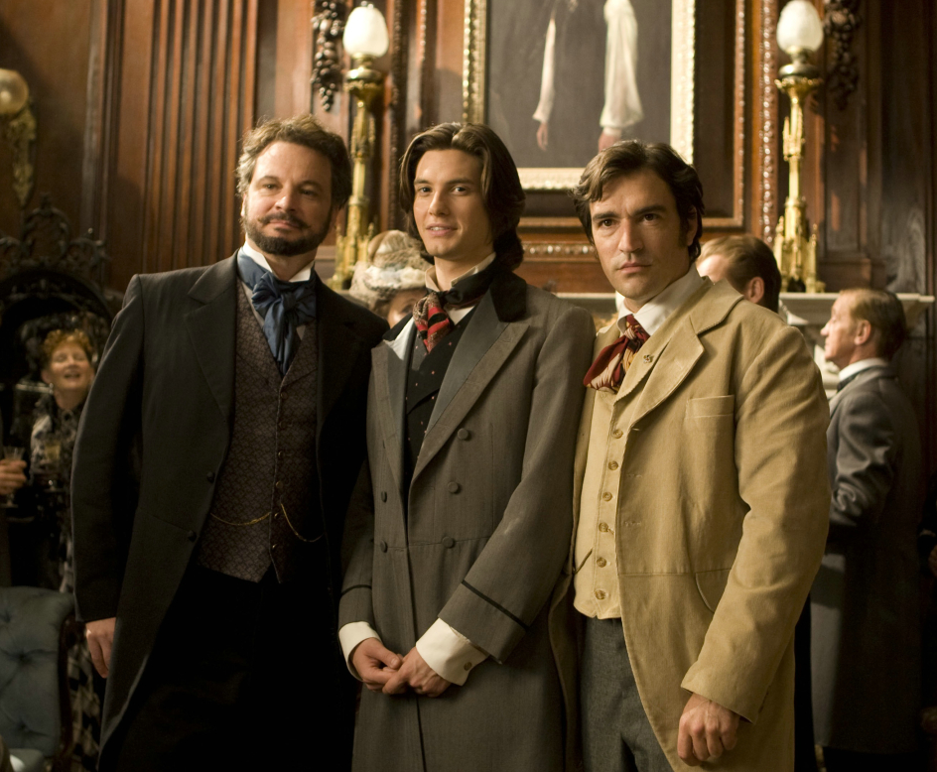
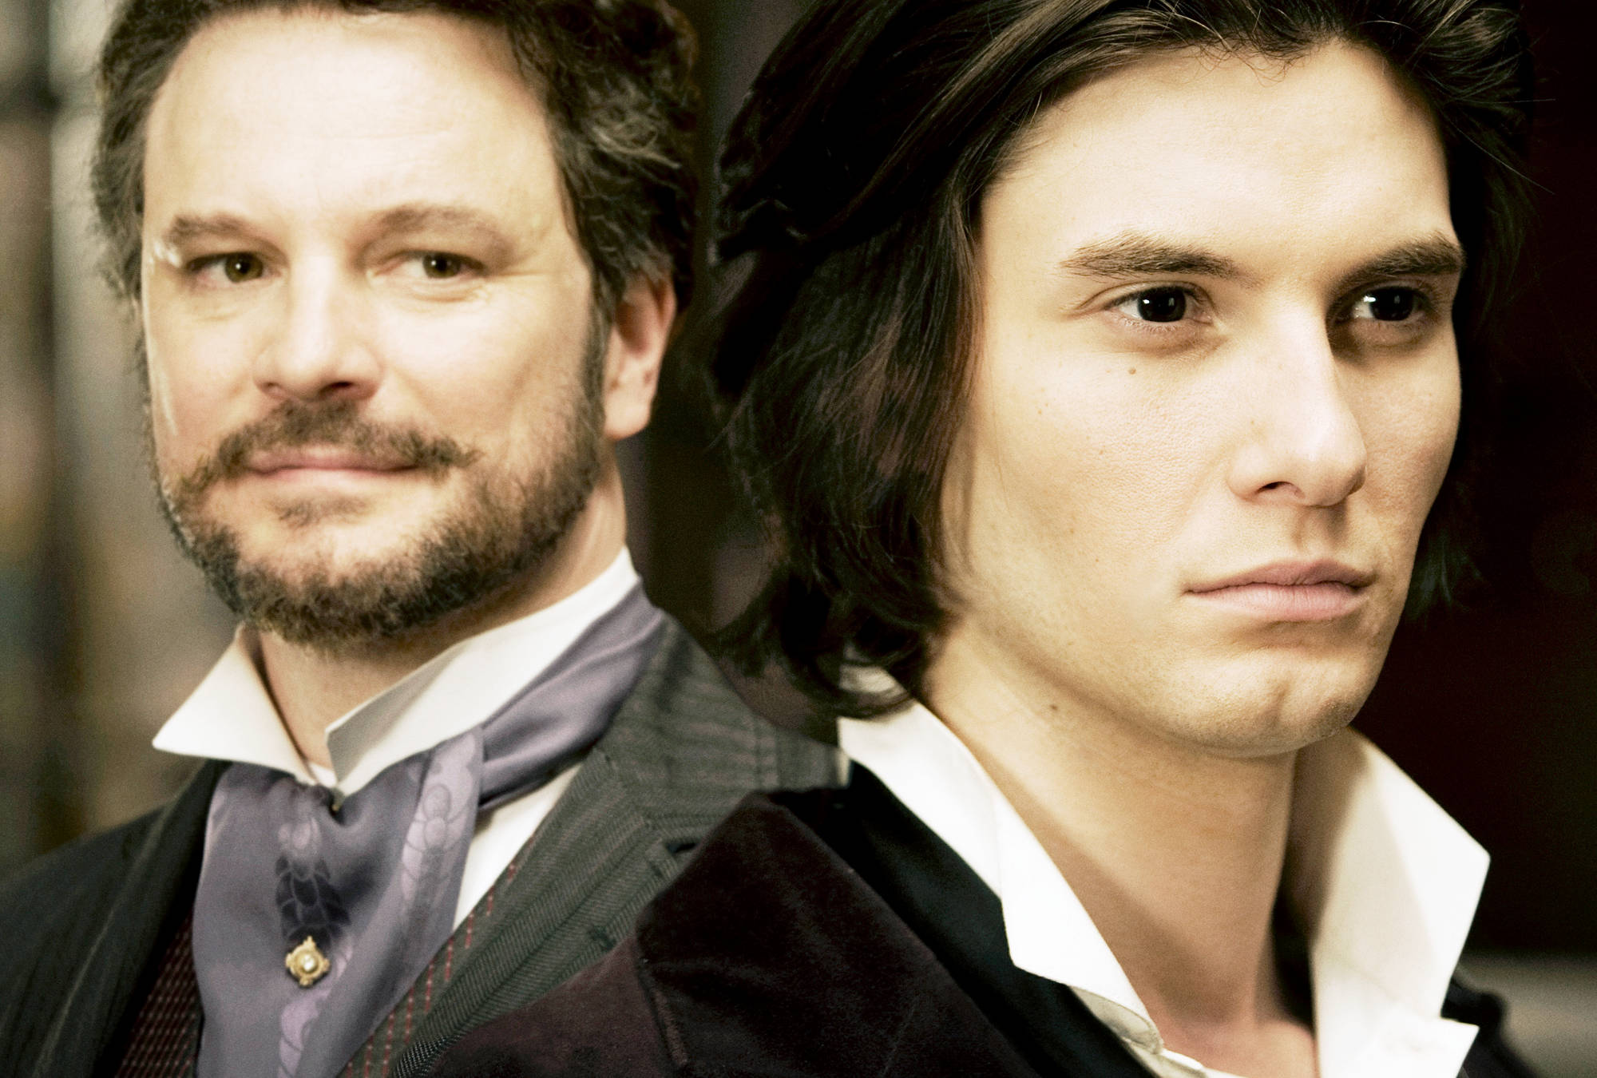
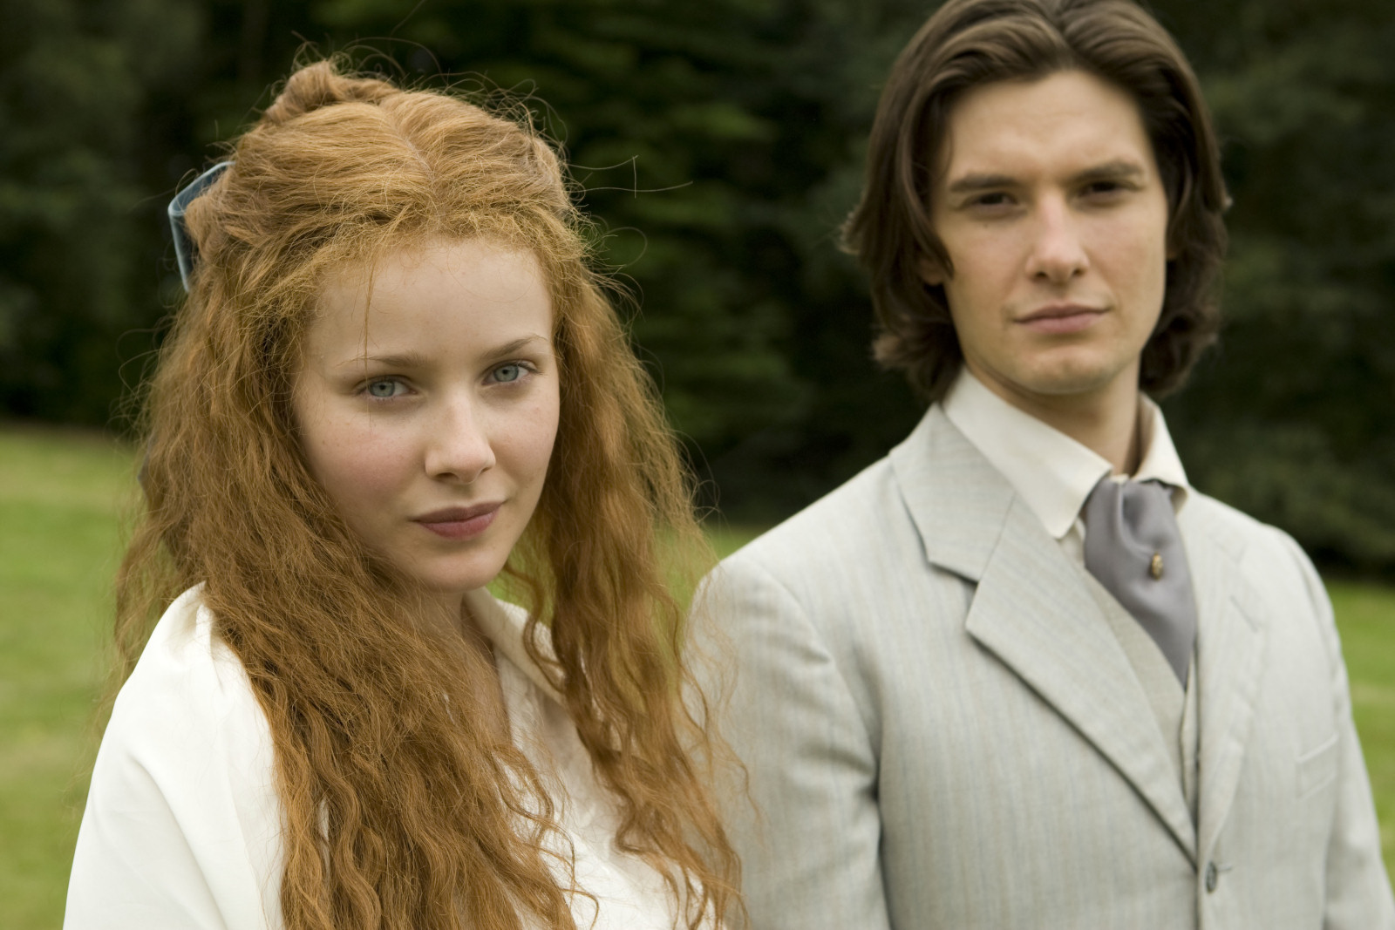
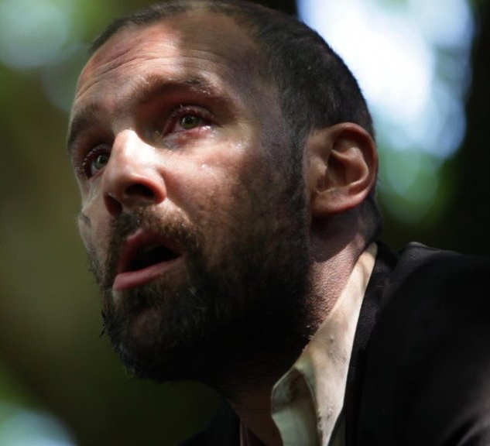
Characters
Dorian Gray

Slide 2
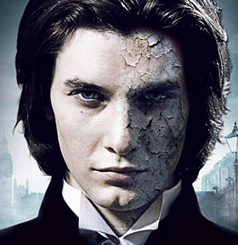
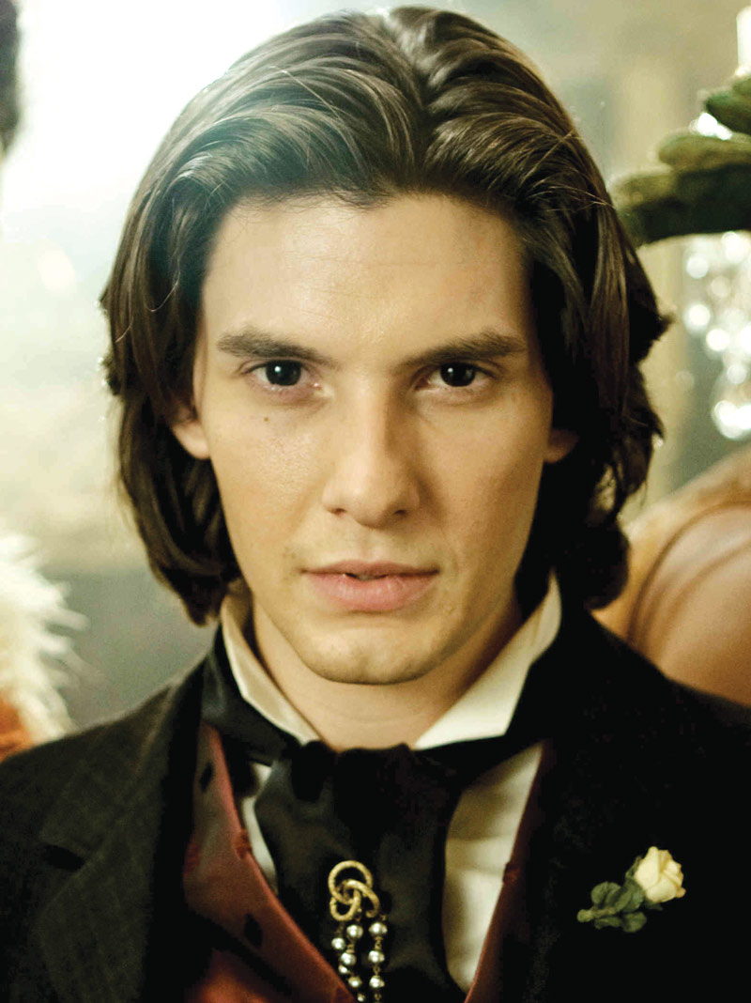
Dorian Gray:
At the opening of the novel, Dorian Gray exists as something of an ideal:
he is the archetype of male youth and beauty.
As such, he captures the imagination of Basil Hallward, a painter, and Lord Henry Wotton, a nobleman who imagines fashioning the impressionable Dorian into an unremitting pleasure-seeker.
Dorian is exceptionally vain and becomes convinced, in the course of a brief conversation with Lord Henry, that his most salient characteristics
—his youth and physical attractiveness—are ever waning.
The thought of waking one day without these attributes sends Dorian into a tailspin:
he curses his fate and pledges his soul if only he could live without bearing the physical burdens of aging and sinning.
He longs to be as youthful and lovely as the masterpiece that Basil has painted of him, and he wishes that the portrait could age in his stead.

Slide 3
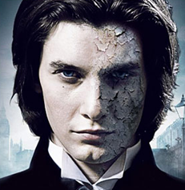
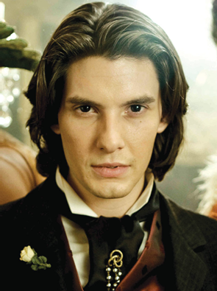
Dorian Gray:
His vulnerability and insecurity in these moments make him excellent clay for Lord Henry’s willing hands.
Dorian soon leaves Basil’s studio for Lord Henry’s parlour, where he adopts the tenets of “the new Hedonism” and resolves to live his life as a pleasure-seeker with no regard for conventional morality.
His relationship with Sibyl Vane tests his commitment to this philosophy: his love of the young actress nearly leads him to dispense with Lord Henry’s teachings, but his love proves to be as shallow as he is.
When he breaks Sibyl’s heart and drives her to suicide, Dorian notices the first change in his portrait—evidence that his portrait is showing the effects of age and experience while his body remains ever youthful.
Dorian experiences a moment of crisis, as he weighs his guilt about his treatment of Sibyl against the freedom from worry that Lord Henry’s philosophy has promised.

Slide 4
Dorian Gray:
When Dorian decides to view Sibyl’s death as the achievement of an artistic ideal rather than a needless tragedy for which he is responsible, he starts down the steep and slippery slope of his own demise.
As Dorian’s sins grow worse over the years, his likeness in Basil’s portrait grows more hideous.
Dorian seems to lack a conscience, but the desire to repent that he eventually feels illustrates that he is indeed human.
Despite the beautiful things with which he surrounds himself, he is unable to distract himself from the dissipation of his soul.
His murder of Basil marks the beginning of his end:
although in the past he has been able to sweep infamies from his mind, he cannot shake the thought that he has killed his friend.
Dorian’s guilt tortures him relentlessly until he is forced to do away with his portrait. In the end, Dorian seems punished by his ability to be influenced:
if the new social order celebrates individualism, as Lord Henry claims, Dorian falters because he fails to establish and live by his own moral code.

Slide 5
Lord Henry Wotton:
Lord Henry is a man possessed of “wrong, fascinating, poisonous, delightful theories.”
He is a charming talker, a famous wit, and a brilliant intellect. Given the seductive way in which he leads conversation, it is little wonder that Dorian falls under his spell so completely.
Lord Henry’s theories are radical; they aim to shock and purposefully attempt to topple established, untested, or conventional notions of truth.
In the end, however, they prove naïve, and Lord Henry himself fails to realize the implications of most of what he says.

Slide 6
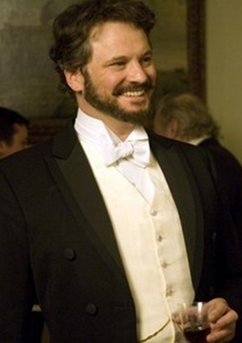
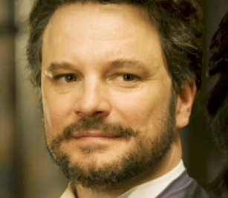
Lord Henry Wotton:
Lord Henry is a relatively static character—he does not undergo a significant change in the course of the narrative.
He is as coolly composed, unshakable, and possessed of the same dry wit in the final pages of the novel as he is upon his introduction.
Because he does not change while Dorian and Basil clearly do, his philosophy seems amusing and enticing in the first half of the book, but improbable and shallow in the second.
Lord Henry muses in Chapter Nineteen, for instance, that there are no immoral books;
he claims that “[t]he books that the world calls immoral are books that show the world its own shame.”
But since the decadent book that Lord Henry lends Dorian facilitates Dorian’s downfall, it is difficult to accept what Lord Henry says as true.

Slide 7
Lord Henry Wotton:
Although Lord Henry is a self-proclaimed hedonist who advocates the equal pursuit of both moral and immoral experience,
Yet he lives a rather staid life.
He participates in polite London society and attends parties and the theatre, but he does not indulge in sordid behaviour.
Unlike Dorian, he does not lead innocent youths to suicide or travel incognito to the city’s most despised and desperate quarters.
Lord Henry thus has little notion of the practical effects of his philosophy.
His claim that Dorian could never commit a murder because “[c]rime belongs exclusively to the lower orders” demonstrates the limitations of his understanding of the human soul.
It is not surprising, then, that he fails to appreciate the profound meaning of Dorian’s downfall.

Slide 8
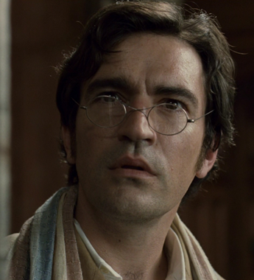
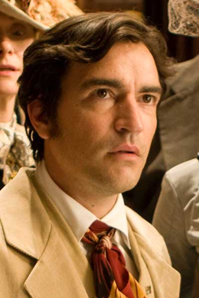
Basil Hallward:
Basil Hallward is a talented, though somewhat conventionally minded, painter.
His love for Dorian Gray changes the way he sees art; indeed, it defines a new school of expression for him.
Basil’s portrait of Dorian marks a new phase of his career.
Before he created this masterwork, he spent his time painting Dorian in the veils of antiquity—dressed as an ancient soldier or as various romantic figures from mythology.
Once he has painted Dorian as he truly is, however, he fears that he has put too much of himself into the work.
He worries that his love, which he himself describes as “idolatry,” is too apparent, and that it betrays too much of himself.

Slide 9
Basil Hallward:
Though he later changes his mind to believe that art is always more abstract than one thinks and that the painting thus betrays nothing except form and colour, his emotional investment in Dorian remains constant.
He seeks to protect Dorian, voicing his objection to Lord Henry’s injurious influence over Dorian and defending Dorian even after their relationship has clearly dissolved.
Basil’s commitment to Dorian, which ultimately proves fatal, reveals the genuineness of his love for his favourite subject and his concern for the safety and salvation of Dorian’s soul.

Slide 10
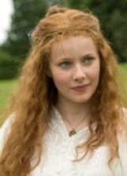
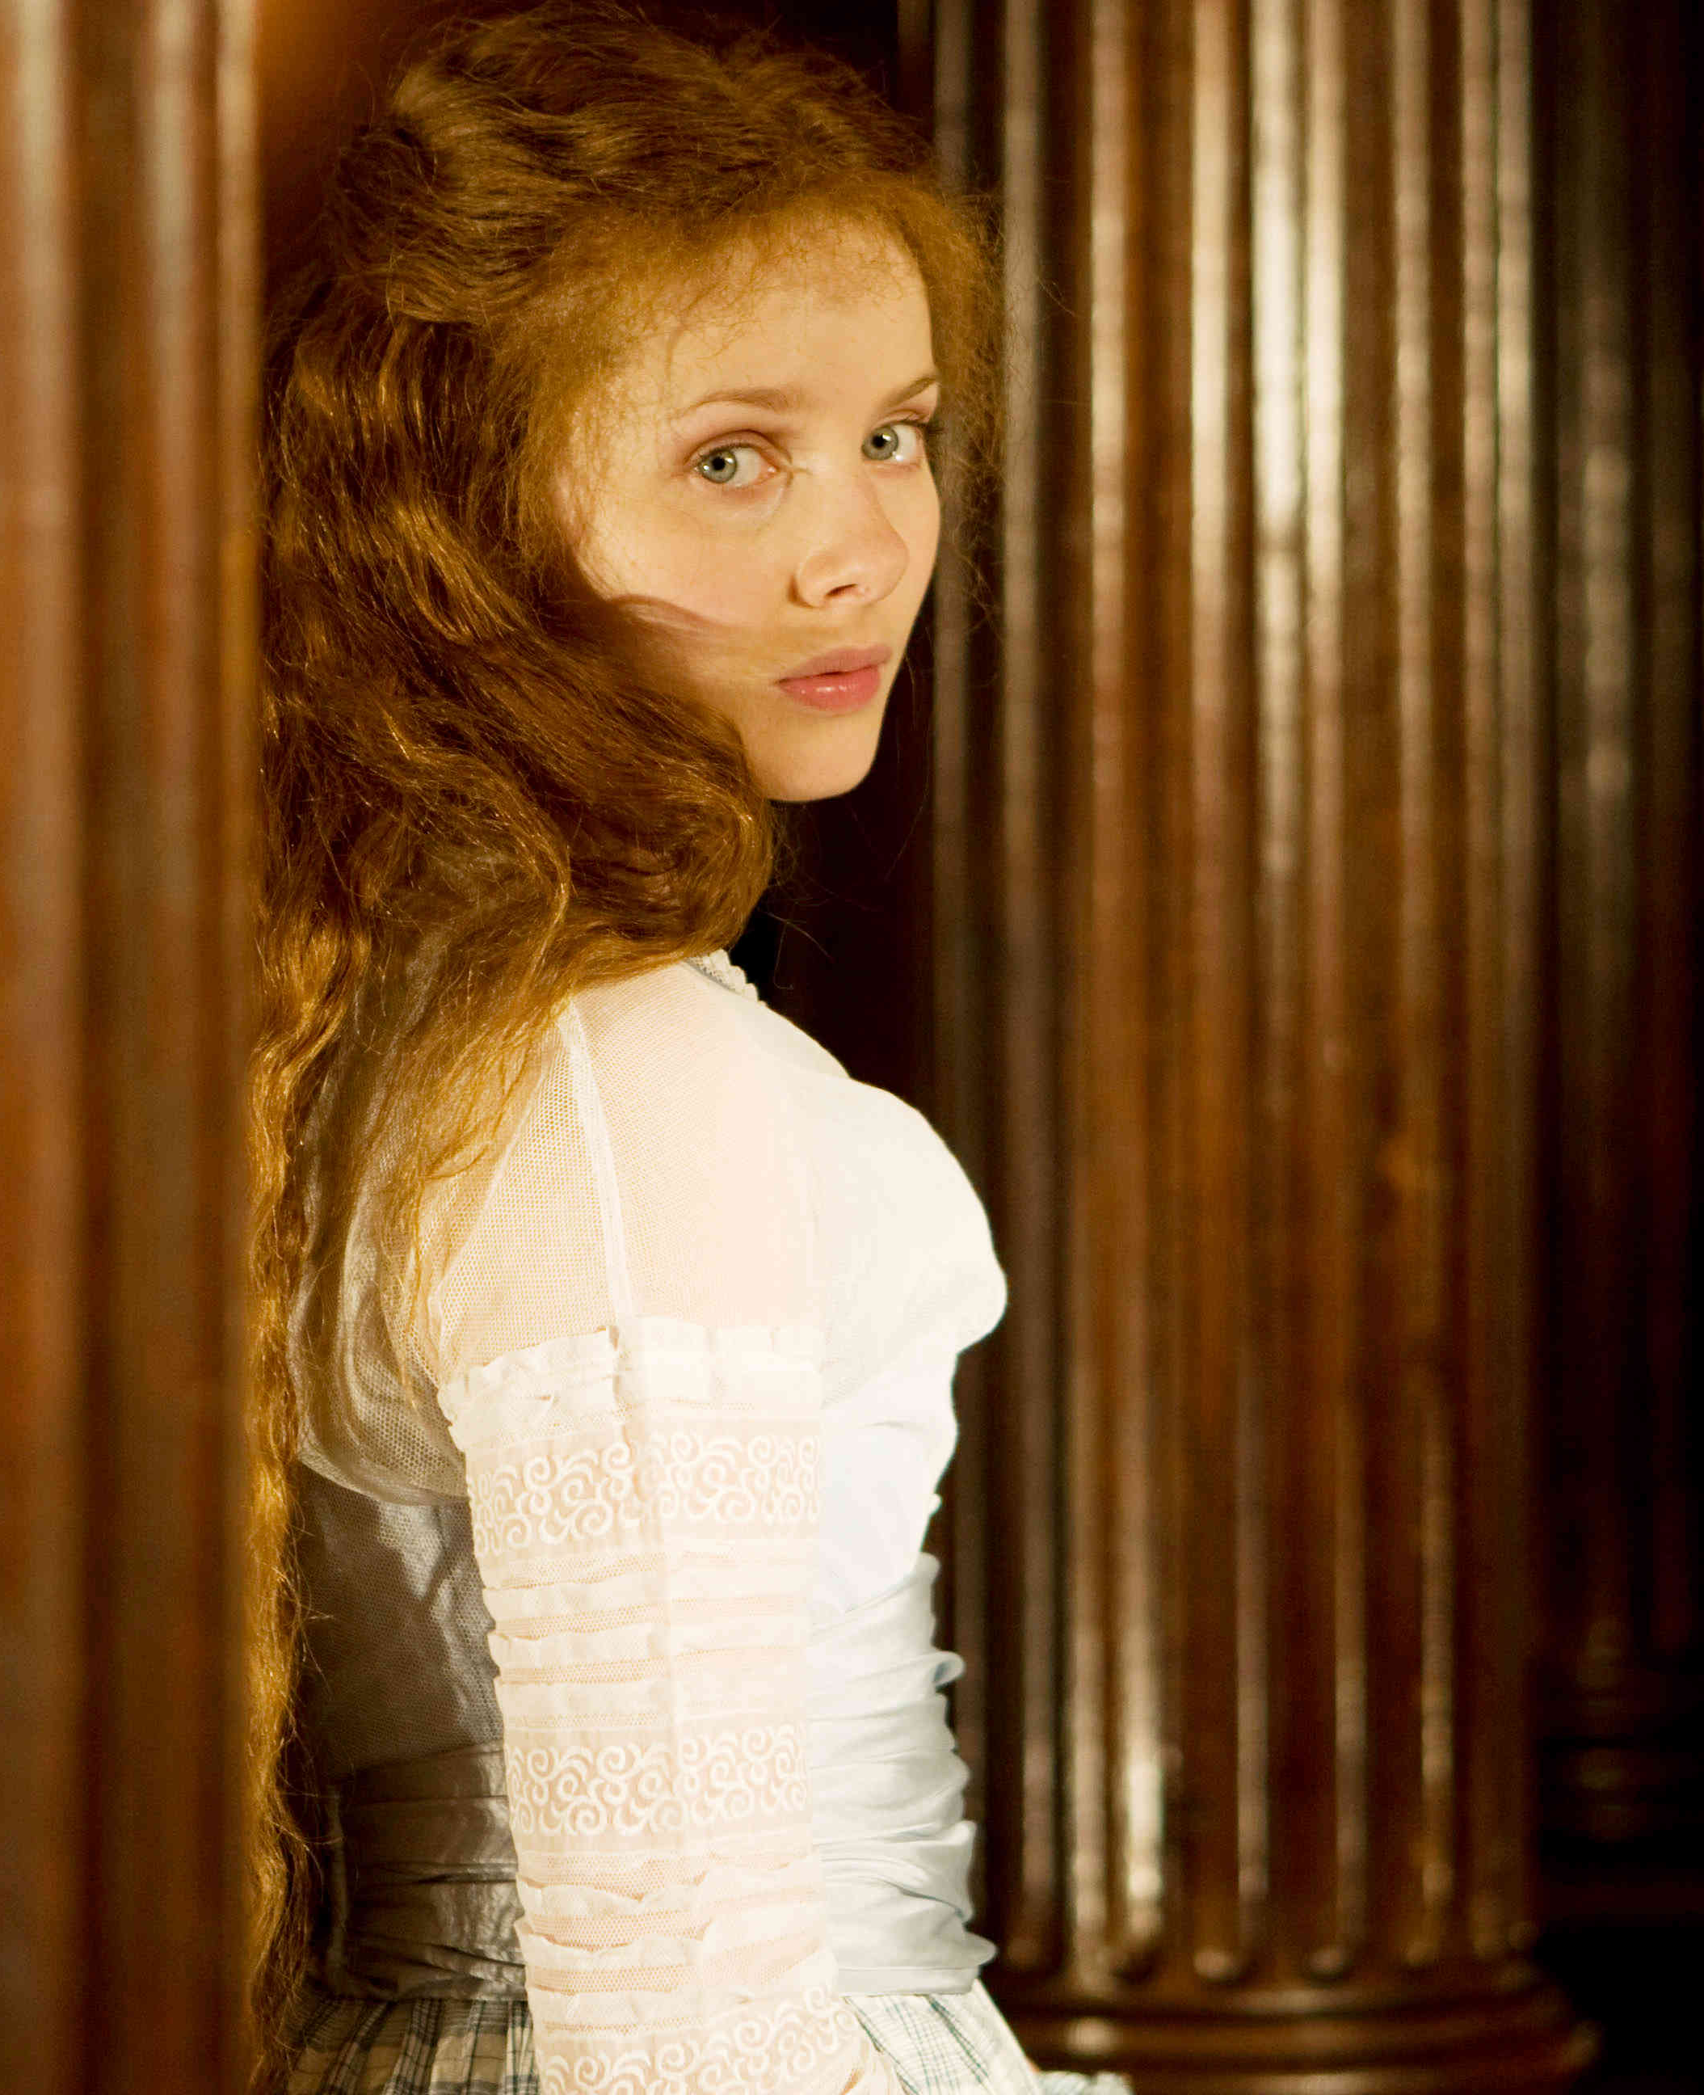
Sybil Vane:
A poor, beautiful, and talented actress with whom Dorian falls in love.
Sibyl’s love for Dorian compromises her ability to act, as her experience of true love in life makes her realize the falseness of affecting emotions onstage.
A young actress, from a poor family, who performs Shakespeare’s heroines every evening at a low class theatre.
Dorian falls in love with her performances, but she finds performance paltry in comparison to true love and her acting suffers after her engagement to Dorian.
Dorian, in turn, is uninterested in her after she no longer has her art. He leaves her heartbroken and Sybil, a Juliet-like martyr for love, commits suicide.
She is a symbolic character, pure in her love and embodying an artistic ideal

Slide 11
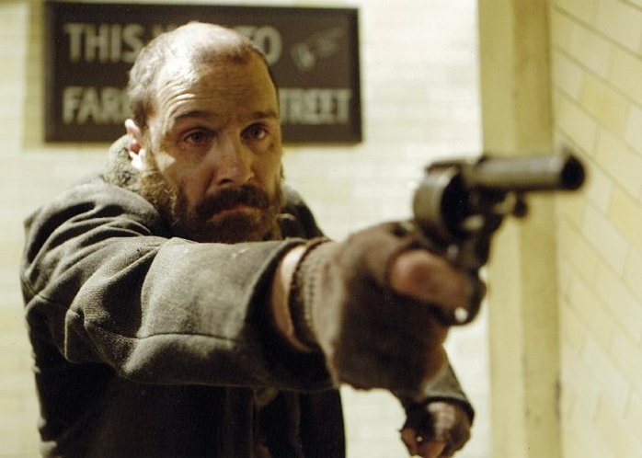
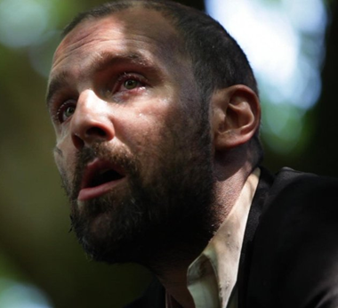
James ‘Jim’ Vane:
Sibyl’s brother, a sailor bound for Australia.
James cares deeply for his sister and worries about her relationship with Dorian.
Distrustful of his mother’s motives, he believes that Mrs. Vane’s interest in Dorian’s wealth disables her from properly protecting Sibyl.
As a result, James is hesitant to leave his sister.
The burly sailor brother of Sybil Vane and very different from his sister in experience and appearance.
He is rough looking but very decent and seeks above all else to protect his sister.
He threatens to kill whoever hurts her, and, avenging her suicide, follows and haunts Dorian.
His face becomes a symbol of the goodness that Dorian has destroyed.

Slide 12
Alan Campbell:
Once an intimate friend, Alan Campbell is one of many promising young men who have severed ties with Dorian because of Dorian’s sullied reputation.
He is called on by Dorian to dispose of Basil Hallward’s body.
He is a scientist whom Dorian knew intimately once, but grows like many others to despise Dorian and doesn’t want anything to do with the crime.
Dorian blackmails him and he unhappily completes the task, and commits suicide not long after.

Slide 13
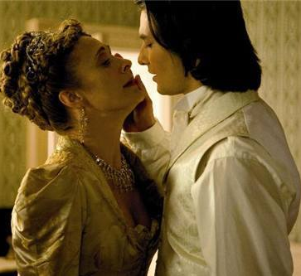
The Duchess of Monmouth:
A pretty, bored young noblewoman who flirts with Dorian at his country estate.
A clever and pretty member of Lord Henry’s social set.
She is unusual amongst the women of the novel as one of the only ones able to impress Lord Henry and keep up equal banter with him.
She is also enamoured with Dorian and shows that marriage in this society is often just a show, revealing secret affections, something that Lord Henry seems to highly approve of.

Slide 14
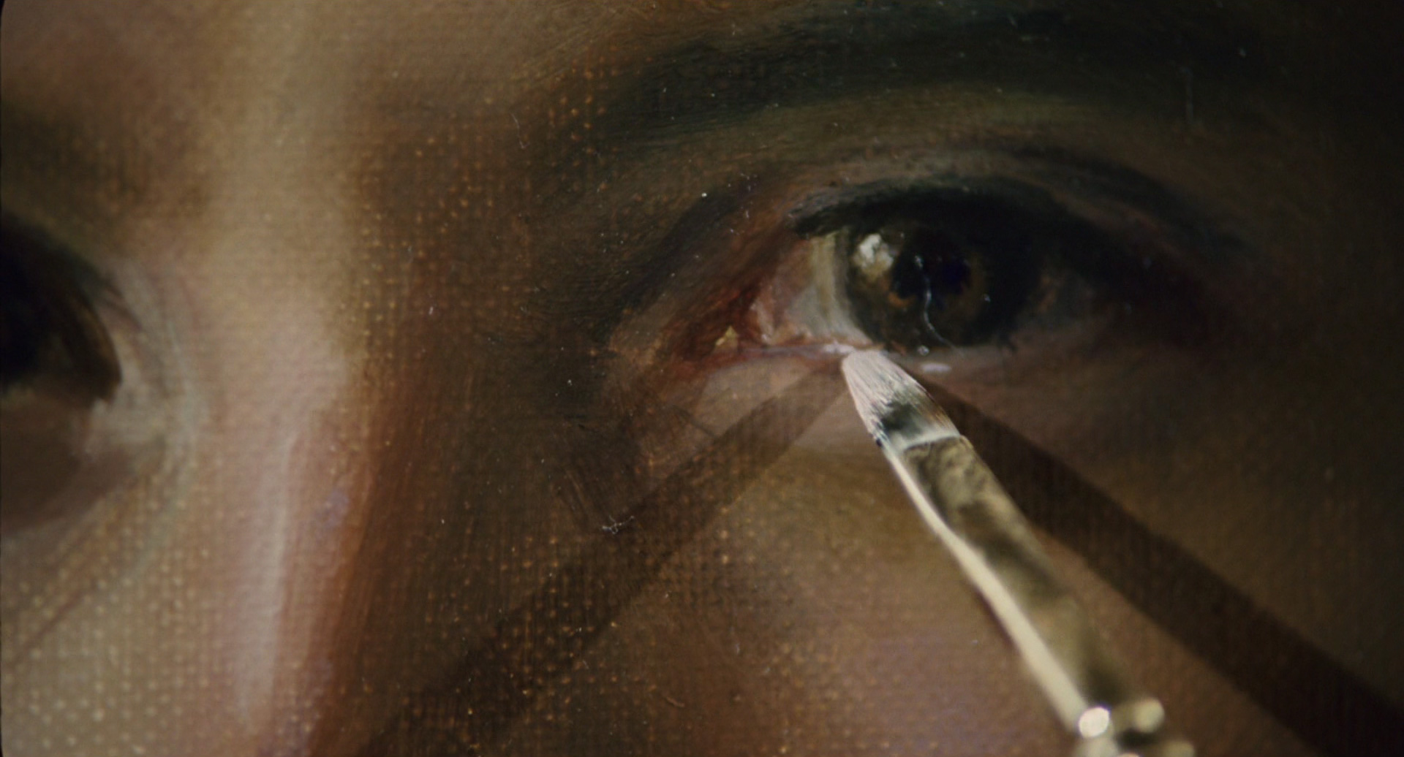
Minor Characters:
Adrian Singleton
Another former friend of Dorian’s, who has been ruined and now sits in opium dens all day.
Adrian gives a glimpse into the real human consequences of Dorian’s influence.
Victor
Dorian’s servant.
Although Victor is a trustworthy servant, Dorian becomes suspicious of him and sends him out on needless errands to ensure that he does not attempt to steal a glance at Dorian’s portrait.

Slide 15
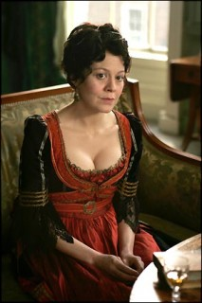
Minor Characters:
Mrs. Vane
Sibyl and James’s mother.
Mrs. Vane is a faded actress who has consigned herself and her daughter to a tawdry theatre company, the owner of which has helped her to pay her debts.
She conceives of Dorian Gray as a wonderful alliance for her daughter because of his wealth;
this ulterior motive, however, clouds her judgment and leaves Sibyl vulnerable.

