Slide 1
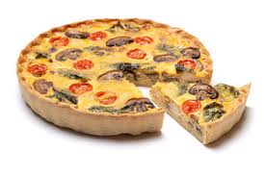
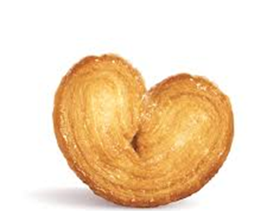
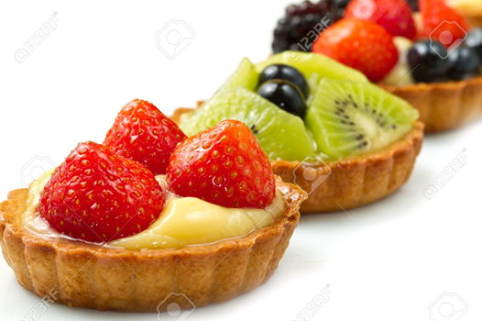
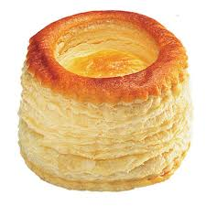
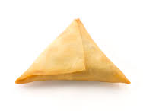
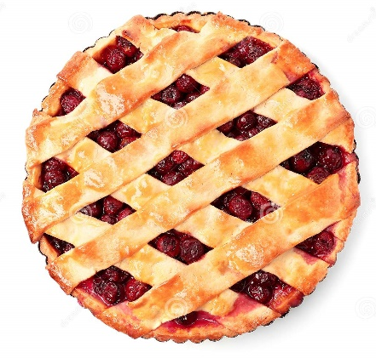
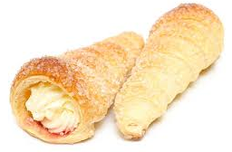
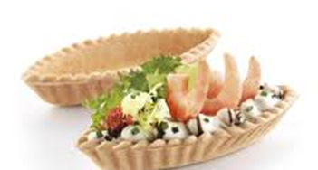
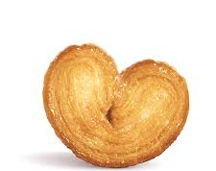
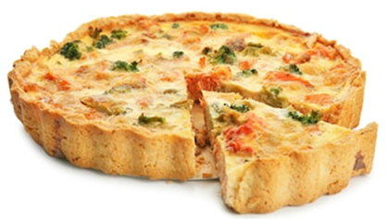
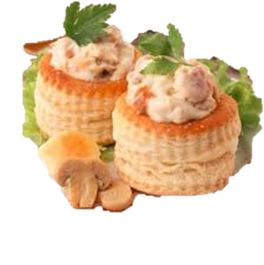
PASTRY

Slide 2
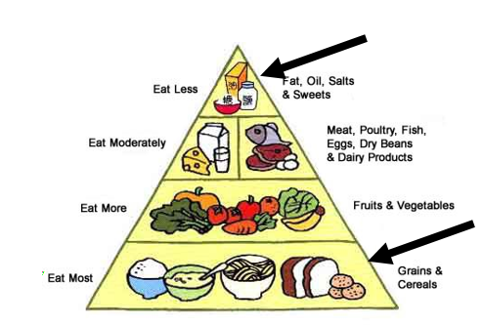
Pastry is a dough of flour, water and shortening that may be savoury or sweet used for many dishes.
DEFINITION & NUTRITIONAL VALUE
High in starch and fat
Cereals and starch food group
Fats, oils and sweet group
Filling: proteins, vitamins
and minerals

Slide 3
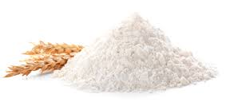
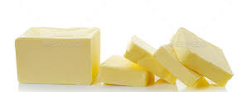
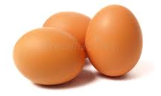
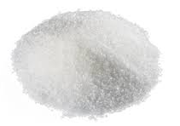
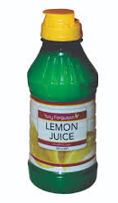
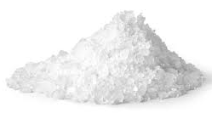
Cake / all purpose. It has enough gluten to produce a structure
Butter is best. Lard, Vegetable oils. Creates texture. Rich flavour and colour.
Makes pastry more pliable, provides colour and flavour assists in making pastry hold its shape
Creates softer crumb, adds colour only used in sweet pastry
Water/ milk develops gluten, transforms into steam and helps to leaven dough. Acid in lemon juice, buttermilk and sour cream softens the gluten in the flour. Makes pastry easy to roll.
Adds flavour and improves shelf life
Flour
Shortening
INGREDIENTS AND FUNCTIONS
Eggs
Sugar
Liquid
Salt

Slide 4
Quality characteristics:
Soft, short crumb
Golden brown
Not flaky
Crisp
Rich
Texture should not be gummy
Ratio Flour to Fat : 1: ½
Flour to Liquid: 1: ¼
USES:
Savoury
Quiche
Pie
Tarts
Cornish Pastie
Barquettes
Sweet
Custard and chocolate pies
Fruit tartlets
Flans
Hertzoggies
Lemon meringue tart
SHORTCRUST PASTRY /
PÂTÈ FONCER
TYPES:
Rich shortcrust / Pâte brisée: Eggs used to bind the ingredients
Sweet shortcrust/ Pâte sucrée: Dough enriched with sugar and egg yolks. Used for sweet tarts
SHORTCRUST PASTRY
Non laminated: no layers

Slide 5
Ratio Flour to Fat : 1: 1
Flour to Liquid: 1: ½
No eggs
No sugar
Quality Characteristics:
Lightest of all pastries
Light, flaky layers
Light golden-brown colour
Uneven surface
Rich, delicate taste
Buttery taste
Not oily
TYPES
Rich pastry
Laminated - thin layers
Lengthy and complicated process
Butter (beurrage) incorporated into the rolled out dough (détrempe) : made of flour, water and a small amount of butter through rolling and folding
Rough puff pastry:
- Rises less
Lower proportion of fat to flour
Flaky puff pastry
- Few layers
Lower proportion of fat to flour
Butter not added in one piece
PUFF PASTRY / PÂTÈ FEUILLETLEE
PUFF PASTRY
USES
Savoury
Boucheés
Vol-au-vents
Beef Wellington
Fleurons
Sausage Rolls
Sweet
Jam tartlets
Custard slices
Palmiers
Cream horns
Mille feuilles
Tart tatin
Turn overs

Slide 6
Quality Characteristics:
Golden brown colour
Light texture
Paper thin
Crisp
Brittle
Ratio Flour to Fat : 1: 2
Paper thin
Frozen pastry
Phyllo
Non laminated
Made of flour, water, eggs, oil
After defrosting, cover lightly with plastic and damp towels to avoid drying
Not rolled out , melted butter brushed onto layers of sheets
USES
Savoury
Spanakopita
Samoosas
Spring rolls
PHYLLO PASTRY / STRUDEL PASTRY
PHYLLO PASTRY
Sweet
Apple strudel
Baklava
Greek milk tart
Purr
Non laminated
Not as thin as phyllo
Made of flour, oil and water
Covered with damp towel after defrosting

Slide 7
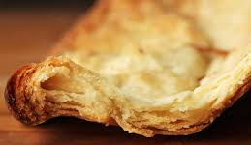
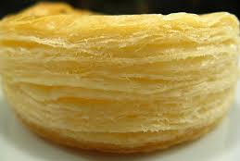
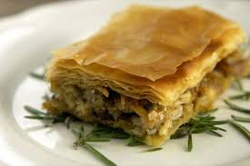
Shortcrust Pastry
Puff Pastry
Phyllo Pastry

Slide 8
Measure ingredients accurately | Incorrect measurements can change the characteristics of the pastry
Keep everything ice cold: work surface, ingredients, utensils and your hands | Shortening remains hard and forms layers between the pastry layers makes rising easier Warm butter is absorbed by flour, flakiness is not achieved
Don’t overmix the dough, handle lightly | Heat from hands can melt the shortening Over handling can cause the dough to shrink Crust may be tough
Use minimum flour when rolling out the dough | Too much flour will change the ratio and make the dough dry and hard
Incorporate as much air as possible by folding dough correctly | The more air is included the better the end product
Roll out lightly, always in the same direction | Too much pressure may cause uneven thickness
Don’t stretch the pastry | Stretching the dough will cause shrinking during baking
Rest and chill pastry after each of making and assembling | Prevents the dough from shrinking during baking
Bake at the correct temperature | Too low temperature may result in a soft, doughy crust or fat oozing out High temperature may burn crust
GENERAL RULES

Slide 9
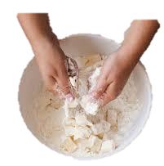
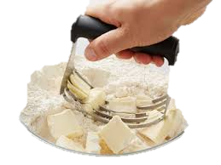
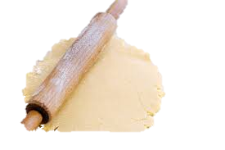
Using fingertips to rub butter lightly into flour. Mixture is lifted out the bowl and let to fall back through the fingers.
RUBBING IN
TECHNIQUES
Butter is cut into the flour using a dough cutter or two knives. Criss cross movement until lumps of butter are dispersed evenly.
CUTTING-IN
Dough is chilled for 30 minutes before rolling. Little flour is sprinkled on the surface to prevent the dough from sticking. Roll in the same direction lightly.
ROLLING

Slide 10
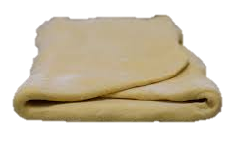
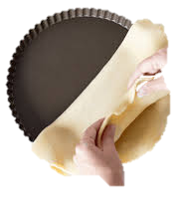
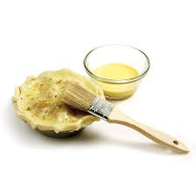
Fold the top third of the dough over the centre and fold the bottom third over to make layers of dough. Seal air inside the layers by pressing the edges of the dough lightly with a rolling pin.
FOLDING
To ensure the round of the dough is big enough to cover the base and overlap the sides of the tin / dish. Pastry should be wider than tin. Press down well to make sure it fits the dish.
LINING
TECHNIQUES cont…
Brush the pastry before baking to give it a shiny golden look.
GLAZING

Slide 11
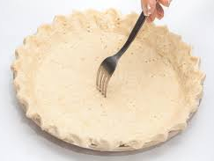
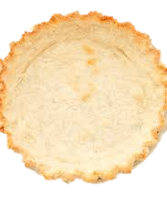
DOCKING
The base of the tart dough and sides are pricked with a fork to allow air trapped between the dough to escape
Before adding an egg filling, the pastry case needs to be pre-baked and sealed to prevent it from becoming soggy. Brush the base and sides of the partially baked pastry with beaten egg and return to the oven for 3-4 minutes
TECHNIQUES cont…
SEALING
Cutting the dough into different forms and shapes
SHAPING

Slide 12
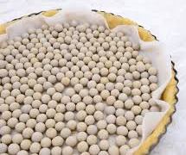
Pastry
BAKING BLIND
Grease proof paper
Beans
Steps in blind baking:
Line the tart pan with pastry and dock it
Line the case with foil or greaseproof paper
Weigh the lining and pastry down with dried beans or rice
Bake the pastry case in an oven at 180°C for 10-15 minutes
Remove the beans or rice and lining and bake for a further 5-10 minutes until the pastry is dry and lightly browned
Some pastries have to baked before the filling is added
TECHNIQUES
Reasons for baking blind:
The filling you are going to use is already cooked
To keep crust from blistering
To ensure the pastry case is cooked thoroughly
To help the crust to become crisp

Slide 13
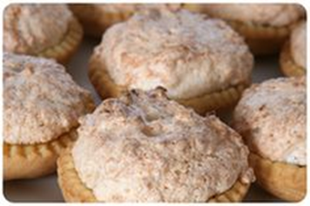
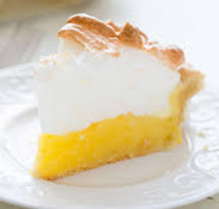
BARQUETTE
HERTZOGGIES
QUICHÈ
Small oval or boat-shaped pastry cases, blind baked, sweet / savoury fillings
SHORTCRUST PASTRY USES
Jam-filled tartlet or cookie with a coconut topping commonly served on a cup-like pastry base.
Custard made with milk and eggs poured into a pie crust and baked, sealed pastry
LEMON MERINGUE TART
Baked pie made of shortcrust pastry, lemon custard filling and a fluffy meringue topping.

Slide 14
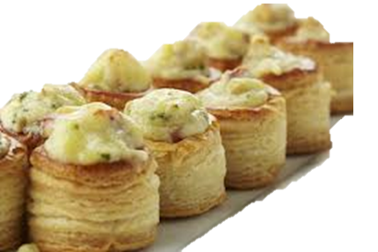
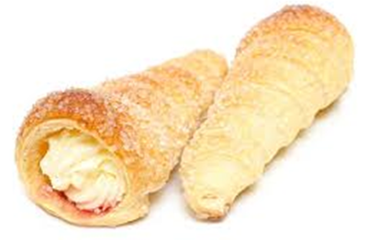
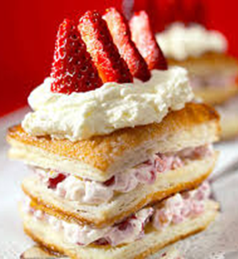
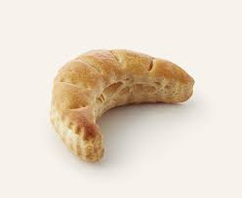
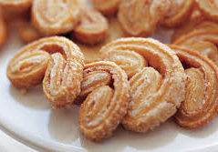
VOL-AU VENT
BOUCHÉES
CREAM HORNS
5cm, bite-size, sweet / savoury fillings
Filling must be thick
Pastry cut into strips wrapped around a metal cornet mould, filled with Chantilly cream
10cm, savoury filling, filling must be thick
PUFF PASTRY USES
MILLE FEUILLES
FLEURONS
PALMIERS
Rectangular, two rectangular layered with cream and jam or crème pâtissiére.
Crescent shaped, a small piece of puff pastry used for garnishing.
Multilayered, shaped like a palm leaf sprinkled with sugar and baked until the sugar is caramelized. Also called elephant ear / pigs ears

Slide 15
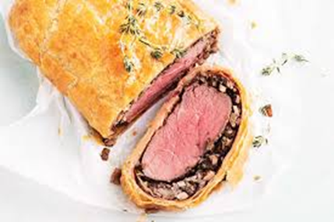
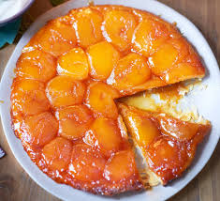
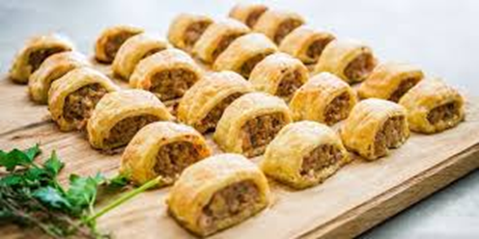
BEEF WELLINGTON
TART TARTIN
SAUSAGE ROLLS
PUFF PASTRY USES cont…
Piece of sausage meat wrapped in pastry
Upside-down apple tart consisting of pastry baked over slices of fruit arranged in caramelized sugar, served fruit side up after cooking.
Fillet coated in pâté and wrapped in puff pastry.

Slide 16
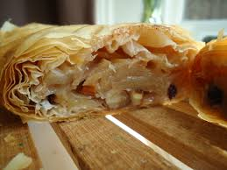
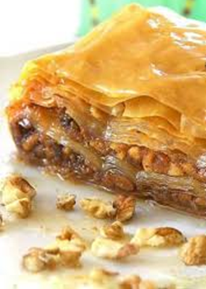
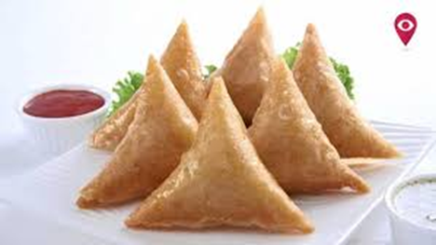
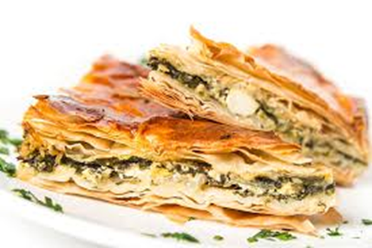
APPLE STRUDEL
BAKLAVA
SAMOOSAS
PHYLLO USES
Oblong strudel pastry jacket with an apple filling inside.
Layers of phyllo filled with chopped nuts and sweetened and held together with syrup or frosting or honey.
Fried or baked pastry with a savoury filling
SPANAKOPITA
A filo pastry stuffed with spinach and feta cheese.

Slide 17
SHORTCRUST PASTRY
Hard crust | To much water was used
Soft | Too much fat
Soggy | Too much water Oven was too cold / not preheated Pastry not baked for long enough
Shrunken pastry | Over-handled or rolled No resting time Stretched during handling
PROBLEMS AND FACTORS

Slide 18
PUFF PASTRY
Hard pastry | Too much water Too much flour used during rolling Over handled
Fat oozes out during baking | Fat too soft Dough too soft Edges not sealed Uneven rolling and folding Oven too cold
Pastry is not flaky | Fat too warm Heavy use of rolling pin
Shrunken pastry | Over-handled Insufficient resting between rolling Over-stretched
Pastry has risen unevenly | Uneven distribution of fat Uneven rolling and folding Oven not closed properly
PROBLEMS AND FACTORS

Slide 19
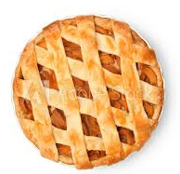
Fish and Shellfish
Sweet: fruit, mousse, crème patissiere, Chantilly
FILLINGS
Moisten additional dough for decoration with egg white or water so that the decoration will stick to the pastry
Vegetables: pre-cooked spinach, mushrooms
Egg set: milk talk, quiche
FILLINGS AND DECORATIONS
FINISHING AND DECORATION
Meat: steak and kidney, venison.
Pie cover: lattice pattern for open flan
Fleuron

Slide 20
UNCOOKED
FROZEN: 3 months
Wrap well to prevent freezer burn
Defrost by placing on a baking sheet and leave in the refrigerator overnight
CHILLED: few days
Wrap well with cling wrap to prevent drying out
STORAGE
BAKED UNFILLED
Airtight container for 2 weeks
BAKED FILLED
Refrigerator for a few days

Slide 21
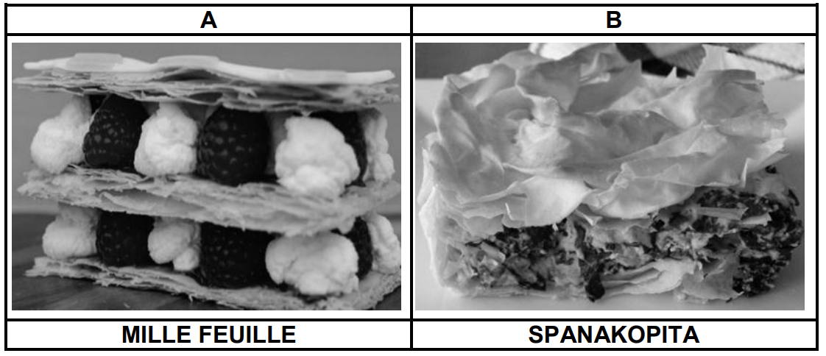
1.1 Study the pastry pictures below and answer the questions that follow.
ACTIVITES
1.1.1 Identify the type of pastry used for dishes A and B respectively. (2)
A- Puff√
B- Phyllo√
1.1.2 Explain the purpose of using iced water in pastry A. (1)
The ice water will change into steam/ act as a rising agent/It will cause the pastry to form layers√

Slide 22
1.1.3 Give TWO reasons why fat may ooze out of pastry A during the
baking process. (3)
-Oven is too cold√
-Fat too soft√
-Dough too soft√
-Edges not sealed√
-Uneven folding and rolling√ (Any 2)
ACTIVITES
1.1.4 Motivate why all apparatus must be cold when preparing pastry A. (2)
Shortening remain hard√
Forms layers√
Provides better rising√
Warm butter absorbed by flour will affect the flakiness.√ (Any 2)

Slide 23
1.1.5 Describe TWO precautionary measures when thawing pastry B.
Leave in the refrigerator for 12 hours/overnight√
Remove from the fridge one hour before using it√
Keep pastry covered to prevent it from drying out√ (Any 2)
1.1.6 Name and describe a technique that should be applied to the pastry before it is baked to give the pastry a shiny golden brown appearance. (2)
ACTIVITES
Glazing√
• Brushing√ of the pastry with egg wash or milk√
1.1.7 State THREE ways in which shrinking of the pastry can be prevented during the preparation process. (3)
By not stretching the pastry√
• Pastry needs to be rested√ and chilled after each stage of
making and assembling√
• By not over handling the pastry√ (Any 3)

Slide 24
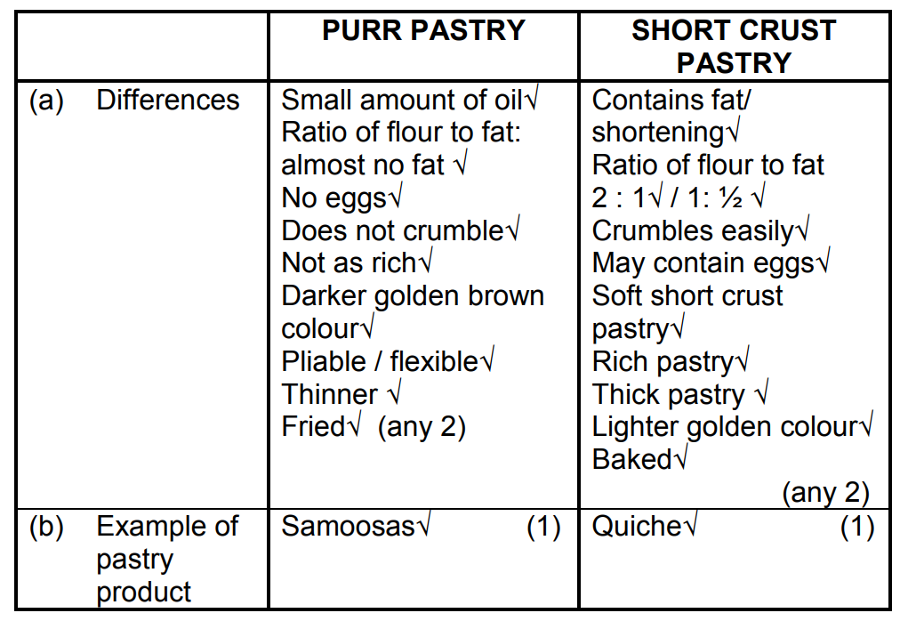
1.2 Distinguish between purr pastry and short crust pastry used to prepare the snacks with regard to the following aspects. Tabulate your answer as follows in the ANSWER BOOK:
 | PURR PASTRY | SHORTCRUST PASTRY
(a) Differences | (2) | (2)
(b) Example of pastry product listed above | (1) | (1)
ACTIVITES

Slide 25
1.4 Study the extract below and answer the questions that follow.
Pastry Ingredients: oil, butter eggs, sugar flour, milk
The ingredients above are incorrect. Select THREE correct ingredients used in rich short crust pastry
and arrange them in the correct order. (3)
ACTIVITES
Flour√
• Butter√
• Eggs√
• Milk√ (Any 3)

Slide 26
1.5 The crust of one of the products on the platter is baked blind.
(a) Identify the product which is baked blind.
Quiche √
ACTIVITES
(b) Explain why the crust of the product identified in QUESTION (a) is baked blind. (2)
To ensure that the pastry case is thoroughly cooked √ To help the crust to become crisp / prevents it from being soggy√ To keep the crust from blistering √ (Any 2)

