Slide 1
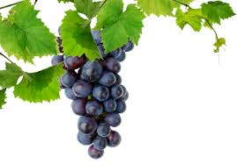
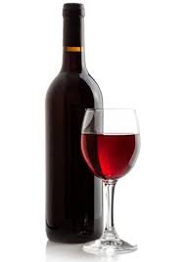
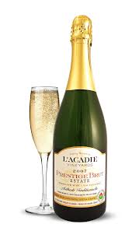
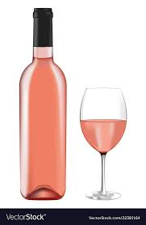
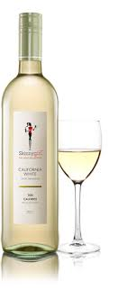
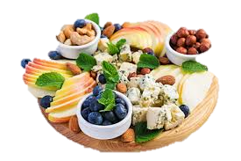
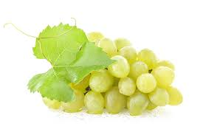
WINE

Slide 2
Wine is an alcoholic beverage made by fermenting the juice of fresh grapes. The grapes are grown specifically for this purpose. Grapes are different from table grapes.
Guests in restaurants will ask for advice about suitable wines to accompany their meal.
Knowledge of the different types of wines will allow you to recommend an appropriate wine to accompany a particular dish.
Wine is not only the result of the fermentation of grape juice but is the culmination of many factors that greatly affect the finished product. First and foremost are the grape itself. The many varieties of wine grapes grown worldwide produce varying degrees of sweetness, flavor, acidity, tannins
DEFINITION

Slide 3
Still / Natural wines
Sparkling wines
Non-alcoholic / Low alcohol wines
Fortified wines
CLASSIFICATION

Slide 4
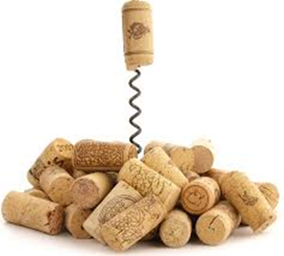
Wine that has no bubbles. Referred as table wines. Nothing has been added during the fermentation process. The different varieties of grapes used to make wine are called cultivars.
Cultivars: wine grape varieties that are the building blocks of the craft of wine making. A cultivar is a grape variety which has been selectively cultivated. The main difference between cultivars is the colour of grapes used for making white, rosé and red wines.
STILL / NATURAL WINES

Slide 5
WINE MARKING PROCESS
Grapes are harvested
Grapes destemmed and Crushed = MUST
Pressing: White-juice separated from skins Red-skins left
Blending
Fermentation: Sugar converted into alcohol and carbon dioxide
Clarification
Bottling
Labelling and Sealing

Slide 6
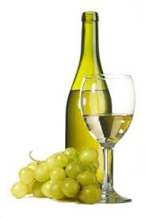
Light skinned grape varies from pale green to gold.
Made using green and black grapes, if black grapes are used skin must be removed before crushing
Based on sugar content = very dry, dry, semi-sweet, sweet
Sauvignon Blanc
Chenin Blanc
Rhine Riesling
Chardonnay
Gewürztraminer
CULTIVARS
Colombar
Paarl Riesling
WHITE WINE

Slide 7
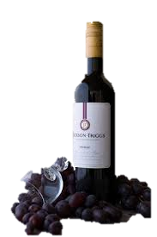
Usually dry, produced in wooded or unwooded styles.
Made using black grapes and the skin remains through the fermentation process
Available as a single cultivar or a blend of two or more types of grapes
Merlot
Cabernet Sauvignon
Shiraz
Pinotage
CULTIVARS
Cabernet Franc
Cinsaut
Pinot Noir
RED WINE

Slide 8
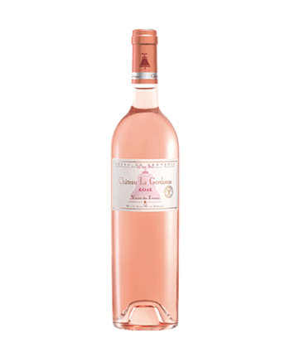
Can be dry, off dry,semi-sweet
Made from red grapes and the skins are removed from the juice as soon as a rosy colour appears
Made by blending red and white wine
ROSÉ WINE

Slide 9
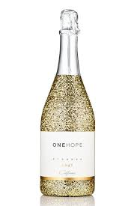
Large carbon dioxide bubbles.
Carbonated by fermentation or by inserting carbon dioxide.
METHODS
Charmat/Tank: Second fermentation occurs in the tank
Carbonation: Carbon dioxide is injected into the wine
Cap Classique: Second fermentation occurs in the bottle
SPARKLING WINE
DEGREE OF SWEETNESS
Brut = Very dry
Sec = Dry
Demi-sec = Medium dry (slightly sweet)
Doux = Sweet

Slide 10
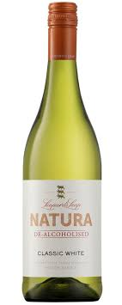
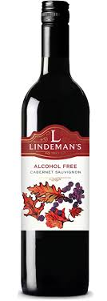
ALCOHOL FREE, DEALCOHOLISED AND LOW ALCOHOL WINE
ALCOHOL FREE:
Grape juice concentrate and grape juice. Unfermented
DEALCOHOLISED:
Alcohol has been removed
Made the same way as normal wine but alcohol removed before bottling
Less than 0.5% alcohol

Slide 11
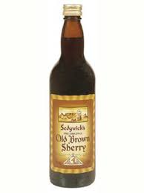
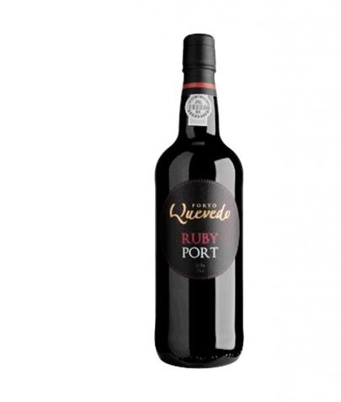
FORTIFIED WINES
Non-sparkling
Wines in which spirits are added
Fermentation stops by addition of spirit
TYPES:
Sherry
Port

Slide 12
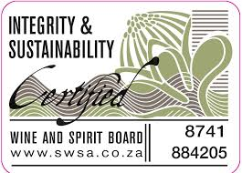
Back Label
Authenticity Seal
Descriptive information
WINE LABEL
LEVILE’S WINERY
Merlot
Plum flavours, touch of oak and chocolate.
Serving Suggestions: Compliments Beef roast, pasta and steak
Serving Temperature: 16°C
14%alc 750ml
LEVILE’S WINERY
Merlot
2019
Robertson
14%alc 750ml
Producer
Vintage
Serving Sugg.
Cultivar
Origin
Serving Temp
Alcohol Content
Volume
Barcode
Front Label

Slide 13
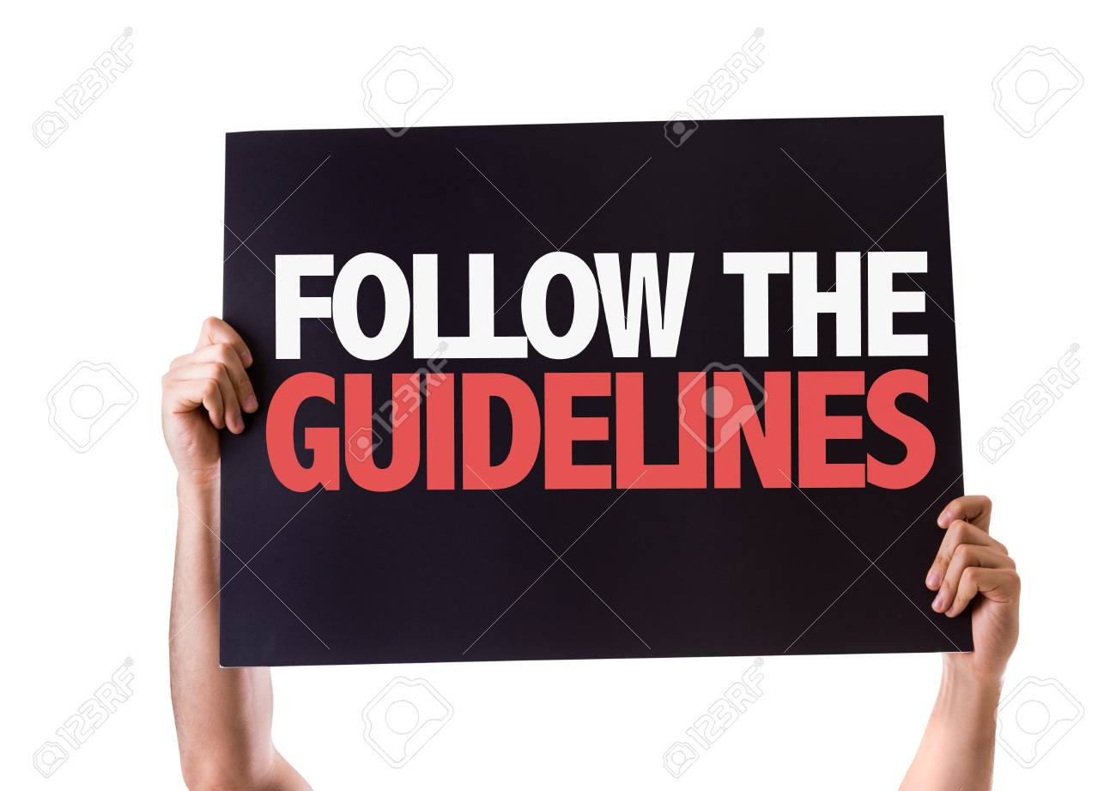
Acidic flavours such as vinegar or lemon need to be
matched with acidity
Starters pair well with a dry white / rose wine
Fish, poultry and shellfish pair well with a dry white wine
Veal, pork pair well with a medium white wine
Game meat are complemented by red wines
Rich red wines pair well with red meat dishes
Sparkling wine complements most foods but mostly for caviar and oysters
Desserts require sweeter wines / port
Cheese blends well with port and dry red wine
Drink white wine before red wine
Drink dry wine before sweet wine
Serve a good wine before a great wine
MATCHING FOOD AND WINE

Slide 14
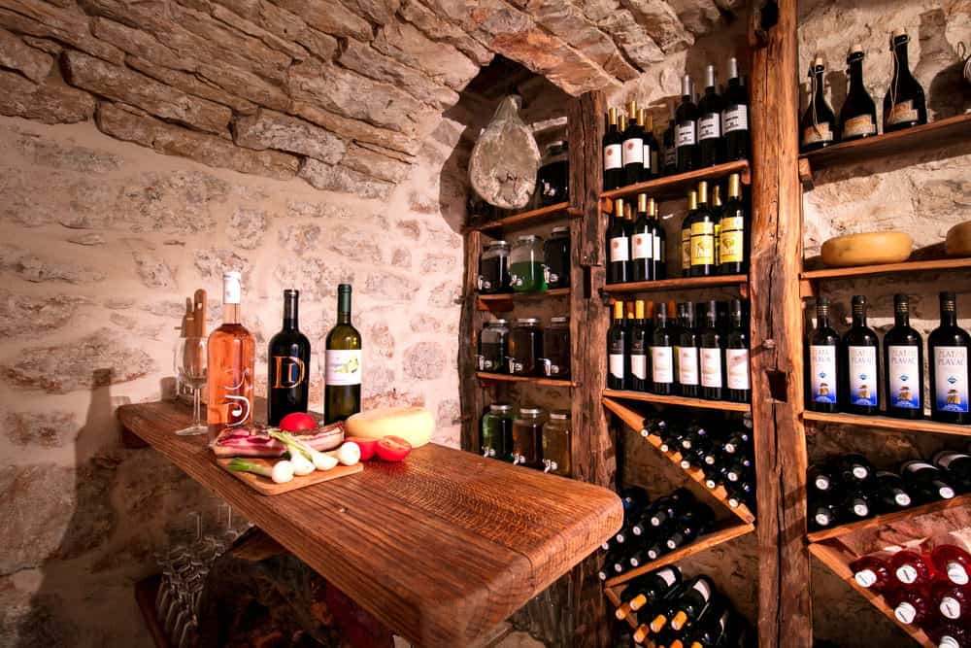
Ideally an underground cellar free from vibrations. Vibrations will affect the quality of the wine
Cellar must be free from dampness and unwanted odours
Ideal temperature is 10-16°C
Cellar must be clean and well ventilated
STORAGE OF WINE
Similar wines must be stored together
Wine must be rotated regularly
When stored in boxes arrows should face up
Bottles must be kept on their sides so the corks stay moist and swollen. If air goes in the wine becomes sour

Slide 15
Selling aid usually compiled by a sommelier .
Other beverages are often included in a wine list
Listed in the order in which they may be consumed
Grouped according to the type of drink
Aperitifs-sparkling wine, fortified wines, mineral water
***
Cocktails
***
Spirits
***
Wines (Still and Sparkling)
***
Beer
***
Liqueurs
***
Speciality Coffees
***
Non-alcoholic drinks
BASIC BEVERAGE AND WINE LIST

Slide 16
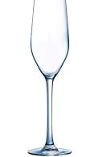
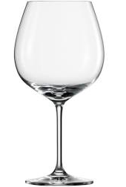
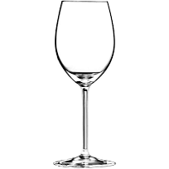
Rinse in warm water
Polish glasses by hand
Shine by holding over a container of boiling hot water to steam it and shine with a glass cloth
Ensure that no fibres from dishcloths stick to the glasses
Store glasses right side up or hanging upside down
WINE | TEMPERATURE
Sparkling wine | 6-8°C
White wine | 7-12°C
Rosé wine | 7-12°C
Red wine | 15-20°C / Room temperature
SERVING TEMPERATURES, CORRECT AND CLEANING GLASSES
Sparkling Wine Glass
Red Wine Glass
White wine Glass

Slide 17
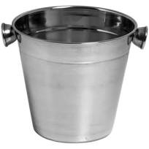
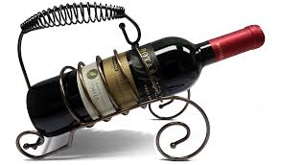
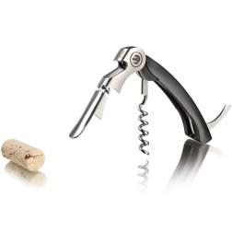
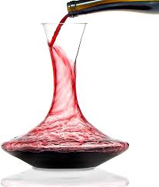
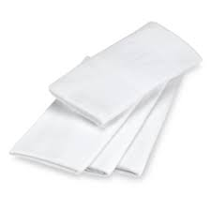
Ice bucket: Chills sparkling/ white wine, Rosé wines
Wine Cradle: For presenting and pouring red wine, angle allows the sediment to settle at the bottom of the bottle
Wine opener/Waiters friend/ Corkscrew: opens wine bottles
TOOLS FOR THE CORRECT SERVICE OF WINE
Service Cloth: Used to absorb water when the bottle is removed from the wine cooler
Decanter: Old vintage wine may need to be decanted to ensure that the sediment remains in the bottle

Slide 18
Strict laws regulate the sale of alcohol to the public. Laws governed by the Liquor Act No 59 of 2003.
OFF CONSUMPTION LICENSES
Includes liquor stores, grocers etc…
Sell liquor BUT may NOT all the opening or drinking of alcohol on their premises.
ON CONSUMPTION LICENSES
Includes hotels, restaurants, pubs, theatres, clubs etc..
They are allowed to serve liquor with a meal BUT are NOT allowed to let guests remove open bottles of alcohol from the premises
REGULATIONS FOR SERVING WINE ON PREMISES
DISQUALIFICATIONS | GENERAL REQUIREMENTS FOR ON CONSUMPTION
A person who has in the preceding 10 years been sentenced to imprisonment | No person under the age of 18 may be served alcohol
A person who is an rehabilitated insolvent | Enough guest toilet facilities for males and females must be provided
A person who is a minor on the date of application | Ordinary meals should be available during hours when liquor is sold
A husband or wife of the above persons
Any violation of the law may results in the loss of the license

Slide 19
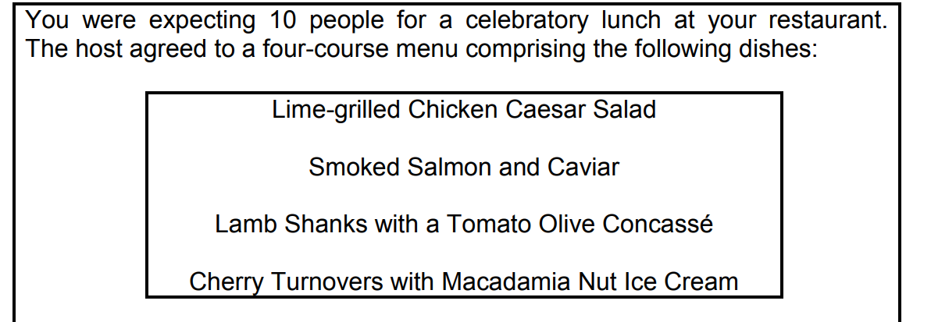
1. Study the scenario below and answer the questions that follow
ACTIVITES
1.1 Match each dish named in the scenario above with a suitable wine cultivar. (4)
• Lime Grilled Chicken Caesar Salad: White wine
• Smoked Salmon and Caviar: Champagne
• Lamb Shanks: Red wine
• Cherry Turnovers with Macadamia Nut Ice Cream: Dessert
wine, sweet white wine, port (Any suitable example)

Slide 20
1.2 Advise the restaurant manager on how to store the wine correctly. (4)
The wine:
• needs to be kept in the dark to avoid damage from ultraviolet
light
• should preferably be stored in a damp location
• should be free from vibration
• bottles should be placed on their sides so that the corks stay
moist
• should be rotated on a regular basis
• that is similar should be stored together
• bottles should be packed and stored with the label to the top or
to the front
• cellar should be clean and well ventilated
• should be stored upside down in a box (Any 4)

Slide 21
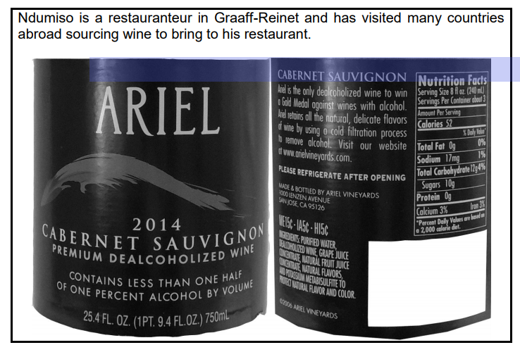
2. Study the wine label below and answer the questions that follow.
2.1 Classify the wine above. (2)
Natural√ / Still√ / Red wine√/ dealcoholized wine (Any 2

Slide 22
2.2 Refer to the wine label above and give the following information:
Cultivar (1)
Cabernet Sauvignon√
(b) Producer
Ariel√ (1)
(c) Class designated name (1)
Dealcoholized
2.3 Study the dishes below and identify TWO suitable and TWO
unsuitable dishes for the wine in QUESTION 2.1.

Slide 23
2.4 Determine the procedure you will follow when presenting this wine to
a guest. (4)
-Stand on the right-hand side of the guest√
-Hold the wine selected on a service cloth√
-Label must face towards the guest√
-Present the wine to the host whilst saying the name and vintage of
the wine to confirm that it is the correct one√
-Open the bottle once the host is satisfied√
-Permit the guest to feel the temperature of the wine if they wish to
do so. (Logical order - Any 4

Slide 24
2.5 Ndumiso has failed several times to secure a liquor license.
Discuss the statement above. (3)
Ndumiso might be failing to secure a liquor licence due to the following:
-In the preceding 10 years, been sentenced to imprisonment, for any offence, without the option of a fine√
-Rehabilitated insolvent√
-A minor/under 18 on the date of consideration of the application√
-A husband of any of the above persons√
-The restaurant is next to the school and no permission is granted from the
community.√ (Any 3

