Slide 1
EASTERN CAPE DEPARTMENT OF EDUCATION
ISIXHOSA ULWIMI LWASEKHAYA
UKUCAZULULWA NOKUHLOLWA KWESIBHENGEZO NTENGISO NEKHATHUNI
ISIBHENGEZO NTENGISO (UMBUZO 3)
Injongo yokuyila isibhengezo ntengiso kukulobela, ukukhumbuza nokwazisa umthengi kulo nto ithengiswa yinkampani okanye ishishini.
Xa kucazululwa isibhengezo ntengiso kufanele kuqwalaselwe oku kulandelayo:
Igama lemveliso ethengiswayo
Udidi lwabantu esijoliswe kubo isibhengezo ntengiso
Ubugcisa obusetyenzisiweyo bokuloba/ ukucenga umthengi
Islogani

Slide 2
Isibhengezo sisaqhutywa…
Umyalezo waso
Isibhengezo ntengiso senzelwe ukuba:
Sithathelwe ingqalelo - imifanekiso, islogani, isihloko
Sitsale umdla - ukusetyenziswa koonobumba abakhulu, uburharha ngamagama nangemifanekiso, imibuzo okanye imibuzo buciko.
Senze ulangazelelo - amagama akwenza ucinge ukuba ubomi bakho buya kuphucuka/ uya kukhuseleka/ awunakuphila ngaphandle kwale ntengiso
Umntu enze/ athenge imveliso – ngokubayalela, ngokwenza ngobungxamo, ngumenza acinge ukuba sisisulu

Slide 3
Isibhengezo ntengiso sisaqhutywa…
Ukusetyenziswa kobugcisa obucengayo:
Islogani - libinzana elifutshane elinomtsalane elakha umfanekiso-ngqondweni, sinyanisekile, siveza ukuzimisela kwenkampani (ingaba ingakwenza inkampani oko ikuthembisayo?)
Imifanekiso – imifanekiso yabantu abaziwayo, ababukekayo. Umfanekiso wale nto ithengiswayo owenza ukuba uyirhalele
Isigama esilobayo – Ukwehla kwamaxabiso, fumana izinto ezimbini ngexabiso lento enye, ukubhatala ngezavenge, ukufana wedwa
Ulwimi – Oluchukumisayo, olucengayo, oluqhathayo
Iindidi zeefonti – ukuqapheleka nokwenza umtsalane
Uthelekiso – imifanekiso eveza phambi kokuyisebenzisa nasemva kokuyisebenzisa

Slide 4
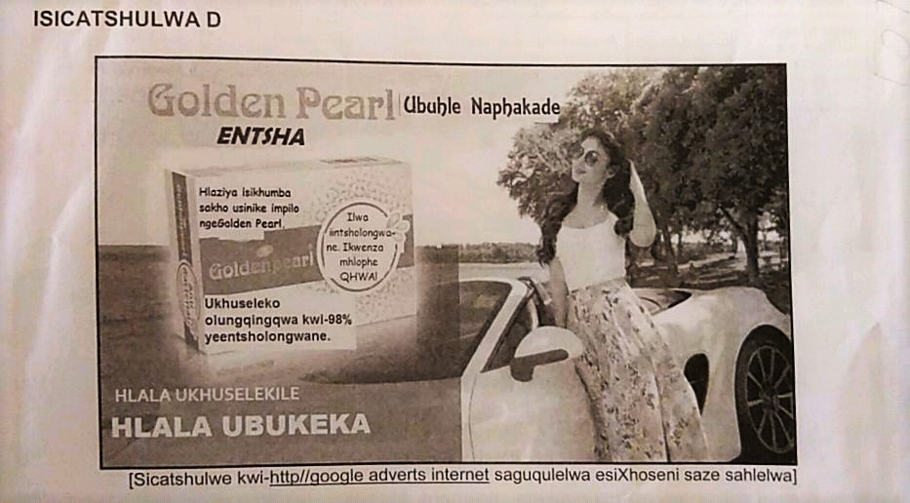
Isibhengezo ntengiso sisaqhutywa…
Imizekelo yezibhengezo ntengiso ezithatyathwe kumaphepha eemviwo eminyaka edlulileyo:

Slide 5
Isibhengezo ntengiso sisaqhutywa…

Slide 6
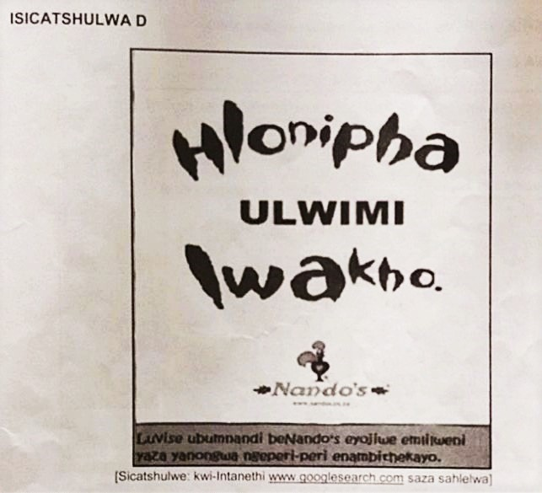
Isibhengezo ntengiso sisaqhutywa…

Slide 7
Imizekelo yemibuzo elindelekileyo (Amanqaku :10):
Xela igama lemveliso/ inkonzo ethengiswayo
Xela igama lomzi-mveliso othengisa le mveliso/ nkonzo
Ijoliswe koobani intengiso?
Chonga islogani sale ntengiso/ Yila islogani sale ntengiso
Kutheni umbhalo ubhalwe ngqindilili/ ngokungaqhelekanga?
Nika ingcinga edluliswa ligama/ umntu
Kubethelela ngcinga ni ukusetyenziswa/ ukuphinda-phindwa kwegama?
Ingaba uyangqinelana?
Nika isizathu sokusetyenziswa komfanekiso…
Sebenzisa igama linike intsingiselo eyahlukileyo
Ingaba uphumelele umyili wale ntengiso ekudluliseni umyalezo wakhe?

Slide 8
IKHATHUNI (UMBUZO 4)
Ikhathuni ikwenza ucinge nzulu, ikutsalela kuluvo oluthile
Kusenokusetyenziswa isakhelo/ ibhokisi enye, kungenjalo zibe mbini nangaphezulu
Abalinganiswa basenokuchazwa kungenjalo kunonjolwe iintetho/iingcinga zabo
Naku omawukuqaphele xa uhlalutya ikhathuni (Umfundi makabaze amehlo):
Imizobo yabalinganiswa – isinxibo, inkangeleko yobuso, indlela abahleli/ abemi ngayo,
Iintetho zabalinganiswa – okuvezwa ziintetho
Iingcinga zabalinganiswa – okuvezwa ziingcinga
Ulwimi olusetyenziswayo

Slide 9
Ikhathuni isaqhutywa…
Yahluka njani intetho kwiingcinga?
Ubaxo – ubungqina bobaxo
Isigqebelo – isiphumo ebesingalindelekanga
Umelo – inkangeleko emele okuthile
Umyalezo womzobi wekhathuni
Indawo abakuyo abalinganiswa – ubungqina boko
Amaxesha onyaka – aveza ukuguquka kwezinto
Iimpawu zobhalo – imisebenzi yazo

Slide 10
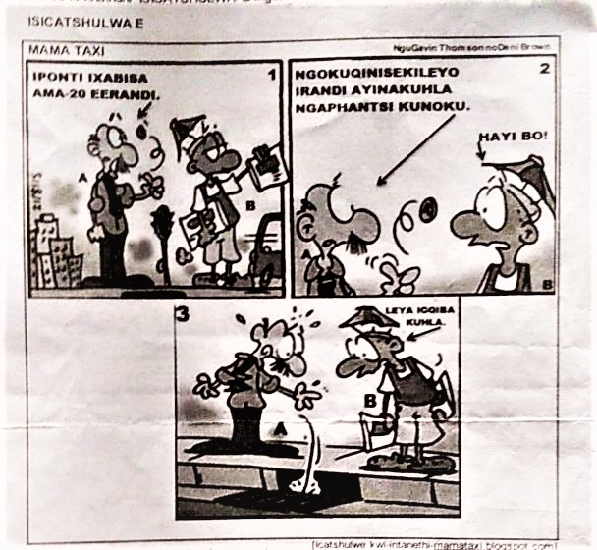
Ikhathuni isaqhutywa…
Imizekelo yeekhathuni ezithatyathwe kumaphepha eemviwo eminyaka edlulileyo:

Slide 11
Ikhathuni isaqhutywa…

Slide 12
Ikhathuni isaqhutywa…

Slide 13
IMIZEKELO YEMIBUZO ELINDELEKILEYO (AMANQAKU:10)
Babonakala bephi aba bantu bakule khathuni? Xhasa impendulo yakho
Isityhilela ntoni ingcinga/ amazwi/ inkangeleko yomlinganiswa ngaye?
Chaza/ thelekisa umahluko kwinkangeleko/ isenzo/ isinxibo…
Ngqina ukuba…
Nika umsebenzi weempawu zobhalo
Khetha impendulo echanekileyo
Nika iingcebiso ngendlela esemthethweni…
Nika intsingiselo evezwa…
Mfundiso ni/ ngowuphi umyalezo odluliswa ngumzobi wale khathuni?

