Slide 1
RESPONDING TO THE ENVIRONMENT (HUMANS)
HUMAN NERVOUS SYSTEM
PRESENTER: Ms Z. Sanda

Slide 2
EXAMINATION GUIDELINES

Slide 3
INTRODUCTION
All living organisms must be able to respond to the environment in order to survive.
To achieve this, humans have two co-ordinating systems which allow them to adapt to changes within the environment and maintain their internal conditions.
In humans there are two co-ordinating systems, namely, the nervous system and the endocrine system.
The nervous system is made up of nerves and is a fast responding system.
The endocrine system involves hormones which are released into the blood and is a much slower responding system.

Slide 4
ORGANIZATION OF THE NERVOUS SYSTEM

Slide 5
NERVOUS SYSTEM
All bodily activities, voluntary or involuntary are controlled by the nervous system → it is the body’s control & communication centre
It consists of receptors to detect stimuli from the environment and convert these stimuli into nerve impulses which are transmitted by specialized cells called neurons to the central nervous system ( brain and spinal cord) for interpretation and from there to the effectors such as glands or muscles which respond to stimuli and allow for changes to take place.

Slide 6
Key Terminology
Receptor
Effector
Stimulus (stimuli-pl)
Impulse
Neurons
Structure that receives a stimulus and converts it into an impulse e.g. touch receptors in the skin, light receptors in the eye
Structure in the body that responds to a stimulus e.g. muscles and glands
A detectable change in the internal or external environment e.g. internal – body temperature, water, sugar levels; external – pain, environmental temperature, touch, danger
An electrochemical message transmitted by nerves
Specialized cells in the nervous system that transmit impulses

Slide 7
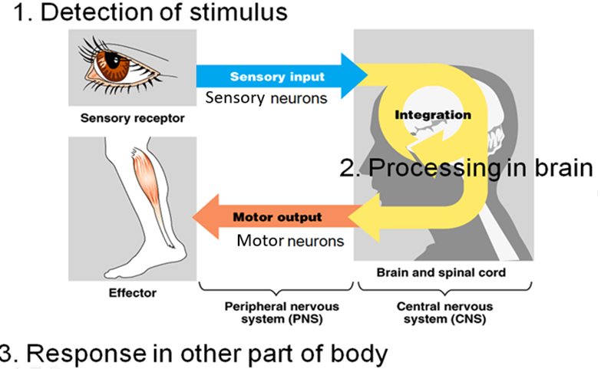
FUNCTIONS OF NERVOUS SYSTEM
It detects changes in the environment, thus allows the body to react to these changes.
It allows co-ordination of the various activities of the body.

Slide 8
PERIPHERAL NERVOUS SYSTEM
Is all the nervous tissue outside the CNS
Consists of:
12 pairs of cranial nerves.
31 pairs of spinal nerves.
These nerves form a communication network all over the body

Slide 10
ORGANISATION OF THE PERIPHERAL NERVOUS SYSTEM
PERIPHERAL
AUTONOMIC
regulates the internal environment so that homeostasis can be maintained. Carries information from the CNS to the smooth muscles and glands
(INVOLUNTARY)
SYMPATHETIC
responsible for the fight or flight (action) function in emergency situations
(AROUSAL)
PARASYMPATHETIC
restores the body to a normal state (rest) after an emergency situation. (CALMING)
SOMATIC
carries information from the sense to the CNS and from the CNS to the skeletal muscles
(VOLUNTARY)
NOTE: The sympathetic and parasympathetic system work antagonistically to each other i.e. have opposite effects

Slide 11
Differences between the Sympathetic and Parasympathetic Divisions of the Autonomic Nervous System
Sympathetic nervous system | Parasympathetic nervous system
Mostly stimulating in effect | Mostly inhibitory in effect
Increases heart rate | Decreases heart rate
Constricts many arteries | Dilates arteries
Relaxation of the bladder wall | Contraction of bladder wall
Dilates pupils | Constricts pupils
Inhibits peristalsis | Accelerates peristalsis
Widens bronchioles | Constricts bronchioles

Slide 12
FUNCTIONS OF PERIPHERAL NERVOUS SYSTEM
Transmits impulses from the receptors to the central nervous system via the sensory neurons
Transmits impulses from the central nervous system to the effectors via the motor neurons

Slide 13
STRUCTURE AND FUNCTIONING OF THE NERVE
Nerves are made up of nerve fibres that are held together by connective tissue.
The nerve fibre in turn is made of specialised nerve cells called neurons which carry nerve (electrical) impulses through the body
Neurons are therefore regarded as structural units of nervous system.
Nerves Nerve fibres neurons

Slide 14
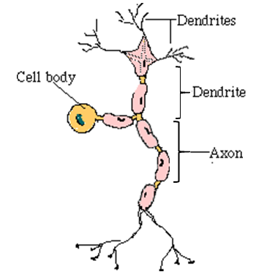
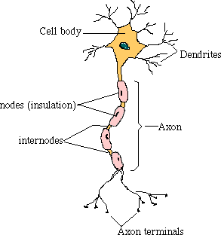
3 MAIN TYPES OF NEURONS
Sensory neuron
Motor neuron

Slide 15
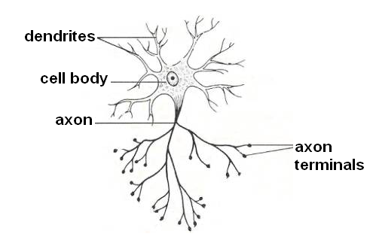
Interneuron/ Connector Neuron

Slide 16
TYPES OF NEURONS
Sensory neuron
Connector or interneuron
Motor neuron
carries the impulses from the receptors (nerve ending or sense organ) to the CNS (brain and spinal cord)
carries impulses inside the central the CNS from sensory to motor neuron
carries the impulses from CNS to the effector organs (muscle and glands)

Slide 17
FLOW OF INFORMATION THROUGH THE BODY

Slide 18
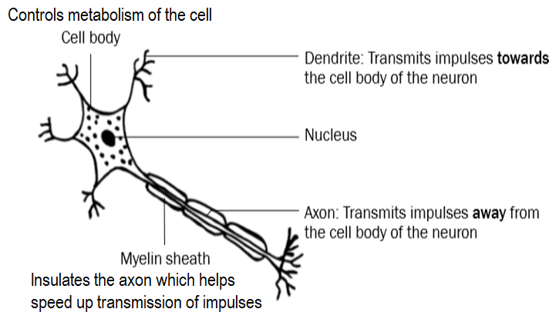
STRUCTURE OF A NEURON
All neurons are made up of three basic parts namely; cell body, dendrites and an axon
dendrites – transmitting impulses towards the cell body
cellbody (with a nucleus) – controlling the metabolism of the cell
an axon – transmitting impulses away from the cell body
myelin sheath – insulating the axon and speeding up the transmission of impulses; myelin sheath is enclosed by a membrane called the neurilemma which helps to repair damaged neurons
Cytoplasm

Slide 19
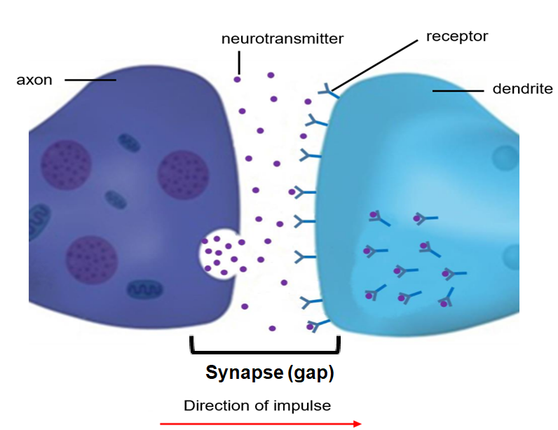
TRANSMISSION OF NERVE IMPULSES
More than one neuron is involved when neurons carry nerve impulses.
The axon terminals of one neuron lie next to the dendrites of the next neuron.
Neurons are not directly connected to each other
The microscopic gap between axon terminals of one neuron and the dendrite of another neuron is called a synapse
Nerve impulses are carried across a synapse by means of chemical substance called neurotransmitters e.g. Acetylcholine

Slide 20
Revision questions
1. Give the correct biological term for each of the following descriptions.
1.1 A part of the neuron that conducts impulses towards the cell body
DENDRITE✓
1.2 The microscopic space between two adjacent neurons is a/an
SYNAPSE✓
1.3 A change in the internal or external environment that will be detected by a receptor and converted into an impulse
STIMULUS✓
1.4 Chemical substance which carries impulses across the synapse
NEUROTRANSMITTER✓
1.5 A part of the neuron that insulates the axon and speed up transmission of impulses
MYELIN SHEATH✓

Slide 21
2.

Slide 22
2.2 Identify the type of neuron represented by:
(a) B
MOTOR NEURON✓
(b) C
CONNECTOR NEURON✓/ INTERNEURON
(c) E
SENSORY NEURON✓
2.3 Give the LETTER only of the part that represents the:
(a) Receptor
F✓
(b) Effector
A✓
2.4 Give the LETTER and NAME of the:
(a) Region where the impulse is transmitted chemically
D ✓ -SYNAPSE✓
(b) Part that has an insulating function
G ✓ -MYELIN SHEATH✓

