Slide 1
ANIMAL TISSUES
TOPIC: Connective tissues, Blood & Structure of a Long Bone
PREPARED BY : MR SOMTSEWU
PRESENTER: MR Kofi
CHRIS HANI WEST DISTRICT

Slide 2
LESSON OUTLINE
Terminology
Brief overview on tissues
Connective tissues
Structure of the long bone &
Blood

Slide 3
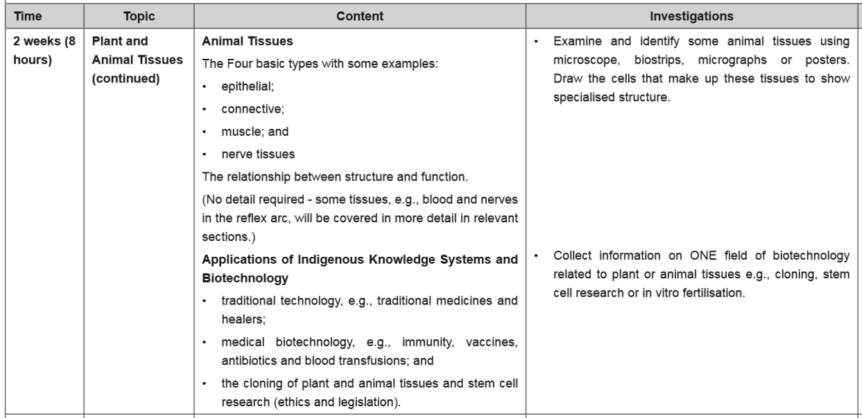
CAPS DOCUMENT : ANIMAL TISSUES- CONTENT TO BE TAUGHT

Slide 4
Important Terms
Glottis: is the opening of the trachea
Epiglottis: is a leaf shaped cartilage that opens and closes the glottis.
Chondrin: is the ground substance of cartilage.
Lacunae: are fluid filled spaces found embedded in the chondrin.
Chondrocytes: are the cartilage cells found within the lacunae.
Tendons: attach muscle to bones
Ligaments: connect bone to bone
Tissue: is a group of cells that have the same structure that work together to carry out the same function.

Slide 5
DO YOU REMEMBER WHAT IS A TISSUE?
A tissue is as a group of cells that have the same structure that work together to carry out the same function.
Or a tissue may be defined as a group of similar cells performing a similar function.
These tissues are found in both plants and animals cells
In this lesson we shall look at connective tissues.

Slide 6
Connective tissues
What are connective tissues?
Connective tissues are tissues that support and join other tissues in the body of mammals.
They consist of different cells and fibres embedded in the matrix.
The matrix is the non –living and can be fluid /jelly-like or even a solid substance.
Connective tissue
3 Basic components
1. Cells e.g. white blood cells, fat cells
3. Matrix
can be fluid or jelly-like or solid
2 . Fibres e.g. collagen and elastic

Slide 7
Types of Connective Tissue
There are Six types of connective tissues
These are:
Areolar
White fibrous connective tissue
Yellow elastic connective tissue
Cartilage
Bone and
Blood

Slide 8
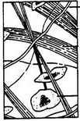
AREOLAR TISSUE: Location, structure and function
Location: this tissue is found under the skin.
Structure: The matrix is jelly-like.
Inside the matrix two types of fibres are found
yellow elastic fibres (branched)
white inelastic collagen fibres (parallel)
Basic types of cells are dispersed/ scattered throughout the matrix, i.e. fibroblasts, macrophages, mast cells, fat cells and lymphocytes.
Elastic fibre
Collagen fibres
Matrix
Fibroblast (cell)
Structure of areolar (loose) connective tissue

Slide 9
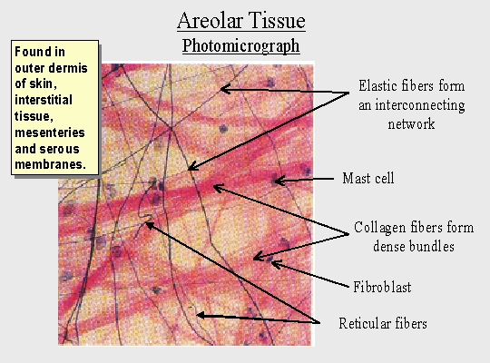
AREOLAR TISSUE: Location, structure and function continued
Functions of areolar tissue:
Serves as an insulating material- prevent heat loss.
Protects the organs by serving as a packing tissue, e.g. around the kidneys.
Connects the skin to underlying layers.
It serves as a packing tissue that fills the spaces between organs, blood vessels, nerves and muscles.
NB: [when large amount of fat are stored in this tissue, it is known as adipose/fat tissue]

Slide 10
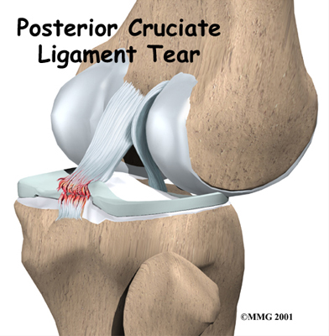
yellow elastic Connective tissue
LOCATION:
This tissue is used to form the ligaments.
APPEARANCE:
Has the same basic structure as areolar tissue.
However the yellow elastic contains much mre yellow elastic fibers.
FUNCTION:
It makes up the ligaments.
The ligaments connect bone to bone.

Slide 11
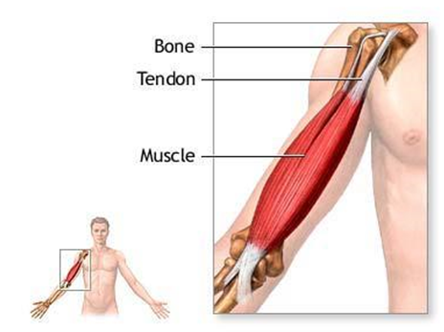
White Fibrous Connective Tissue
LOCATION:
Found within tendons and discs between the vertebrae.
APPEARANCE:
This is tissue has the same basic structure as the areolar tissue with large amounts of white fibers.
Contain large number of fibres that run more or less parallel to one another.

Slide 12
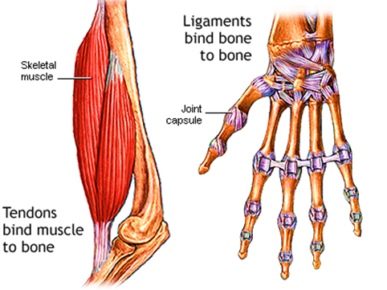
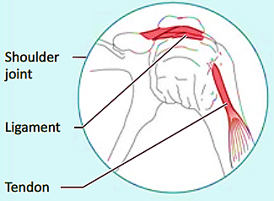
Tendons vs Ligaments
NB: Tendons are inelastic and can not stretch & Ligaments are elastic they can stretch

Slide 13
Tendons vs Ligaments
FUNCTION:
Inelastic tendons join muscle to bones – they relay muscle contraction and relaxation to the bone so that movement can take place.
Elastic ligaments join bone to bone-these permit a degree of movement in joints.

Slide 14
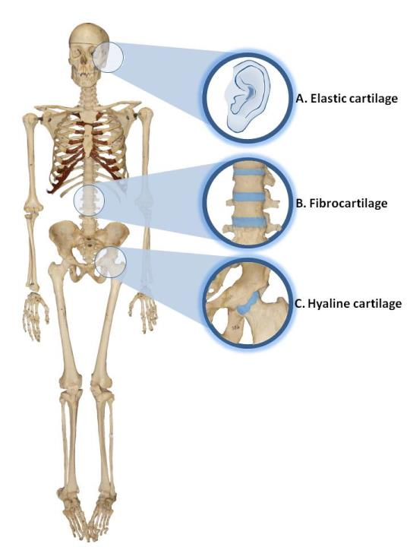
Cartilage
Cartilage is a tough, flexible elastic connective tissue that forms part of the endoskeleton of vertebrates.
There are 3 types:
Hyaline cartilage
Fibrocartilage
Elastic cartilage
Location: It occurs between bones. For example C-shaped rings in the trachea.
Types of Cartilage

Slide 15
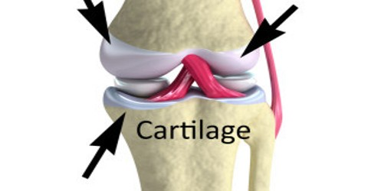
Cartilage
Functions:
Cartilage is flexible it provide support
For example nose, ears, and joints.
Prevent damage between bones in a joint
Keep the trachea open at all time
Connect the ribs to the sternum

Slide 16
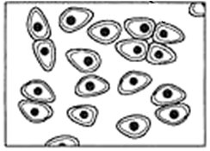
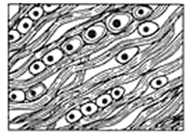
Types of Cartilage
Type | Location | Structure | Function
Hyaline Cartilage
Found between the bones, in the ribs, the ear and as rings in the air passages
Reduces friction between bones and joints
chondrocyte
matrix
(chondrin)
Fibrocartilage
Found between vertebrae
Act shock absorbers
chondrocyte
collagen fibres
Elastic Cartilage
Ear lobe and epiglottis
chondrocyte
Forms the epiglottis.
The epiglottis opens and closes the glottis.
The glottis is the opening of the trachea.
elastic fibres

Slide 17
Bone Tissue
Head
Structure of Long Bone
The human skeleton has two long bones viz. femur (thigh bone) and humerus (upper arm bone).
Each long bone has a head at either end with a long shaft in between.
Heads are made up of spongy bone tissue that are covered by cartilage.
Spongy bone tissue contain red bone marrow that produces red blood corpuscles.
Shaft
Head

Slide 18
Structure of Long Bone
The Shaft is made up of compact bone tissue with a hollow area known as marrow cavity.
The marrow cavity is lined by a soft membrane known as the Endosteum.
Inside the marrow cavity we find Yellow marrow which is made up of cells and blood corpuscles.
The periosteum is a strong membrane that covers the shaft and is richly supplied with blood vessels
Both spongy bone and compact bone form bone tissue and work complementary to each other to bring about functions of bone

Slide 19
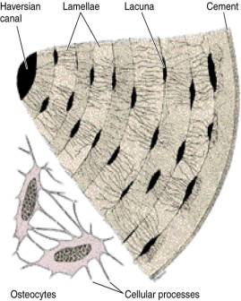
Bone Tissue

Slide 20
Functions of Bone Tissue
Bone gives strength and support
It protects internal organs such as the brain, spinal cord, heart and lungs.
It serves as a place of attachment for muscles to make movement possible.
Serves as a storage for minerals ,e.g. calcium stored in bone tissue.

Slide 21
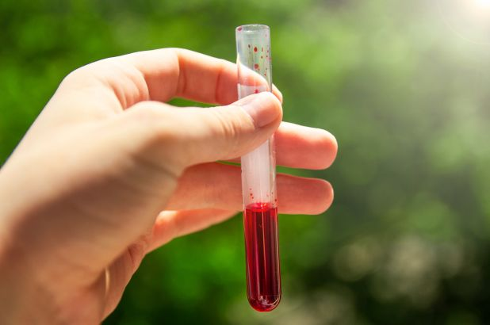
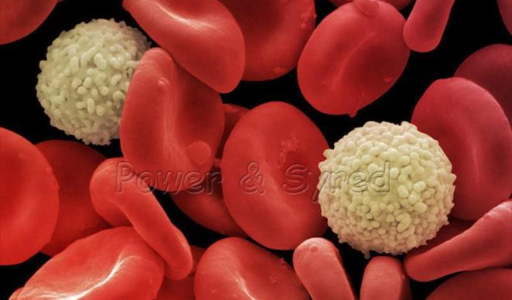
BLOOD TISSUE
NB: Blood does not look or behave like other connective tissues, but it is classified as a connective tissue because it consist of cells in a fluid matrix.

Slide 22
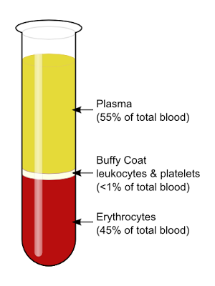
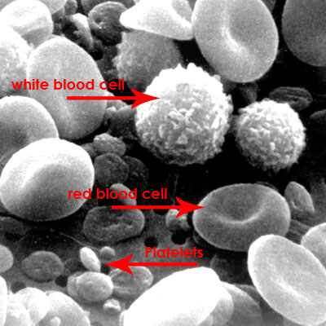
Blood Tissue
LOCATION:
Found in the blood vessels.
These blood vessels are the arteries, veins and capillaries.
APPEARANCE:
Blood is made up of a liquid called blood plasma and blood cells.
These blood cells are the red blood cells, white blood cells and the platelets.

Slide 23
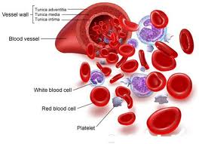
BLOOD
FUNCTION:
Transports substances such as food, hormones, enzymes, respiratory gases and excretory wastes.

Slide 24
BLOOD
FUNCTION:
Transports substances such as food, hormones, enzymes, respiratory gases and excretory wastes.

Slide 25
ACTIVITY
1. Which of the following tissues can be considered as connective tissue?
(i) blood
(ii) cartilage
(iii) skin
(iv) ligaments
(v) squamous epithelium
A (i), (iii), (v)
B (ii), (iii), (iv)
C (i), (ii), (iv)
D (iii), (iv), (v)
ANSWER: C

Slide 26
2. Connective tissue that has a fluid matrix
Areolar
Cartilage
Bone
Blood
ANSWER: D

Slide 27
Match tissue in Column I with Function in Column II. Write correct letter next to the number
Column I | Column II
1. Areolar tissue | A Connects bone to bone
2. Blood tissue | B Point of attachment for muscles allowing movement
3. Cartilage | C Packing tissue that fills space between organs
4. Ligament | D Transports substances e.g. food, O₂and CO₂in the body
5. Tendon | E Reduces friction at joints
6. Bone Tissue | F Connects muscle to bone
ANSWER
C
D
E
A
F
B

Slide 28
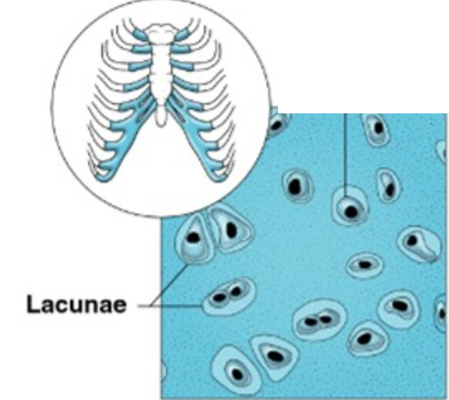
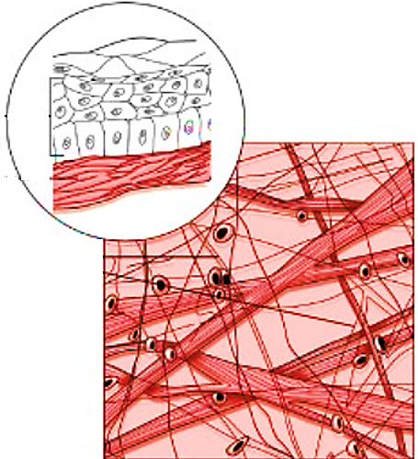
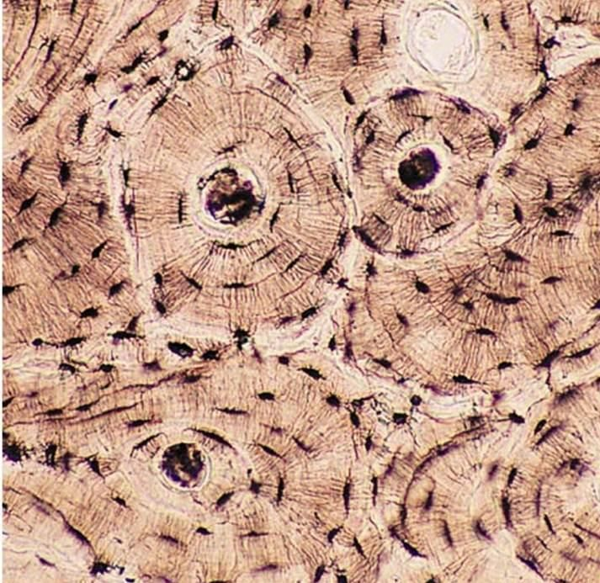
Identify the tissues represented by the diagrams below
Diagram | Name of tissue
1.
2.
3.
Hyaline Cartilage
Areolar
Bone Tissue

