Slide 1
Geography Grade 10(CAPS) Plate Tectonics

Slide 2
Presentation layout
Plate tectonics
Types of Plate boundaries
Land forms associated with different plate boundaries

Slide 3
Tectonic plate- a section of the Earth’s crust which can move on the mantle.
Divergent boundaries- plates move away from each other. New crust is created from erupting volcanoes at divergent plate boundaries.
Convergent boundaries- plates come together. One plate is forced under another into the mantle. The plate melts causing earthquakes and volcanic eruptions.

Slide 4
Transform/transverse/passive boundaries- plates grind past each other and movement is associated with earthquakes.
Plate boundary- the edge of a tectonic plate. Plate tectonics is a theory that suggests the crust of the Earth is divided into 7 giant pieces and 12 small ones called tectonic plates.

Slide 5
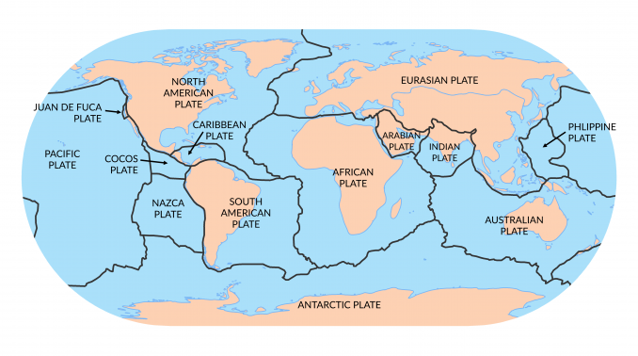
Plate boundaries

Slide 6
Folding and Faulting
Rocks change shape when they are compressed from the sides. A fold is a bend in a rock that is caused by compressional forces. A fault is a break within the crust. Faulting can be caused by forces of compression or tension.

Slide 7
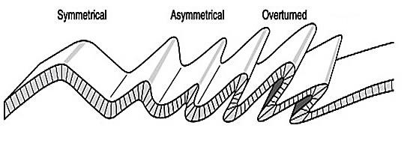
Types of Folds

Slide 8
Faulting
A fault is a crack which forms in rocks as a result of continuous tension and compression.
Faulting is caused by forces of compression or tension. Fault line is a line along the surface of the Earth where a fault occurs.

Slide 9
Cont...
TYPES OF FAULTS
NORMAL FAULT- This is caused by forces of tension.
REVERSE FAULT- Is caused by forces of compression.
TRANSFORM/TEAR FAULT- Tearing forces cause rocks to move past each other laterally.

Slide 10
Earthquakes and Volcanoes
An earthquake refers to an intense trembling of the earth’s crust caused by vibrations.
Volcanism refers to the movement of molten material from one part of the crust to another.

Slide 11
Earthquakes

Slide 12
Volcanoes

Slide 13
Causes of earthquakes and Volcanoes
Nuclear explosions
Impact of meteors
Faulting, folding
Landslide
Mine blasts
Volcanoes occur when magma comes out on to Earth’s surface a lava. This is known as extrusive volcanism.
Most volcanoes occur on the tectonic plate boundaries, at the subduction zone where one plate is sliding beneath another plate.

Slide 14
Impact of Earthquakes and Volcanoes
Earthquakes can cause building and bridges to collapse. Tsunami can carry boats, cars, people and houses with them. Large areas may be submerged by water.
Minerals are found in volcanic rock. e.g. Copper and diamond. Volcanic ash fertilizes the soil. Volcanoes attract tourists.
Natural hot springs are
Ash buries buildings and covers fields.

Slide 15
THANK YOU

