Slide 1


Slide 2

Computer Applications Technology
Grade 10 – Term 2
EXTENDED HARDWARE CONCEPTS
Output and Storage

Slide 3
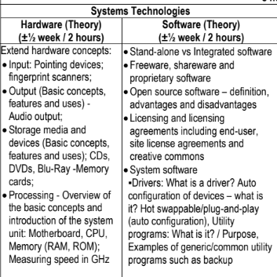
CAPS DOCUMENT*

Slide 4
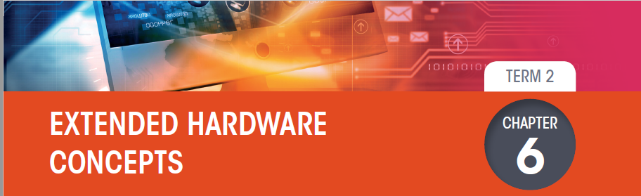
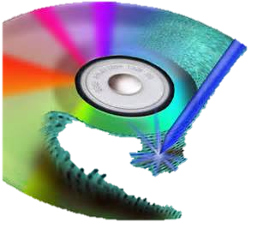
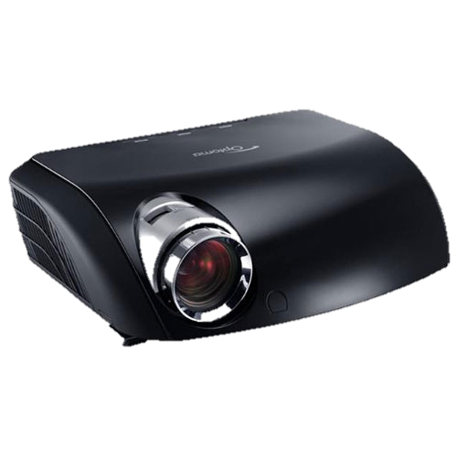
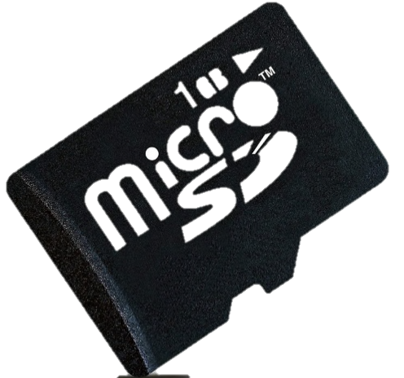

Slide 5
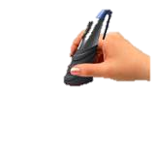
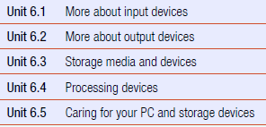
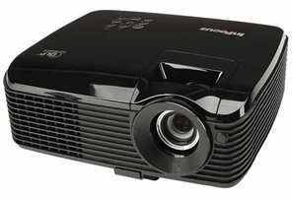
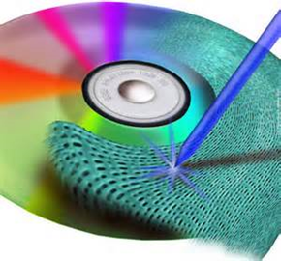
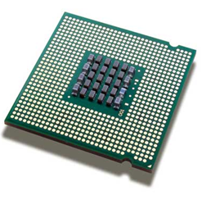
CHAPTER OVERVIEW

Slide 6
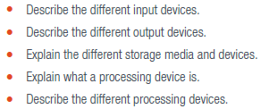
At the end of this chapter, you should be able to:

Slide 7
REVISION

Slide 8
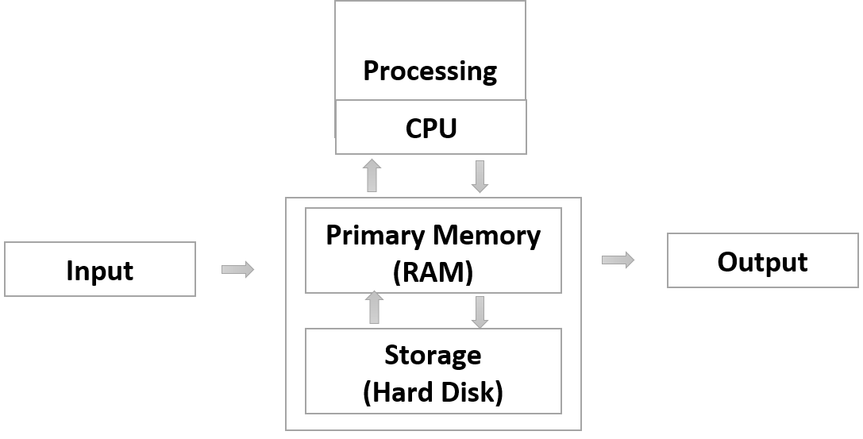
Four parts of a Computer

Slide 9
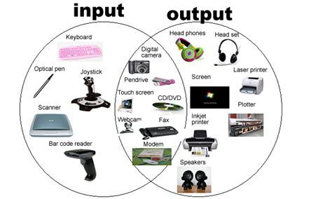
Outside the ‘box’ (Peripherals/Devices)
Definition, Function, Purpose, role of I/O devices

Slide 10
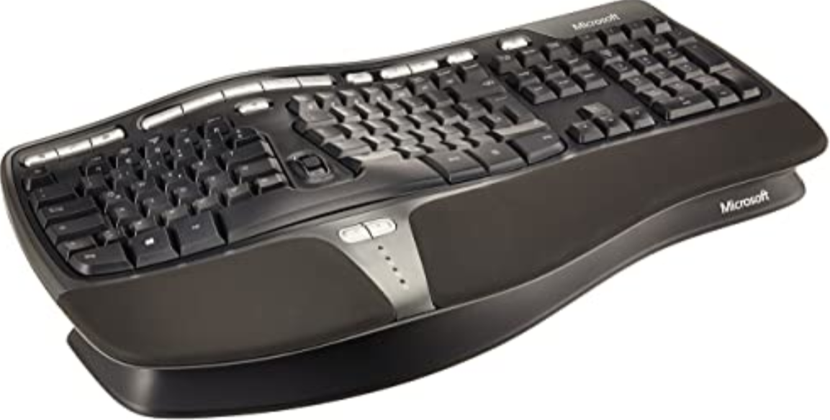
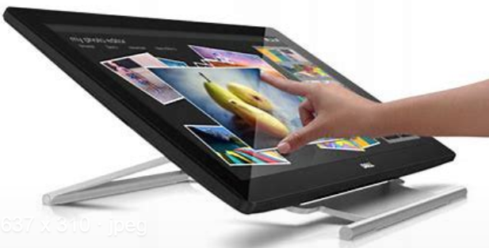
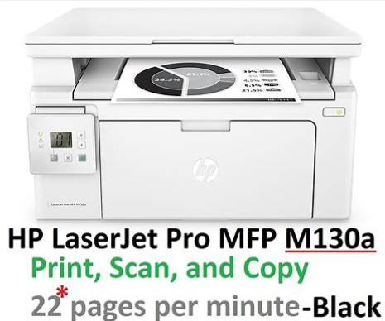
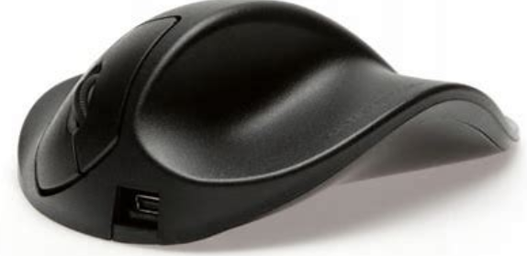
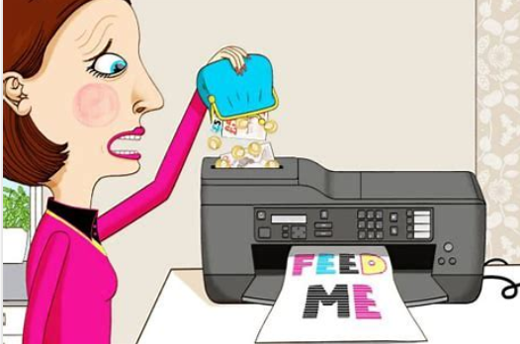
Common Input and Output Devices
Input devices
Output devices
Keyboard
  Factors to consider
    Ergonomics
    Wired (USB connection), wireless (Bluetooth, RF)
Mouse
  Factors to consider
    Ergonomics
    Wired (USB connection, wireless (Bluetooth, RF)
Monitor
  Factors to consider:
    Size
    Resolution
    Touch or not
Printer
  Factors to consider:
    Type (Inkjet or Laser)
    Single or Multifunction
    Connectivity (wired, wireless)
    Speed (ppm)
    Image quality / Resolution
    Running cost/Cost per page
https://youtu.be/Q0iXO1DEzQ4?list=PLFQ-xGtoymjJ9yRu9ppfCloxjYf0lDnlg
https://youtu.be/5wLFYPUbGKA?list=PLFQ-xGtoymjJ9yRu9ppfCloxjYf0lDnlg

Slide 11
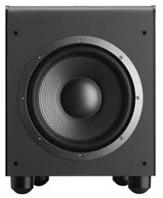
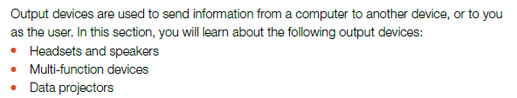
More about output devices

Slide 12
OUTPUT
Basic Concepts
  Output refers to the feedback when communicating with a computer.
Features
  Output device is a piece of hardware that a person use to get the results of the input instruction
  Uses
  The use of an output device is get the processed results that is put into the computer.

Slide 13
  What is an audio output device?
    It’s a device that produce sound like music or voice

Slide 14
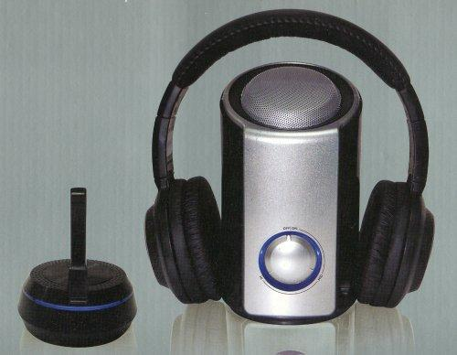
Headsets and speakers
Headset is a speaker that is small enough to fit into your ear, so that only you can listen to the music
Speakers can be plugged into your computer and you can listen to audio OUTPUT

Slide 15
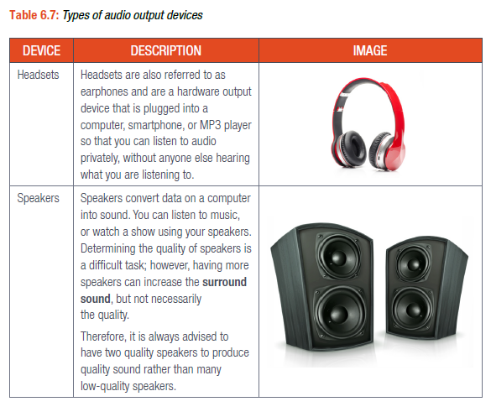
TYPES OF AUDIO OUTPUT

Slide 16
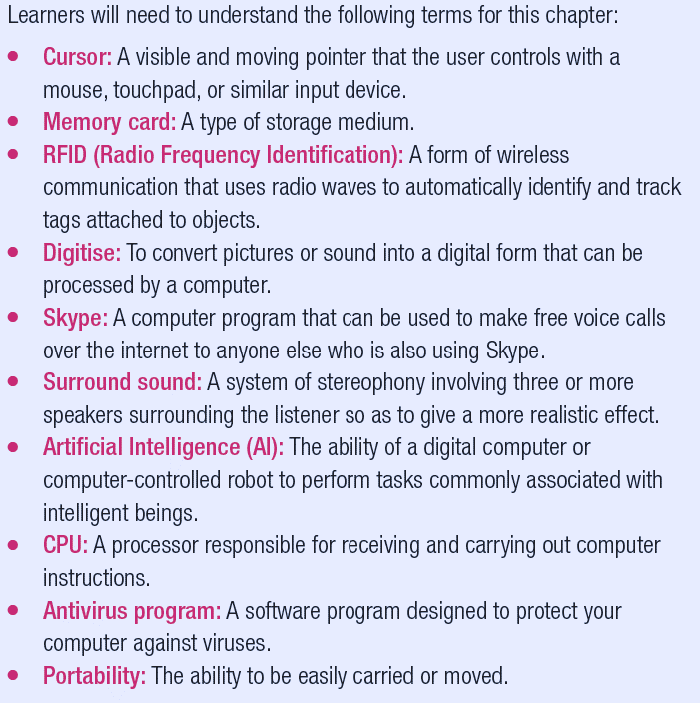
Word to remember

Slide 17
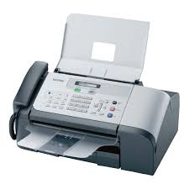
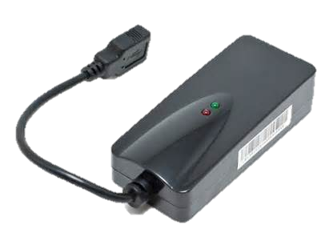
Fax machines and fax modems
    Fax Machine
    Fax machine or facsimile is used to send information through a telephone line from one fax machine to another – Scans a document and sends
    Fax Modem
    Fax modem is a device connected to a computer, the output can be sent through a telephone line to a fax machine and this device can connect to the Internet

Slide 18
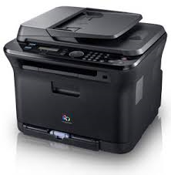
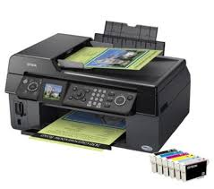
Multifunction Output Devices
This device consist of more than one function for example a Multifunction Printer, that can
print,
scan,
copy and
fax.
Advantage:
only takes up the space of a single device

Slide 19
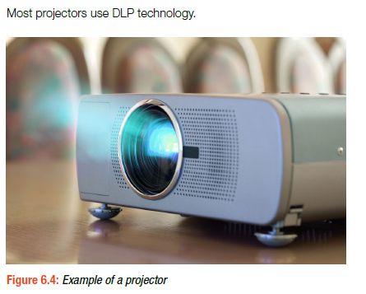

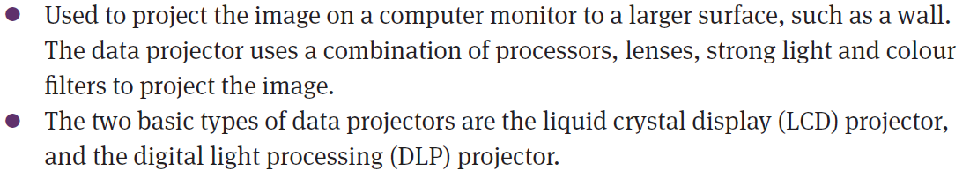
Data projector - output

Slide 20
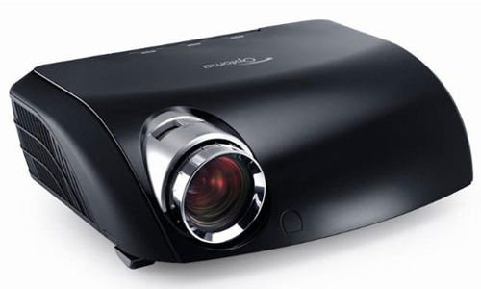
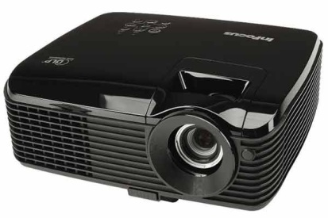
Data Projector - output
  Connects to your computer and
  shows everything that is on the computer screen on a
  flat surface on the wall or screen.
  The Projector works with a light bulb and lenses as well as colour filters.
    Advantage: large display
    Used: Schools, Meetings

Slide 21
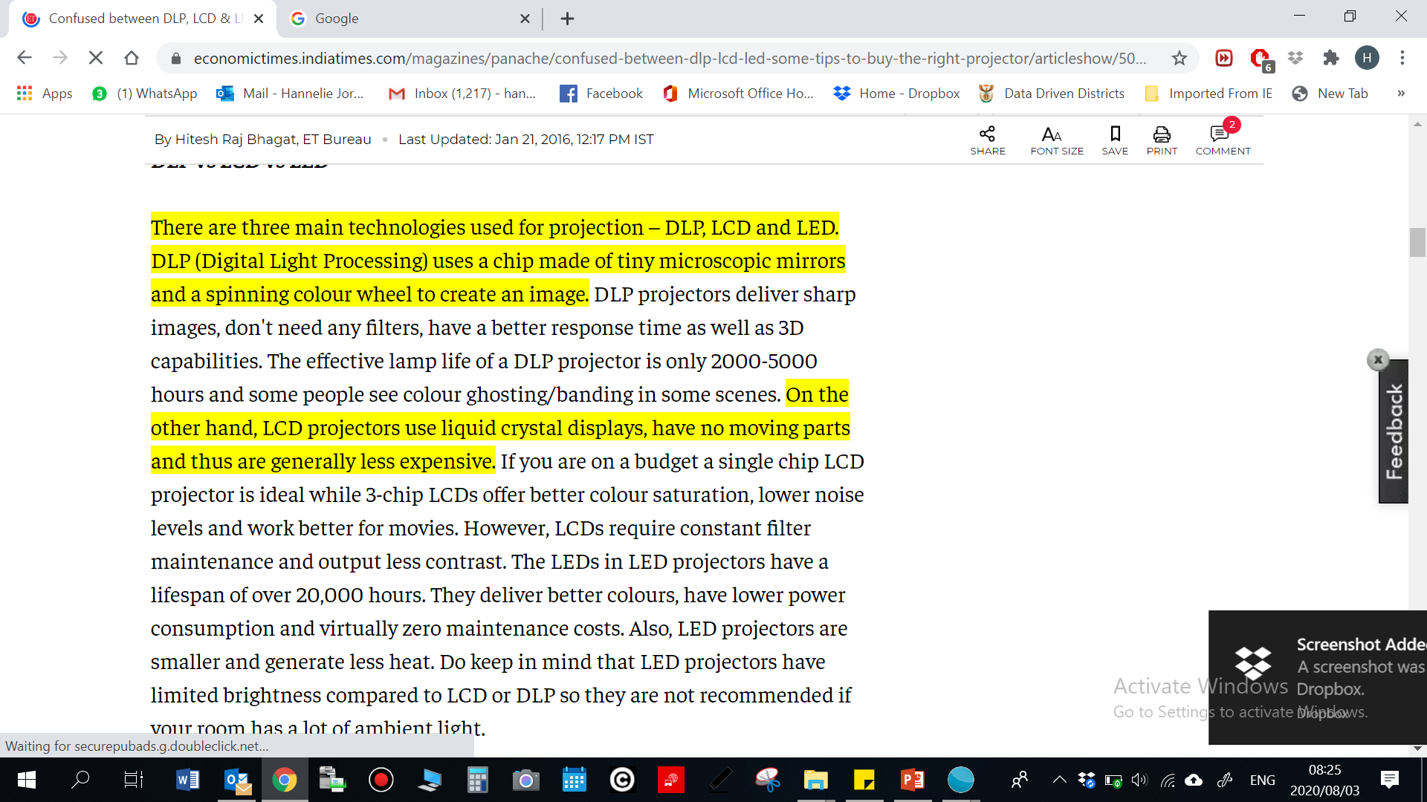
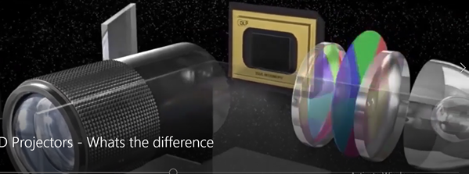
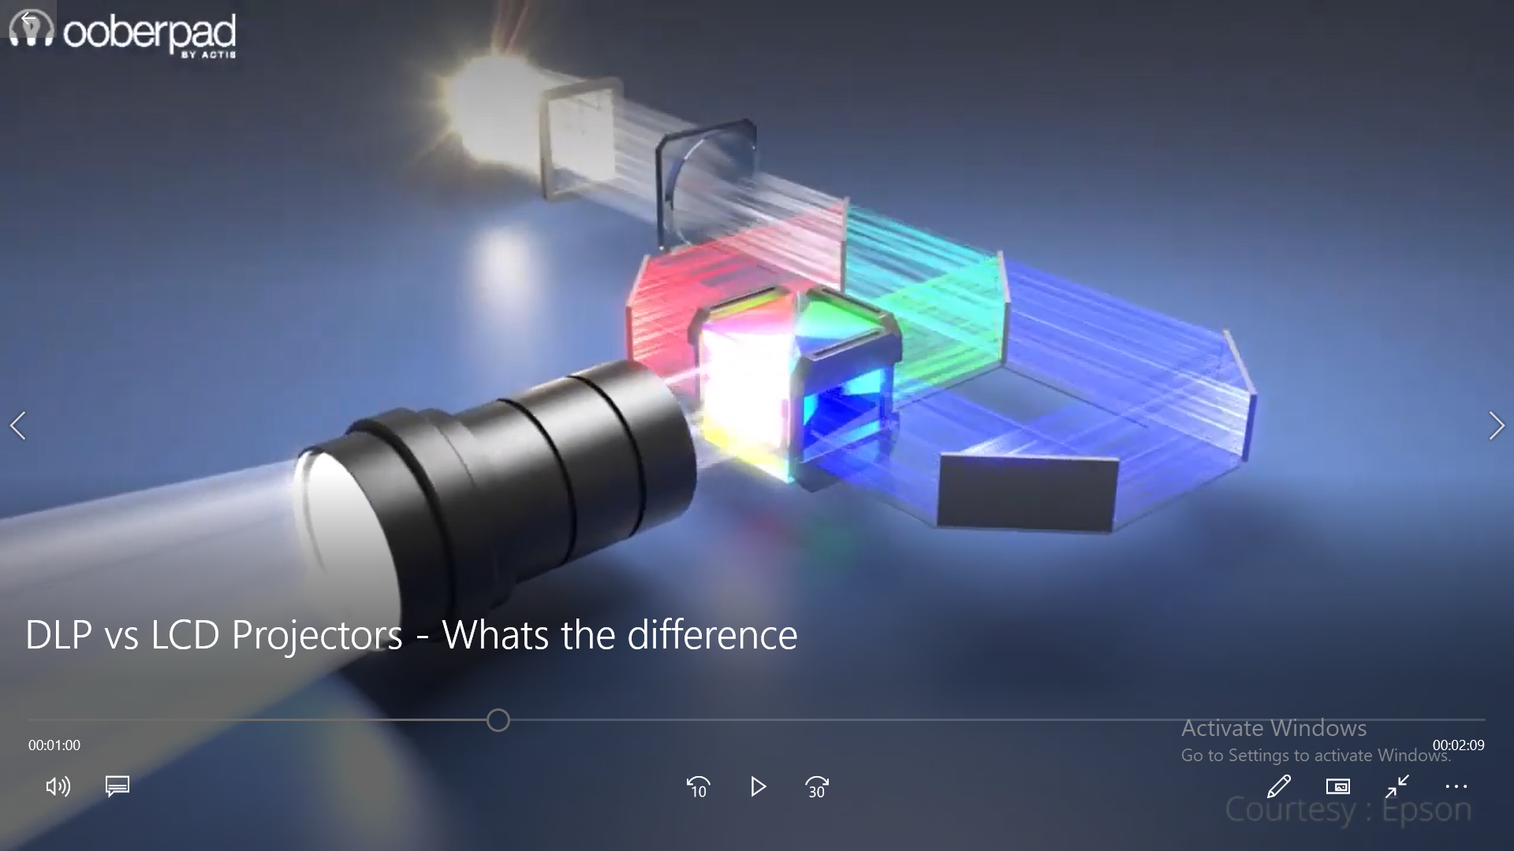
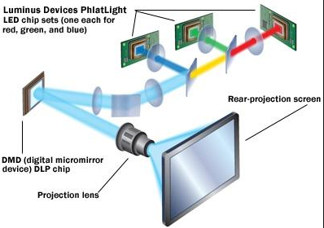

Slide 22
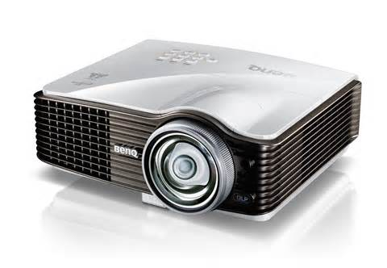
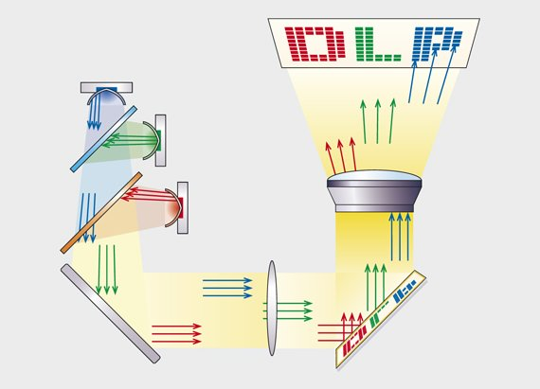
DLP - Output
    (Digital light processing) Projector
    This type of projector use tiny mirrors to reflect light, this projector often has a better quality output than the other data projector

Slide 23
Storage Media

Slide 24
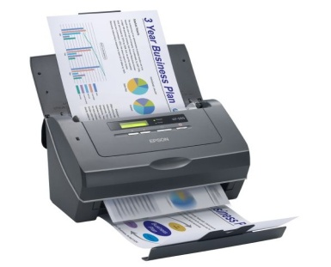

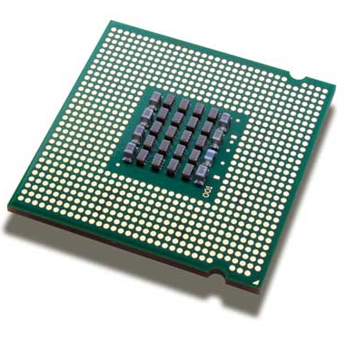
Extended Hardware Concepts
Input
Output
Storage media and devices
Processing
24

Slide 25
Storage (Secondary Memory)
Hard disk drive (HDD)
External HDD
Flash Drive
Memory Card
DVD
Solid State Drive (SSD)
Factors to consider:
Capacity (e.g. GB, MB, TB)
Robustness
Price per GB

Slide 26
Storage media and devices
Basic Concepts
Storage refers to permanetly saving/storing data and information
Features
  Storage device is a piece of hardware that a person use to store/save the results of the input instruction.
  Uses
  The use of an storage device like a harddrive is to get the processed results that was saved.

Slide 27
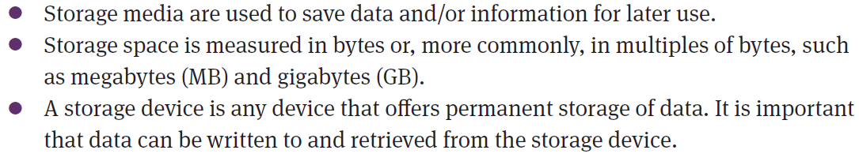
Storage and storage media

Slide 28
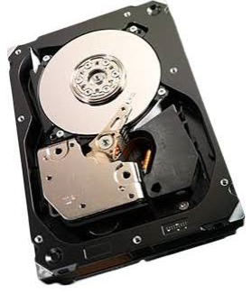
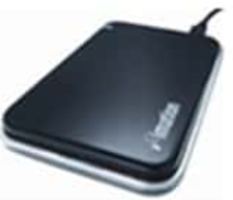
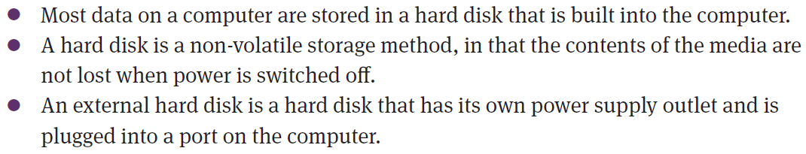
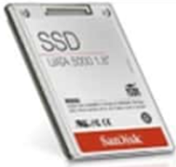
Hard disk

Slide 29
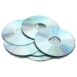
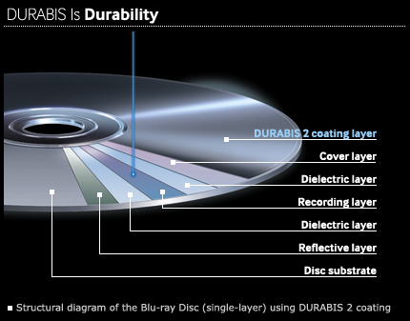
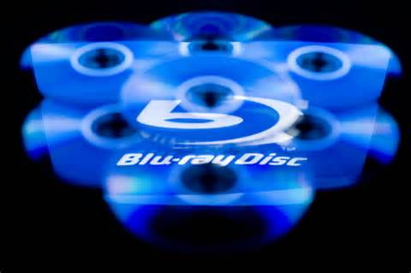
Storage media and devices
  CDs, DVDs
  These are a way of storage, CDs and DVDs are inexpensive and good quality movies and music can be stored.
  Blu-Ray
  These disks have a massive storage capacity and can store up to 50 GB od data.

Slide 30
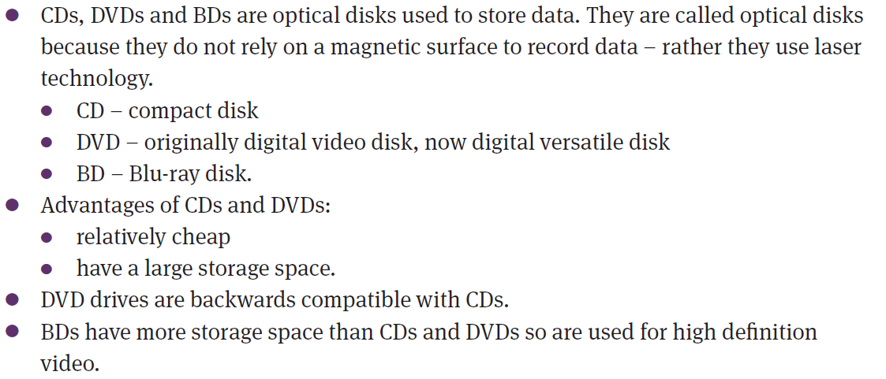
CDs, DVDs and BDs

Slide 31
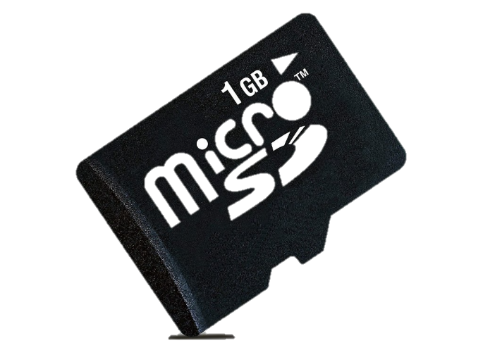
  Memory cards
  Storage device
  This device is found in a device such as:
  cameras,
  smart phones and
  video cameras,
  This device can store data from as big as 8Mb up to 8 Gb.
  Just connect the device directly to the computer
  and copy the data from the card to computer.
  OR use the card reader (external or on-board)

Slide 32
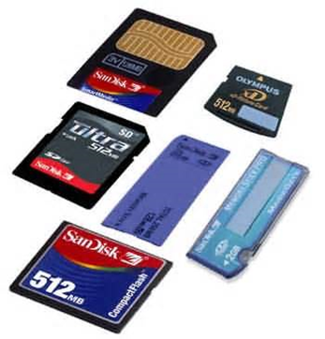

Memory cards

Slide 33



USB flash drives
ADVANTAGES:
Portable
Small
All shapes and sizes
Different storage sizes
USB – all computers have port
Easy P&P
Fast to copy data
Type 2 and 3
DISADVANTAGES
Easily lost/stolen

Slide 34


Slide 35


Determining available storage space
Double click the My Computer/Computer icon.
Right-click on the disk you are interested in.
For instance, Local disk C
Right click
Select properties

Slide 36


Slide 37

Summary
Care for storage devices

Slide 38
Now let’s test your knowledge!

Slide 39




Slide 40


Slide 41



Slide 42


Slide 43


Slide 44


Slide 45



Slide 46
Homework:
Summarise Term 2 Hardware
  Output
  Storage
  Caring for your computer
Answer the activities from your textbook.

Slide 47





REFERENCES
Visit our Provincial IT and CAT website for links to lessons on all topics https://sites.google.com/view/itandcatinec/home
Notes:
I need to acknowledge the following sources
And
Would like to remind you that the Internet is full of
Wonderful recourses you can use help you understand content better
Important sites include ….

