Slide 1
HYDRAULIC BRAKING SYSTEM
Hydraulic brakes
Master cylinder (Parts & Operation)
Vacuum servo unit (purpose & operation)
ABS braking system (basic lay-out and operation)

Slide 2
Master cylinder (Parts & Operation)
Tandem master cylinder: A braking system is used to decrease the speed of the vehicle or to bring it to a halt. Braking action on the road wheels of a vehicle is normally achieved by means of hydraulic braking system. This is a dual-type brake master cylinder, one section serves the brake system to the front wheels while the second system serves the rear wheels. If there is a leakage in one of the systems, the second system will develop sufficient braking power to stop the motor vehicle within the safe distance. A warning light is mounted on the dashboard to warn the driver should any of the system become defective

Slide 3
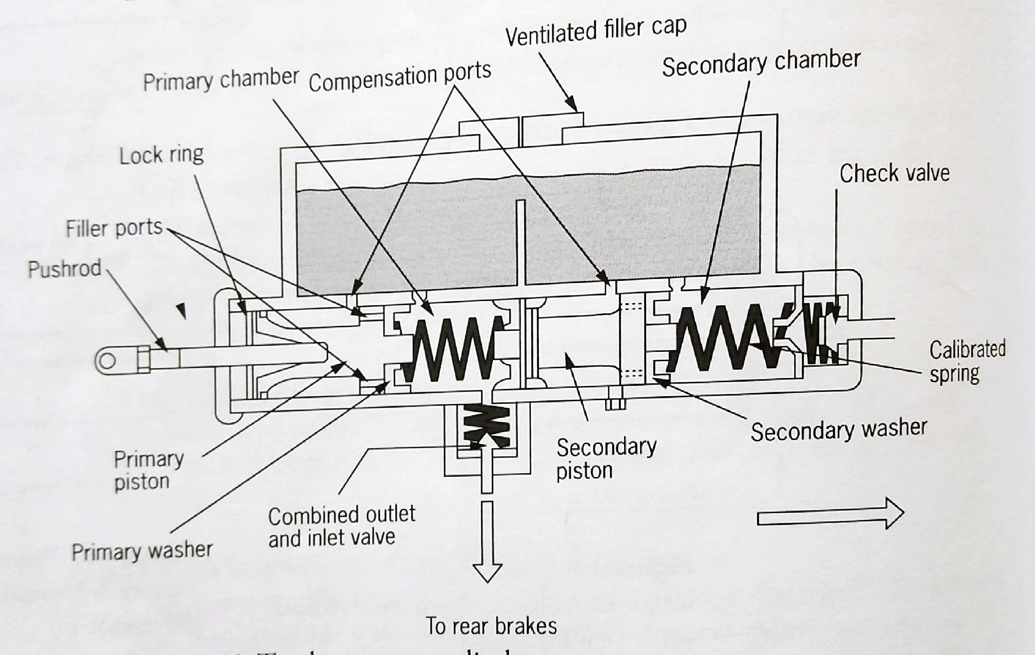
Master cylinder

Slide 4
Hydraulic brakes cont…
Construction: The tension of the primary calibrated springs is less than that of the secondary spring. When brake drums are used in both systems, both outlet ports are equipped with outlet- and -return valves to maintain a predetermined pressure in the brake system. When one of the system is equipped with disc brakes, the aforementioned valve is omitted in that specific system. The reason for this design is that no springs for returning the brake shoes are used in the disc system and it is only the spring property of the rubber seals which force the piston back slightly. If a valve is used in disc brake system, the pressure will not be relieved sufficiently.

Slide 5
Hydraulic brake cont…
When brakes are applied:
The pushrod forces the primary piston towards the front
The primary washer on the primary piston shuts off the relief port and pressure builds up between the pistons
The secondary piston moves forward and the secondary washer shuts off the relief port in the section as well
Further movement of the brake pedal and pushrod increases the pressure in both sections and this pressure is transmitted to the brake fluid in the pipes and wheel cylinders

Slide 6
Hydraulic brakes cont…
Should the system that is connected to the rear pressure chamber fails, the primary piston will move up against the secondary piston. The pistons move forward as a unit and pressure builds up in the front pressure chamber. In this case excessive movement of the brake pedal will be experienced
This will be the same if front pressure chamber fails.

Slide 7
Hydraulic brakes cont…
When brakes are released: During the release of the brakes, the operation is identical to that of the single type brake master cylinder, depending on whether the combined valve is used or not.
Functions of the port in the cylinder piston:
It serves as an opening so that the hydraulic system may be filled with brake fluid after repairs
In the released position, the port remains open to relieve any pressure build-up in the system, preventing the brakes from being activated
If the servo unit is inoperative, the brakes can still be used because the pressure from the brake master cylinder is transmitted through the port to the wheel cylinder

Slide 8
Hydraulic brakes cont…
Brake pedal free play: Brake pedal free play is needed to prevent binding of the brakes and overheating. Brakes will bind if the master cylinder piston is not allowed to return to its brake release position against the stop washer and circlip. The compensating port is not fully uncovered and the pressure in the master cylinder pressure chamber cannot be released. Excess volume of brake fluid must be able to return to the reservoir when the brakes are released. If brake pedal free play is not according to specifications, the master cylinder pushrod must be adjusted. A worn pedal bushing or weak return spring can affect the free play.

Slide 9
Hydraulic brakes cont…
Vacuum servo unit: It improve the efficiency of the brake system by increasing the force on the drums or discs with less force applied to the brake pedal.
Construction: A brake servo system contains the following components:
A vacuum cylinder housing a spring-loaded diaphragm, known as the brake booster
The slave cylinder, from where pressure is transmitted to the wheel cylinder
The valve unit with a control valve and an air valve, The control valve is activated by hydraulic pressure from the brake master cylinder

Slide 10
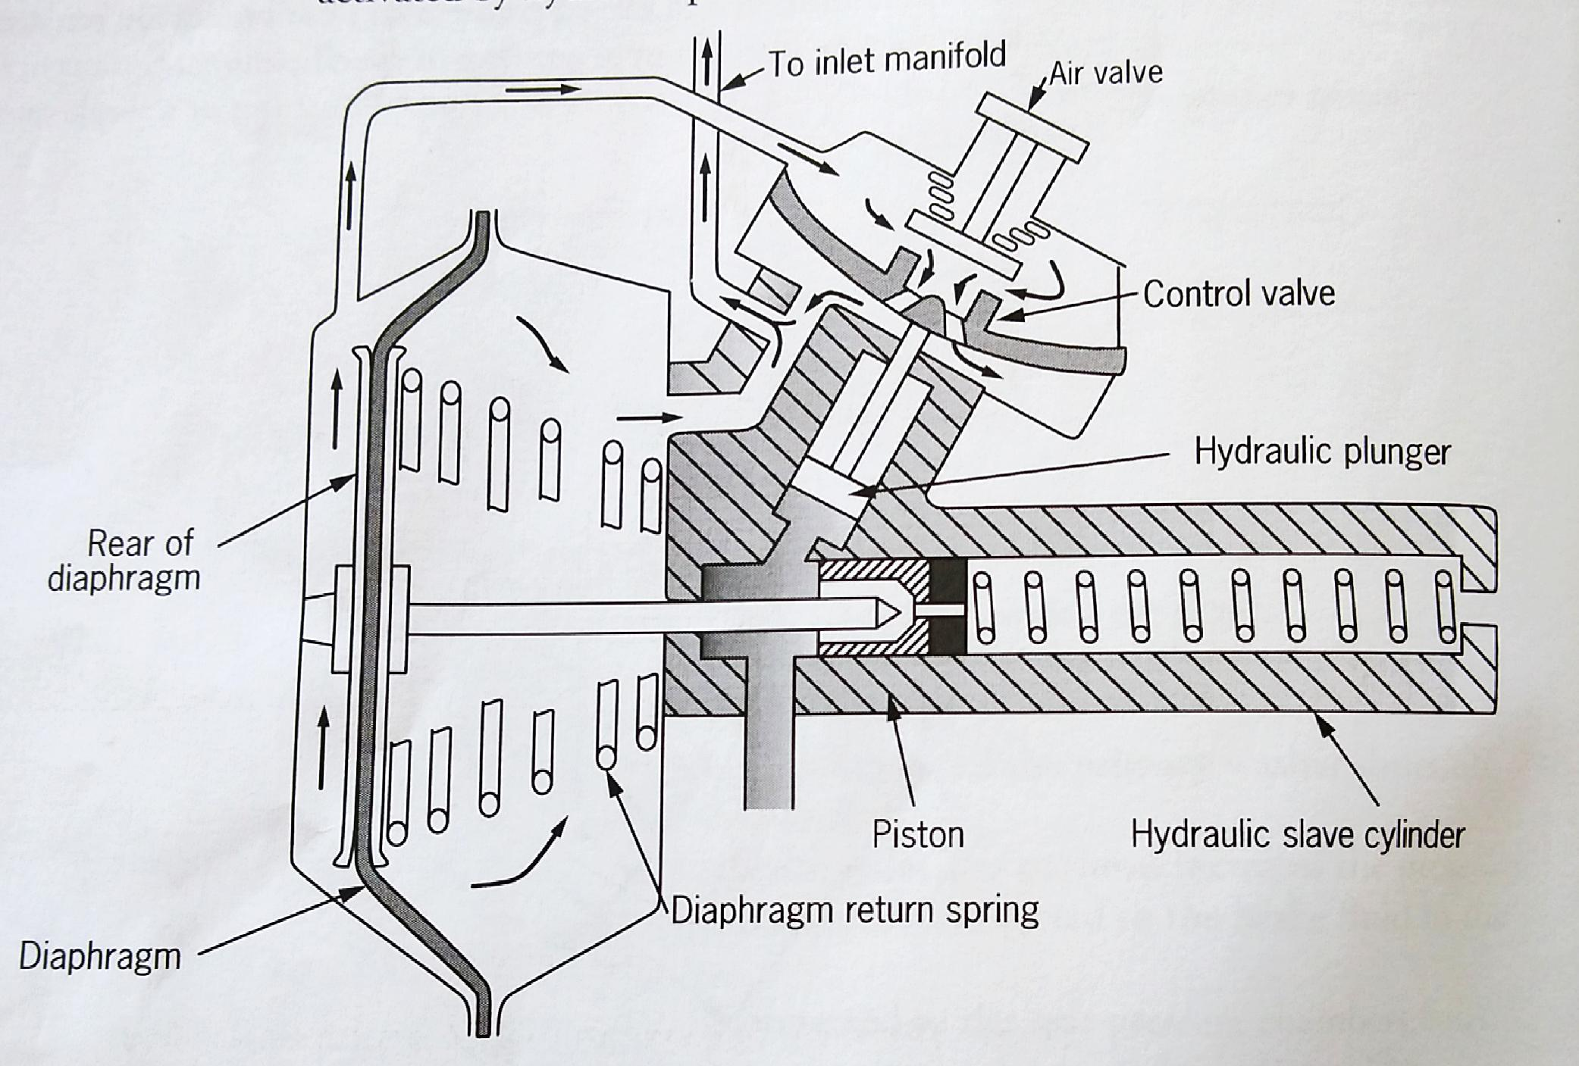
Vacuum servo unit

Slide 11
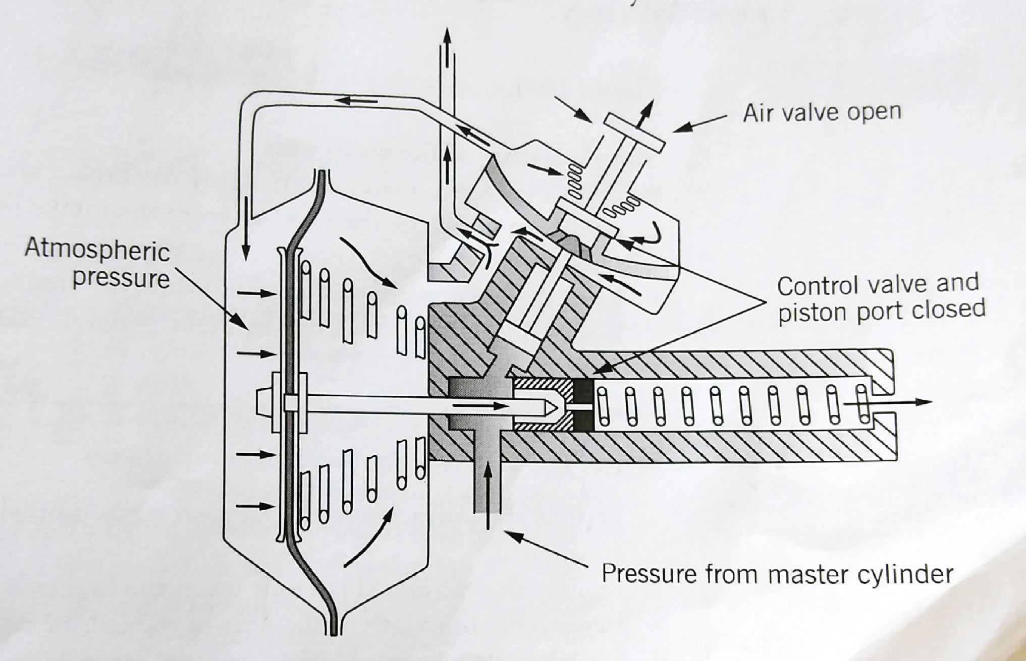
Vacuum servo unit cont..

Slide 12
Hydraulic brakes conti…
Operation: Release position
The control valve is open
The air valve kept shut by the return spring and the vacuum
Vacuum from the intake manifold is directly applied to the spring side of the diaphragm
Simultaneously, vacuum from the intake manifold and through ports in the control valve is also applied to the rear side of the diaphragm
With even pressure on both sides of the diaphragm, the return spring in the booster keeps the diaphragm in the released position

Slide 13
Hydraulic brakes cont…
Brake pedal applied:
Pressure from the brake master cylinder activates the hydraulic plunger in the valve unit
The control valve is closed while the air valve is opened
Air under atmospheric pressure is admitted through the air valve to the rear of the diaphragm
Vacuum from the inlet manifold is applied to the spring side of the diaphragm
The pressure difference causes the diaphragm to move against the spring tension

Slide 14
Hydraulic brakes cont…
The diaphragm rod closes the port in the piston of the slave cylinder
Further movement of the diaphragm causes pressure to build up in the slave cylinder, brake tubing and the wheel cylinder
Brakes released after application:
Pressure from the brake master cylinder on the hydraulic plunger in the valve unit is released
The control valve is opened while the air valve is closed
Vacuum from the intake manifold is applied to both side of the diaphragm
The return spring in the booster forces the diaphragm to the released position

Slide 15
Hydraulic brakes cont…
The diaphragm rod opens the port in the piston of the slave cylinder
The pressure on the wheel cylinder is relieved
Simple testing of the servo unit:
With the engine switched off, apply brakes several times. This operation displaces the vacuum from the intake manifold and the servo unit.
Keep the brake pedal well applied while the engine is started
If the servo unit is efficient, the brake pedal should drop slightly

Slide 16
Hydraulic brakes cont…
ABS brakes
Introduction: In early 1980s, the first antilock brake system(ABS) was introduced in the motor industry in the United States. It was a safety feature to give motor vehicle drivers more control when braking. ABS uses microprocessor and individual wheel speed sensor to observe the brakes.
Hydraulic control-valves for each brake circuit prevent skidding during emergency braking or when braking hard on wet, iicy or slippery surfaces

Slide 17
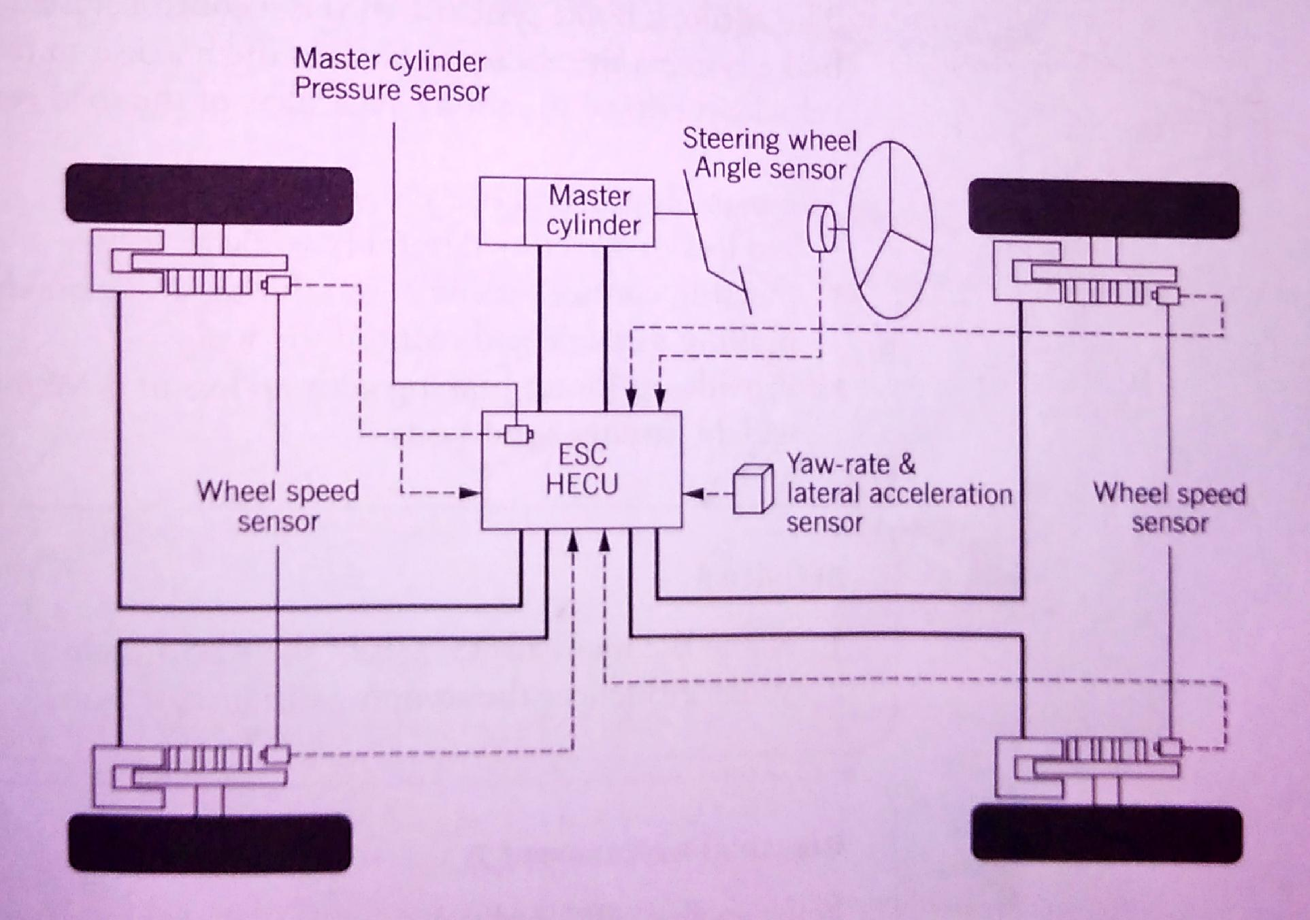
Hydraulic brakes cont…

Slide 18
Hydraulic brakes cont…
Operation:
Wheel-speed sensor monitor the rotary motion of each wheel
When brakes are applied, the ABS microprocessor compares wheel speeds
If one or more wheels are rotating more slowly than the others, the system energises control valves to isolate the affected brake circuit
Brake pressure is held briefly and is then released before it is re-applied
This cycle allows the wheel to recover traction and avoid skidding

Slide 19
Hydraulic brakes cont…
Advantages of ABS:
No loss of directional stability while braking
Steering control retained even during heavy braking, shortest possible braking distance and reduce tire wear
Provide optimum braking with no loss of directional stability under widely varying conditions

Slide 20
Hydraulic brakes cont..
What influences the stopping distance of a car:
The stopping distance of a car is influenced by a variety of factors, including weather conditions, road surface, prevailing traffic and the amount of brake pressure applied

