Slide 1
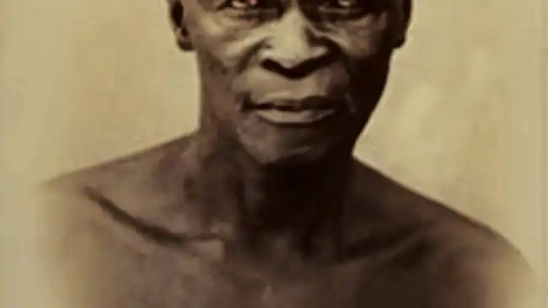
UNkosi Jongumsobomvu Maqoma
UNkosi Jongumsobomvu Maqoma uyakhasa, ngowe1797 ulikrwala ngowe1818. uYise, uNgqika ngowe1817 wenza umnqophiso ngomhlaba noSomasethi oliSetlani. Ubalulekile kwimbali yamaqhawe amaXhosa omhlaba kaRharhabe ngemfazwe zakhe nabangeneleli, abangamaNgesi, ngeminyaka yo-1800. Ukho ukufika kwamaSetlani ngowe1820, kwimfazwe kaMlanjeni ngowe1850.Yinkosi yamaJingqi eyaswelekela eRobben Island ngowe 1874 ngenxa yokuba uthe akukhululwa ejele wafika umhlaba wakubo eNcerha, kaXhoxho wabelwe amadlagusha afikayo. Watshica itha. Wabanjwa waxhixhinjiswa ukusiwa eRobben Island . Waziwa ngembhubhiso enkulu ayenze kwimikhosi yamaNgesi ngeMfazwe kaMlanjeni. Amathambo akhe abuyiswe eKapa apho ngowe1978.
Sithetha nje umfanekiso wakhe oqingqiweyo umiswe e-MacLean Square ecaleni, ngakwiposi yaseQonce ngenkxaso yeSebe leNkcubeko namaSiko loMzantsi Afrika.

Slide 2
Umongo nomxholo ngokufutshane
Umongo
Umxholo
UNkosi uMaqoma ligorha, akoyiki, akalobhetyebhetye, unengqondo ebukhali,uyaqiqa, ubona izinto ezifihliweyo, ukhalimele isivumelwano sikayise uNgqika noSomerset sokunikisa ngomhlaba, wakhalimela iziphumo zikaNongqawuse, wabanjwa wavalelwa akukhululwa kwakhona wafika kunikiswe ngomhlaba oseNcerha nalapho wazijul’ijacu wathathwa selemdala wayovalelwa eRobben Island apho alandulele khona eli.
Kuthethwa ngoNkosi uMaqoma ongelobhetyebhetye, ongatyhwatyhwiyo, owayebangquba abafuna ukuwudla ilifa umhlaba wabamnyama waze ngenxa yokungathuli wabanjwa wade wayokufela eRobben Island.

Slide 3
Iimpazamo zabafundi malunga nomxholo
Bacaphula umqolo omnye
Bathetha ngomqolo kwisitanza okanye isitanza esinye.
Baxela okuthethwa ngako bangatsho ukuba kutheni.
Bayayala endaweni yokuxela ukuba imbongi ithetha nge… (etheni)…. ithi mayi…( ukuba kukho imeko enjalo)

Slide 4
Izixhobo zokucacisa umxholo ISIMBO
Isingqisho
Ulwimi/ isakhiwo sangaphakathi
Izafobe
Isakhiwo
Sangaphandle
- isitanza/ izitanza
Imfanozandi
Isingqi
Imvanosiphelo
imvanosiqalo
Isigama esikhethiweyo
Ithoni
Uphindaphindo
Imifanekiso ntelekelelo/ ngqondweni
-Imiqolo
Isandi
Isandi

Slide 5
UNjani uphendulwa ngoku kulandelayo
Sihlalutya ngokunika ingqwalasela:
Udidi lombongo neempawu zawo
Ukwakheka kwezitanza, imiqolo, uphinda phindo
Izafobe ezisetyenzisiweyo
Imifanekiso ngqondweni nemifanekiso ntelekelelo
Umoya wembongi
Izixhobo zesandi neendelela zophindaphindo
Ulwimi lusetyenziswe njani ukuchaza/ ukuqaqambisa/ ukudala umfanekiso ntelekelelo/indlela imbongi eyichukumisa ngayo imizwa

