Slide 1
Civil Technology – Construction GRADE 11
TOPIC: JOINING (SPECIFIC)
TERM 2 WORK

Slide 2
JOINING (SPECIFIC)
TOPIC: JOINING (SPECIFIC)
CONTENT:
JOINING BRICKS TO:
Steel doors and windows
Aluminium doors and windows
Wooden doors and windows
Cavity walls: Different types, materials and spacing of ties

Slide 3
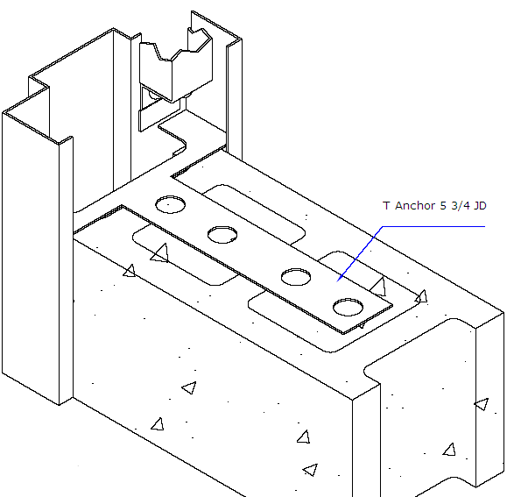
Joining bricks to: 1.1 Steel doors and steel windows

Slide 4
Windows and doors so far as possible, should not compromise the main performance requirements selected for the walls in which they are to be incorporated.
Nevertheless, any puncturing of the external wall carries with it a risk of reduced overall performance with respect to one or more of the following:
Strength and stability
Weather exclusion
Fire resistance
General safety issues including security
Thermal and sound insulation

Slide 5
Windows have two prime purposes:
The admission of daylight and sunlight.
The admission and emission of air needed for ventilation purposes.
Doors main purpose:
To provide an entry and exit point to a building for occupants and goods.

Slide 6
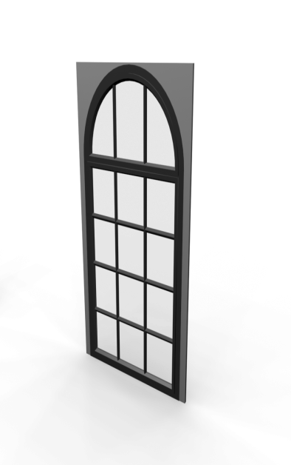
Steel windows:

Slide 7
Steel windows:
Steel windows are universally praised for their incomparable strength, durability, and unparalleled aesthetic value.
Steel windows are always very popular and have many advantages over other types of windows. The main advantage to steel windows is that they are very strong. As a result, glass area can be maximized since window parts can be made extremely thin.
Steel windows form the face of a home and with their slim appearance they contribute charm, style and elegance.

Slide 8
Steel windows:
With quality steel windows maintenance is not a worry because they are incredibly durable and have a long life. Galvanized windows are permanently sealed against corrosion, they will not rust and should last the life of your home, while polyester powder coated steel windows do not require redecoration for 15-20 years.
Steel windows are competitively priced and represent great value compared to the alternatives. The inherent strength of steel windows means that they provide more protection than any other window type against intruders and fire and are available with tried and tested locking systems. Steel windows are durable, but not maintenance free; steel will rust if you don't keep paint on it.

Slide 9
Weather Performance:
Long experience has demonstrated the suitability of steel windows for most sites and exposure conditions. Security:
The inherent strength of steel windows ensures maximum rigidity once the window frames have been installed and glazed. The most secure steel window is a regular, standard window divided into small panes of glass, with vertical and horizontal bars tenon-riveted into the frame and with strong intersecting joints. Even if the glass is broken, entry cannot be made through this window.
A high measure of security can be achieved with large pane steel opening windows by a variety of locking methods, while a supplementary ventilator, mounted in the top glazing rebate will give permanent or controlled ventilation with locked window security.

Slide 10
Operation and Control:
Steel window fittings available offer a comprehensive selection of casement handles and stays, folding openers, hinges, pivots, catches and bolts all designed to provide the optimum in performance and flexibility. Stringent quality control procedures, combined with modern manufacturing techniques, ensures that all products are of a consistently high standard. INSTALLATION:
(Fixing)
Steel windows are suitable for fixing direct to brickwork, concrete, stone or into subframes.
(Glazing) Steel windows can be single glazed or fitted with insulating glass units.

Slide 11
Aftercare and Maintenance
The modern steel window is an extremely durable, maintenance practices are observed. Frames should be cleaned at regular intervals, using a mild, non-alkaline detergent in warm water, applied with a soft cloth or sponge.
Glazing and perimeter sealants should be inspected on an annual basis and appropriate maintenance action taken. Galvanized steel windows, which are not factory finished with a polyester powder coating, are manufactured with clearances set to allow for up to three or four coats of paint on the meeting surfaces. When the repainting programme has exceeded this, strip the paint off all meeting surfaces prior to repainting.

Slide 12
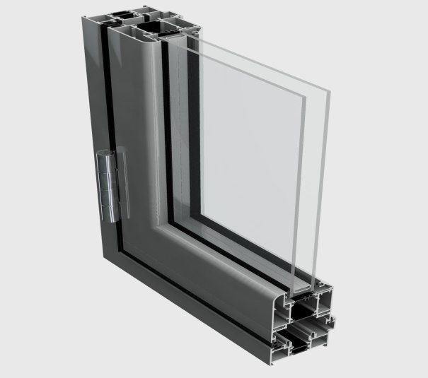
All hinges, pivots, handles, stays and other mechanical parts should be checked for operation, kept free of excessive paint build up and lightly lubricated.
1.2 ALUMINIUM DOORS AND ALUMINIUM WINDOWS
ALUMINIUM WINDOWS:

Slide 13
ALUMINIUM WINDOWS:
Aluminium Windows are naturally strong and durable, resisting warping and twisting because of their inherent rigidity. Aluminium windows and doors' unique combination of strength and lightness enables frames, sashes and fittings to be neat and unobtrusive.
Aluminium Windows are available in the following colours:
Natural anodized Bronze
White powder coated
Also new Kal-Kote - an advanced coating process which produces authentic wood finishing in the following varieties: beechwood, mahogany, oak, cherrywood and Oregon pine etc.

Slide 14
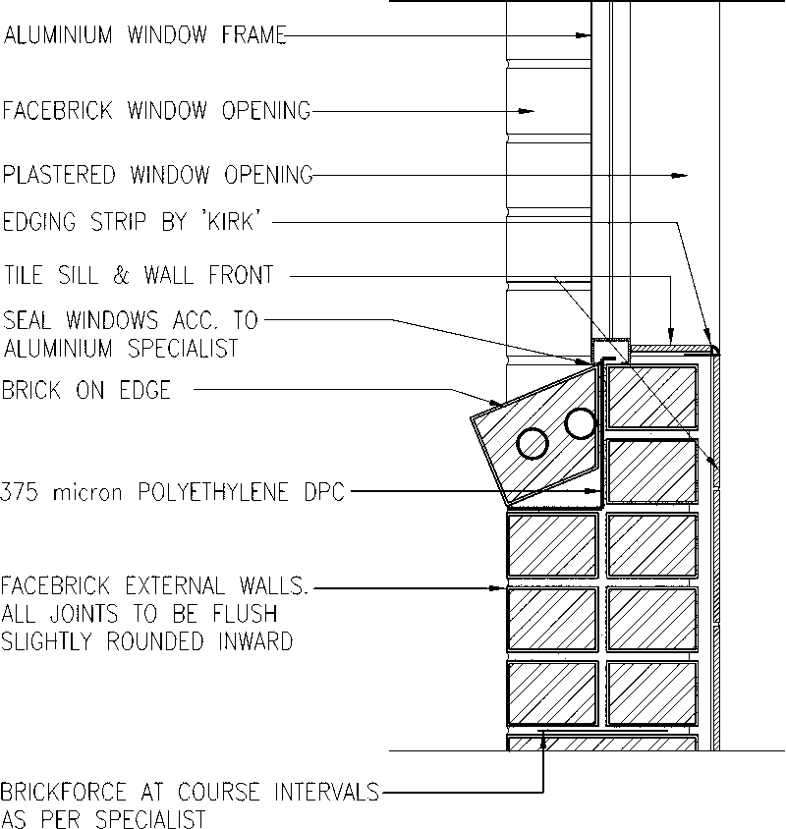

Slide 15
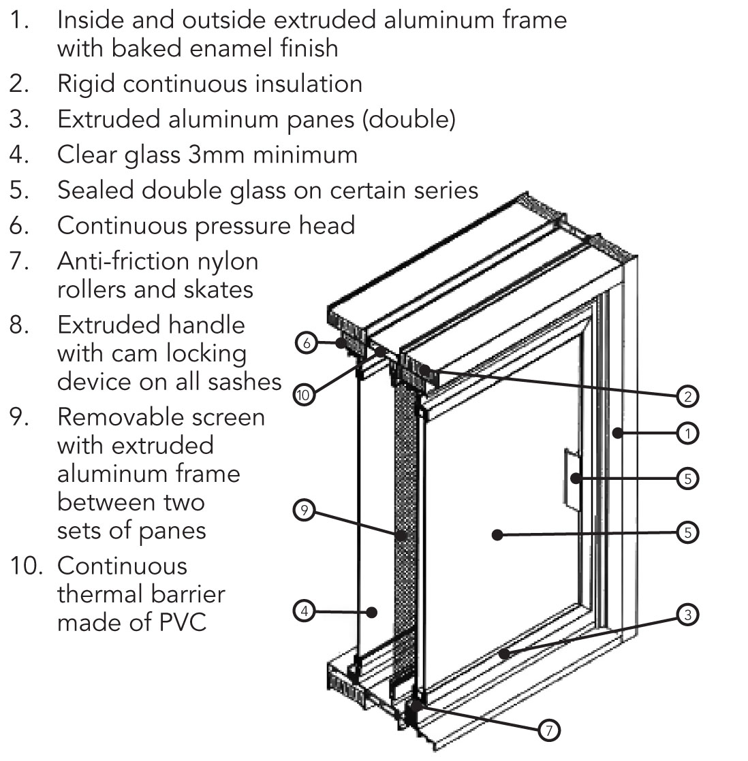

Slide 16
ALUMINIUM DOORS:
Aluminium doors provide stability, are readily available and are easy to maintain. Doors made from aluminium are a good choice for houses of modern design, with a choice of finishes such as natural anodized, bronze or white powder coating, and also modern coating processes which provide various wood look-alike finishes. Aluminium doors do not rust, and they provide excellent weatherproof qualities.
Aluminium doors are naturally strong and durable, resisting warping and twisting because of their inherent rigidity. Aluminium doors' unique combination of strength and lightness enables frames, sashes and fittings to be neat and unobtrusive. To maintain aluminium doors and windows, all that is needed is the occasional, gentle wash down to remove any surface dirt or grime, nothing more, pure and simple

Slide 17
ALUMINIUM DOORS AND WINDOWS:
Aluminium windows and doors don't require painting, will not warp or rot and their dimensional stability ensures years of trouble free operation. For sheer looks, security and durability, there's simply nothing to match aluminium doors and windows. The only maintenance needed for aluminium windows and doors is the occasional, gentle wash down to remove any surface dirt or grime, nothing more, pure and simple.
Aluminium windows and doors simply don't warp, so your doors and windows will continue to open and close smoothly for years and years. Unlike other doors and windows, aluminium windows and doors do not need so many locking points or hinges to prevent warping.

Slide 18
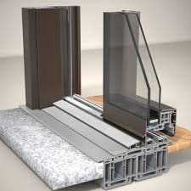
In short, aluminium windows provide stability, are readily available and are easy to maintain. Windows made from aluminium are a good choice for houses of modern design, with a choice of finishes such as natural anodized, bronze or white powder coating, and also modern coating processes which provide various wood look-alike finishes. Aluminium windows do not rust, and they provide weatherproof qualities.
Aluminium Doors:

Slide 19
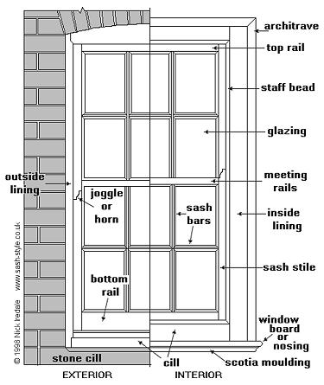
1.3 WOODEN DOORS AND WOODEN WINDOWS
WOODEN WINDOWS:

Slide 20
WOODEN WINDOWS:
Wooden windows can be painted or stained, and are strong and easy to work with. Ease-of-use makes for easier custom windows, which is why highly detailed window frame designs are typically made from wood. With regard to energy efficiency, few sash and frame materials are better insulators than wood.
Full Pane Wooden Windows:
Opening your house to the outside and giving maximum ventilation, the Full Pane Wooden Window allows for breathability and versatility across a variety of design applications. It's side-hung design helps to create a sense of space and is the perfect complement to open plan living.

Slide 21
Small Pane Wooden Windows:
The Small Pane Wooden Window, also known as the Cottage Pane Window, has the versatility to work well across quite a number of design applications. Even so, it is often seen featured in many warm. cosy holiday cottages dotted all along the South African coastline.
Top Hung Wooden Windows:
Held open by a stay, this range of wooden windows can fit in with almost any contemporary abode. Key to its appeal is simplicity in form and flexibility in usage. In combination with either standard or sliding doors, the Top Hung windows not only add a sense of space on an aesthetic level, but also improves ventilation on a practical one.

Slide 22
Mock Sash Wooden Windows:
With the unmistakeable touch of the Cape Dutch style, the Mock Sash Wooden Window range is a classical addition that fits with any contemporary application or architectural design. Affordable and easy to install, this range of window comes in a large variety of either small or full pane configurations.
Round Tops:
Apply the aesthetically perfect Round Top Wooden Window to all standard window shapes. Adding that little bit of extra appeal and shape to the hard corners of square and rectangular window designs, they let in significantly more light. Available in both small and full pane designs, the Round Top Windows are quality crafted from only the very best hardwoods.

Slide 23
WOODEN WINDOWS:
The only downside to using wooden windows is that they require regular maintenance. Peeling paint is more than an eyesore, it's a sign that wood is being exposed to weather, which will ultimately cause it to rot. A small number of high-end producers use rot-resistant species like mahogany, but most domestically manufactured windows are made from less-resistant wood species such as pine. That said, a properly maintained wooden window could last hundreds of years.
Maintenance of wooden windows:
Wooden Windows are designed and engineered to meet the requirements and expectations of modern living and construction. Failure to keep to a planned maintenance schedule may at best ruin the wooden window’s appearance and, at worst, could lead to the early deterioration of the components. The natural beauty of wood as a material for windows means that, if maintenance is carried out regularly, it will retain its visual appeal for a lifetime.

Slide 24
WOODEN WINDOWS:
What you need to maintain on a wooden window:
Unless correctly maintained, there is a reasonable chance that anything in a product that can go wrong will go wrong. It is therefore necessary to check all aspects of a wooden window. The most important elements to maintain are the coating system and the hardware. However, it is advisable to check the whole window(interior and exterior) for any signs of deterioration. If there are any causes for concern, follow these guidelines. If the problem persists,
contact the window manufacturer. The type and level of maintenance required will depend on the wooden window’s location and exposure to the weather.

Slide 25
WOODEN WINDOWS:
A few guidelines for maintenance of wooden windows:
Mould and algae:
All wooden windows can suffer from mould and algae caused by airborne spores, which settle on the surface. To remove mould and algae, wash with a solution of one part bleach to two parts water, and leave for 20 minutes to work. Then rinse. If the blemish is stubborn, scrub with a stiff nylon bristle (not metallic) brush.
Cleaning and washing:
Wash with hot water and liquid detergent every 6 months. Rinse with clean water. During this process it is advisable to inspect all components of the window for defects and take action if necessary.

Slide 26
Damage:
If any part of the window’s coating system is damaged to the point of showing bare wood,
contact the manufacturer to find out which is the appropriate coating material to use and their practical instructions on how to maintain it.
Re-decorating wooden widows:
All products deteriorate over time and this is particularly true of those that are exposed to the elements. Wind, rain and sunlight – not to mention wind-borne spores and insects – all contribute to the breakdown and deterioration of all materials’ appearance. It is therefore important to protect your wooden windows by putting a barrier between them and the elements.

Slide 27
WOODEN WINDOWS:
The beauty of re-coating wooden windows is that when they are done, they look brand new again. Alternative materials can go permanently yellow or grey, or become pitted and brittle.
When the surfaces of your wooden windows become damaged or exposed to the elements, contact the manufacturer to find out what the best procedure is to prepare the wood for re-decorating, and which sealants are best to use.

Slide 28
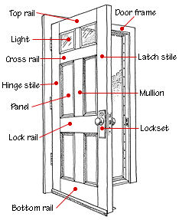
Wooden Doors:

Slide 29
Wooden Doors:
The sheer beauty of wooden doors ensure that they have been, and always will be a firm favourite amongst many property owners. Wooden doors can be painted or stained, and are strong and
easy to work with. Ease-of-use makes for easier custom doors, which is why highly detailed door designs are typically made from wood. With regard to energy efficiency, few materials are better insulators than wood.
The only downside to using wooden doors is that they require regular maintenance. Peeling paint is more than an eyesore, it's a sign that wood is being exposed to weather, which will ultimately cause it to rot. A small number of high-end producers use rot-resistant species like mahogany, but most domestically manufactured doors are made from less-resistant wood species such as pine. That said, a properly maintained wooden door could last hundreds of years.

Slide 30
Maintenance of wooden doors:
Wooden doors are designed and engineered to meet the requirements and expectations of modern
living and construction. Failure to keep to a planned maintenance schedule may at best ruin the wooden door’s appearance and, at worst, could lead to the early deterioration of the components. The natural beauty of wood as a material for doors means that, if maintenance is carried out regularly, it will retain its visual appeal for a lifetime.
What you need to maintain on a wooden door:
Unless correctly maintained, there is a reasonable chance that anything in a product that can go wrong will go wrong. It is therefore necessary to check all aspects of a wooden door. The most important elements to maintain are the coating system and the hardware. However, it is advisable to check the whole door(interior and exterior) for any signs of deterioration.

Slide 31
Wooden Doors:
There are any causes for concern, follow these guidelines. If the problem persists, contact the door manufacturer. The type and level of maintenance required will depend on the wooden door’s location and exposure to the weather.
A few guidelines for maintenance of wooden doors:
Mould and algae:
All wooden doors can suffer from mould and algae caused by airborne spores, which settle on the surface. To remove mould and algae, wash with a solution of one part bleach to two parts water, and leave for 20 minutes to work. Then rinse. If the blemish is stubborn, scrub with a stiff nylon bristle (not metallic) brush.

Slide 32
Cleaning and washing:
Wash with hot water and liquid detergent every 6 months. Rinse with clean water.
During this process it is advisable to inspect all components of the door for defects and take action if necessary. Damage:
If any part of the door’s coating system is damaged to the point of showing bare wood, contact the manufacturer to find out which is the appropriate coating material to use and their practical instructions on how to maintain it.

Slide 33
Re-decorating wooden widows:
All products deteriorate over time and this is particularly true of those that are exposed to the
elements. Wind, rain and sunlight – not to mention wind-borne spores and insects – all contribute to the breakdown and deterioration of all materials’ appearance. It is therefore important to protect your wooden doors by putting a barrier between them and the elements. The beauty of re-coating wooden doors is that when they are done, they look brand new again.
When the surfaces of your wooden doors become damaged or exposed to the elements, contact the manufacturer to find out what the best procedure is to prepare the wood for re-decorating, and which sealants are best to use.

