Slide 1
Civil Technology – Construction
GRADE 11
TOPIC: JOINING (GENERIC)
TERM 2 WORK

Slide 2
TOPIC: JOINING (GENERIC)
CONTENT:
Properties, use precautions and applications of the following:
Contact glue
PVC adhesives
Silicone
PVA-wood glue

Slide 3
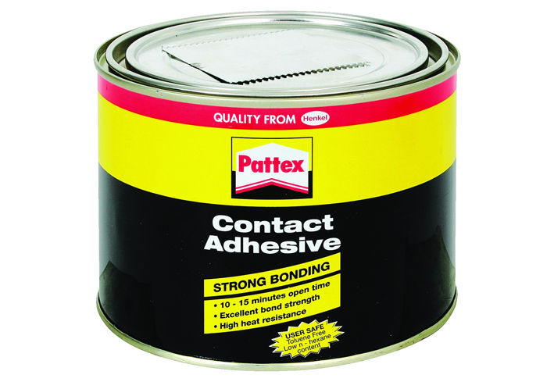
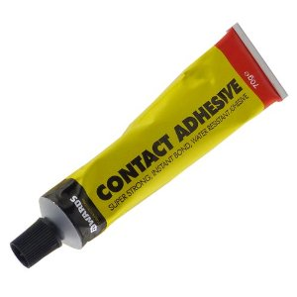
Properties, use, precautions and application of the following adhesives:
1.1 Contact glue:

Slide 4
1.1 CONTACT GLUE:
The ultimate general-purpose Contact Adhesive that is a toolbox essential.
Offers fast, flexible and permanent bonding - one of the best bonding agents for durability.
It can be used for bonding almost anything but is especially useful for non-porous materials (e.g. glass, metal, hard plastics) that other adhesives can’t glue together.
Genkem Contact Adhesive offers good brush ability for easy application in hard to reach places. In its wet form, it will stick to a variety of surfaces, and in its tacky to dry form, it will only stick to itself. Once adhered, it is nearly impossible to rip apart.

Slide 5
SUITABLE FOR USE ON:
Wood, processed boards, masonite, plywood, veneer,
floor coverings, foam, canvas, leather, felt, cloth,
linoleum, glass, metal, rubber, cork and some plastics.
Ideal for hobby crafts, shoe repair, leather work,
decorative work and general DIY projects
NOT SUITABLE FOR USE ON:
Certain plastics such as polystyrenes and sheet vinyl

Slide 6
HANDY HINTS & TIPS:
For a professional finish to wood veneers, Iron it gently with a warm
domestic iron after the veneers have been bonded. This will produce
a smooth finish and ensure the best overall bond.
Always stir Genkem Contact Adhesive well before use.
Clamping bonded parts will always improve the bond.
With thin or flexible substrates, place the bonded article between two
sheets of wood, or metal thick enough to resist bending and then
clamp these firmly together. If possible, leave it for 24 hours before
attempting to use it.
Check whether enough adhesive has been spread over
the area, once the adhesive is dry, as it should have a
glossy uniform.
Genkem Contact Cleaner can be used to clean spills, tools and the
removal of excess glue.

Slide 7
HEALTH & SAFETY:
Caution: This product contains ingredients that are
hazardous.
In case of accidental contact with eyes or skin, wash the affected are with plenty of water and seek medical advice
This product is harmful if swallowed. Do not induce vomiting; call your local poison centre or doctor.
Deliberate misuse by inhalation of any product containing solvents without adequate ventilation may cause eye watering, weakness, fatigue, nausea, headache or dizziness.

Slide 8
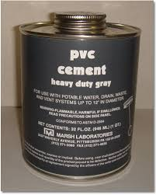
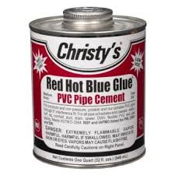
1.2 PVC adhesive:

Slide 9
PVC adhesive:
Working with PVC conduit and its fittings is easy and with the right technique, you can have a strong holding bond between the conduit and the fitting by using this great tip on how to glue with PVC glue.
Unlike rigid metal conduit that has threaded fittings or EMT conduit that has setscrew fittings, PVC conduit has glued fittings that require some special twists and turns to make them secure and stay holding strong.

Slide 10
PVC adhesive:
There are three plastic plumbing pipes that are put together with glue. They are ABS, PVC, and CPVC pipes. We don’t really call it glue, but solvent-cement. None of the plumbing cements are interchangeable, each one is specific for its pipe.
Each pipe is joined with its own cement. One exception is transition cement, used to weld ABS pipe and PVC pipe together. This transition cement is green in colour so it's easy to recognize. The other exception is all-purpose cement which can be used to join any of the three pipes to each other.

Slide 11
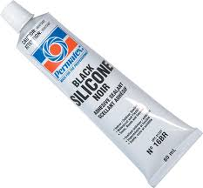
1.3 Silicone:

Slide 12
Silicone:
Based on elastomeric technology, silicone adhesives offer unparalleled flexibility and exceptionally high heat resistance, making them suitable for a wide range of applications in the electrical, electronic, automotive, aerospace and construction industries.
Silicone adhesives are available in varieties including two component systems that require the addition of a curing agent, one component systems that cure simply by the moisture in the air, UV or EB radiation curing adhesives that cure with exposure to a UV light or pressure sensitive versions that adhere to surfaces with very slight contact pressure.

Slide 13
Silicone:
In general, users can count on silicone adhesives to produce bonds that can withstand high temperatures (in some cases up to 600°F), remain flexible even after curing and resist chemicals including water.
With their ability to resist water and other chemicals, silicone systems are used for sealing gaskets and engines in the transportation industry. They are also used for potting and heat sink attachment in electronic applications.

Slide 14
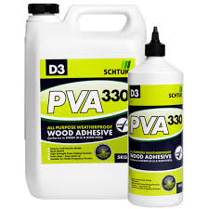
1.4 PVA wood glue:

Slide 15
PVA wood glue:
PVA stands for Polyvinyl Acetate and it's a type of aliphatic resin that is also water based and is available for interior or exterior use but is also non toxic.
This glue is now very popular and in many opinions it is the best timber adhesive available because it dries clear, it's very easy to apply and has super strong holding strength on wood. They can creep over time but a tight joint helps to prevent that. Because of its many great features Polyvinyl Acetate is excellent for bonding woodwork joints together or as a furniture and carpentry adhesive.
Polyvinyl Acetates are very versatile and are relatively fast drying but excess glue must be wiped away after applying or it is very difficult to remove when dry.
Polyvinyl Acetate glues are available in white and yellow and are relatively inexpensive compared to most glue, they also have a reasonably long shelf life.
The white type is better for interior use because moisture weakens it over time and the yellow is better for outdoor use because it is water resistant but it doesn't dry completely clear.

