Slide 1


Grade 12
GEOGRAPHY
Examination preparation

Slide 2


Paper 1

Slide 3
STRUCTURE OF PAPER 1
SECTION A
Climate/Geomorphology
SECTION B
Settlement/ RSA Econ
QUESTION 1
1.1 Clim(7/8)
1.2 Geo(7/8)
1.3 Clim (15)
1.4 Clim (15)
1.5 Geo (15)
1.6 Geo (15)
QUESTION 2
2.1 Clim(7/8)
2.2 Geo(7/8)
2.3 Clim (15)
2.4 Clim (15)
2.5 Geo (15)
2.6 Geo (15)
QUESTION 3
3.1 Sett(7/8)
3.2 Econ(7/8)
3.3 Sett (15)
3.4 Sett (15)
3.5 Econ (15)
3.6 Econ (15)
QUESTION 4
4.1 Sett(7/8)
4.2 Econ(7/8)
4.3 Sett (15)
4.4 Sett (15)
4.5 Econ (15)
4.6 Econ (15)
Answer THREE questions
Two paragraph-type questions in each of the four questions

Slide 4
Weighting of cognitive levels
LOWER ORDER Knowledge & Remembering | MIDDLE ORDER Understanding & Applying | HIGHER ORDER Analysing, Evalu-ating Creating
25% (75) | 50% (150) | 25% (75)
Name Give Define Identify Describe Find Match List Label | Discuss Explain Choose Summarise Show Illustrate Use Describe Apply | Evaluate Justify Predict Assess Construct Compose Integrate Rewrite Argue

Slide 5
EXAMPLE OF A QUESTION
1.6 Figure 1.6 shows river erosion
1.6.1 What type of erosion is associated with rejuvenation? (1x1) (1)
1.6.2 What evidence indicates that rejuvenation has taken place? (1x1) (1)
1.6.3 Identify the force of upliftment associated with rejuvenation.
(1x1) (1)
1.6.4 Why is rejuvenated land not suitable for human activity? (2x2) (4)
1.6.5 In a paragraph of approximately EIGHT lines, explain how
rejuvenation could change the fluvial features downstream
of the point of rejuvenation. `(4x2) (8)
Questions become more difficult!

Slide 6
Two - Four mark questions: These data- response type questions where a discussion and detailed reference were required, were often poorly
answered.
NB Command words
REPORT
PAPER 1
Short/one word questions: Candidates performed satisfactory in the shorter questions.
Paragraph-type
questions: These questions were mostly of a medium-
and higher order and had
been in most cases, competently to very poorly answered.
Concepts: Most candidates do not have a sound knowledge of the basic concepts. Not used well when answering questions

Slide 7
Short questions
Study the 2018 question paper and write down the type of short questions found in the question paper
Choose correct answer in brackets
Refer to diagram and choose
Matching columns
Choose one term from the list
Multiple short questions
Direct short questions

Slide 8
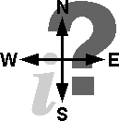
DATA RESPONSE QUESTIONS
How can it be managed?
What
is it?
What is the impact on the environ-ment?
Questions
Where
Is
it?
Geographers ask
What does it look like?
Why is it
there?

Slide 9
EXAMINATION QUESTION
Tropical cyclones
Identify the type of cyclone at A. WHAT IS IT?
Give the location of the cyclone, as shown on the map. WHERE IS IT?
Why is the cyclone found there? WHY IS IT THERE?
Draw a diagram to show the mature stage of the cyclone. WHAT DOES IT LOOK LIKE?
Explain how the cyclone causes destruction. WHAT IS THE IMPACT ON THE ENVIRONMENT? (*NB PARAGRAPH)
What can be done to limit the destruction caused by tropical cyclones to the minimum? HOW CAN IT BE MANAGED? (*NB PARAGRAPH)

Slide 10
EXAMINATION QUESTION
Urban Settlement
Identify the land-use zone at A. WHAT IS IT?
Is the zone of decay found at B or C ? Give TWO reasons for your answer. WHERE IS IT?
Discuss the factors that influenced the location of the industries at D. WHY IS IT THERE?
Discuss the characteristics of the buildings and types of functions found in the zone of decay. WHAT DOES IT LOOK LIKE?
Identify the types and sources of pollution found in the city on the diagram. WHAT IS THE IMPACT ON THE ENVIRONMENT? (*NB PARAGRAPH)
What can be done to manage traffic jams in the city on the diagram? HOW CAN IT BE MANAGED? (*NB PARAGRAPH)

Slide 11
You have to study with these questions in mind
LANDUSE ZONES - CBD
What is it?
Where is it?
Why is it there?
What does it look like?
Impact on the environment?
How can it be managed?

Slide 12
You have to study with these questions in mind
RIVER CAPTURE (STREAM PIRACY)
What is it?
Where is it?
Why is it there?
What does it look like?
Impact on the environment?
How can it be managed?

Slide 13
PLEASE NB THE FOLLOWING QUESTIONS
Discuss the HUMAN factors.....
Discuss the PHYSICAL factors…..
Discuss the ECONOMIC factors…..
Explain the HUMAN and PHYSICAL factors …..

Slide 14
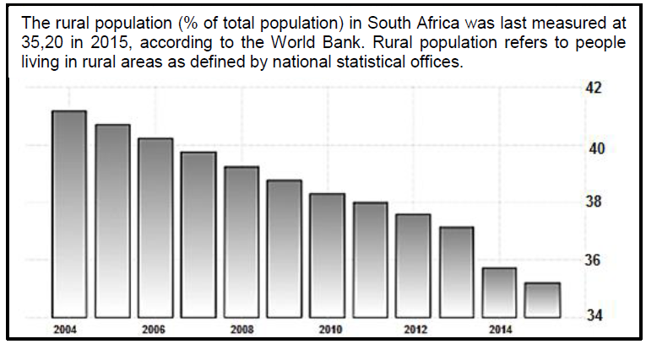
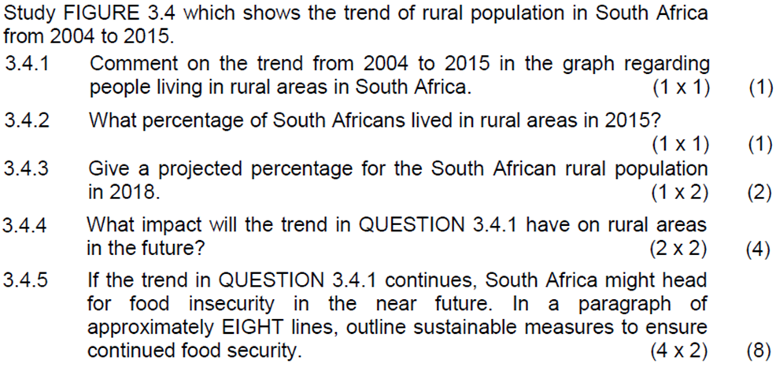
DATA HANDLING:
Statistics
Graphs
Tables
Infographics

Slide 15
CASE STUDIES, REPORTS, ETC
Read at least twice.
When part of infographic, integrate with other information.
Do not regard as comprehension test.
In many cases used to set the scene on which questions are based.
Do not quote form passage if not asked to.
Refer to facts in passage as basis for your answers.

Slide 16
Paragraph-type questions 2018
Weather CF
Human Act
Drainage Dens
Changes rejuvenation
Factors beef export
Water access rural areas
Dome cost of maintenance
Protests service delivery
Energy & labour - copper

Slide 17
PARAGRAPH-PYPE QUESTIONS
Requires critical and analytical thinking Cannot merely reproduce knowledge gained in the classroom.
Responses should be well thought through and adapted to the source given.
Answer these questions in full sentences and to the point.
Limit your answers to the prescribed eight lines.
Many paragraph questions contain two components that must be referred to.
Underline the following:
the main topic of the question
the action word
the focus areas of the question.

Slide 18
INTERPRETING A PARAGRAPH-TYPE QUESTION
A paragraph is made up of full sentences
List and account the main characteristics
Part 1 of your response
NB Length
Write a paragraph of approximately EIGHT lines to describe the human and environmental impacts of the mid latitude cyclone on agricultural activities.
Part 2 of your response
Negative or positive not stated could include both
Specific to farming.
(Crop and stock)

Slide 19
Write a paragraph of approximately EIGHT lines to describe the human and environmental impacts of the mid latitude cyclone on agricultural activities.
RESPONSE
NB Must mention at least ONE of both Human and Environment
Impact on Human activities
Positive: - Provides rain for agriculture
- Increases yield and income
- Snow can be a tourist attraction
Negative: - Cold conditions and flooding can cause loss of life
- Stock losses and damage to crops
- Costly repairs and aid projects
Impact on the environment
Positive: - Rain sustains natural vegetation and animals
Negative: - Flooding causes erosion and loss of topsoil
- Eroded material slit up rivers and dams
- Cold conditions can lead to vegetation damage (4x2) (8)

Slide 20
PRESCRIBED SUBJECT CONTENT
For 2019 the following core industrial areas must be studied:
PWV/ Gauteng
Port Elizabeth-Uitenhage/Nelson Mandela Metropole.
For 2019 the Saldanha Bay IDZ and case studies of the Platinum SDI and the Richards Bay SDI must be studied.

Slide 21
PAPER 2

Slide 22

















SECOND
QUESTION PAPER
Question 2
Calculate
Skills
Question 1
MCSQ
QUESTION 3 APPLICATION AND INTER-PRETATION
Question 4
GIS

Slide 23
QUESTION 1 – MULTIPLE CHOICE
The general direction of flow of the Buffels River in Block J5 is …
A North
B Northeast
C South
D Southwest
Attempt to answer ALL questions
Elimination
Guess

Slide 24
Calculations
QUESTION 2
Distance
Distance
Area
Gradient
Map distance x Scale
100 000
VI (Height)
HE (Distance)
L x b
Answer in km
Answer in km²
No units (1:23)
Magnetic declination
Magnetic Bearing
Vertical exaggeration
Mag N
True N
Magnetic declination
Vertical scale
Horizontal scale
+
23° 53’
Bearing
Answer = X Times

Slide 25

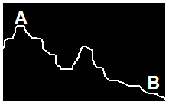
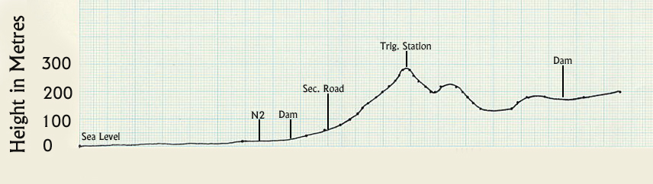
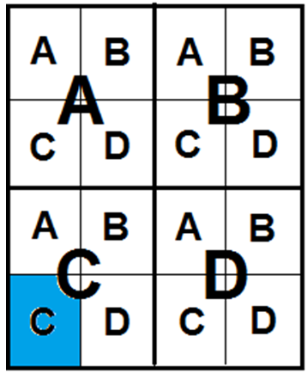
QUESTION 2
N
W
E
DIRECTION OF RIVER FLOW
S
DIRECTION BEARING
MAP
SKILLS
Contours
Trig. Stations
Spot heights
Bench marks
INTER-VISIBILITY
HEIGHT
CROSS SECTION
MAP
REFERENCE
CO-OORDINATES
33° 22’ 18” S
18° 34’ 42” E

Slide 26

QUESTION 3 - INTERPRETATION
elief
BROWN
Contours far – Gradual
Contours close - Steep
rainage
BLUE
Types of rivers
Dams
Sea
nfra struct.
RED BLACK
Main roads Railway lines
ettlements
GREY
Labour
Market
con. act
GREEN BLACK
Farms Industries

Slide 27
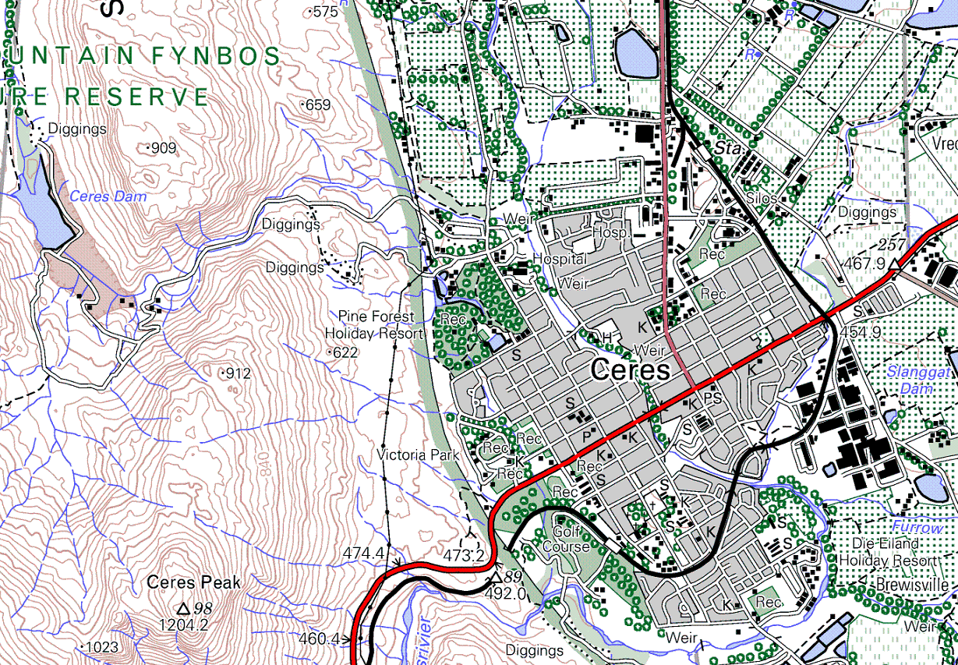

Slide 28

Parys is a popular holiday resort.
Give ONE reason why Parys become a popular holiday destination
✓
Mountain? Flat?
✓
Close to sea, river?
✓
Accessibility
Roads Railway
✓
What in and around settlement
Farms wine tasting

Slide 29
Although West End (W) in block H7 is situated close to the CBD it experiences much lower average temperatures than expected.
Give and explain ONE reason for the statement above.
✓
Contours higher or lower?
✓
Close to sea, river?
Building density Green belt?
✓
Farms cooler
Industrial areas warmer
✓

Slide 30
QUESTION 4 - GIS
CONCEPTS
What is GIS?
Remote sensing
Spatial data
Attribute data
Buffering
Resolution
Data layers
Data integration
Vector data
Raster data
Data layers
How to use GIS? (Scenario)
Shops
Crime
Available plots
Costs of plots
Distance to other shops
Client base
Client buying habits
Central place
Influence sphere
Type
Location
Time
Frequency
Risk zones
Neighbourhood characteristics

Slide 31


for your attention
Good luck for the Geography examination

