Slide 1
Geographic Information Systems
Grade 12
J.A.(André)Jacobs
andre@cartografix.co.za

Slide 2
WHAT IS A GIS?
a computer system of hardware, software and methods
to capture, manage, manipulate, analyse, model, display
spatial data (geographic objects) and
non-spatial data (attribute data)
to solve planning and management problems.
This is the main purpose of the GIS!

Slide 3
COMPONENTS OF GIS
GIS
CPU, screen, keyboard, mouse, scanner, printer, digitizing tablet
Application programme such as ArcView
Hardware
Methods
Software
GIS design according to user’s needs
Maps, aerial photos, satellite images, administrative records, etc.
People
Data
Data capturers, data users, GIS analysts

Slide 4
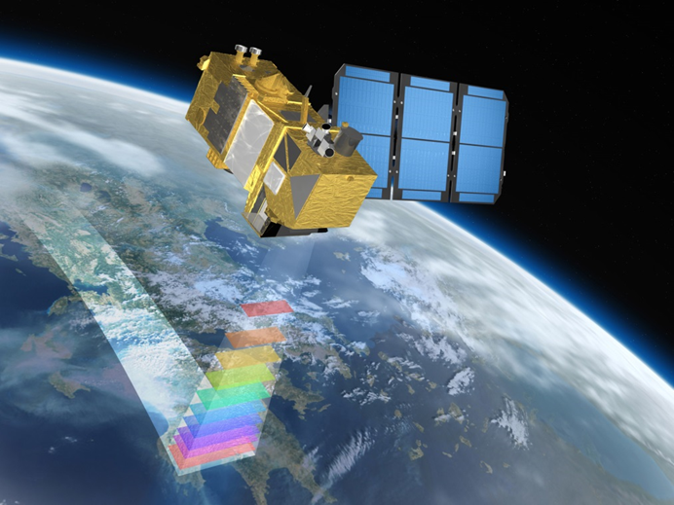
REMOTE SENSING
The collecting of information
about the earth’s surface
with sensors on platforms such as weather balloons, aeroplanes and satellites
using energy reflected or radiated from the earth
without being in physical contact with the earth

Slide 5
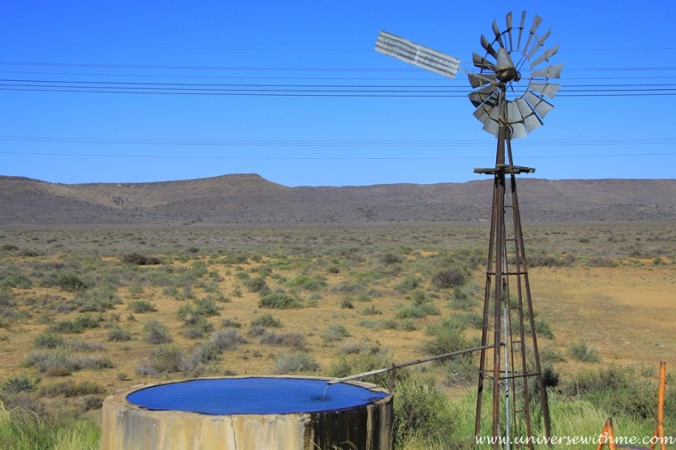
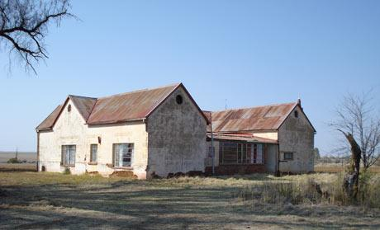
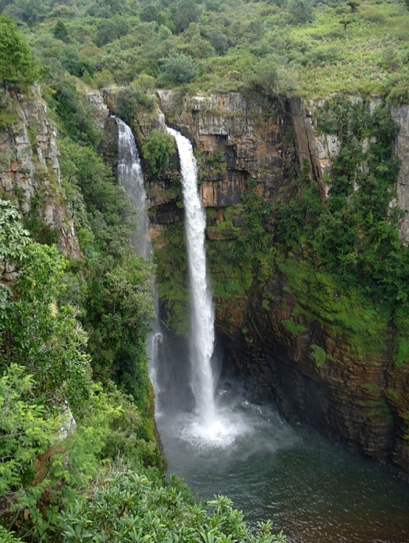
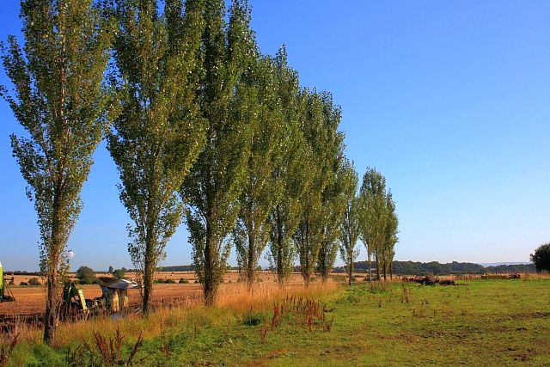
What is a spatial object?

Slide 6
Spatial objects
Building
Point
Node
River
Line
Arc
Orchard
Area
Polygon

Slide 7
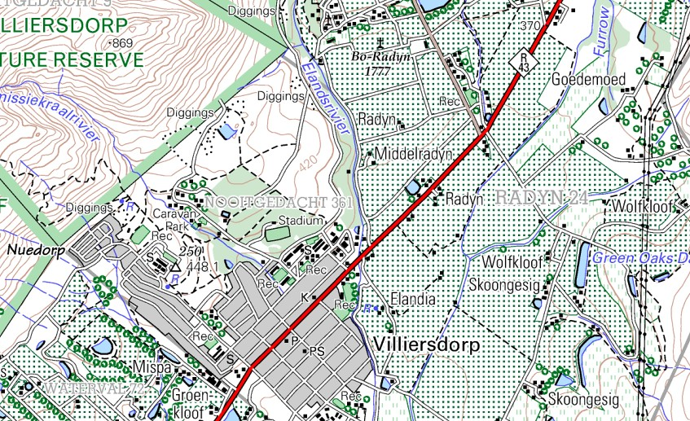
Spatial objects
Geographical phenomena
Line
Point
Area

Slide 8
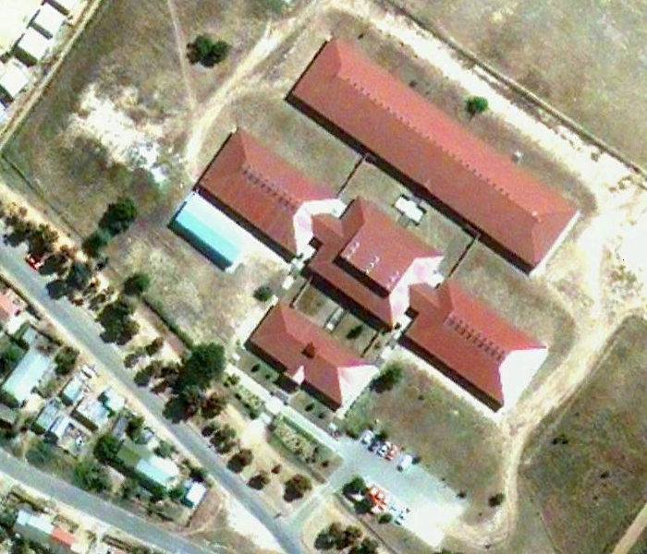
What is resolution?
The ability of a remote sensing sensor to
create a sharp and clear image

Slide 9
Spatial resolution
High
Low
Many pixels
Small pixels
Objects easily recognised
Less pixels
Larger pixels
Objects not easily recognised

Slide 10
GIS DATA TYPES
SPATIAL DATA
All geographic features/objects both natural and man-made
[Map data]
ATTRIBUTE DATA
Characteristics/description/information of the geographic objects

Slide 11
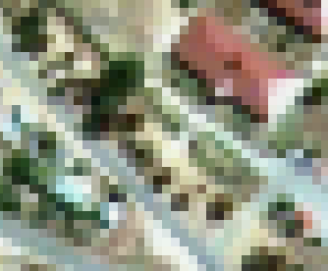
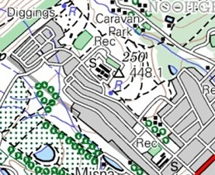
Spatial data structures
Raster
Vector
Pixels
Points, lines, areas
(Nodes, arcs, polygons)

Slide 12
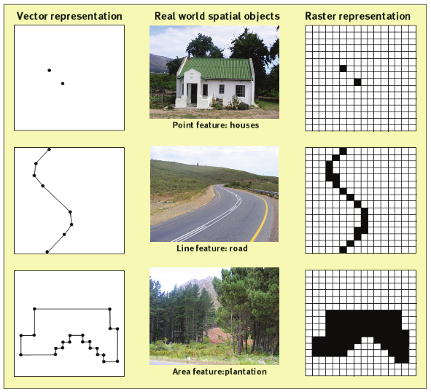
Spatial data structures
Raster
Vector

Slide 13
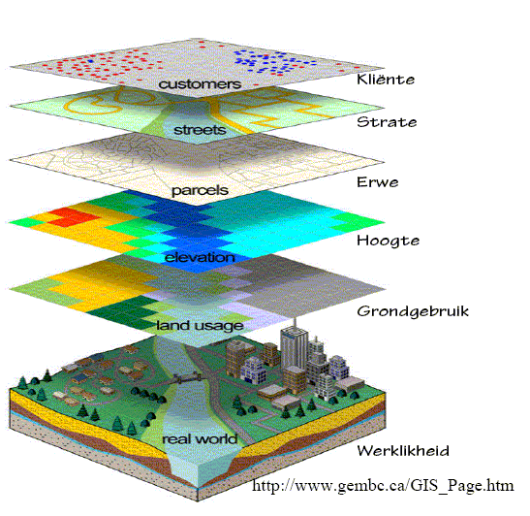
GIS DATA LAYERS
All spatial data whether it is vector data or raster data are shown in layers
Each layer represents a single entity/theme
It is this characteristic that enables a GIS to manipulate, integrate, and query data.

Slide 14
DATA MANIPULATION AND ANALYSIS
Data can be manipulated (edited and processed) and analysed by a GIS.
Transforming from one map projection to another
Converting data from raster to vector format and from vector to raster format
Interpolation between points (eg. spot heights)

Slide 15
DATA INTEGRATION
The integration of data involves the combination of two or more data layers in order to create a new one

Slide 16
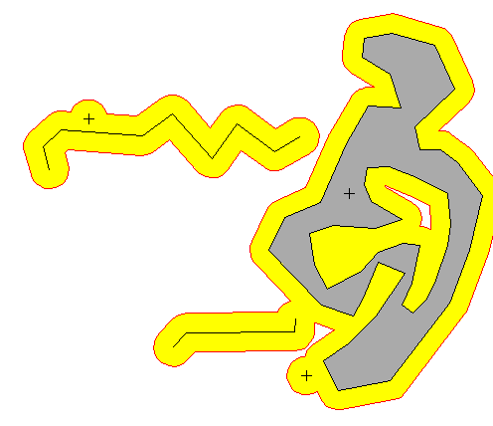
BUFFERING
It is sometimes necessary to identify zones at different distances from certain geographic features.
noise buffers next to roads
safety buffers for dangerous areas

Slide 17
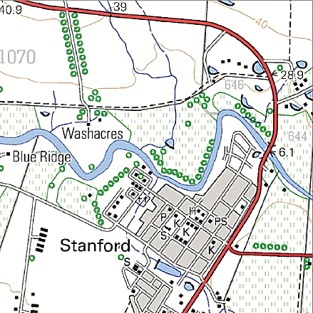
NOW LET’S GIS
Road
Cultivated fields
Schools
Examples of:
Points/nodes
Lines/arcs
Areas/Polygons
Using both the vector and raster data structure,
show a road, the two schools and the cultivated fields
Create an attribute table for the hospital

Slide 18
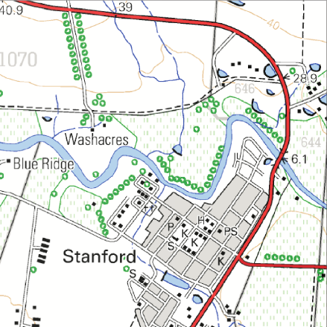
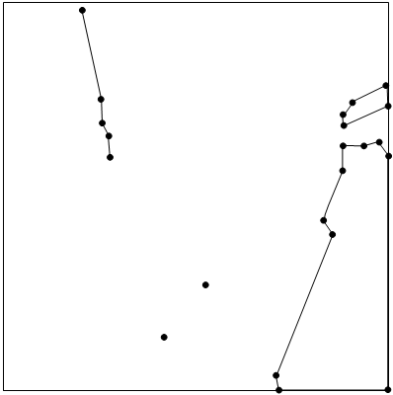
Vector
REMEMBER
Points, lines, areas
(Nodes, arcs, polygons)

Slide 19
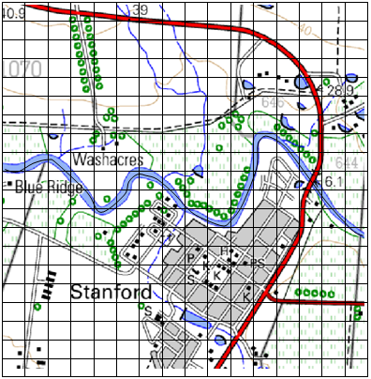
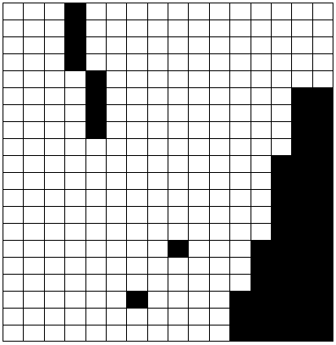
Raster
REMEMBER
Pixels

Slide 20
POSSIBLE ATTRIBUTES
Name of hospital
Street address
Postal address
Geographical Coordinates
Number of beds
Number of doctors
Number of nursing personnel
Intensive care unit
Paediatric centre
Number of operating theatres

Slide 21
HOW TO USE GIS?
Grade 12 Paper 2 GIS Question recently asked questions relating to analysis
Determine/identify/name which data layers to use in solving a problem?
Without thinking about GIS identify factors/issues that play a role or relates to the problem
This will also be the data layers needed in the analysis to get the solution to the problem?

Slide 22
Shops
Floods
Crime
Available plots
Costs of plots
Distance to other shops
Client base
Client buying habits
Central place
Influence sphere
Relief (contours)
History
Rainfall figures
50 year floodline
Development above 50yfl
Development below 50yfl
Bridges
Residential areas affected
Evacuation routes
Type
Location
Time
Frequency
Risk zones
Neighbourhood characteristics

Slide 23
Telecom
Terrain Analysis
Relief (contours)
Viewsheds
Intervisibilty
Distance between towers
Signal strength
Vegetation type
Vegetation structure
Soil type
Soil texture
Soil moisture
Slopes
Aspect
Surface roughness

Slide 24
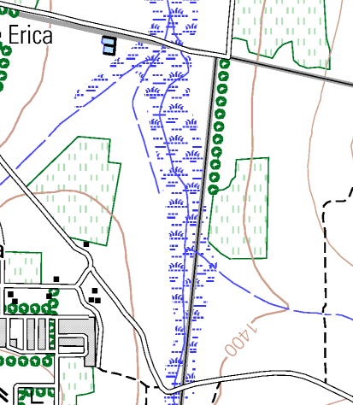
Application P2 Nov 2014
Create a bufferzone of 250m around marsh/vlei area
Remember that 250m in reality will be 5mm on a 1:50 000 map

