Slide 1
Human Ear
Sense organ for hearing and balance
Presenter: Ms T. Zibobo
SES-Life Sc
CHE

Slide 2
Content (as per exam guidelines)

Slide 3
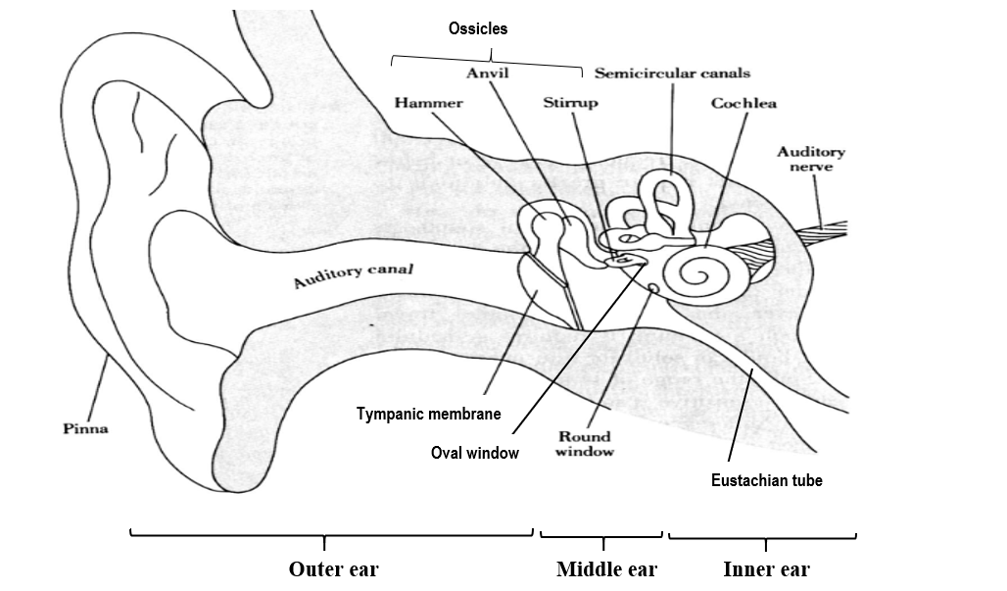
Structure of the human ear
The ear consists of three regions – The air-filled outer ear, air-filled middle ear & fluid-filled inner ear

Slide 4
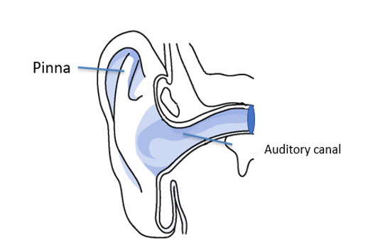
The outer ear
Made up of the cartilaginous pinna and an
auditory canal.
The pinna projects slightly out of the head
to trap & direct sound waves through the
auditory canal to the tympanic membrane.
The auditory canal conducts sound waves to
the tympanic membrane.
Cerumen(wax) and hairs in the auditory
canal prevent entry of small organisms into
the ear.
Cerumen also prevents the tympanic membrane
from drying out.

Slide 5
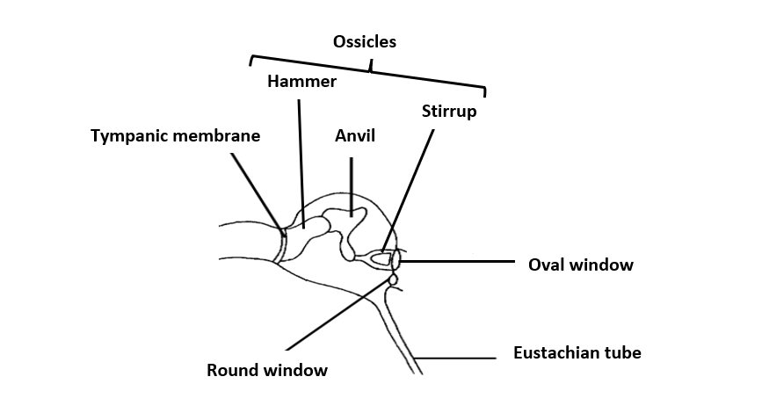
The middle ear
Is an air filled cavity within the temporal
bone of the skull.
It is separated from the outer ear by the
tympanic membrane/tympanum (eardrum)
It is separated from the inner ear by the
oval window and the round window.
Within the middle ear there are three
small bones (ossicles) arranged from
largest to smallest i.e. malleus (hammer) ,
incus (anvil) , and the stapes (stirrup).
The stirrup is attached to the oval window; the anvil
lies between the hammer and the stirrup.

Slide 6
Middle ear (continued)
The middle ear is connected to the pharynx
by the Eustachian tube.
Normally, the opening of Eustachian tube is closed.
It opens up during swallowing, yawning and sneezing
allowing air into middle ear and out .
For hearing to occur properly the pressure
in the middle ear must be equal to pressure in the
outer ear (atmospheric pressure)
Note: A difference in pressure can be produced with
sudden changes in altitude (e.g. in ascending/descending
elevator or airplane)
Unequal pressure (outside & in middle ear) can stretch
the tympanic membrane resulting in pain
What can one do to equalise the pressure ?

Slide 7
Functions of the middle ear
Tympanic membrane vibrates and transmits
vibrations to the ossicles
The ossicles transmits vibrations from the
tympanic membrane to the inner ear.
They also amplify (intensify) the vibrations.
The Eustachian tube equalises pressure on
either side of the tympanic membrane
The tympanic membrane covers a larger
surface area than the oval window,
concentrating sound waves on
to a smaller area, thus amplifying the sound
Oval window transmits vibrations to the inner ear
The round window absorbs the pressure set up
in the inner ear and releases it into the middle
ear.

Slide 8
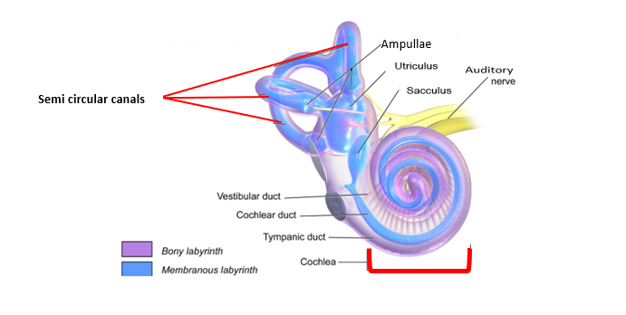
The inner ear
Is a fluid filled cavity made up of the bony and a membranous sacs and tubes
Bony part of inner is filled with perilymph and has a shape identical to that of the membranous part of inner ear
Membranous part of inner ear is filled with endolymph
Inner ear has three parts:
- Semicircular canals (at different angles)
- Vestibule (utriculus and sacculus)
- Cochlea (is coiled)

Slide 9
Inner ear (continued)
The base of the semicircular canals are enlarged and called ampullae
Ampullae contain receptors for balance(receptors to be discussed later)
Utriculus and sacculus contain receptors for balance
Cochlea contains receptors the for hearing

Slide 10
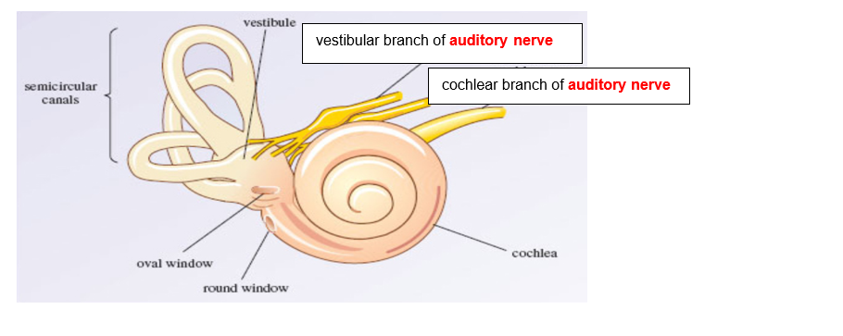
Functions of parts of the inner ear
The semicircular canals, sacculus and utriculus are concerned with
balance and equilibrium.
Cochlea is concerned with hearing
The branch of the auditory nerve arising from the semicircular canals and the vestibule transmit impulses to the cerebellum
The branch of the auditory nerve arising from cochlea transmits sound impulses to the cerebrum

Slide 11
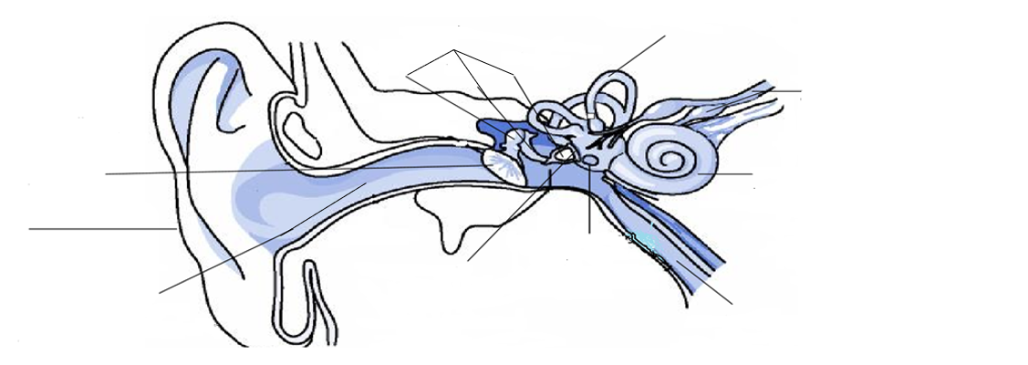
THE PARTS OF THE EAR AND THEIR FUNCTIONS
10……………..
Function
9………………Function
8………………Function
1……………Function
7……………Function
2…………..Function
5…………..Function
4……………Function
3……………Function
6………………Function

Slide 12
10. Ossicles
Transmit vibrations from the tympanic membrane to inner ear
9. Semi circular canals
Responsible for balance
8. Auditory nerve
Transmits impulses to the brain
1. Tympanic membrane
Transmits sound vibrations
to middle ear
7. Cochlea
Has receptors for hearing that convert sound waves into impulses
2. Pinna
Directs sound waves to tympanic membrane
5. Round window
Absorbs pressure from the inner ear
4. Oval window
Transmits sound vibrations to the inner ear
3. Auditory canal
Transmits sound waves to tympanic membrane
6. Eustachian tube
Equalises pressure on either side of the tympanic membrane

Slide 13
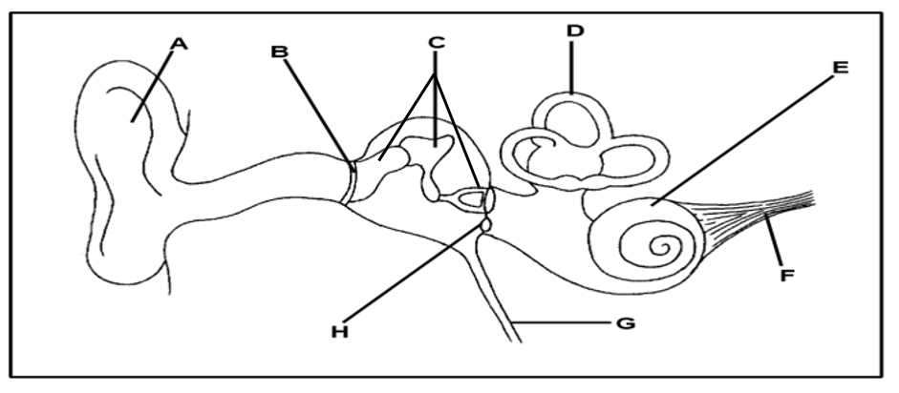
QUESTIONS
1.1 The diagram below represents ear of humans
1.1.1 Give the LETTER and the NAME of the part that :
(a) Collects and directs sound waves into the auditory canal (2)
A ✓- Pinna ✓
(b) Transmits impulses to the brain (2)
F ✓ - Auditory nerve ✓
(c) Allows pressure to equalise between the outer ear and the middle ear (2)
G ✓ - Eustachian tube ✓
(d) Absorbs sound waves to prevent an echo (2)
H ✓ - Round window ✓
(e) Has receptors for balance (2)
D ✓ - Semicircular canals ✓

Slide 14
QUESTIONS
1.1.2 Identify the structures numbered C and state their function. (3)
Ossicles ✓
The ossicles transmit vibrations from the tympanic membrane to the inner
ear. ✓
They also amplify the vibrations ✓
1.1.3 Explain the result if part G is blocked with mucus (4)
- Air will not be taken in ✓ /released
- to equalise pressure ✓ on both sides of the tympanic membrane ✓
- Tympanic membrane/ ossicles may not vibrate freely ✓
- This may lead to the tympanic membrane bursting ✓ and
- therefore could lead to hearing loss ✓ /deafness/ pain (Any 4) (4)

