Slide 1
FUNCTIONING OF THE EAR IN HEARING AND BALANCE
SUBJECT: LIFE SCIENCES
SUBJECT ADVISOR NAME: Ms Dlamini. P.N
DISTRICT: ORTID

Slide 2
EXAMINATION GUIDELINES 2017
Functioning of the human ear in:
• Hearing (include the role of the organ of Corti, without details of its structure)
Balance (include the role of maculae and cristae, without details of their structure)

Slide 3
PARTS OF THE EAR INVOLVED IN HEARING

Slide 4
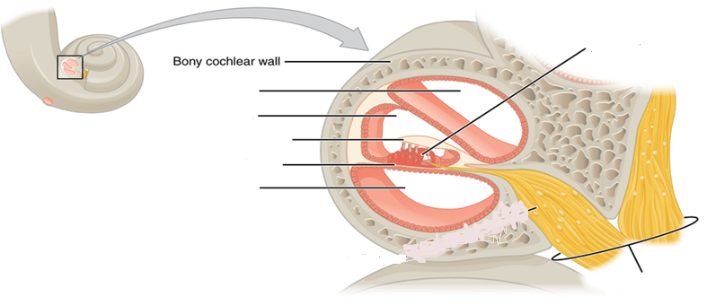
HEARING PROCESS
Organ of Corti
Perilymph
Endolymph in cochlear canal
Basilar membrane
Perilymph
Auditory nerve

Slide 5
HEARING PROCESS ANIMATION- INDICATE THE EVENTS IN THE HEARING PROCESS THAT OCCUR FROM ARROW A TO F
F
A
B
C
D
E

Slide 6
PROCESS OF HEARING
The pinna traps and directs sound waves into auditory canal towards the tympanic membrane.
The tympanic membrane vibrates as the sound waves strike against it
Vibrations are passed to the ossicles which vibrate and amplify vibrations which are then transmitted to the oval window
Vibrations of the oval window set up pressure waves of the perilymph which are then transferred to endolymph in the cochlea.
Organ of Corti in the cochlea is stimulated by pressure waves and converts the stimulus to an impulse
Impulse is transmitted by the auditory nerve to cerebrum where the impulse is interpreted as a specific sound.
Pressure waves in the cochlea are absorbed by round window into the middle ear.

Slide 7
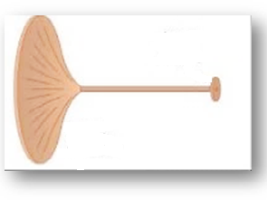
PATH OF SOUND WAVES THROUGH THE EAR
Tympanic membrane area
Area of oval window
The area of the tympanic membrane is much larger than the area of the oval window
Therefore sound is amplified in the middle ear
Amplification of vibrations

Slide 8
STRUCTURES INVOLVED IN BALANCE AND EQUILIBRIUM
Semi circular canals
Utriculus and succulus
vestibular branch of auditory nerve
Auditory nerve
Cochlear nerve
ampulla
cristae
maculae
Sensory hair cells
Sensory hair cells
endolymph

Slide 9
BALANCE AND EQUILIBRIUM IN AMPULLA
When the body is stationery, the endolymph does not move, there is no stimulus on the cristae
sudden change in speed and direction of body(rotation)
causes movement of endolymph which stimulates the cristae
Cristae changes stimulus to an impulse
Impulse transported by auditory nerve to cerebellum,
Cerebellum restores balance by coordination of skeletal muscles
ampulla
Cone shaped jelly substance
cristae
impulse

Slide 10
BALANCE AND EQUILIBRIUM- AMPULLAE OF SEMI CIRCULAR CANALS
cristae in the ampulla
cerebellum
CONTROL CENTRE
STIMULUS
Movement of endolymph in ampullae due to change in speed and direction of the body
EFFECTOR
skeletal muscles co-ordinated to restore balance and equilibrium
RECEPTOR

Slide 11
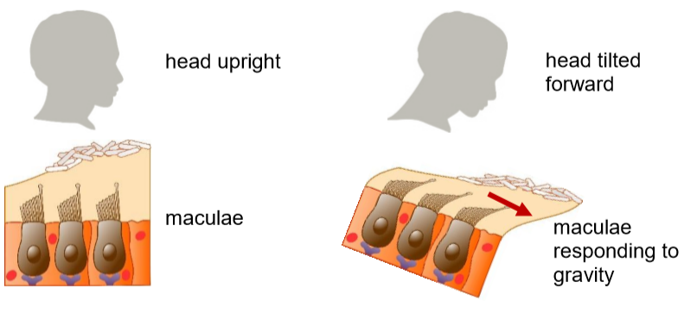
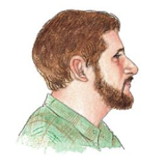
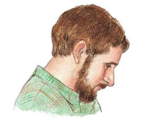
BALANCE AND EQUILIBRIUM (UTRICULUS AND SUCCULUS)
When head is upright, there is equal tension on maculae, therefore maculae are not stimulated .
When the position of head changes (bent) maculae are stimulated by the pull of gravity
There is unequal tension on the maculae ,which serves as a stimulus
Maculae change stimulus to impulse which is transmitted to the cerebellum
Cerebellum restores balance and equilibrium by coordinating the skeletal muscles .
-

Slide 12
BALANCE AND EQULIBRIUM-UTRICULUS AND SUCCULUS
maculae in the utriculus and succulus
cerebellum
CONTROL CENTRE
STIMULUS
Pull of gravity due to the change in the position of the head
EFFECTOR
skeletal muscles co ordinated to restore balance and equilibrium
RECEPTOR

Slide 13
ACTIVITY 1
1.1 Describe how an increased production of mucus in the nose and throat may leading to the bursting of part E (5)
-The Eustachian tube will be blocked
-pressure on either side of tympanic membrane will not be equalized,
Pressure exerted on tympanic membrane, causing it to burst, no vibrations in middle ear
no stimulation of organs of Corti,
No impulse transmitted to cerebrum, no hearing
1.2 Explain why fusion at part A may lead to hearing loss (4)
Vibration will not amplified, low intensity of pressure waves generated in cochlea
No stimulation of Organ of Corti, no impulse generated, no hearing

Slide 14
ACTIVITY 1 continuation
1.3 Which part of the brain will receive impulses from part C? (1)
Cerebrum
1.4 Explain the consequence to the human body if
(i) part B is damaged. (4)
Impulses from maculae, cristae will not be transmitted to cerebellum, no balance and equilibrium
Impulses from the organ of Corti will not be transmitted to the cerebrum, no hearing will occur
(ii) part D becomes hardened- (2)
-pressure waves in the cochlea will not be absorbed to the middle ear, there will be distortion of sound.
Effective hearing will not occur

Slide 15
ACTIVITY 1 continuation
1.5 Explain the significance of the spiral shape of part C.(2)
-increased surface area to accommodate many organ of Corti
Vibrations of lowest frequency are detected
Impulse transmitted for effective hearing
1,6 State three structural features of the ear that allow amplification of vibrations (4)
-Tympanic membrane has a large surface area
Oval window has a small surface area compared to the tympanic membrane
The ossicles decrease in size from the hammer to the stirrup

