Slide 1
EAR: HEARING DEFECTS AND THEIR TREATMENT PRESENTER: MADIKIZELA B.N OR TAMBO INLAND
RESPONDING TO THE ENVIRONMENT (HUMANS)

Slide 2
EXAMINATION GUIDELINES 2017
Cause and treatment of the following hearing defects:
Middle ear infection (the use of grommets)
Deafness (the use of hearing aids and cochlear implants)

Slide 3
CAUSES OF HEARING LOSS- POINT OF INTEREST
HEARING LOSS
REDUCED ABILITY TO HEAR SOUNDS
DEAFNESS
PERSON CANNOT UNDERSTAND SPEECH THROUGH HEARING
EVEN WHEN SOUND IS AMPLIFIED
AGE
HEREDITY
HEAD INJURY/ TRAUMA
VIRUS OR DISEASE ( RUBELLA DURING PREGNANCY)
MALFORMATION OF THE INNER EAR
USE OF PARTICULER DRUGS DURING PREGNANCY
AUTO IMMUNE INNER EAR DISEASE
EXPOSURE TO LOUD NOISES

Slide 4
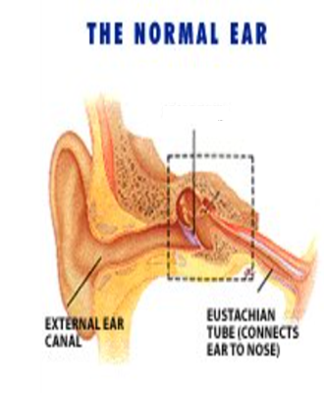
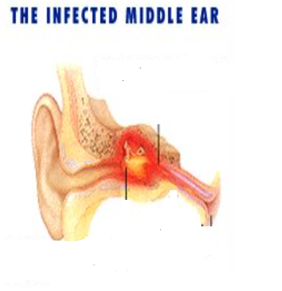
MIDDLE EAR INFECTIONS
Micro-organisms cause the production of fluids in the middle ear,
the fluid cannot then drain through the eustachian tube as it is swollen,
The fluid caused by the infection makes the Eustachian tube to be swollen, inflamed and clogged.
the accumulation of the fluids increases pressure in the middle ear causing the ear to ache.
Eustachian tube closes and pus and fluid form
Viruses , bacteria enter the tube from the throat
WHY ARE CHILDREN MOSTLY AFFECTED BY MIDDLE EAR INFECTIONS
Fluid puts pressure on the tympanic membrane causing redness and pain

Slide 5
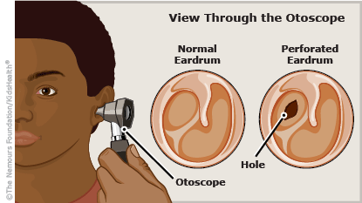
TREATMENT 0F MIDDLE EAR INFECTIONS
ANTIBIOTICS- clear infection
GROMMETS- tiny plastic buttons with a fine hole down the middle may be inserted into the eardrum to allow drainage of the middle ear until the Eustachian tube recovers.

Slide 6
CAUSES OF IMPAIRED HEARING( reduced hearing/ hearing loss
Explain how damage to the following parts of the ear affects hearing?
Hardened wax ( A)
Perforated tympanic membrane (B)
Fused ossicles (C)
Hardening of ear tissues such as oval window and round window (D)
Blocked Eustachian tube (E)
Damage to hair cells in the cochlea (F)
due to disease, ageing or injury
Injury to parts of the ear, nerves or parts of brain responsible for hearing (F)
A
C
D
B
G
F
E

Slide 7
TREATMENT OF HEARING DIFFICULTIES
HEARING AIDS
Hearing aids are devices worn in or on the ear that amplify sound,
Hearing aids work much like a microphone and speaker system
A microphone picks up sounds in the environment around the user
This amplified and modified sound is easier for the ear to pick up than regular, unmodified sound

Slide 8
TREATMENT OF HEARING DIFFICULTIES
Cochlear implants bypass the “hearing” parts of the inner ear entirely.
They turn sound into electrical impulses and use those impulses to directly stimulate the auditory nerve.
The auditory nerve perceives these electrical signals as sound waves and transmits them to the brain.
Cochlea implant
Notes:
HOW A COCHLEAR IMPLANT WORKS

Slide 9
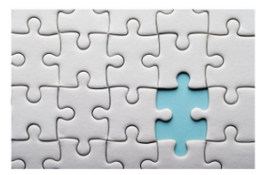
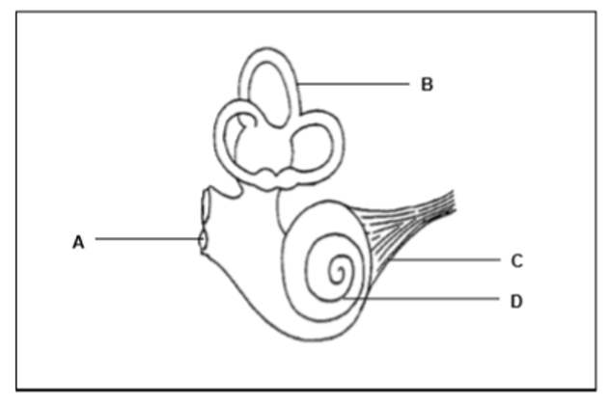
ASSESSMENT
1.The diagram below shows part of the human ear
1.1 Explain why people with middle ear infections
are advised not to go by aeroplane (4)
1.2 Explain how a grommet may decrease the
pain caused by fluid accumulation in the middle ear. (4)
1.3 Explain the consequence to the human body if:
(a) Receptor in part D is damaged (4)
(b) Part E becomes hardened (4)
1.4 Recommend with reasons a possible
treatment option for a person in Q1.3(a) (3)
E

Slide 10
1.1Why people with middle ear infections are advised not to travel by aeroplane
Mucus in the middle ear will block Eustachian tube.✓
Pressure on either side of tympanic membrane will not be equalized ✓
pressure exerted on the tympanic membrane✓
cause tympanic membrane to burst✓
leading to hearing loss ✓

Slide 11
1.2 Explain how a grommet may decrease the pain caused by fluid accumulation in the middle ear. (4)
Fluid in the middle will be drained by the grommet ✓
Less pressure on the tympanic membrane✓
Less stimulation of pain receptors✓
Less pain will be felt✓

Slide 12
ASSESSMENT
1.The diagram below shows part of the human ear
1.3 Explain the consequence to the human body if:
(a) Receptor in part D is damaged (4)
stimulus will not be changed to an impulse✓
Impulse from the cochlea will not be transmitted✓
to the cerebrum✓
No hearing will occur✓
(b) Part E becomes hardened (4)
Part A will not be able to vibrate✓
The round window will not absorb pressure waves ✓
in the cochlea✓
There will be distortion of sound✓
E

Slide 13
ASSESSMENT
1.4 Recommend with reasons a possible
treatment option for a person in Q1.3(a) (3)
Insertion of cochlear implant through surgery✓
Electrical signals will be generated by the cochlear implant ✓
The electrical signals will be directly taken to the auditory nerve✓
Auditory nerve will transmit impulses to the cerebrum✓
Interpretation of sound will occur ✓

