Slide 1
Life at the Molecular Cellular and Tissue Level
TOPIC: ANIMAL TISSUES - EPITHELIAL, MUSCLE & NERVE TISSUES
PRESENTER: MS Z. SANDA
LIFE SCIENCES PLANNER (EC)

Slide 2
CAPS DOCUMENT: PG. 28
WILL NOT BE COVERED IN 2020 DUE TO COVID-19

Slide 3
What is a Tissue?
A tissue is as a group of cells that have the same structure that work together to carry out the same function
Two or more tissues organized to carry out a particular function form organs and groups of organs with related functions make up the different organ systems.

Slide 4
Levels of Organization in the Human Body

Slide 5
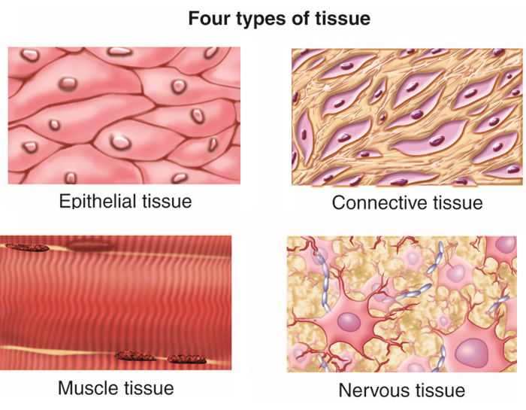
Types of Animal Tissues
Most animal bodies are made up of four different types of tissue:
1. Epithelial tissue
2. Connective tissue
3. Muscle tissue
4. Nervous tissue

Slide 6
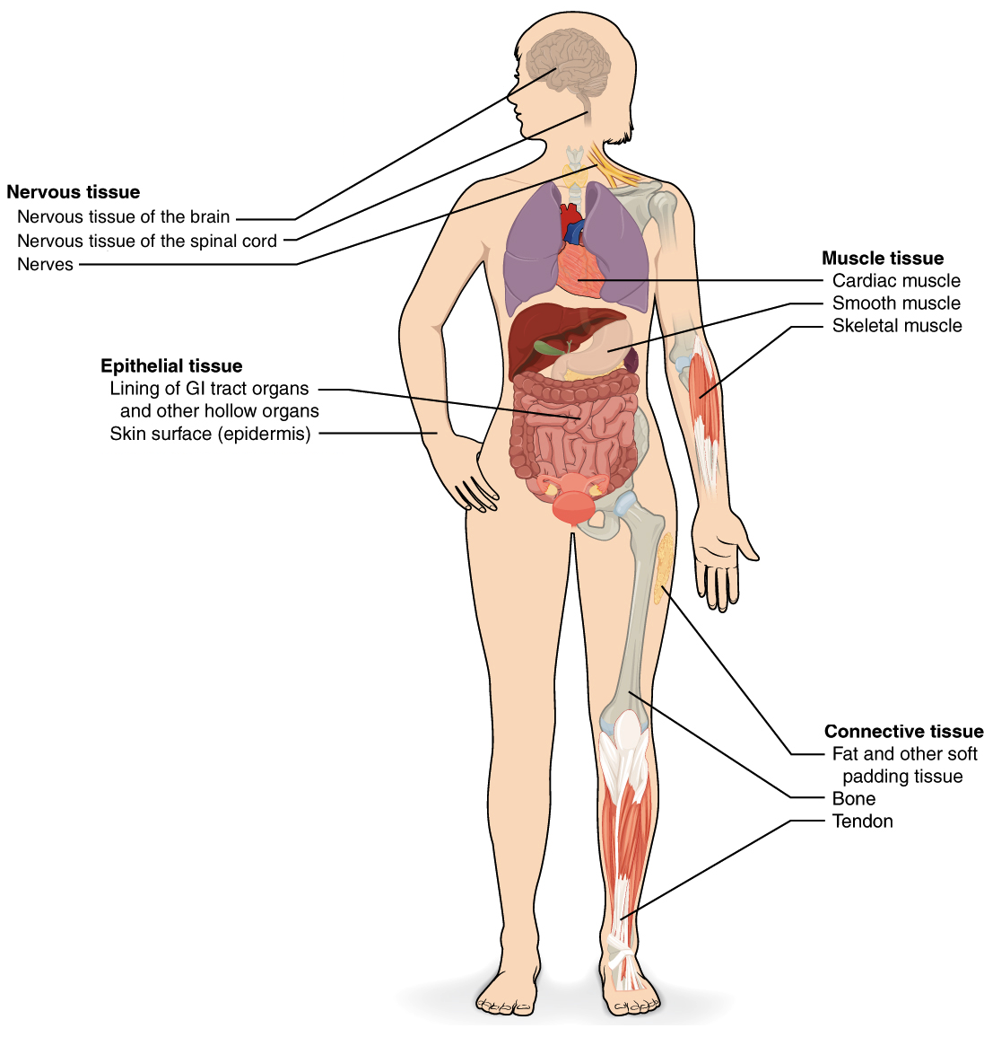
FOUR TYPES OF ANIMAL TISSUES

Slide 7
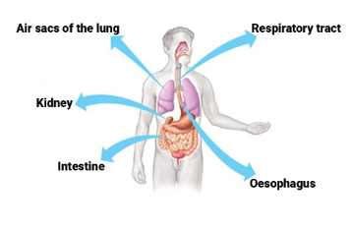
Epithelial Tissue
Forms the outer layer of the body and also lines many of the body cavities where it has a protective function.
The tissue has tightly-joined, closely-packed cells.
Epithelial cells protect against mechanical injury, invasive microorganisms, and fluid loss and also provides surface for absorption, excretion and transport of molecules

Slide 8
Classification of Epithelial Tissues
Epithelial tissues can be classified based on the number of cell layers and the shape of cells
On the basis of the number of cell layers we have:
Simple epithelium – made up of a single layer of cells
Compound epithelium - has many layers of cells

Slide 9
Simple Epithelial Tissues
There are 5 types of simple epithelial tissues but we will look at 4 of these:
Squamous
Cuboidal
Columnar
Ciliated
(Pseudostratified)

Slide 10
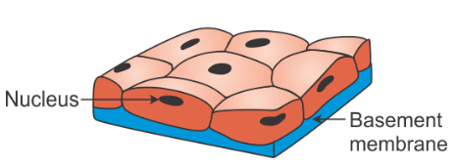
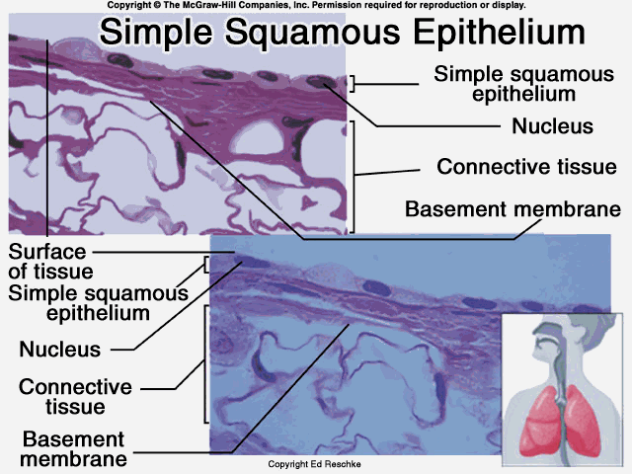
Squamous Epithelium
LOCATION: Lines the mouth ,alveoli in the lungs, blood vessels
STRUCTURE: Thin, large flat cells which are closely packed cells and have elliptical nuclei located mostly at the centre of the cell
FUNCTION: Lines surfaces, protection and allows certain substances to pass through

Slide 11
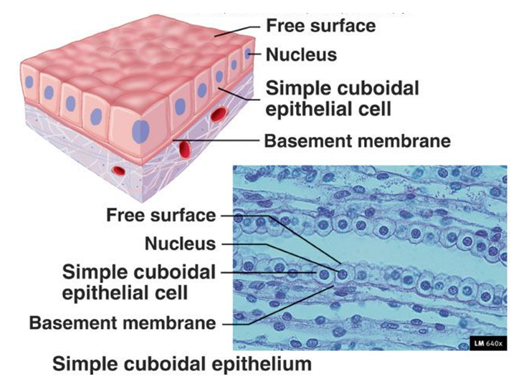
Cuboidal Epithelium
LOCATION: Kidney tubules or glands (regions of the body responsible for excretion).
STRUCTURE: Cells are cuboidal in shape with rounded nuclei lying in the centre of the cell
FUNCTION: Secretion and transportation in glands, reabsorption and excretion.

Slide 12
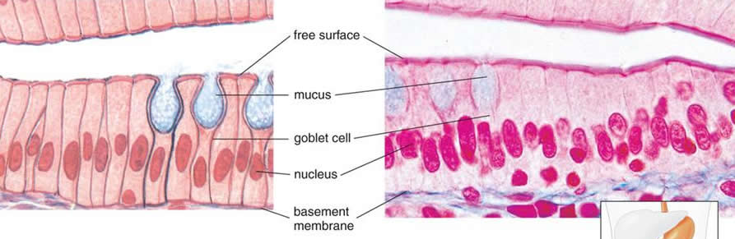
Columnar Epithelium
LOCATION: Digestive tract e.g. stomach, intestines and gall bladder, reproductive organs
STRUCTURE: Cylindrical cells lying side by side with slightly elongated nuclei located at the base of the cells. Sometimes glands e.g. goblet cells are found in columnar epithelium forming glandular epithelium
FUNCTION: Provides support to other cell types. Absorbs food, water and minerals. Contains goblet cells to secrete mucous

Slide 13
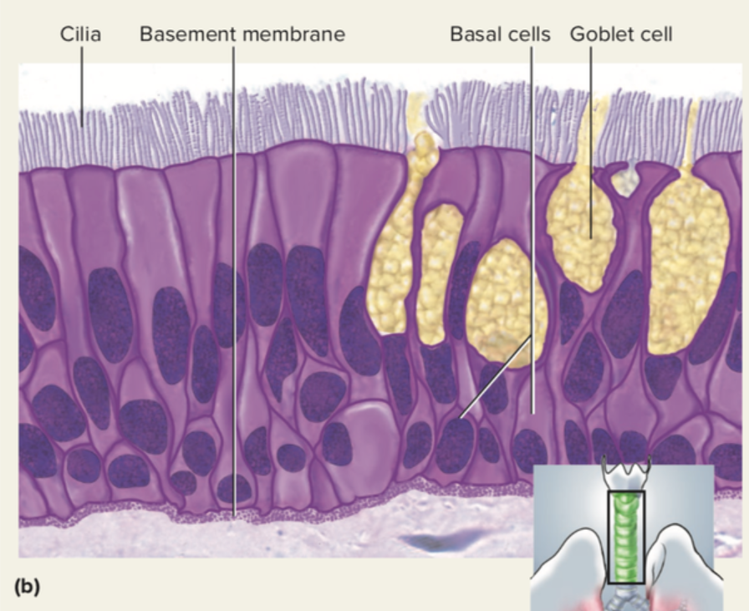
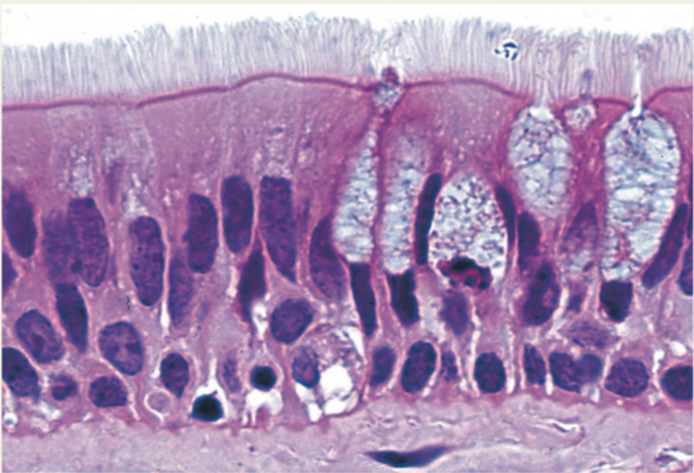
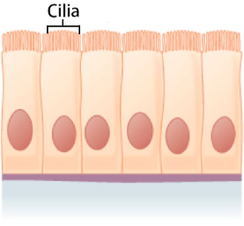
Ciliated Epithelium
LOCATION: Trachea and bronchi of the respiratory system and in the fallopian tubes of the female reproductive tract
STRUCTURE: Ciliated columnar epithelium contain little finger-like projections called cilia.
FUNCTION: Mucous from goblet cells traps dust. Beating cilia drives out the mucous with the dust. Sense organs – helps detect stimuli

Slide 14
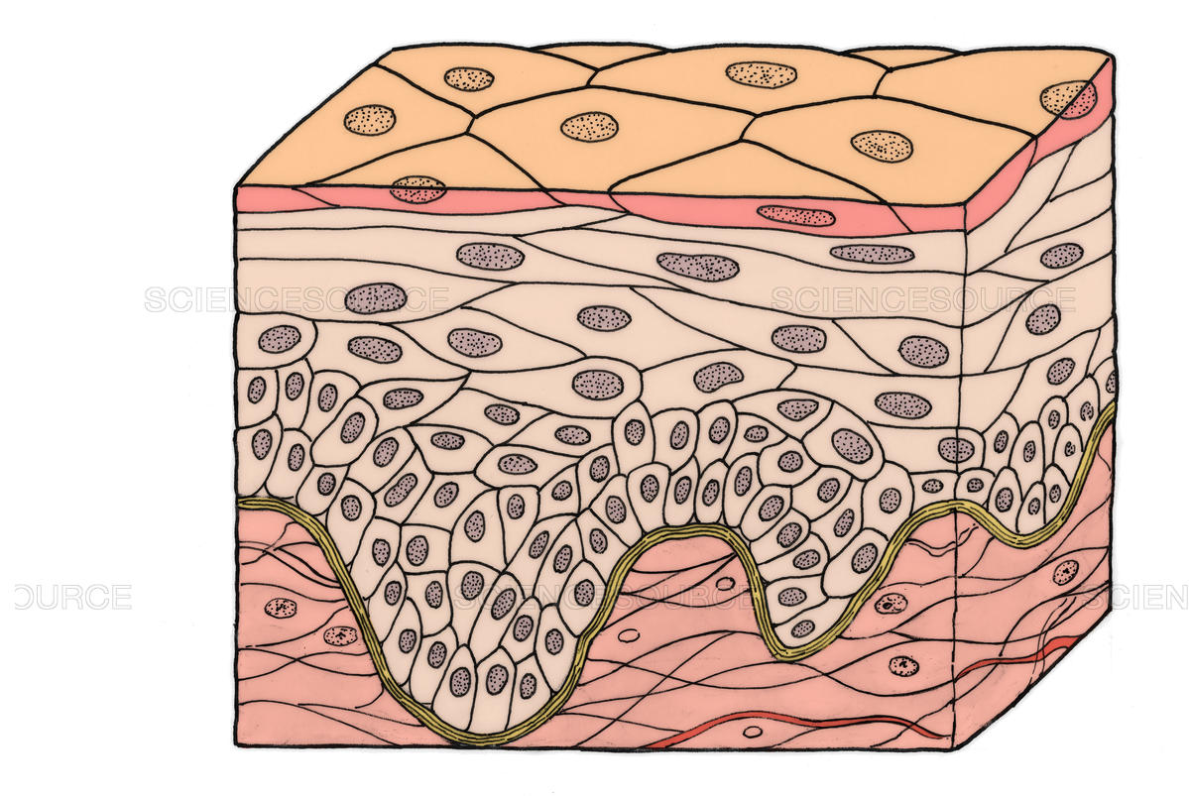
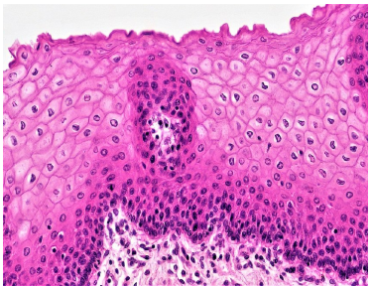
COMPOUND EPITHELIUM
cc
Compound epithelium is made up of many layers of cells
An example is Stratified Epithelium which is made up several layers of epithelial cells of the same shape or different shape
It is found lining the skin.

Slide 15
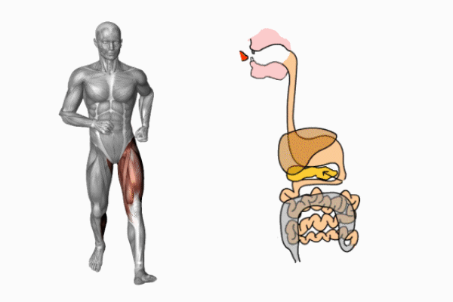
Muscle Tissue
Enables various forms of movement, both voluntary and involuntary.
Voluntary movement means it is consciously controlled by one’s will whereas involuntary means it occurs automatically without control of one’s will
Peristalsis:
Food movement through the alimentary can- an involuntary movement
Walking:
a voluntary movement

Slide 16
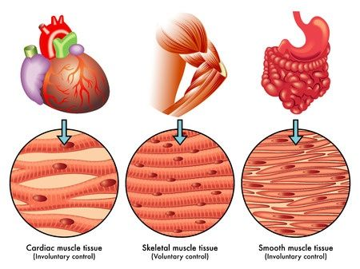
Types of Muscle Tissue
There are 3 types of Muscle Tissue:
Skeletal Muscle
Smooth Muscle
Cardiac Muscle

Slide 17
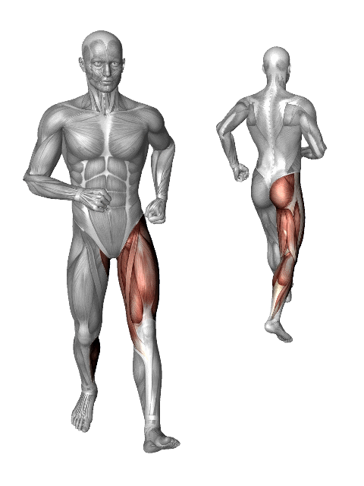
Skeletal muscle
is a voluntary muscle.
It is striated in appearance.
has regularly arranged bundles.
is anchored by tendons and is used to effect skeletal muscle movement such as locomotion and maintain posture.
The muscles have a reflex action but can also respond to conscious control.
The voluntary movements are done with the help of skeletal muscles

Slide 18
Skeletal Muscle

Slide 19
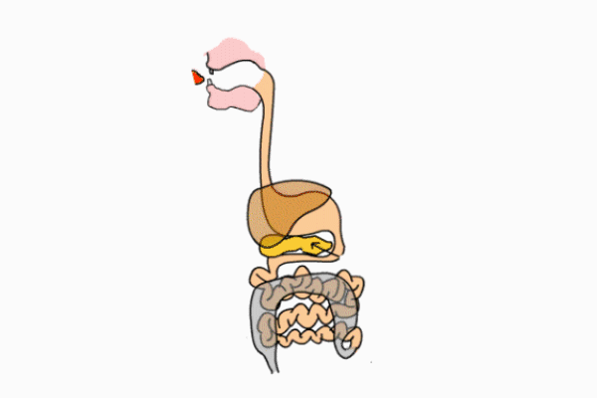
Smooth Muscle
is an involuntary, non-striated muscle with tapered ends. It is found within the walls of blood vessels such as arteries and veins.
Smooth muscle is also found in the digestive system, urinary tract and in the trachea.
It is responsible for involuntary rhythmic contractions of peristalsis required for moving food down the alimentary canal, and for the dilation and constriction of blood vessels to control blood pressure

Slide 20
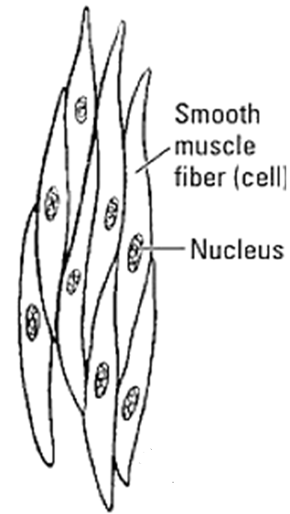
Smooth Muscle

Slide 21
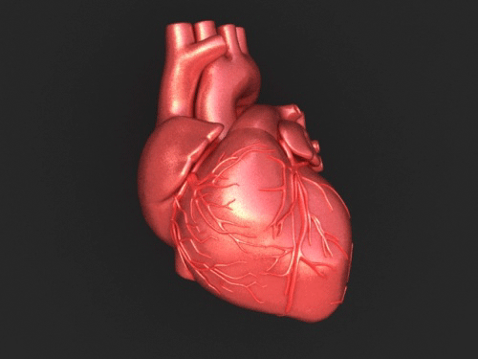
Cardiac Muscle
is the major tissue making up the heart.
It is an involuntary muscle that is striated in appearance.
However, unlike skeletal muscle, cardiac muscle connects at branching, irregular angles.
The connected branches help with coordinated contractions of the heart
Involuntary movement of the heart is brought about by the cardiac muscle

Slide 22
Cardiac Muscle

Slide 23
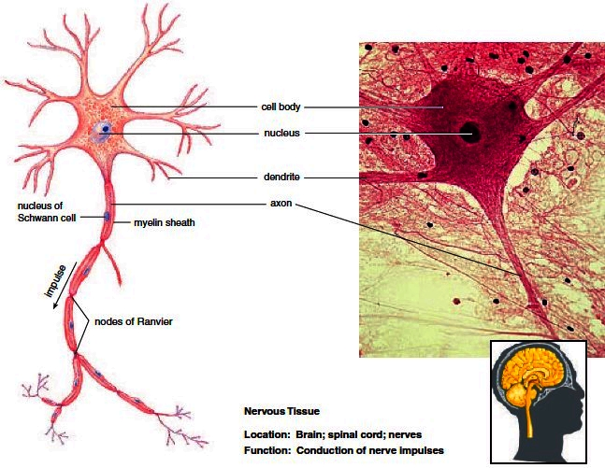
Nervous Tissue
Is responsible for the carrying of electrical and chemical signals and impulses from the brain and central nervous system to the periphery, and vice versa.
Nerves are made up of cells called neurons.
Neurons can be classified by their function, structure or their special use.

Slide 24
Types of Neurons
Sensory neurons carry impulses from the receptors to the central nervous system (CNS)
Motor neurons carry impulses from the CNS to the muscle cells and glands, which are effectors.
Connector Neurons: carry impulses to the motor neurons and connect neurons together.

Slide 25
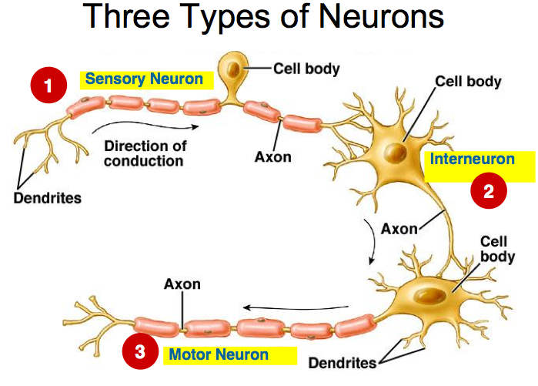

Slide 26
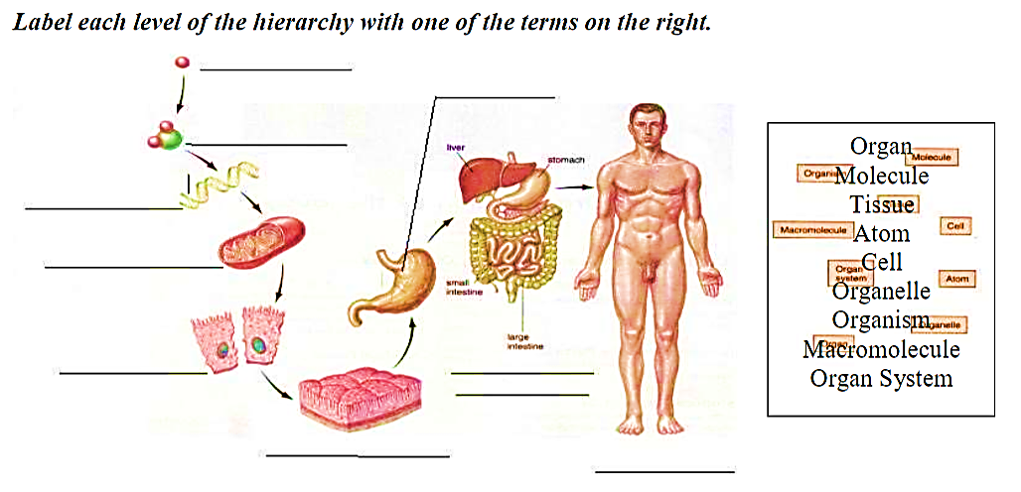
ACTIVITY
Atom
Organ
Molecule
Macromolecule
Organelle
Cell
Organ System
Tissue
Organism

Slide 27
Muscle
Name the four major types of tissues in the human body labelled A-D in the diagram
Nervous
Epithelium
D
Connective

Slide 28
Name and describe the general function of each of the following tissues
protect against mechanical injury, invasive microorganisms, and fluid loss and also provides surface for absorption, excretion and transport of molecules
Is responsible for the carrying of electrical and chemical signals and impulses from the brain and central nervous system to the periphery, and vice versa.
enables various forms of movement, both voluntary and involuntary

Slide 29
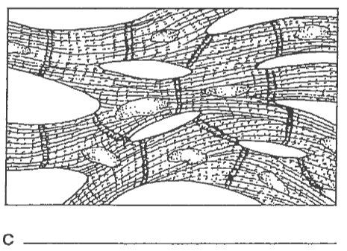
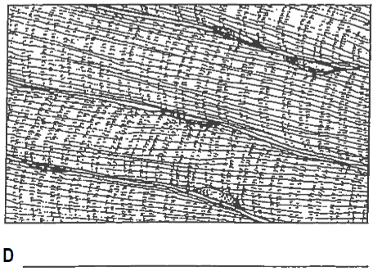
Identify tissues labelled A-D in the diagrams below
Squamous epithelium
Cuboidal epithelium
Cardiac Muscle
Skeletal Muscle

