Slide 1

HUMAN ENDOCRINE SYSTEM
SUBJECT: LIFE SCIENCES
PRESENTER: MAMPOFU N.P.
ORTI DISTRICT

Slide 2

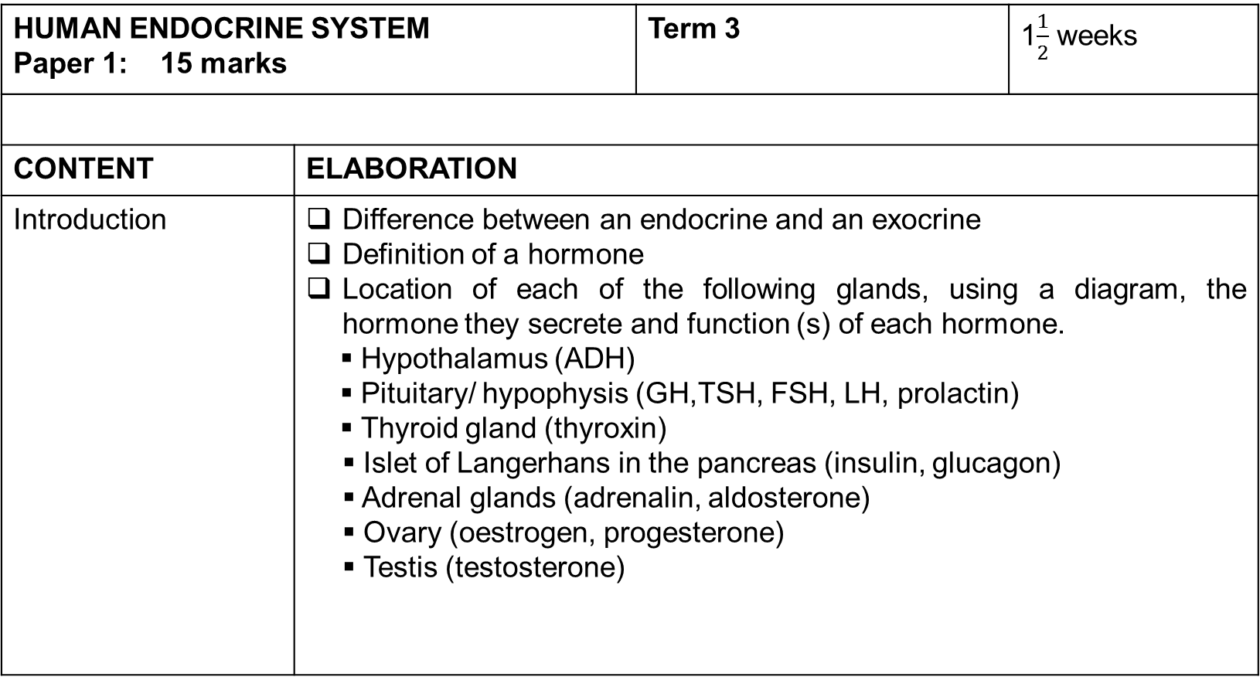
EXAMINATION GUIDELINES 2017
HUMAN ENDOCRINE SYSTEM Paper 1: 15 marks |  | Term 3 | 1$\frac{1}{2}$ weeks
CONTENT | ELABORATION
Introduction | Difference between an endocrine and an exocrine Definition of a hormone Location of each of the following glands, using a diagram, the hormone they secrete and function (s) of each hormone. Hypothalamus (ADH) Pituitary/ hypophysis (GH,TSH, FSH, LH, prolactin) Thyroid gland (thyroxin) Islet of Langerhans in the pancreas (insulin, glucagon) Adrenal glands (adrenalin, aldosterone) Ovary (oestrogen, progesterone) Testis (testosterone)

Slide 3
TERMINOLOGY
Hormone: is an organic chemical, secreted in small quantities by the endocrine glands into the blood stream.
Endocrine gland: ductless glands that secrete hormones into the bloodstream.
Exocrine gland: glands that do not produce hormones instead they pour their secretion directly into ducts.
Target organs: organs which react to specific hormones received through the bloodstream.
Coordination: joint linking and working together of systems and activities within the body to bring about a harmonious response.
Homeostasis: the process of maintaining a constant optimal internal environment.

Slide 4
Differences Between an Endocrine and an Exocrine Gland
Have no ducts/ are ductless.
Secrete hormones.
Pour their secretions directly into the bloodstream to reach target organs.
Have ducts.
Secrete enzymes or digestive juices.
Pour their secretion directly into ducts e.g. salivary duct of the salivary gland.

Slide 5
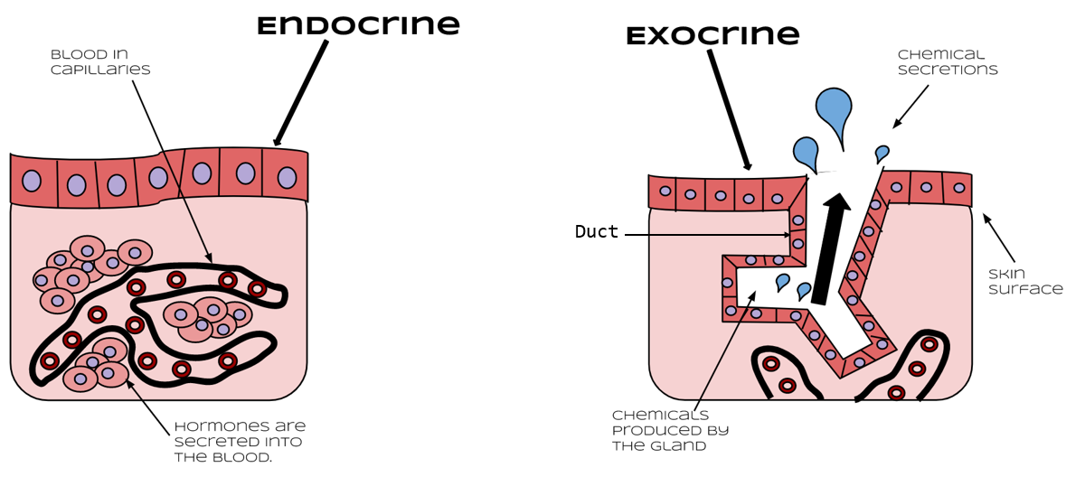

Slide 6
HORMONES
They are organic chemical messengers which are mostly protein.
They are secreted by endocrine glands and carried in the blood stream to their target organs to regulate them and cause responses.
Their functions are to:
regulate secretions from various glands.
Control growth and development of the body.
Maintain homeostasis.
Regulate metabolism and energy release.
Control the process of reproduction.

Slide 7
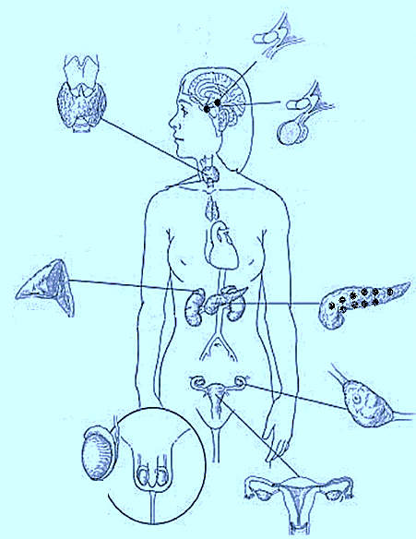
Locations of some Important Endocrine Glands
Hypothalamus
located beneath the thalamus in the brain
Thyroid gland
Situated in the anterior part of the neck where it straddles the trachea, just below the pharynx
Pituitary gland/ Hypophysis
Situated in a small bony cavity on the floor of the skull and connected to the hypothalamus
Adrenal gland
Situated in anterior end of each kidney
Islets of Langerhans situated in the pancreas
Testes (males)
situated inside the scrotum, hanging outside the body
Ovaries (females)
In the uterus (womb)

Slide 8

Functions of Endocrine Glands

Slide 9
A. Pituitary gland
It is a pea-sized gland found at the base of the brain. Its posterior lobe is connected hypothalamus, a part of the brain.
GLAND/ ORGAN | HORMONE(S) | FUNCTION | TARGET ORGAN
Pituitary gland – anterior lobe Hypothalamus | Growth hormone Thyroid stimulating hormone (TSH) Follicle stimulating hormone (FSH) Luteinising hormone (LH) Prolactin ADH | Regulates over all growth of the skeletal muscle. Regulates the growth of thyroid gland and secretion of its hormone, thyroxin. Stimulates the development of follicles in the ovary. Stimulates ovulation and formation of corpus luteum in ovaries. Stimulates mammary glands to secrete milk. Promotes reabsorption of water in the kidney. The hormone is stored in the posterior lobe of the pituitary gland. | Skeletal muscle Thyroid gland Mainly ovary Mainly ovary Mammary glands Kidneys

Slide 10
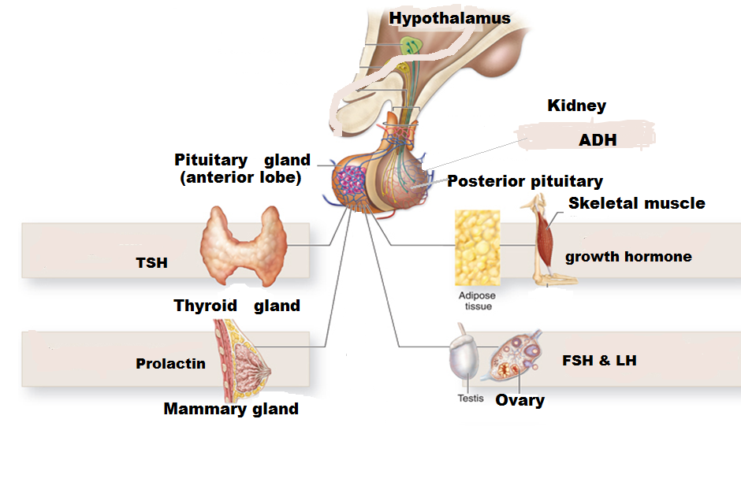
PITUITARY GLAND AS A MASTER GLAND
Pituitary gland / hypophysis is given a nickname, master gland because it controls activity of other glands.

Slide 11
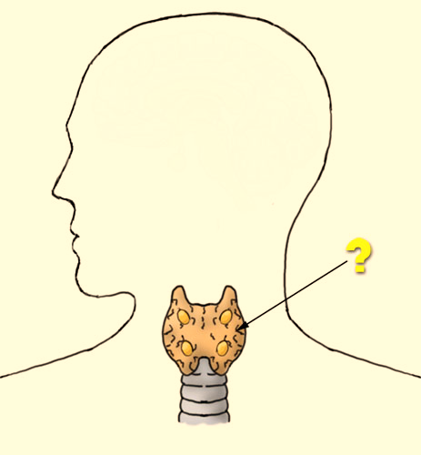
THE ENDOCRINE SYSTEM (continues)
B. Thyroid gland: it is an H-shaped two lobed gland on either sides of the trachea.
GLAND | HORMONE | FUNCTION | TARGET ORGAN
Thyroid gland | Thyroxin | Controls energy production and the basal metabolic rate of all cells. Regulates tissue growth and development in the reproductive and nervous system. | Respiring cells

Slide 12
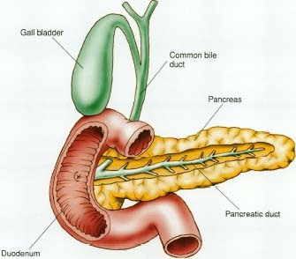
C. ISLETS of LANGERHANS
are found in the pancreas.
Secrete hormones (insulin and glucagon) which regulate the amount of glucose in the blood.
GLAND | HORMONE(S) | FUNCTION | TARGET ORGAN
Islet of Langerhans | Insulin Glucagon | Decreases the amount of glucose in the blood by stimulating: respiring cells to absorb glucose. the utilisation of glucose by cells. the conversion of glucose by liver cells and muscles to osmotically inactive glycogen which is then stored in the liver and muscles. Increases the amount of glucose in the blood by stimulating the liver and muscles to change stored glycogen to glucose which is then add into the blood | Liver, muscles, organs with respiring cells. Liver, muscles

Slide 13
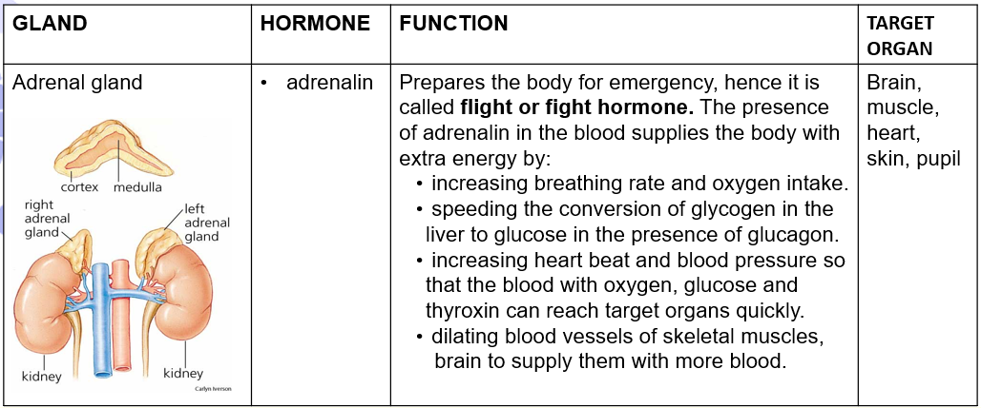
D. Adrenal glands
are found as caps on top of the kidneys.
The outer layer is called cortex and the central part is called medulla.
The cortex secretes aldosterone and medulla secretes adrenalin.

Slide 14
ADRENAL GLAND (continues)
GLAND | HORMONE | FUNCTION | TARGET ORGAN
Adrenal gland | Adrenalin Aldosterone | by constricting the blood vessels to the skin and digestive system to supply them with less blood. increasing the metabolic rate in muscles and brain cells to supply them with more energy so that their activity increases. increasing skeletal muscle tone and sweating. causing pupils to dilate. Regulates the amount of salt in the blood. Assists ADH to regulate the water content of the blood. | kidneys

Slide 15
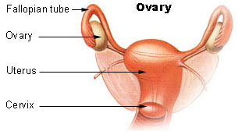
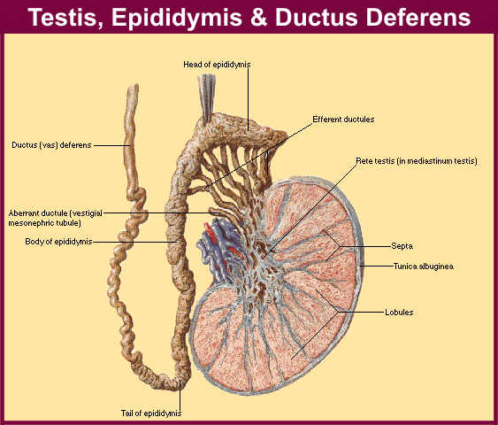
E. GONADS
gonads or reproductive glands in females are called ovaries which are found at the end of fallopian tubes.
In males they are called testis which are found below the abdomen.
GLAND/ ORGAN | HORMONE | FUNCTION | TARGET ORGAN
Ovary Testes | Progesterone and oestrogen Testosterone | Control development of female sex organ and secondary sexual characteristics. Also control menstrual cycle and pregnancy. Controls the development of male sex organs and secondary sexual characteristics. | Uterine walls Seminiferous tubules.

Slide 16
ACTIVITY
Complete the following table by writing the numbers 1.1 to 1.9 in your answer book and next to
each number the correct missing information. (1x9) (9)
Gland | Position in the body | Hormone | Function of hormone
1.1 | 1.2 | TSH | 1.3
1.4 | Below the larynx | 1.5 | 1.6
1.7 | 1.8 | 1.9 | Prepares the body for an emergency
Pituitary gland
At the base of the brain
Regulates the growth and functioning of the thyroid gland.
Thyroid gland
Thyroxin
Controls energy production and metabolism in al cells
Adrenal gland
On-top of the kidneys
Adrenal gland

Slide 17
2. The graph represents a data comparing the growth rate of boys and girls at different ages.
2.1 Between which years did the growth
rate of boys decrease the most? (1)
16-19
2.2.Calculate the decrease in growth rate
of boys during the period mentioned in
above. (2)
7-0= 7 kg/year
2.3 List TWO hormones involved in human
growth. (2)
Growth hormone and thyroxin
2.4 At what age, in year, did girls reach
their final adult size? (1)
At 14

