Slide 1

Endocrine System
Negative feedback mechanism involving:
TSH and Thyroxin; Insulin and Glucagon
PRESENTER: Z. SANDA (Planner Life Sciences – EC)

Slide 2

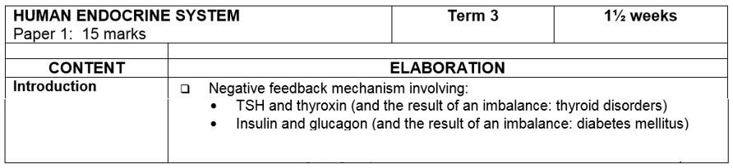
EXAMINATION GUIDELINES

Slide 3
CAPS DOCUMENT PG. 60
INVESTIGATIONS:
Research disorders caused by under- and over secretion of at least one hormone. Different learners should research different hormones. Brief written report

Slide 4
NEGATIVE FEEDBACK MECHANISMS
The secretion of hormones by the endocrine glands is regulated by negative feedback mechanism

Slide 5
DEFINITION OF NEGATIVE FEEDBACK
When a condition in the body changes from the norm, this information is sent to a control center.
Control center the instructs effectors, such as glands and muscles, to send a response that reverses the change.
This is known as negative feedback and is a process by which homeostasis takes place.

Slide 6

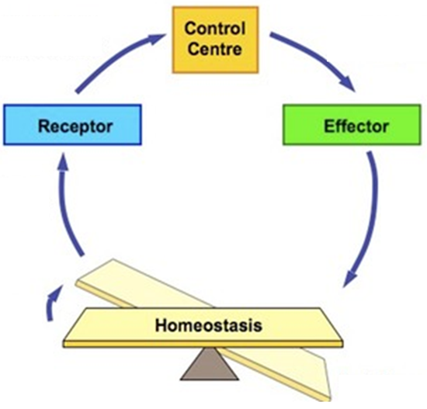
NEGATIVE FEEDBACK SYSTEM
Input via sensory neurons
Output via sensory neurons
Change detected
Response opposes change
Imbalance

Slide 7


THE PRINCIPLE OF NEGATIVE FEEDBACK
negative feedback
(hormone level DROPS)
Rise above
normal value
(detected by receptors)
Endocrine gland REDUCES production of hormone
NEGATIVE FEEDBACK MECHANISM
normal value
normal value
negative feedback
(hormone level RISES)
Endocrine gland INCREASES production of hormone
Fall below
normal value

Slide 8
NEGATIVE FEEDBACK MECHANISM INVOLVING TSH AND THYROXIN
When the thyroxin in the blood drops below normal:
The pituitary gland detects the decreased level of thyroxin in the blood
The pituitary gland then secretes more TSH into the bloodstream
The thyroxine level therefore rises and returns to normal
The higher level of thyroxin inhibits further secretion of TSH from the pituitary

Slide 9
NEGATIVE FEEDBACK MECHANISM INVOLVING TSH AND THYROXIN
When the thyroxin level is too high:
The pituitary gland detects the increased level of thyroxin in the blood
The pituitary is stimulated to secrete less tsh
This stimulates the thyroid gland to secrete less or no thyroxin
The level of thyroxin is reduced to normal limits

Slide 10
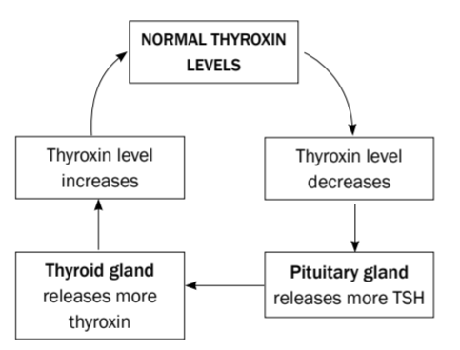
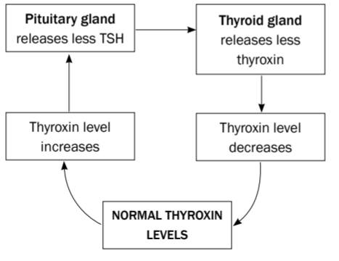
Negative feedback regulating the production of TSH and thyroxin
Decreased level of thyroxin
Increased level of thyroxin

Slide 11
UNDERSECRETION OR OVERSECRETION OF THYROXIN
An oversecretion (hypersecretion) of thyroxin is known as hyperthyroidism e.g. goitre
An undersecretion (hyposecretion) of thyroxin is known as hypothyroidism e.g cretinism

Slide 12
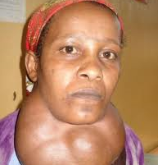
SIMPLE OR ENDEMIC GOITRE
Is characterized by an enlargement of the thyroid gland, due to mainly a deficiency of iodine in the diet and drinking water.
The gland may otherwise function normally.
People living in iodine-deficient areas should use iodized salt to supplement their diet

Slide 13
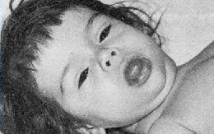

HYPOTHYROIDISM
Cretinism
Hypothyroidism (Thyroid deficiency) in infants and young children
Is characterized by the following symptoms:
  A low metabolic rate
  Retarded mental development
  Lack of development of the sexual organs
  Retarded skeletal growth (cretins are dwarfs)
  Dry and thickened skin
  Increase in the size of the tongue which protrudes from the mouth

Slide 14
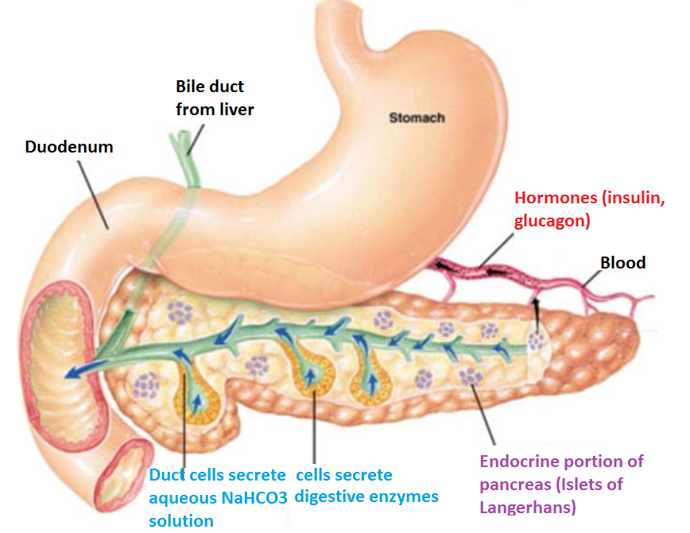
HOMEOSTATIC CONTROL OF BLOOD SUGAR THROUGH NEGATIVE FEEDBACK
Remember the pancreas – unusual gland as it functions as both an exocrine and an endocrine gland
Exocrine function - is the secretion of pancreatic juice which flows along the pancreatic duct into the duodenum where it helps in digestion
Endocrine function – is the secretion of hormones by a group of cells called the Islets of Langerhans. The hormones are secreted directly into the bloodstream

Slide 15
HOMEOSTATIC CONTROL OF BLOOD GLUCOSETHROUGH NEGATIVE FEEDBACK (CONT.)
Hormones
The Islets of Langerhans contain two types of cells:-
Glucagon secreting cells (alpha cells)
Insulin secreting cells (beta cells)
Both hormones play a role in controlling blood sugar
  Insulin lowers the level of blood glucose, while
  Glucagon raises it

Slide 16
THE CONTROL OF BLOOD GLUCOSE
Glucose is the main fuel for cellular respiration
  Lack of glucose deprives the cell of its major energy source. This results in respiration slowing down or stopping
  Too much glucose may draw water out of the cells by osmosis
In a healthy human, normal glucose concentration is between 80 -100 per 100ml of blood

Slide 17

HOW IS BLOOD GLUCOSE LEVEL LOWERED/ HOW DOES INSULIN FUNCTION?
After a meal containing carbohydrates, glucose from the digested food is absorbed from the small intestine and moves into the blood
As this blood passes through the pancreas the insulin secreting cells (beta cells) detect the raised glucose levels and respond by secreting insulin into the blood
The insulin is carried to all cells of the body

Slide 18
In the main target organs, the liver and muscles, the effects of insulin include:
  An increased absorption of glucose from the blood into the cells
  An increase in the rate at which glucose is converted into glycogen
  An increase in the rate of respiration where glucose is used
All these processes take glucose out of the blood which lowers the blood glucose levels
The drop in glucose level is detected by the insulin secreting cells which then stop releasing insulin into the blood.An example of negative feedback

Slide 19
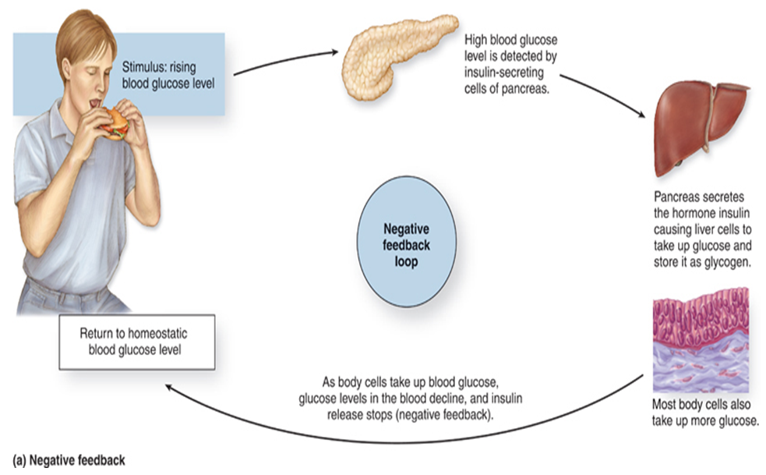

Slide 20
How is blood glucose level increased/ how does glucagon function
When waking up in the morning or after exercise the blood glucose level is low
This drop is detected by the glucagon secreting cells (alpha cells) in the pancreas
The glucagon secreting cells respond by secreting glucagon which affect the liver cells( not the muscle cells)

Slide 21
These effects include the breakdown of glycogen into glucose
As a result, the liver releases glucose into the blood increasing the blood glucose level
This blood flows around the body, passing through the pancreas
Here the glucagon secreting cells sense the higher glucose levels, switching off glucagon secretion (an example of negative feedback mechanism)

Slide 22
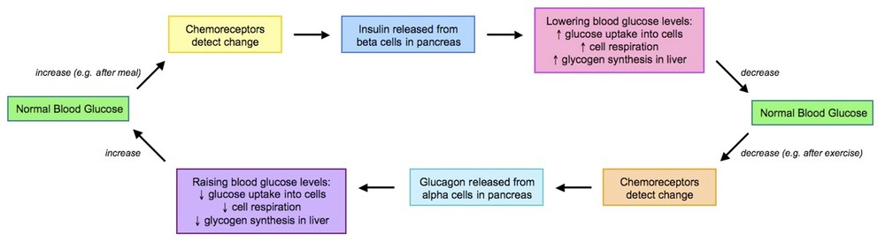
NEGATIVE FEEDBACK USING INSULIN AND GLUCAGON

Slide 23
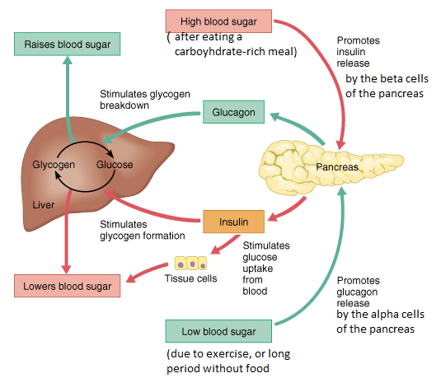

Slide 24

UNDERSECRETION OR OVERSECRETION OF INSULIN
Undersecretion of insulin occurs in people with diabetes mellitus
The Islets of Langerhans do not secrete enough insulin and so blood glucose levels remain high (hyperglycemia)
Oversecretion of insulin results in very low blood sugar levels (hypoglycemia). This can be treated fairly easily with the intake of carbohydrates such as sugars or starch

Slide 25

MORE ABOUT DIABETES
Type 1 Diabetes or insulin-dependent diabetes
is caused by the immune system destroying beta cells of the Islets of Langerhans in the pancreas in younger people, usually develops before the age of 15 years.
So a person with type 1 diabetes is unable to produce insulin. May also be due to genetic causes.

Slide 26
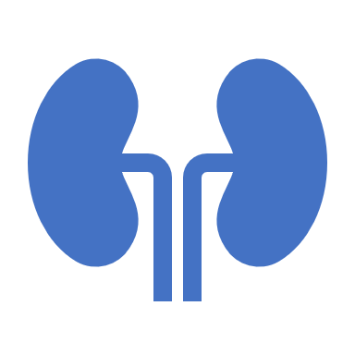
MORE ABOUT DIABETES
Type 2 Diabetes or non-insulin dependent diabetes – more common in people over 35 leading an unhealthy lifestyle and are obese. The pancreas of a person may be able to produce insulin, but it does not work sufficiently.

Slide 27
SYMPTOMS OF DIABETES
TIREDNESS (AS LESS ENERGY IS AVAILABLE TO THE BODY DUE TO REDUCED CELLULAR RESPIRATION)
PRODUCTION OF LARGE QUANTITIES OF DILUTE URINE CONTAINING GLUCOSE
GREAT THIRST

Slide 28
EFFECTS OF DIABETES
Diabetes negatively affects many different parts of the body
The most serious effect is heart & circulatory disease, which leads to heart attacks, cerebral strokes & high blood pressure
Kidney disease can develop, which might need renal dialysis. A common sign of kidney disease is oedema in the legs and feet
Retina can be destroyed, which can lead to blindness
Blood supply to the legs and toes is reduced.These might need amputation if gangrene sets in
Nerves in the blood vessels are damaged, causing tingling or numbness in the finger or toes

Slide 29

TREATMENT
Diabetes cannot be cured, but can be controlled with a strict diet and insulin injections to lower blood sugar levels

Slide 30
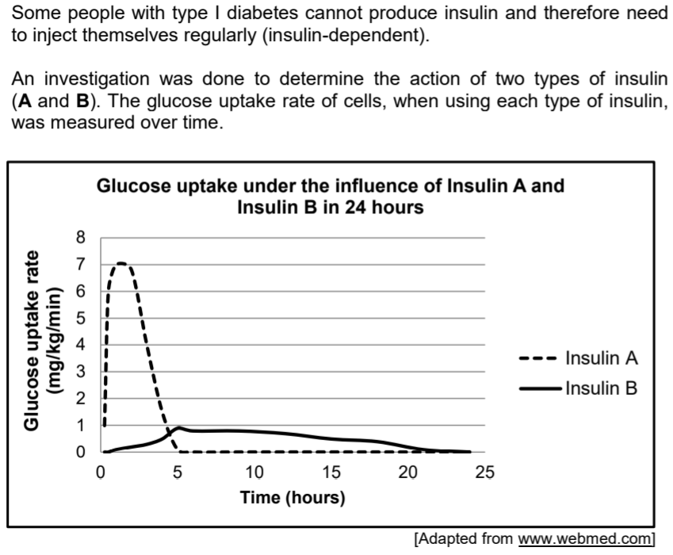
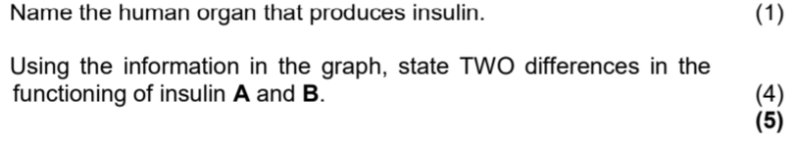
ACTIVITY

Slide 31
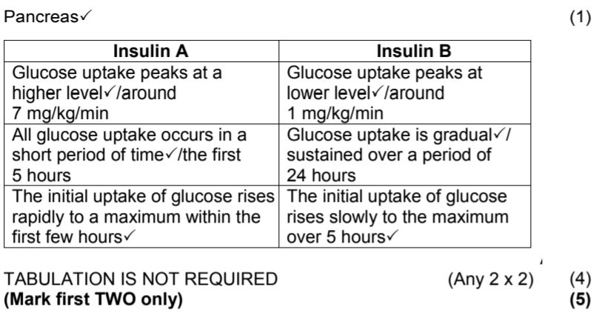
ACTIVITY ANSWER

