Slide 1
Energy Transformation to Sustain Life
TOPIC: PHOTOSYNTHESIS
PRESENTER: MS Z. SANDA
LIFE SCIENCES PLANNER (EC)

Slide 2
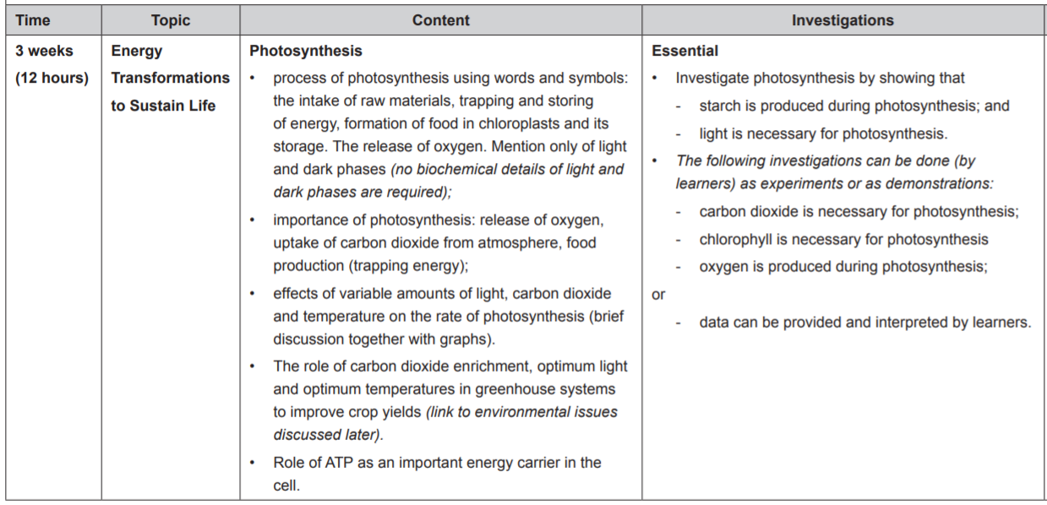
WHAT LEARNERS NEED TO KNOW AS PER CAPS DOCUMENT PG. 42
NOT COVERED IN 2020 DUE TO COVID-19

Slide 3
INTRODUCTION
Energy is required by all living things to survive
This energy can be acquired directly from the sun in the form of light energy or can be obtained from food in the form of chemical energy
Living organisms can be divided into two groups according to how they obtain their energy:
Autotrophs –e.g. Plants are able to make their own food using energy from the sun
Auto = self; troph = feeding
Heterotrophs – e.g. Animals cannot make their own food , food is obtained from another source
Hetero = other

Slide 4
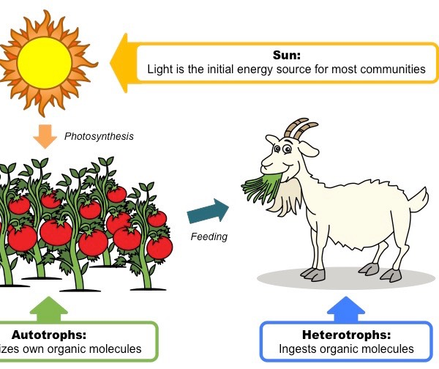
INTRODUCTION

Slide 5
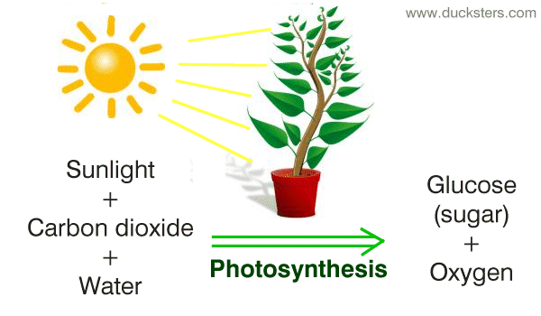
PHOTOSYNTHESIS : THE PROCESS
Photo = light; synthesis “to make”
Photosynthesis is a process used by green plants to make organic compounds such as carbohydrates using light energy from the sun

Slide 6
PHOTOSYNTHESIS DEFINITION
Photosynthesis can be defined as the making of glucose (C₆H₁₂O₆) from the raw materials, carbon dioxide (CO₂) and water (H₂O), using light / radiant energy from the sun that is trapped by chlorophyll molecules. Oxygen (O₂)is given off as a waste product

Slide 7
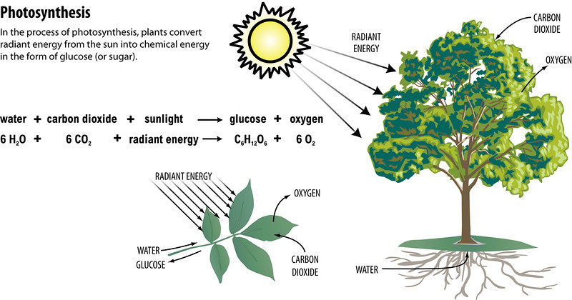

Slide 8
PHOTOSYNTHESIS REQUIRES:
Carbon dioxide (CO₂)
Water (H₂O)
Light energy
Chlorophyll

Slide 9
PHOTOSYNTHESIS PRODUCES
Glucose
Oxygen (waste product)

Slide 10
PHOTOSYNTHESIS CONVERTS
Light energy
Chemical energy

Slide 11
THE INTAKE OF RAW MATERIALS

Slide 12
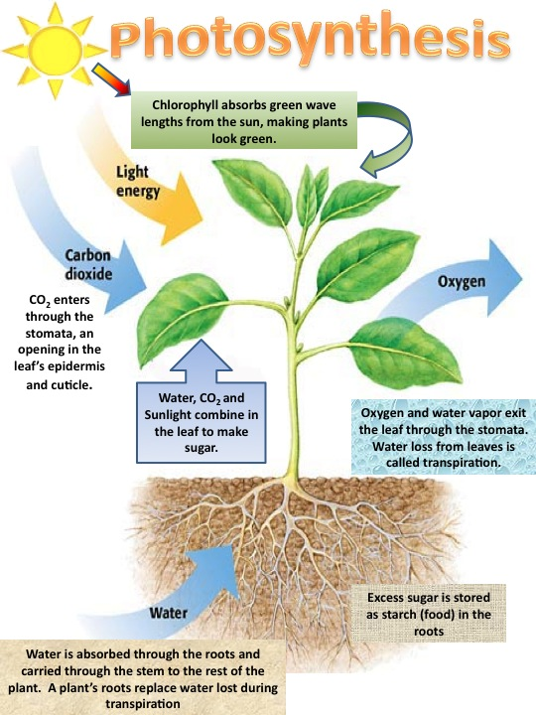
CO₂ from the air enters by diffusion. Concentration of CO₂ outside influences rate at which CO₂ is taken up. Passes into the intercellular spaces between spongy mesophyll cells & then into chloroplasts
Light is absorbed by chlorophyll molecules
Water is absorbed by osmosis and moves up by transpiration pull

Slide 13
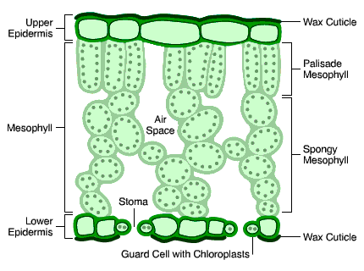
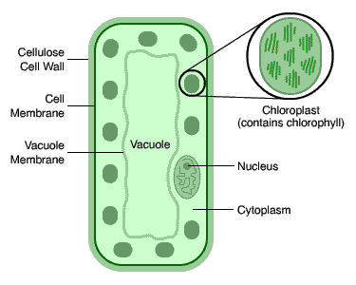
WHERE DOES PHOTOSYNTHESIS TAKE PLACE?
As you can see there are two kinds of mesophyll cells :- palisade mesophyll and spongy mesophyll. The mesophyll cells contain tiny bodies called chloroplasts which contain a green chemical called chlorophyll . chlorophyll enables the light energy from sunlight to be converted into chemical energy for the photosynthesis reaction.
Internal Structure of a leaf
Chloroplast

Slide 14
STRUCTURAL SUITABILITY OF LEAVES FOR PHOTOSYNTHESIS
EXTERNAL FEATURES

Slide 15
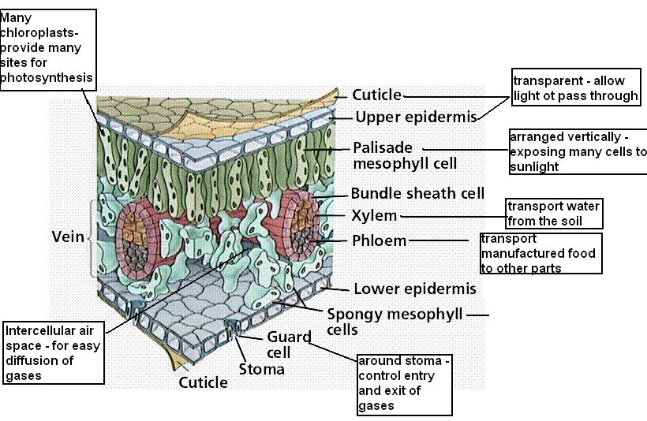
INTERNAL STRUCTURE

Slide 16
LOCATION OF CHLOROPHYLL IN CHLOROPLASTS

Slide 17
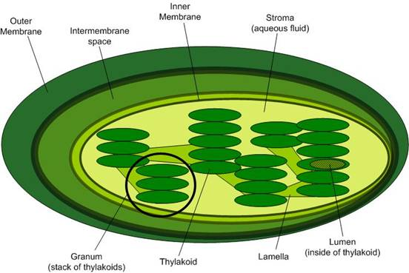
INSIDE THE CHLOROPLAST
The fluid material within the chloroplast is called the stroma.
Within the stroma are stacks of thylakoids , the sub-organelles which are the site of photosynthesis.
The thylakoids are arranged in stacks called grana (singular: granum).
A thylakoid has a flattened disk shape.
Inside it is an empty are called the thylakoid space or lumen.
The light phase (light dependent phase) of photosynthesis takes place on the thylakoid membrane
The dark phase (light independent phase) of photosynthesis takes place in the stroma.
Note that the chloroplast is surrounded by a double membrane.

Slide 18
Process of photosynthesis takes place in the chloroplasts and this is how they are structurally suited for their function :

Slide 19
PROCESS OF PHOTOSYNTHESIS
Photosynthesis involves 2 steps:
LIGHT DEPENDENT PHASE (LIGHT PHASE) and
LIGHT INDEPENDENT PHASE (DARK PHASE)
Both steps take place in the Chloroplasts of the mesophyll cells

Slide 20
LIGHT DEPENDENT PHASE
Light energy is absorbed by chlorophyll.
Water (h₂o) is split (photolysis), oxygen is released and the hydrogen joins into a hydrogen carrier molecule (NADP) to form NADPH –an energy rich molecule.
Energy is released during (photophosphorylation) and stored in ATP molecules
Takes place in the grana of the chloroplast

Slide 21
LIGHT INDEPENDENT PHASE (DARK PHASE)
Hydrogen + energy combine with carbon dioxide to form carbohydrates in the form of glucose
Takes place in the stroma of the chloroplast

Slide 22
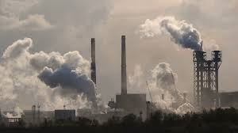
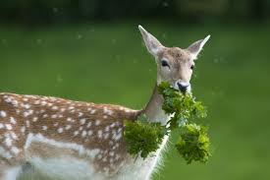
Importance of Photosynthesis
It provides oxygen for respiration in living things life forms
Uses up vast quantities of carbon dioxide produced during respiration, burning f fossil fuels and decomposition
Primary source of food all organisms, forms the base of all food chains

Slide 23
RATE OF PHOTOSYNTHESIS: LIMITING FACTORS
Limiting factors
The main factors affecting the rate of photosynthesis are:
Light intensity
Carbon dioxide concentration and
Temperature
In any given situation any one of these may become a limiting factor, in other words the factors that directly affects the rate at which photosynthesis can take place masking the effects of the other factors

Slide 24
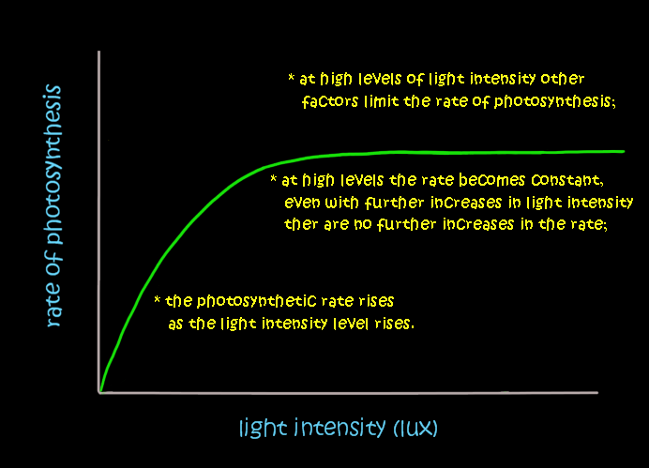
LIGHT INTENSITY
No light = no photosynthesis
As the light intensity increases the rate of photosynthesis increases until it reaches its maximum rate
Further increase light intensity will not cause any increase in rate of photosynthesis
CO₂ levels in the air and temperature are kept constant

Slide 25
EFFECT OF CARBON DIOXIDE
An increase in CO₂ concentration will increase rate of photosynthesis until it reaches maximum concentration.
Further increase in CO₂ will not cause the biochemical reaction to go any faster
Light intensity and temperature are kept constant

Slide 26
EFFECT OF TEMPERATURE
Enzymes work optimally at 37°C. Lower temperatures mean lower rate of photosynthesis . A the temperature increases, the rate of photosynthesis increases until it reaches the optimum temperatures, then start to decrease

Slide 28
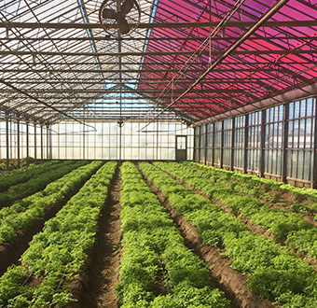
Greenhouse system to Improve Crop Yields
An improved rate of photosynthesis will increase the amount of crop mass. The following methods can be used to increase crop mass:
Glass roof and walls of greenhouses trap light and increase temperature inside the greenhouse increasing photosynthesis.
Gas cylinders are used to release extra carbon dioxide into the greenhouse. An increase in carbon dioxide increases the rate of photosynthesis.
There is an improvement in water availability inside a green house
Insects are more easily controlled inside a greenhouse

Slide 29
Role of ATP
ATP is an energy-rich molecule that is used by cells for various life processes. Some examples of ATP use are:
Synthesis of macromolecules (giant molecules like proteins, fats and nucleotides)
Contraction of the muscle cells
Beating of cilia and flagellae
Active transport – movement of substances across cell membranes from a low to a high concentration.

Slide 30
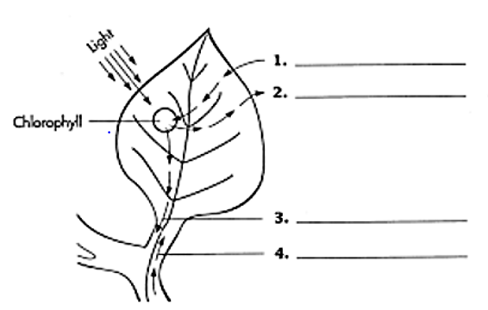
ACTIVITY
After it is labelled the diagram below will illustrate photosynthesis. Write each of the following terms on the correct numbered line
Carbon dioxide
Glucose
Oxygen
Water
Carbon dioxide
Oxygen
Glucose
Water

Slide 31
In photosynthesis what three things come from outside the plant?
_______________ ____________ _______________
3. What are the products of photosynthesis?
_______________ ____________
In what organelle does photosynthesis occur? _______________
Write the overall equation for photosynthesis.
____________________________________________________
How does life on earth depend on photosynthesis
____________________________________________________
____________________________________________________
Light energy
Carbon dioxide
Water
Glucose
Oxygen
Chloroplast
CO₂ + H₂O + light energy → C₆H₁₂O₆ + O ₂
Provides food for living organisms
Provides oxygen needed for cellular respiration

