Slide 1
ECONOMIC GEOGRAPHY
The economy is a system of activities and people depending on each other to supply their needs.

Slide 2
Economics : is the study of how people produce goods and services.
Economic Geography: looks at where economic activities are carried out and why certain locations are chosen.
Gross Domestic Product (GDP): the value of the goods and services produced in a country in a year.
GROSS NATIONAL PRODUCT (GNP): the value of goods and services produced by permanet citizen of a country in a year

Slide 3
ECONOMIC SECTORS
Primary sector: the exploitation of natural resources e.g. farming , mining, fishing, forestry and hunting.
Secondary sector: change raw materials into something more useful and valuable e.g. processing and manufacturing.
Tertiary sector: The provision of services, profession, trade and transport.
Quaternary sector: Intellectual services, e.g. research, espionage, IT

Slide 4
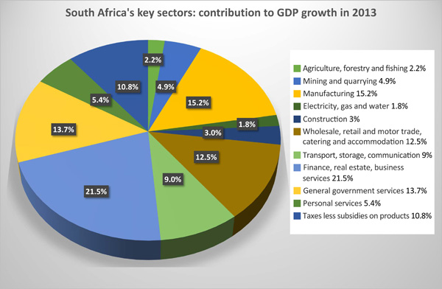

Slide 5
The structure of South Africa’s economy
Contribution of different sectors :
- Primary sector :
1,6 million workers
Mainly agriculture and mining
Secondary sector :
2,6 million workers
Mainly manufacturing and construction
Tertiary and Quaternary sector:
6,8 million workers
Mainly wholesale and retail

Slide 6
Contribution by the provinces to the GDP

Slide 7
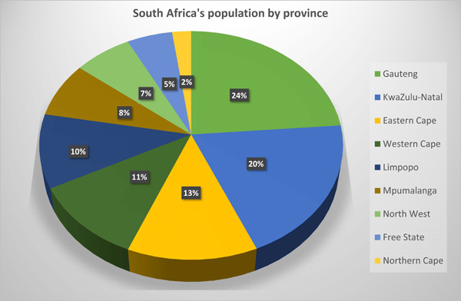

Slide 8
Changing economic structure

Slide 9
PRIMARY SECTOR

Slide 10
Importance of the primary sector
It provides food
It provides raw materials for factories
It provides the coal to generate power
It provides valuable export products
It provides employment
It stimulates the development of infrastructure
It stimulates the development of industries

Slide 11
Agriculture
Main agric products produced in SA
Field crops e.g. Maize
Horticulture (science and art behind fruit, flower and vegetable farming) e.g. Wine
Animal products e.g. Meat and wool

Slide 12
FARMING
 | LARGE SCALE | SMALL SCALE
DEFINITION | Production of crops for local and overseas markets to make a profit. Only practiced on a commercial level | Farming on smaller plots of land with the purpose of making a profit. Can be practiced on a COMMERCIAL OR SUBSISTENCE LEVEL
TECHNOLOGY | Use of Scientific farming methods: Chemicals, fertilizers, hybrid seeds, livestock, crop spraying, GM seeds, contour ploughing Capital intensive – Use of high tech machinery | Specialised farming: Use of irrigation and small dams Intensive farming: Every available piece of land is used.

Slide 13
FARMING (Cont.)
Subsistence farming: farmers produce sufficient crops for the needs of their families. Mixed farming, small farms, communal land ownership, traditional techniques
Commercial farming: farming that is conducted in order to sell the produce. Specialize in fewer products, large farms, new techniques, more infrastructure, farm names and private landownership.

Slide 14
SUBSISTENCE FARMING
Traditional methods
No capital
Cereals
Vegetables

Slide 15
COMMERCIAL FARMING
Modern machinery .
Specialize in certain products.
Cultivated lands and pastoral farming.
Scientific methods.
Market orientated

Slide 16
Extensive farms are large farms using low inputs per hectare. Mechanisations reduces labour use. Sheep, cattle and game

Slide 17
Intensive farming: smaller farms using high levels of input. They produce high yields of high value goods. Near to market areas.

Slide 18
MACHINERY

Slide 19
STORAGE

Slide 20
FACTORS THAT FAVOUR AGRICULTURE IN SA (NB!!!)
Climate
A range of climates makes it possible for many products .
Most arable areas have at least 200 frost free days.
Temperatures are neither too hot nor too cold.
Subsistence farmers have developed coping methods of dealing with moderate droughts .
Improved climate research has made drought prediction more accurate
East coast has no frost, allows for tropical fruits to grow (Avos and mangos)

Slide 21
High rainfall on east coast (Sugarcane)
SW Cape has winter rainfall (Wine)
Rivers and lakes can supply additional water.
Soils
Much of the landscape is flat .
Neutral soils across the country
Suited to livestock and mixed farming
Exotic crops introduced can produce higher yields.

Slide 22
Ownership of land
Large commercial farms across country
Irrigation (watering) of crops, GM crops and pesticides.
Water from transfer schemes e.g. Lesotho Highlands.
Trade
EU and SA have NO trade restrictions.
Import duties are limited.
N hemisphere relies on SA products in their winter.

Slide 23
Factors that hinder agriculture in SA (NB!!!)
Climate
Insufficient rain and shortage of water.
SA average annual rainfall is 495mm/ year (World avg 850mm/year)
West coast dry with high evaporation rates – farming is difficult
Frost is common on the plateau
Subsistence farmers are at risk of droughts
Soils
Only 7% of the land is arable.
Many arable areas are too densely populated for farmers to develop commercial farms
Many arable areas are too densely populated for farmers to develop commercial farms

Slide 24
Soils are thin especially those on steep slopes
Alkaline (PH greater than 7) soils on west coast mean few crops can grow
Severe overgrazing and poor farming techniques has damaged soils
Some exotic crops like maize produce good yields in years with enough rain but are very poor in times of drought
Poverty seriously limits agricultural development.

Slide 25
Ownership of lands
Land tenure
Nationalisation
Farm attacks
Trade
Subsidies after 1980 decreased
Foreign competition is often a serious hindrance
Fluctuations in maize price has hurt farmers

Slide 26
Food security When all people have excess to nutritious food to meet their needs for a healthy and productive life.

Slide 27
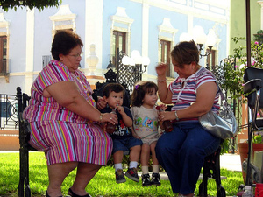
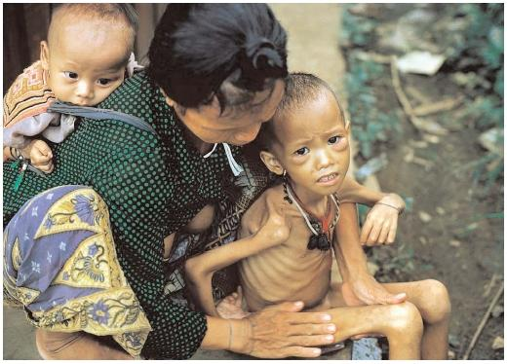
Food insecurity exists when people live in fear of hunger and starvation.
As many as 39% of our population lives with food insecurity

Slide 28
Importance of food security in South Africa
Food needs to be available on a national and household level
Food must be accessible on a sustainable basis to households and at national level.
Food must be affordable
Food supply must be reliable and produced under safety regulations
Food must be distributed so that country is food secure in all areas.

Slide 29
Factors influencing food security
Climatic effects such as floods or drought
High fuel prices makes food products more expensive to transport
High levels of HIV/Aids lowers productivity and yields
Unstable socio-political environments
Imbalances in trade mean that consumers push prices
Lack of natural resources hampers the ability to grow food.
Population growth-as population grow so must food supply

Slide 30
Challenges facing South African agriculture

Slide 31
MINING

Slide 32
The importance of mining
SA has a wide variety of minerals e.g. Gold, coal, platinum, diamonds etc
It employs over a 1 million workers.
It has created numerous other industries and services due to the ripple effect it has had on the economy.
It stimulates import-export trade.
It brings in foreign revenue into the country.
It contributes large amounts of revenue to the SA government in the form of taxes.
Beneficiation (separation and crush minerals into valuable substances)

Slide 33
Mining contributed 9.5% of GDP in 2014
R302, 2 billion worth of sales in 2014
Beneficiation (separation and crush minerals into valuable substances)
The wealth derived from mining has funded the
building of South Africa’s infrastructure .
Mines and the people they employ pay many
billions of rands in taxes.
Our coal provides for 92% of the electricity
generated and for 30% of liquid fuel
production by SASOL.

Slide 34
PLATINUM

Slide 35
GOLD

Slide 36
GOLD BEARING ROCKS

Slide 37
GOLD MINE

Slide 38
COAL

Slide 39
Open Cast Coal Mining Equipment

Slide 40
Underground Mining : Board and Pillar Method

Slide 41
Beneficiation Plant
Beneficiation (separation and crush minerals into valuable substances)

Slide 42
Factors that favour mining in SA
Geology
Thick deposits (Bushveld Igneous Complex & Witbank)
South Africa has a wide range of minerals.
The quality and concentrations of minerals is very high.
Most of the minerals are quite near the surface, reducing production costs.
South African rock layers also have a low thermal gradient
Labour
Both skilled and unskilled; migrant labourers

Slide 43
Investment
Countries have invested money in our mines
Infrastructure
Railway, roads, water and electricity readily available
Harbours give access to overseas markets

Slide 44
Factors that hinder mining in SA
Climate
High temps (Kuruman) hard to cool mines down
Distance
Many of our mines are far inland.
Huge distances from mines to harbour (Witbank – Richards bay 500kms)
Labour/Accidents
Strikes, tribal fighting & high cost of training new staff
The cost of wages is increasing.
HIV/AIDS is affecting the workforce.

Slide 45
Water
Water shortages
Underground water is dangerous.
Price
Gold price drops then mines close
Much of our mineral output is exported, and income from minerals is dependent on changes in the rand dollar exchange rate.

Slide 46
The changing face of the mining sector

Slide 47
Change of ownership of mines
The share of ownership and management of mines by black South Africans is increasing.
Black South Africans buy shares and workers are paid in part by shares in the mines.

Slide 48
Environmental responsibility
Mining companies have to take greater care of the natural environments in which they operate.
Mines have released acids and poisons into streams and into the groundwater.
When mining operations cease, the environments have to be restored.

Slide 49
Social responsibility
Some mining companies have been forced to make payments to workers and their families who got lung diseases and from inhaling fine fibres that blew from an old asbestos mine.

Slide 50
SECONDARY SECTOR

Slide 51
SECONDARY SECTOR
Include those human activities in which the form of the original material is changed into a more useful and valuable product.
Wool = Clothes Iron = Steel
They are manufactured for the express purpose of selling or trading these products.
Most of the processing is done in factories.

Slide 52
Secondary Economic Activities- Light and heavy Industries
 | Light Industry | Heavy Industry
EXAMPLE | Jewellery making, clothes factory, computer manufacturer, food and beverages | Power stations, iron and steel factory, motor vehicles factory, paper Mill.
LOCATION | In a city in the CBD, in the zone of Decay, in an industrial estate | On the outskirts of the city,in rural areas near the raw material source
RAW MATERIAL | Small, may be partially processed | Large bulk not processed.
LAND REQUIREMENTS | No specific needs, may be in a multi storey building | Needs a large area of flat land
INFRASTRUCTURE | Uses existing road network and local power supply | Needs access to major roads or railways, water supply and power supply
ENVIRONMENTAL IMPACT | Has little or no impact on the surrounding area. | Utilises a large amount of water and causes air and noise pollution

Slide 53
Raw material orientated industry: is found close to the source of the raw materials. The raw material could be bulky and expensive to transport.
Market Orientated industry: located close to the market. The product could be perishable.
Footloose industry: technology allows these industries to be located anywhere (Vodacom)
Ubiquitous industry: not located at a particular space on a landscape (Telkom – cables cover entire country)
Bridge (break-of-bulk) industry: located between the raw materials and the market.

Slide 54
Secondary and tertiary activities
FOUR main industrial regions in SA
Refer to notes and REMEMBER:
Factors influencing the location
Problems
Main industrial activity
Gauteng/PWV (Pretoria, Witwatersrand & Vereeniging)
Durban/Pinetown
SW Cape
PE – Uitenhage

Slide 55
Factors influencing industrial development
1. Raw materials – coal kick-start industry
2. Labour supply – skilled, unskilled & migrant
Transport infrastructure – air, roads, rail & harbour
Water supply – high rainfall on the eastern part
4. Political intervention – generate cash to funds projects (Water schemes)
Agglomeration – industries locate where other factories have already been established (Toyota factory has stimulate glass, tyre and panel beaters in KZN)
MARKETS – large local and overseas markets

Slide 56
Factors influencing industrial development in South Africa
Raw materials
Energy
Labour supply
Markets
Link industries
Transport infrastructure
Water
Capital
Land
Competition and trade

Slide 57
SOUTH AFRICA’S INDUSTRIAL REGIONS
GAUTENG
KWAZULU-NATAL
EASTERN CAPE
WESTERN CAPE

Slide 58
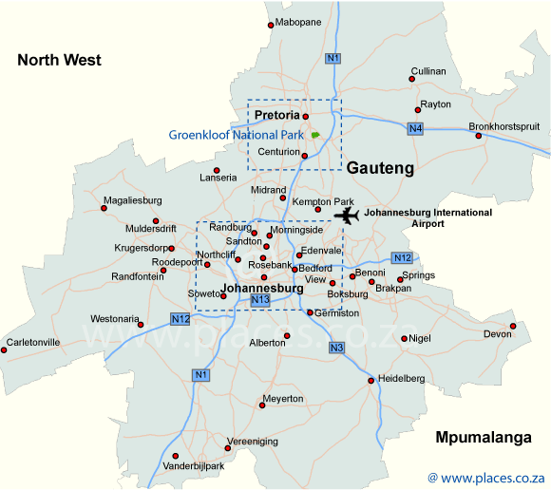
GAUTENG (PWV AREAS)

Slide 59
Gauteng(PWV) Region
Over 10 million people live in Gauteng
Formerly known as the PWV (Pretoria Witwatersrand Vereeniging)
This industrial region produces 43% of all of South Africa’s manufactured goods.
Key factor: the discovery of gold
The mining industry and the presence of a fast -growing population provided an immediate market for a huge range of manufactures

Slide 60
Factors influencing the location and development of manufacturing in Gauteng
Gold
People
Wide range of MARKETS
Huge resources of coal for ENERGY not far to the east.
Many skilled and unskilled members of the LABOUR force.
Many RAW MATERIALS available.
WATER is drawn from the nearby Vaal dam.
Good TRANSPORT links to ports by road and rail.
Capital provided by European investors.

Slide 61
Main industrial activities in Gauteng
Gold mining
Iron and steel
Related metal industries
Explosives
Chemical industries
Sasol
Denel aviation
Glass
Motor vehicles
Food and beverages

Slide 62
DURBAN-PINETOWN

Slide 63
Factors influencing the location of Durban-Pinetown region
The PORT of Durban. Protected facing the Indian Ocean. Suited to trade with the eastern hemisphere.
Kwazulu– Natal has the highest population providing a mix of skilled and unskilled LABOUR.
A warm moist climate produces many RESOURCES.
WATER is plentiful due to higher rainfall in the east.
ENERGY is derived from the coalfields of Northern Natal and Mpumalanga.
The flat land along the coast is ideal for factories
Local and International MARKETS

Slide 64
Main industrial activities in Durban-Pinetown
Chemical industries
Oil refineries
Soap making
Footwear
Sugar refinery
Textiles
Metalwork and machinery
Motor vehicle assembly
Food processing

Slide 65
South Western Cape

Slide 66
Factors influencing the location of South Western Cape
Cape Town was the first western style city in South Africa. (INDUSTRIAL INERTIA)
Cape Town has over 3 million inhabitants.
RAW MATERIALS like fruit, wheat , fish and wool are found in abundance.
ENERGY is obtained from the Koeberg nuclear power plant.
It is situated on an important sea route around Africa.
Local and international markets.
Political influence

Slide 67
Main industrial activities in South Western Cape
Fruit and canning
Viticulture
Textiles
Fishing
Furniture
Explosives
Petroleum refinery
Link industries

Slide 68
The Nelson Mandela Metropolitan Region (Port Elizabeth-Uitenhage)

Slide 69
Factors influencing the location of Port Elizabeth-Uitenhage
Port Elizabeth is the habour most central to the motor car consumer markets.
WATER SUPPLY supplemented by the Orange River Project.
Modern facilities at the Port Elizabeth HARBOUR.
EQUALISED RAIL TARIFFS, made rail costs for the transportation of containers the same all over the country.
Large LABOUR resource in the Eastern Cape.
The Coega Project

Slide 70
Main industrial activities in Port Elizabeth-Uitenhage
Motor assembly
Subsidiary industries to motor
Tyre manufacturers
Leather works
Wool

Slide 71
Gauteng (PWV Complex) | eThekwini (Durban Pinetown) | South Western Cape (S.W.CA) | Nelson Mandela (PE –Uitenhage)
Major industries Iron and steel, metal products ISCOR, AMCOR Chemical products ,explosives AE&CI Sasol Engineering – aircraft (Denel Aviation) Clothing Food Glass | Major industries Petrol refinery Chemical industries Sugar mills Textiles / footwear Ship building and repairs Paper industry Motor vehicle assembly Metal works and machinery. | Major industries Food and beverage – fruit , fish canning, flour and wine Saw mills Textiles , shoes Ship repairs Petrol and oil refining Printing and publishing | Major industries Textiles , shoes, leather Associated industries with cars Wool cotton Rubber products
Factors promoting development: Demand for machines for mines Abundance of raw materials Abundance of unskilled and semi-skilled labour Power from ESCOM Water supply from the Vaal and Lesotho Highlands water project Effective infrastructure (roads, rail) High population density creates a market | Factors promoting development: Busiest harbor for general Cargo Industries related to imported goods (petrol refinery) Good labour force Electricity available Good transport links with interior of SA | Factors promoting development: Habour Dry dock facilities Raw materials Population numbers for worker Local market | Factors promoting development: A huge container break of bulk point Deepest port in SA – biggest ships can dock (Port of Nqgura) Raw materials: cotton, wool subtropical and deciduous fruit. Motor parts trade Motor industries.
Problems encountered Water shortage ( Tugela pumped water and Lesotho Highlands scheme) Pollution Vulnerable – half of all industries located here. | Problems encountered Hilly topography very little flat land hinders expansion Hot humid climate not conducive to work Pollution Limited industry development as harbor cannot expand | Problems encountered Electricity expensive- far from coal fields High transport costs into interior Water shortages ( Gariep dam water scheme) often experience summer droughts No raw materials Lower salaries /less buying power. | Problems encountered No mineral raw materials Electricity expensive. Motor companies have moved their assembly points to Gauteng OR disinvested in SA .

Slide 72
STRATEGIES FOR INDUSTRIAL DEVELOPMENT
Apartheid industrial development strategies:
Border Industries
To provide employment in the borders of new homelands
By opening factories in or near homelands
To define a white South Africa as distinct from the ten self-governing homelands

Slide 73
The development plans had the following initiatives
Industrial development points: To keep black workers in their homelands.
Regional deconcentration points: Close to the metropolitan areas towards which future industrial growth could be developed to reduce overconcentration.
Metropolitan areas: The existing city areas that were already attractive to private enterprise.

Slide 74
Post apartheid industrial development strategies.
Post apartheid government aimed at creating industries along national routes that lead to harbours.
Aimed at making industries more productive, efficient and competitive.
Aimed at increasing investment and reducing high unemployment.
Through the RDP programme water supply was improved, new jobs created and more houses were built.

Slide 75
INDUSTRIAL DEVEOPMENT ZONES
Prescribed IDZ for 2019 – Saldanha Bay IDZ

Slide 76
Industrial Development Zones (IDZs)
Encourage competition
Attract foreign investment
There are FOUR IDZ’s:
PE (Coega IDZ)
East London (ELIDZ)
Richards Bay (RBIDZ)
Gauteng (OR Tambo International Airport)

Slide 77
Concept and distribution of Industrial Development Zones (IDZs)
IDZ is a scheme designed to encourage competition in the country’s economic sectors and to attract increased amounts of foreign investments.
These IDZ places are around ports or airports.
The aim is to upgrade the infrastructure and services of these places to make them more competitive.
The government intends to promote these places by offering special tax incentives to attract investors.

Slide 78
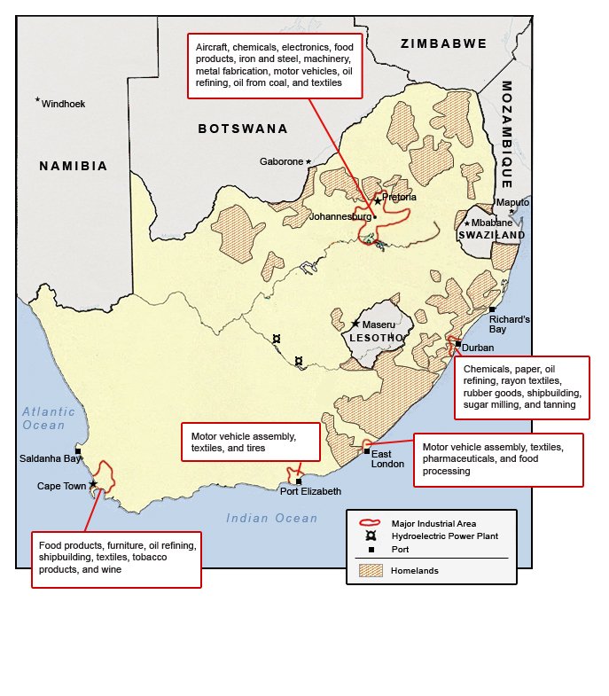

Slide 79
Spatial Development Initiatives (SDI’s)
Prescribed SDI’s for 2019 – Platinum SDI and Richards Bay SDI

Slide 80
Spatial Development Initiatives (SDI)
It is an area along a major transport route linking major markets with harbours.
It encourages industry to relocate along this major transport route.
Aims :
to develop and improve existing transport infrastructure.
To create an attractive environment for private-sector investment.
To initiate and support economic activities along those transport corridors.

Slide 81
Industrial centralisation
It refers to the fact that there must be something on the surface that is attractive to people.
It draws people from all areas to converge around the industries.
Challenges:
Lack of housing
Pollution
Increase in property and rental prices
High crime rate
Congestion

Slide 82
Industrial decentralisation
In South Africa it was a political policy not based on sound economic practice.
It was important for the government to be seen to be providing jobs for people living in townships.
Industries were given incentives to set up close to townships and homelands.

Slide 83
Informal Sector

Slide 84
Characteristics
Contributes significantly to the South African economy
Does not pay company tax
Creates jobs
In South Africa sales take place in spaza shops and fast foods stands on the streets or at taxi ranks
Reduces unemployment and poverty
Businesses are easy to start
The business belongs to the owner

Slide 85
Reasons for high informal sector employment in South Africa
Unemployment rates in formal occupations are high
People venture into informal work part time due to personal reasons such as pregnancy, retirement etc.
Poverty
Illegal immigrants cannot find jobs in the formal sector

Slide 86
Challenges facing South Africa’s informal sector
Institutional Challenges:
No access to education
Limited access to finance and banking institution
Limited access to land and property
Excessive government regulations
Ltd land & property
Infrastructure challenges:
Lack of working premises
Lack of storing facilities
Lack of sanitation (toilets)

Slide 87
Economic challenges:
Insufficient funds do not allow for further investments
Low income
Lack of business skills
Lack of opportunities for bulk purchase
Limited access to technology
Limited communication strategies and channels
Limited capacity in collective bargaining

Slide 88
Thank you

