Slide 1
Responding to the environment
THE HUMAN EYE:
EYE DEFECTS AND TREATMENT
Mrs C.Chitsiga- Magasela
(Sarah Baartman District)
This Presentation is Click Activated

Slide 2
WHAT THE EXAMINATION GUIDELINES SAY…

Slide 3
KEY POINTS TO NOTE…
The following will be covered :
Description of the defect
The cause of each defect
The effect of each eye defect
Treatment of each eye defect

Slide 4
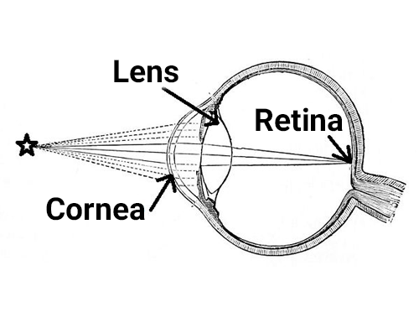
EYE DEFECTS : KEY PARTS INVOLVED
Pathway of light through the eyeball
Click to Show Answers

Slide 5
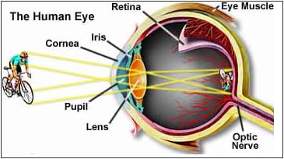
RECAP OF HOW IMAGES ARE FORMED…
The light rays strike an object and bounces oﬀ the object & then enters our eyes enabling objects to be seen.
When light rays enter the eye they are bent (refracted) by the cornea and the lens.
This leads to the rays being focused to form an image on the Retina.
Nervous impulses are sent to the cerebrum of the brain.
During focusing of the rays the image is turned upside down then back to front on the retina and the cerebrum of the brain then interprets the image, turns them the right side up.

Slide 6
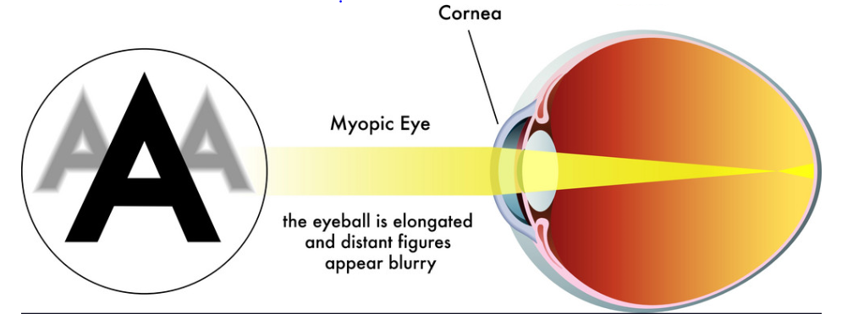
SHORT-SIGHTEDNESS (MYOPIA)
The ability to see objects close by clearly , but not objects far away as they are out of focus (i.e. blurred).
Causes :
The eyeball is longer than normal
The cornea’s curvature is too bulging resulting in
the inability of the lens to become flat enough (i.e. less convex)

Slide 7
CONSEQUENCES OF SHORT- SIGHTEDNESS
There is reduction in the focal length of the eye lens,
This results in the diversion of the light rays from the surface of the retina.
Images of near objects on retina are blurred
The best image (that is most clearly focused) falls in front of the retina
Distant objects therefore cannot be seen clearly

Slide 8
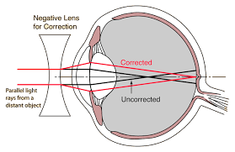
TREATMENT OF SHORT-SIGHTEDNESS
Wear spectacles with concave convergent lenses,
Concave lens will distribute light rays before they enter the eye.
Laser surgery to correct curvature of cornea

Slide 9
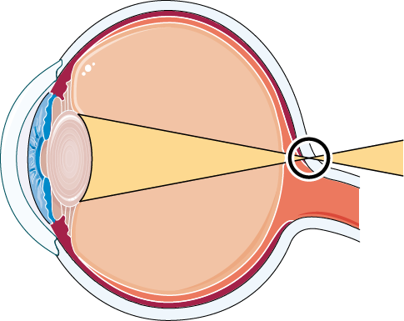
LONG SIGHTEDNESS (HYPERMETROPIA)
The ability to see objects at a distance clearly, but not objects close by (near objects are out of focus).
Causes :
The eyeball is shorter than normal or,
The cornea is too flat
The inability of the lens to become more convex (lens is too weak)
(Image showing long sightedness )

Slide 10
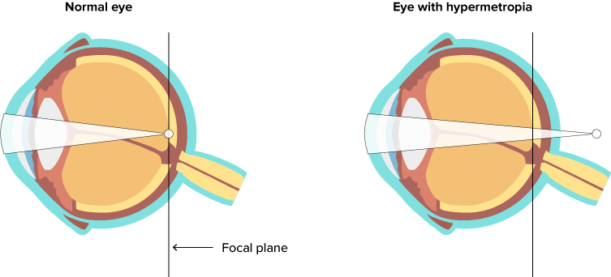
CONSEQUENCES OF LONG-SIGHTEDNESS
There is an increase in focal length of the eye lens,
which prevents the light rays to directly focus on retina.
Images of near objects on retina are blurred while ,
the best image (that is the one most clearly focused) falls behind the retina
Near objects therefore cannot be seen clearly
The ability to see images at a distance is not affected
(Normal eye vision vs long sightedness )

Slide 11
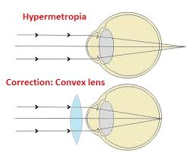
TREATMENT OF LONG-SIGHTEDNESS
Wear spectacles with convex lenses ,
so as to be able to converge (bend) light rays a bit more before they enter the eye.
This forms the image on the retina and not behind it.
Refractive Laser surgery may be used to correct the curvature of the cornea
Diagram showing the corrective lens for long sightedness

Slide 12
STUDY TIP: USE MIND-MAPS AS SUMMARIES FOR REVISION

Slide 13
STUDY TIP: USE MIND-MAPS AS SUMMARIES FOR REVISION

Slide 14
STUDY TIP: USE MIND-MAPS AS SUMMARIES FOR REVISION

Slide 15
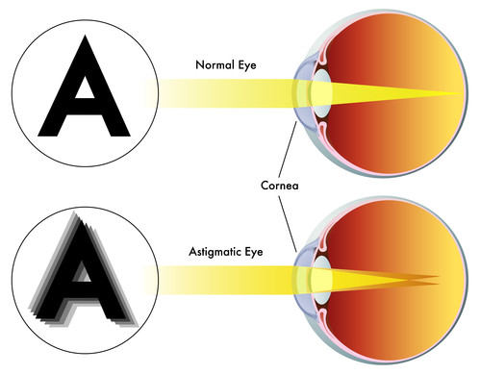
ASTIGMATISM
This is an eye defect caused by the uneven or irregularly shaped curvature on the surface of the lens or cornea.
The defect causes light rays to focus on two points on the retina instead of one point,
Leads to a blurred image.
Can be hereditary , cornea scarred by injury or gradual thinning of cornea.
(Comparison of normal eye vision to an eye with astigmatism)

Slide 16
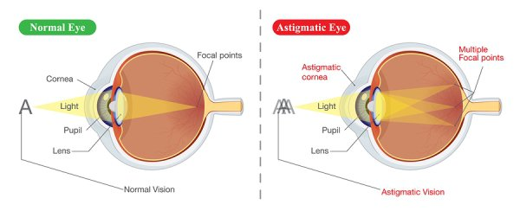
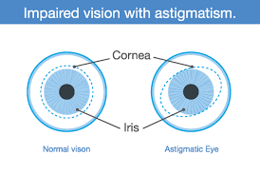
Cornea – (Corneal Astigmatism)
The cornea is shaped more oblong than the normal spherical shape .

Slide 17
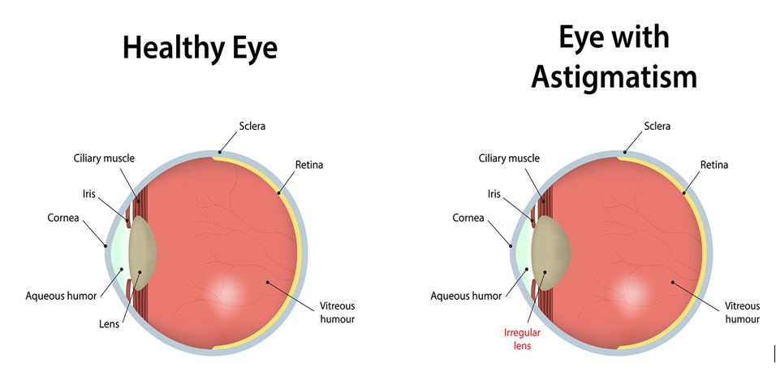
Lens (Lenticular Astigmatism)
Is due to an irregularly shaped lens, located behind the cornea;
Resulting in difference in curvature in the lens.
This will also cause the person to have blurry vision.

Slide 18
DEALING WITH ASTIGMATISM
SYMPTOMS
TREATMENT
Distortion of blurring of images at all distances
Headaches and fatigue
Squinting and eye discomfort or irritation
Prescription lenses for clear and comfortable vision,
(That is if no other problems associated with refraction are present and therefore corrective lenses are not needed)
Refractive Laser Surgery

Slide 19
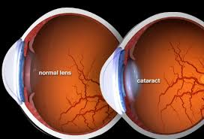
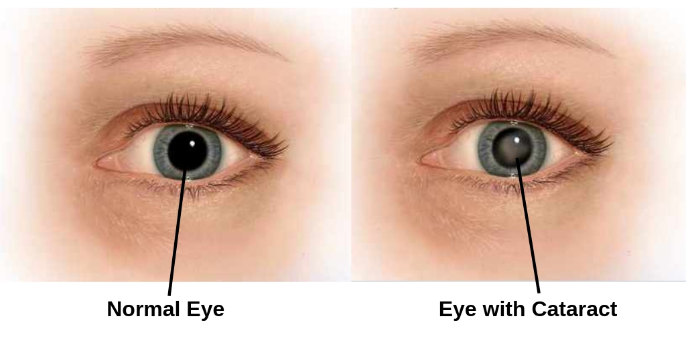
CATARACTS
(Normal eye vs eye with cataract)
This is the blurring of a part of a normal clear lens of the eye
The main chemical composition of the lens (water & proteins) clump together
This forms a cloudy layer on parts of the lens
Thereby preventing sufficient light from passing through to the retina
OR
Lens slowly changes to a yellowish brown colour, thereby adding a brownish tint to objects viewed

Slide 20
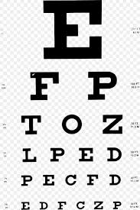
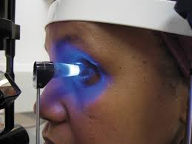
DIAGNOSIS OF CATARACTS… (Two Methods used)
Vision test using an eye chart
(Visual acuity test)
Optometrist will ask you to read letters from a distance to find out how sharp your vision is.
First you'll try it with one eye, then the other.
Eye examination
Done to reveal the colour change in the lens
Pupil dilation:
The pupil is widened with eye drops to allow your eye doctor to see more of the lens and retina and look for other eye problems
Tonometry:
This is a standard test to
measure fluid pressure inside
the eye.

Slide 21
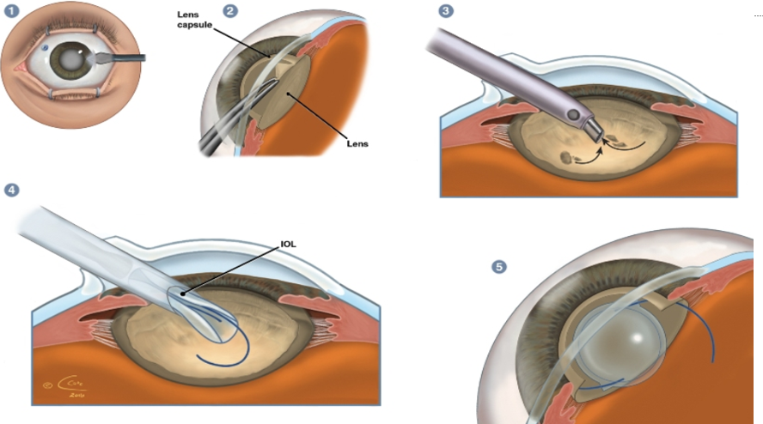
TREATMENT OF CATARACTS
Lens is surgically removed and replaced with a synthetic lens (intraocular implant)
Steps :
Anaesthetic is used
A small cut is made directly into the eye
Clouded lens shattered by ultrasound & suctioned out of the lens capsule
New clear artificial lens rolled up and inserted
Surgical opening is then closed

Slide 22
SURGICAL REMOVAL OF CATARACTs

Slide 23
TEST YOUR KNOWLEDGE

Slide 24
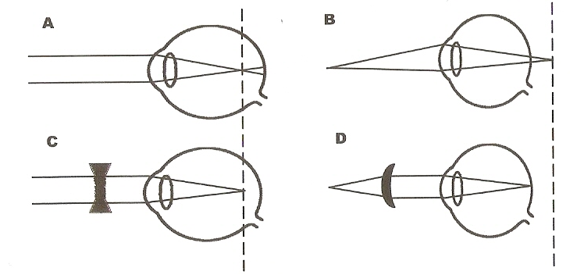
REVISION QUESTION #1
 | Study the following diagrams showing visual defects and answer the questions that follow.
Which diagram (A or B) illustrates
(a) short-sightedness (1)
(b) long –sightedness (1)
(a) A . ✓ (b) B . ✓

Slide 25
REVISION QUESTION #2
Compare short-sightedness and long-sightedness by completing the table below (8)
 | Short sightedness | Long sightedness
Shape of eyeball
Focal point on retina for nearby objects
Corrective type of lens
Corrective corneal laser surgery
Longer than usual
Shorter than usual
Clear focal point on retina
Focus point lies behind retina
Convex lens
Concave lens
Cornea is thickened to make it rounder (more convex)
Cornea is made flatter (less convex)

Slide 26
REVISION QUESTION #3
Explain the nature and treatment of the following:
(a) astigmatism and
(b) cataracts
Nature and treatment of astigmatism: (b) Nature and treatment of cataracts:

Slide 27
REVISION QUESTION #4
Why would a person who has had no specific eye defects, probably need glasses with convex lenses after the age of 40. (5)

Slide 28
ACKNOWLEDGEMENTS
Clitheroe, F. Dempster, E. Doidge, M. Marsden, S. Singleton, N. Van Arde, I. (2013). Focus on Life Sciences Grade 12. Maskew Miller Longman.
Isaac,T. Chetty, S. Manganye, H.T. Mpondwana, N.L. White,L. (2013). Understanding Life Sciences Grade 12. Pulse Education Services.
Mouton,G. Cilliers, J. Myburgh, A. Van der Berg, E. Steyn,H. (2010) Life Sciences. Future Managers (Pty) Ltd.
Gerber, J. and J. Goliath. Material adapted from Learner Tutoring Resource & Answer series (2014)
Grogan, J. and Suter, R. (2015). Mind Action Series Life Sciences Textbook and Workbook.
https://www.vectorstock.com/royalty-free-vector/myopia-vector-3510251
http://bmea2z.blogspot.com/2016/12/clear-illustration-about-phaco-cataract-surgrey.html
https://www.spindeleye.com/procedures/astigmatism-treatment/
https://www.cehjournal.org/article/how-to-measure-intraocular-pressure-applanation-tonometry/
Bennett, M. (Subject Education Specialist) , Sarah Baartman District Education.
Chimbumu, R. (Lead Educator) Mtata High School, O.R Tambo Coastal Region.
Louca, Sheena. (Matriculant, 2020). Port Alfred High School, Eastern Cape.
Sanda, Z. (Deputy Chief Education Specialist- FET). Curriculum FET Programmes, Eastern Cape Education Department.

Slide 29
