Slide 1

EYE STRUCTURE AND FUNCTION
SUBJECT : LIFE SCIENCES
LEAD TEACHER : SOTSAKA .M
DISTRICT : O.R TAMBO INLAND

Slide 2

Examination guidelines

Slide 3
LESSON OBJECTIVES
Study the structure and functions of different parts of the human eye.
Explain the structural adaptations for the various parts to perform their functions.
Explain Binocular vision and stereoscopic vision.

Slide 4
Terminology and definitions
Refraction: bending of light when light passes through a lens.
Photoreceptors: receptors in the eye that convert light stimuli into nerve impulses.
  - Photoreceptors are located on the retina of the eye and are called rod and cone cells.
Binocular vision: the process of looking at an object with both eyes, creating a single visual image.
- Stereoscopic vision: the ability to see the depth and solidity of objects and create a three dimensional presentation of the object.

Slide 5
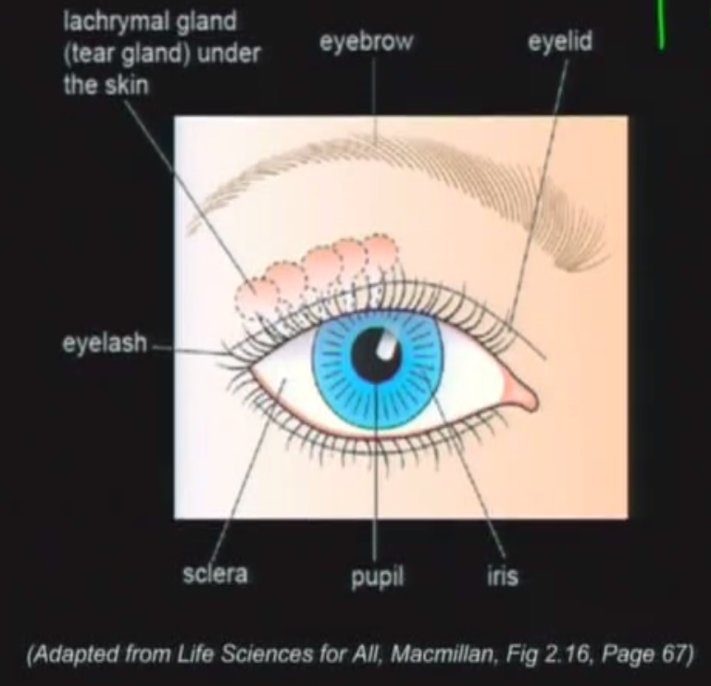
THE LOCATION OF THE EYE

Slide 6
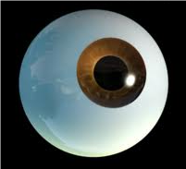
THE HUMAN EYE

Slide 7
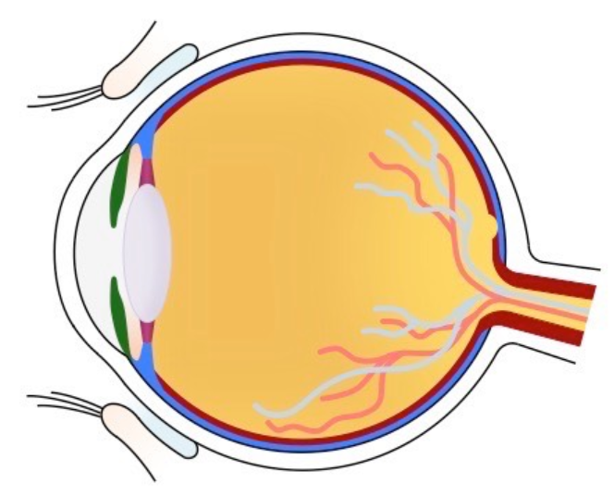

THE STRUCTURE OF THE HUMAN EYE
Suspensory ligaments
Attaches lens to the ciliary body, helps to alter the shape of the lens
Ciliary body and muscle
Enables the lens to change its shape
Sclera
Outer covering (the white) of the eye.
Protects the inner parts of the eye
Attachment of the eye muscles.
Pupil
Opening in Iris allowing light to enter inner eye.
Choroid
Middle layer, continuous with ciliary body and iris, has dark pigment to absorb light within the eye.
Has blood vessels to provide nutrients and $O_{2}$
Cornea
Transparent, curved front of the eye.
Refracts the light rays which enter the eye.
Fovea/Yellow spot
Has only cones
Site for clear vision
Retina
Inner layer of the eye, contains eye photoreceptors (rods and cones).
Site for which the image is formed.
Helps to convert light stimuli to impulses.
Optic nerve
carries impulse from retina to the cerebrum
Aqueous humour
Contains clear fluid that gives shape to the cornea.
Also supply nutrients and oxygen.
Iris
Pigmented muscular structure
Consists of inner rings called circular muscles and outer layer of radial muscles
Regulates the amount of light entering the eye (pupil).
Lens
Elastic, transparent, biconvex structure.
refracts light and focus it to the retina.
Vitreous Humour
Jelly-like structure, helps to maintain shape of the eyeball.
Plays minor role in refracting light rays.
Blind spot
No photoreceptors.
No vision occurs here.

Slide 8
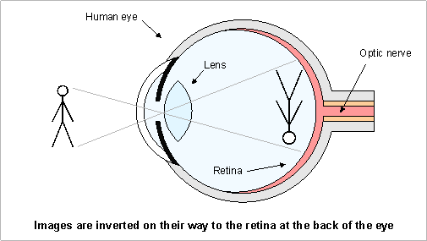
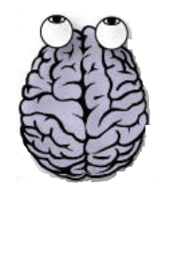


Process of seeing an object
Light reflects on object
conjunctiva
Cornea
Aqueous humour
rods
pupil
lens
vitreous humour
retina
cones
optic nerve
cerebral cortex

Slide 9
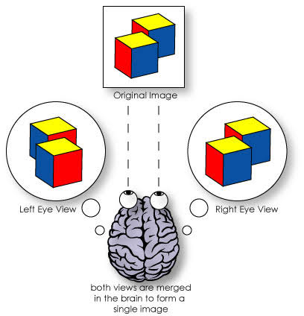
BINOCULAR VISION
Binocular vision is vison in which both eyes are used together
Our eyes are placed some distance apart, creating the ability to observe two separate images. Since each eye forms an image, the two images are combined to form a three dimensional (stereoscopic) presentation of the object.
One of the advantages of binocular vision is that it gives a wider field of view and helps the person to estimate the size, distance and depth (stereoscopic) of the object.

Slide 10
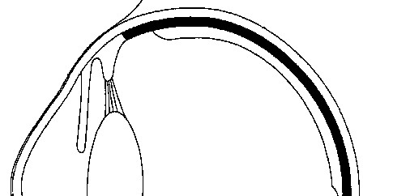
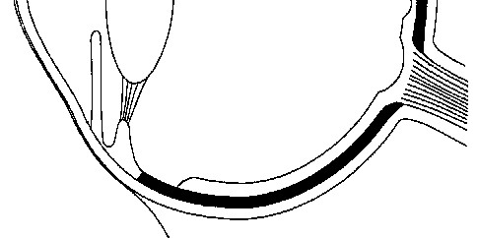
ACTIVITY 1
1.1 The diagram below represent the structure of the human eye
Give the LETTER and NAME of the part which:
1.1.1 regulates the amount of light entering the eye (2)
1.1.2 Supplies food and oxygen on the eye (2)
1.1.3 Transmits impulses to the brain (2)
1.1.4 Contains cones and is the area of clearest vision. (2)
1.1.5 Assists in the refraction of light rays (2)
B-Iris
D
D-Choroid
A
E-Optic nerve
Light stimuli
C
B
E
C-Fovea / yellow spot
A-Cornea
Structure of the human eye

Slide 11
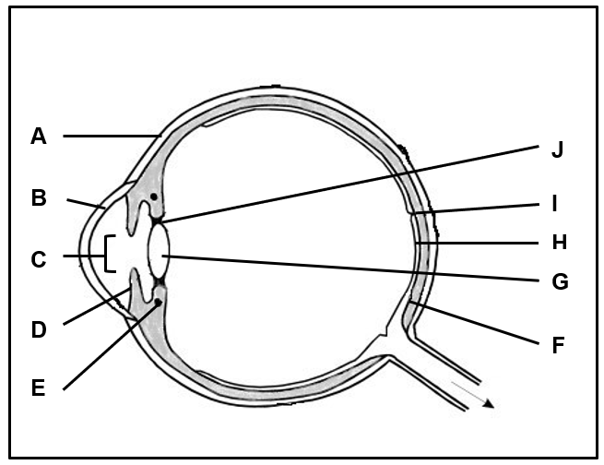
ACTIVITY 2
2.1 The diagram below represent the structure of the human eye.
2.1.1 Name the parts in the correct sequence through which light passes in order to reach structure H.
(Mention the Letter and Name in your answer. (3)
2.1.2 Explain the consequences if the light rays were to fall on part F (3)
2.1.3 Explain two ways in which the lens is structurally suited to perform its function. (4)
- Light has to pass through B-cornea, C-pupil
and G-lens before reaching H the retina
- No receptors  present
- No image will be formed  / cannot see the object
- Light will not be converted into an impulse 
- Lens is elastic therefore can change shape /convexity/allow for accommodation
- Lens is transparent  to allow light rays to pass through 
- Lens is biconvex to refract light rays 
Structure of the human eye

