Slide 1

Responding to the environment
THE HUMAN EYE:
PUPILLARY MECHANISM & ACCOMODATION
MR R.T. CHIMBUMU
Or tambo inland district

Slide 2
What the EXAM Guidelines say…
THE CHANGES THAT OCCUR IN THE HUMAN EYE FOR EACH OF THE FOLLOWING, USING DIAGRAMS:
ACCOMODATION
PUPILLARY MECHANISM

Slide 3

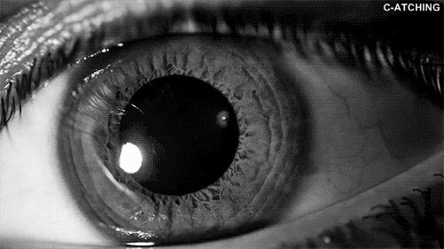

Slide 4
BEFORE WE BEGIN…..
A few things to note about the basic structure of the iris….

Slide 5
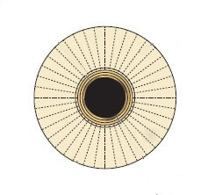
RADIAL MUSCLES
CIRCULAR MUSCLES
PUPIL
IRIS

Slide 6
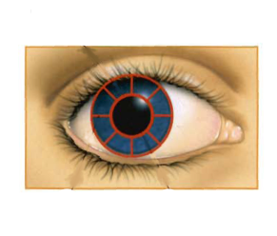
RADIAL MUSCLES
CIRCULAR MUSCLES
IRIS
PUPIL

Slide 7
CIRCULAR MUSCLES
RADIAL MUSCLES
PUPIL
IRIS

Slide 8

The pupillary mechanism is a reflex action and is often called the pupil reflex.
It responds automatically to the stimulus of the amount of light that enters the eye.
The iris regulates the amount of light entering the eye by controlling the size of the pupil.

Slide 9
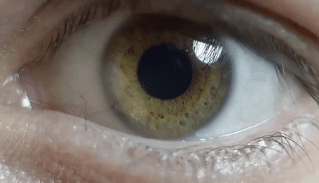
IN BRIGHT LIGHT ✓;
the pupil constricts to allow less light to enter the eye and so prevents damage to the retina ✓ by the ultraviolet rays:
The radial muscles relax ✓ R²
The circular muscles contract✓ C²
The pupil constricts ✓ (becomes smaller)
Less light enters. ✓
P C L
R² C² P C L

Slide 10
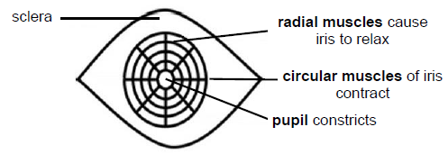
R² C² P C L

Slide 11
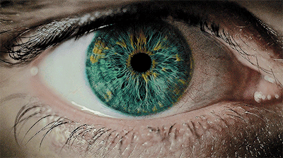
IN DIM LIGHT✓;
the pupil dilates to allow more light to enter the eye and reach the retina in order to form a clear, sharp image.✓:
The radial muscles contract ✓ RC
The circular muscles relax✓ CR
The pupil dilates (enlarges) ✓
More light enters. ✓
P D M
RC:CR:PDM

Slide 12
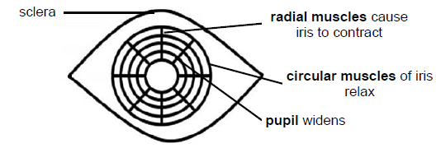
RC:CR:PDM

Slide 13
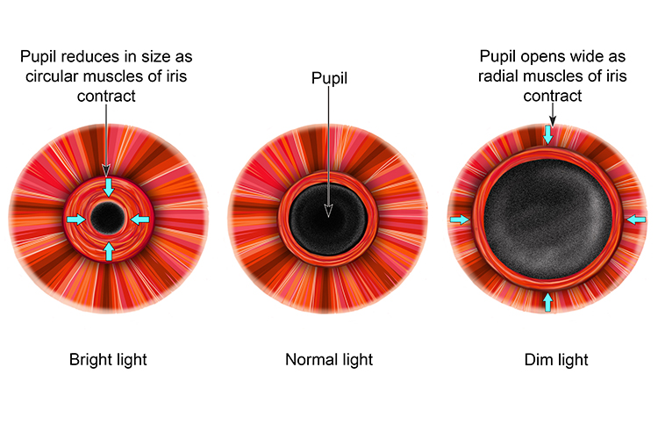


BRIGHT LIGHT
DIM LIGHT
VS
R² C² P C L
RC:CR:PDM
PICK ONE AND KNOW IT BECAUSE WHICHEVER
YOU KNOW, THE OPPOSITE IS TRUE

Slide 14
BRIGHT LIGHT VS DIM LIGHT
CONCLUSION
R² C² P C L
RC:CR:PDM

Slide 15
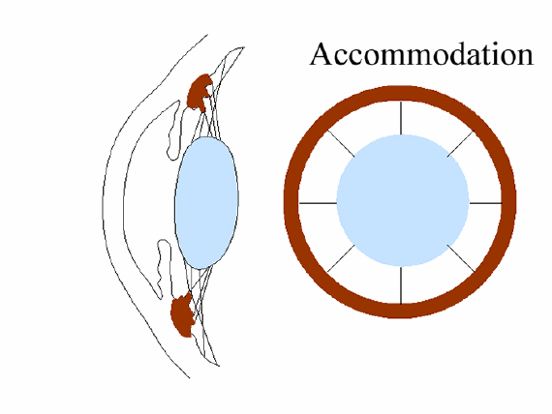
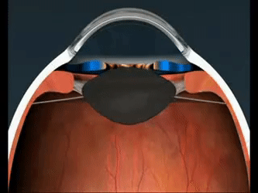
ACCOMODATION

Slide 16
Accommodation is the ability of the eye to alter the shape of the lens to ensure that a clear image always falls on the retina whether the object is near or distant.

Slide 17
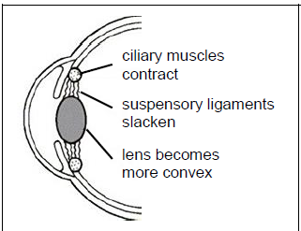
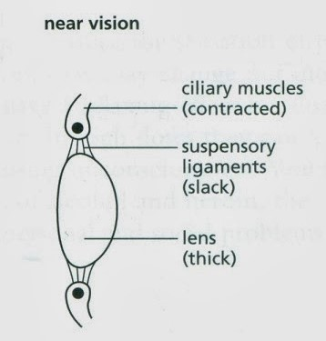
FOR NEAR VISION ✓ (observing objects closer than 6m);
Ciliary muscles contract ✓
Suspensory ligaments become slack (loosen) ✓
Tension on the lens decreases ✓
Lens becomes more convex (bulgy) ✓
More refraction (bending) of light rays occurs ✓
A clear image is focused on the retina ✓

Slide 18
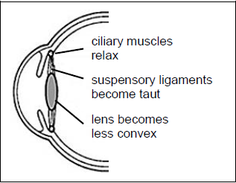
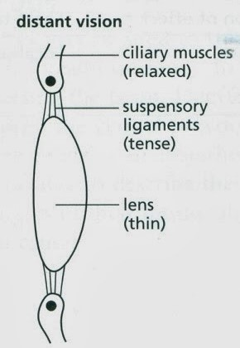
FOR DISTANT VISION ✓ (observing objects 6m or further);
Ciliary muscles relax ✓
Suspensory ligaments become taut (tightened) ✓
Tension on the lens increases ✓
Lens becomes less convex (flatter) ✓
Less refraction (bending) of light rays occurs ✓
A clear image is focused on the retina ✓

Slide 19
REVISION

Slide 20
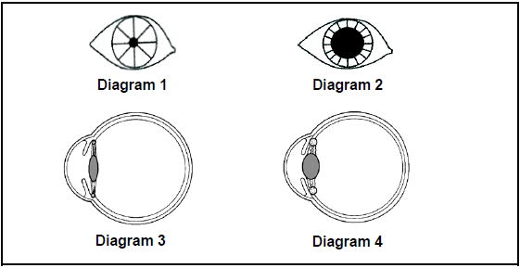
1. The diagrams below show the human eye under different conditions.
Which TWO diagrams above show the result when the ciliary muscles contract and the circular muscles of the iris relax?
1 and 3
3 and 2
1 and 4
4 and 2
Answer: D

Slide 21
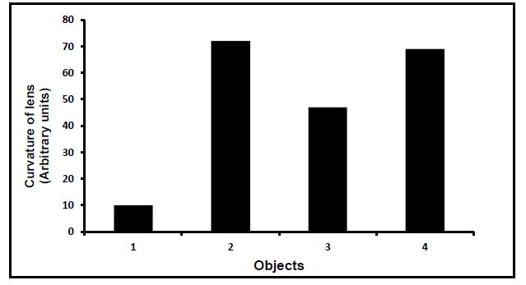
2. The graphs below show the curvature of the human lens when viewing objects at different distances.
Which ONE of the following objects is closest to the human eye?
4
3
2
1
Answer: C

Slide 22
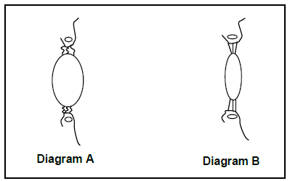
3. Diagram A and B below represent the same part of the same human eye under different conditions.

Slide 23
Which diagram, with a corresponding reason, represents a person looking at an object 10 metres away?
Diagram A because the suspensory ligaments are taut/tight and the lens is less convex
Diagram A because the lens is more convex and the suspensory ligaments are slack
Diagram B because the lens is more convex the suspensory ligaments are slack
Diagram B because the suspensory ligaments are taut/tight and the lens is less convex
Answer: D

Slide 24
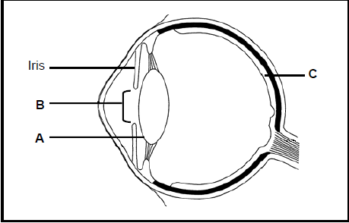
4. The diagram below represents the structure of the human eye.
4.1 Nocturnal animals sleep during the day and are active at night. Explain how part B of nocturnal animals will differ from that found in animals active during the day. (2)
Answer: The pupil/part B can dilate more✓ to allow more light to enter the
eye. ✓

Slide 25
4.2 Describe how the iris controls the amount of light entering the eye when a person is exposed to bright light. (4)
Answer: -The radial muscles of the iris relax✓
-Circular muscles of the iris contract✓
-The pupil constricts✓
-and less light enters the eye✓

Slide 26
5. A goalkeeper in a soccer match prevented a goal from being scored when he dived to save the goal after the ball the was kicked to him. Describe how his eye adjusted to see the ball as it travelled towards him. (7)
Answer: -Accommodation✓ took place.
-The ciliary muscles contracted ✓.
-Suspensory ligaments became slack. ✓
-This reduced the tension on his lens.✓
-The lens became more convex/round ✓.
-Refractive power of the lens was increased ✓.
-An image of the ball fell on the retina. ✓

Slide 27

THE END

