Slide 1
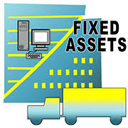
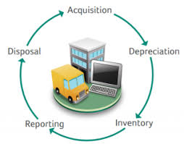
GRADE 12
ACCOUNTING

Slide 2
Presentation Outline
Fixed Assets in the context of the core syllabus
Assessing Prior Knowledge
Depreciation Policy,
Acquisition and Disposal of Fixed Assets
Disclosure: Fixed Assets and Financial reporting
Specific cases of Integration
Ethics and Internal Controls

Slide 3
PRE-AMBLE
TERM 2 TOPIC (2 WEEKS ON THE ATP)
2019: 1 PAPER; 3 HOURS; 300 MARKS
2020: 2 PAPERS; 2 HOURS EACH; 150 MARKS EACH
      Paper 1: Financial Reporting
      Paper 2: Managerial Accounting and Internal Controls
Fixed Assets forms part of BOTH disciplines, as such, different aspects of the topics can feature in each paper.

Slide 4
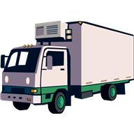
Introduction
What are fixed assets?
Why do we buy them?
What are the different categories / types?
How and where do we record them?

Slide 5

PRIOR KNOWLEDGE
In Grade 10….
  Non-current asset (long term)
  Balance Sheet accounts
  Depreciation (non-cash items)
  Accumulated Depreciation (‘negative’ asset)
  Carrying value
In Grade 11…
  Fully depreciated assets
  Asset disposal
  Calculations and Disclosure
Baseline 1

Slide 6
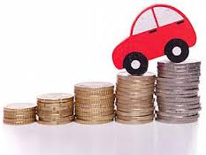
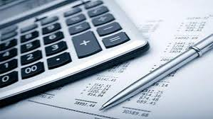
Depreciation…
Fixed Assets (except Land and Buildings) lose value due to usage (wear and tear)
Business policy to show the reduced value each year. Consider the useful life /residual value
Straight line / Fixed Instalment
% of Cost
TWO methods
Depreciation Policy:
  % on cost
  % on carrying value
  New assets: Pro-rata calculations
Diminishing Balance / Reducing Balance
% of Carrying value
Baseline 2

Slide 7
“Reading” the General Ledger Accounts…
(+) EQUIPMENT (B6) (-)
2018 Mar | 1 | Balance | b/d | 112 400
June | 30 | Bank | CPJ | 3 500
Dec | 1 | Creditors Control | CJ | 22 500
 |  |  |  | 138 400
(-) ACCUMULATED DEPRECIATION ON EQUIPMENT (B7) (+)
 |  |  |  |  | 2018 Mar | 1 | Balance | b/d | 67 300
 |  |  |  |  | 2019 Feb | 28 | Depreciation | GJ | ?
Baseline 3/4

Slide 8

Asset disposal (Sale of fixed assets)
Reasons
Accounting treatment (WHAT WE NEED TO KNOW)
  Date of sale
  Depreciation policy (rate and method)
  Cost of the asset sold
  Carrying value of asset sold (Accumulated Depreciation)
  Amount received/receivable for the asset (Proceeds)
  Profit/Loss on sale of asset

Slide 9

Example:
Date of Sale
Cost of asset sold
On 1 December 2018, sold an old office desk which originally cost R6 000 on credit for R3 000.
The Accumulated Depreciation on this desk was R3 200 on 1 March 2018 (the beginning of the financial year).
Depreciation on equipment is provided for at 15% p.a. on carrying value.
Selling Price (Proceeds)
Accumulated Depreciation
Depreciation policy
MAR | APR | MAY | JUN | JUL | AUG | SEP | OCT | NOV | DEC | JAN | FEB
Carrying Value:
R2 800
(6 000 – 3 200) x 15% x 9/12
= R315
Carrying Value:
R2 485
Activity 1

Slide 10
The asset register…
Display Warmers(ovens) Model YT554 Date purchased: 1 March 2015 Date sold: 31 December 2016 Sold for: R81 250 Depreciation policy: 10% p.a. (diminishing-balance method)
 | COST | DEPRECIATION | BOOK VALUE
28 February 2016 | R160 000 | R16 000 | R144 000
28 February 2017 | R160 000 | ? | ?
31 December 2018 | R160 000 | ? | ?

Slide 11

DISCLOSURE
INCOME STATEMENT FOR THE YEAR ENDED 28 FEBRUARY 2018
Sales
Other income
Profit on sale of asset | 3 215
Operating Expenses
Loss on sale of asset | 1 180
Depreciation (20 000 + 34 320) | 54 320
BALANCE SHEET ON 28 FEBRUARY 2018
ASSETS
NON-CURRENT ASSETS | 8 836 000
Fixed/Tangible Assets | 8 816 000
Financial Assets | 20 000
CURRENT LIABILITIES

Slide 12
FIXED ASSET NOTE…
 |  | LAND AND BUILDINGS |  | EQUIPMENT | TOTAL
 | Carrying value on 1 March 2016 | 3 850 000 |  | 645 000 | ?
 | Cost | 3 850 000 |  | ? | 4 970 000
 | Accumulated depreciation | 0 |  | ? | ?
 | Movements: |  |  | 180 000 | 1 165 000
 | Additions (at cost) | ? |  | ? | 1 465 000
 | Disposals (at carrying value) | 0 |  | (67 000) | (67 000)
 | Depreciation (total) |  |  | (233 000) | (233 000)
 | Carrying value on 28 February 2017
 | Cost | ? |  | 1 420 000 | ?
 | Accumulated depreciation | 0 |  | ? | ?
Baseline 5

Slide 13
EXTENSION ACTIVITIES….
GROUP WORK
EACH GROUP WILL REPORT ON A DIFFERENT ACTIVITY
    Activity 2 and 3
    Examples 1 – 4

Slide 14

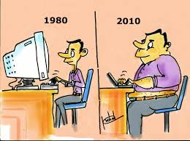


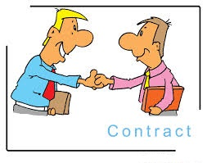




INTERNAL CONTROL PROCESSES and ETHICS…
Thank you

