Slide 1


Natural Sciences and Technology
Grade 6
Term 2: Matter and Materials
Solutions as special mixtures

Slide 2
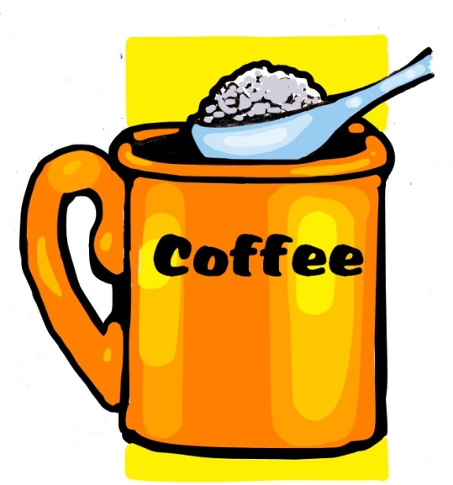

Topic 3
Solutions as special mixtures
Saturated solutions
Gr 6 Natural Sciences and Technology – Term 2, Topic 3

Slide 3

Saturated solutions
A solution is saturated when
no more solute
can dissolve in a
given amount of solvent.
For example: How many teaspoons of sugar (solute) can you add to a cup of water (solvent) before the water can no longer absorb it?
Gr 6 Natural Sciences and Technology – Term 2, Topic 3

Slide 4
Unsaturated solutions
A solution is unsaturated when
more solute
can dissolve in a
given amount of solvent.
Gr 6 Natural Sciences and Technology – Term 2, Topic 3

Slide 5
Saturated and unsaturated solutions
Saturated – NO more solute can dissolve in the solution.
Unsaturated – more solute can still be dissolved in the solution.
Gr 6 Natural Sciences and Technology – Term 2, Topic 3

Slide 6
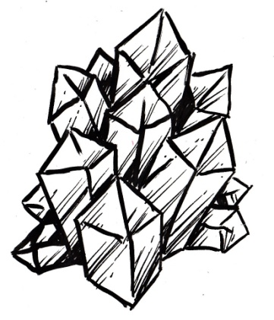
What is crystallisation?
The process of crystal forming is called crystallisation.
Crystals often form in nature when dissolved substances cool and start to harden very slowly.
Certain molecules in the dissolved substances cling together very tightly.
They do this in a uniform and repeating pattern that forms the crystal.
Gr 6 Natural Sciences and Technology – Term 2, Topic 3

