Slide 1
Natural Sciences Grade 7
Term 2: Matter and Materials
Introduction to the Periodic Table of Elements

Slide 2
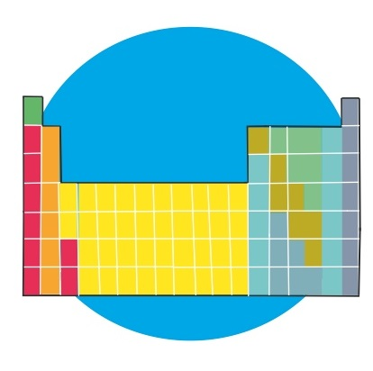
Topic 4 Introduction to the Periodic Table of Elements
Some properties of metals,
semi-metals and non-metals
Natural Sciences - Grade 7

Slide 3
Properties of metals
Shiny.
Hard (some are soft e.g sodium, lithium, potassium and can be cut with a knife).
Good conductors of heat and electricity.
Malleable (can be bent, pounded and flattened into thin sheets - known as foil -, without breaking).
Natural Sciences - Grade 7
Notes:
Metals:
- conductivity increases with decreasing temperature.
- reflect light from its surface and it can be polished e.g. copper, gold and silver.
- 100 gram of silver can be drawn into a thin wire that is 200 meters long.
- Sodium and potassium are soft metals and it can be cut with a knife.
- Iridium and osmium have the highest densities
- Lithium has the lowest density
- Tungsten has the highest melting point
- Sodium and potassium have low melting points
- Metals’ have strength under pressure (compression), stretching (tensile) and sheer forces makes them perfect for structural purposes in
cables, buildings, automobiles, bridges, aircraft frames, gas pipelines and certain sports equipment.

Slide 4
Properties of metals
Ductile (can be stretched into thin wires).
Solid at room temperature (except mercury and gallium which are liquids at room temperature).
High boiling points.
High density.
High melting points.
Magnetic (iron, nickel and cobalt).
Natural Sciences - Grade 7
Notes:
Metals:
- conductivity increases with decreasing temperature.
- reflect light from its surface and it can be polished e.g. copper, gold and silver.
- 100 gram of silver can be drawn into a thin wire that is 200 meters long.
- Sodium and potassium are soft metals and it can be cut with a knife.
- Iridium and osmium have the highest densities
- Lithium has the lowest density
- Tungsten has the highest melting point
- Sodium and potassium have low melting points
- Metals’ have strength under pressure (compression), stretching (tensile) and sheer forces makes them perfect for structural purposes in
cables, buildings, automobiles, bridges, aircraft frames, gas pipelines and certain sports equipment.

Slide 5
Properties of non-metals
Have a variety of different properties (depending on whether they are gases, liquids or solids).
Poor conductors of heat and electricity.
Brittle (breaks easily in solid form, thus not malleable).
Cannot bend without breaking.
Cannot be shaped.
Cannot be stretched (not ductile).
Dull (not shiny).
Natural Sciences - Grade 7

Slide 6
Properties of non-metals
Not magnetic.
Low melting points.
Many non-metals are gases at room temperature.
Do not reflect light.
Natural Sciences - Grade 7

Slide 7
Properties of semi-metals
Have some properties of metals and some properties of non-metals.
Examples: (B) Boron; (Te) Tellurium;
(Si) Silicon; (Sb) Antimony; (Ge) Germanium;
(As) Arsenic
Referred to as metalloids.
Natural Sciences - Grade 7

Slide 8
Properties of semi-metals
Silicon
Most common semi-metal.
Shiny (a metal property).
Brittle, not ductile, not malleable (a non-metal property).
Boron and Germanium
Shiny (a metal property).
Hard and brittle (non-metal properties).
Conducts electricity (not as well as metals; called semi-conductors - used in phones, radios and computers).
Natural Sciences - Grade 7

Slide 9
Uses of semi-metals
Sand is a compound of silicon known as silicon dioxide which is used to make glass.
Silicon and Germanium are used:
to make optical fibres (thin tubes of glass ,
slightly thicker than human hair; very light).
- in electrical devices (e.g. cell phones).
Antimony, Tellurium and Germanium are used to make re-writable DVD’s.
Natural Sciences - Grade 7

