Slide 1

GRADE 12
TOPIC: SETTLEMENT GEOGRAPHY
Rural Settlements Issues
14 APRIL 2020

Slide 2
Important aspects for this lesson
Please revise all your concepts in your textbooks(mind the gap etc)
Rural-urban migration; Rural depopulation.
Causes and consequences of rural depopulation on people and the economy;
Case study that illustrates effects of rural depopulation and strategies to address them; and
Social justice issues in rural areas, such as access to resources and land reform.

Slide 3
Rural Depopulation- A decrease in the number of people living in rural areas.
Rural- Urban migration – People move from the rural areas in search of better opportunities in cities
Rural Settlement Issues
Rural Urban Migration
The cycle of poverty illustrated below explains the situation which traps many rural populations with declining economic prospects.

Slide 4
Rural Settlement Issues
Push and pull factors causing rural-urban migration
Push factors- forcing people to move from the rural areas to the urban areas (city) | Reasons why moving might be difficult | Pull factors – attracting people from rural areas to the cities
Unemployment Mechanization on farms Poor medical and family planning facilities Fewer Primary and secondary schools Limited Social opportunities Poor services Widespread poverty Natural Hazards eg droughts. Population pressure leading to insufficient land | Costs Dangers Distance Transport Leaving family | Better career prospects Better medical and family planning facilities Better educational opportunities Better housing Better social life Better shops, transport and communications Higher wages and standard of living Less threats from natural hazards

Slide 5
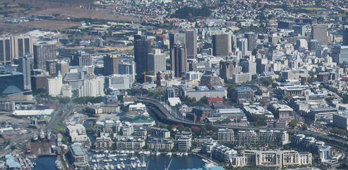
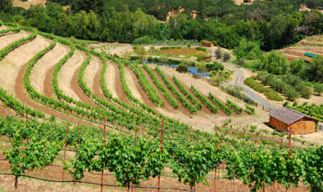
RURAL-URBAN MIGRATION: Movement from rural to urban areas
FACTORS
CONSEQUENCES
PULL
FACTORS
PUSH
FACTORS
Empty farmhouses
Crime (Farm murders)
Unemployment
Few new investments
Many old people
TO CITY
ATTRACT
people to
the cities
FORCE
people to
the cities
WHAT CAN
BE DONE?
Advertise town
Recreation
Tourism
Restore buildings
Rural schools
Cheap Indus sites
Few young men
Low value of properties
Shops close
Empty schools
Services below standard
Rural depopoulation
Better jobs
Salaries
Education
Medical fac.
Bright lights
Mechanization
Low salaries
Droughts
Crime
Unemployment

Slide 6
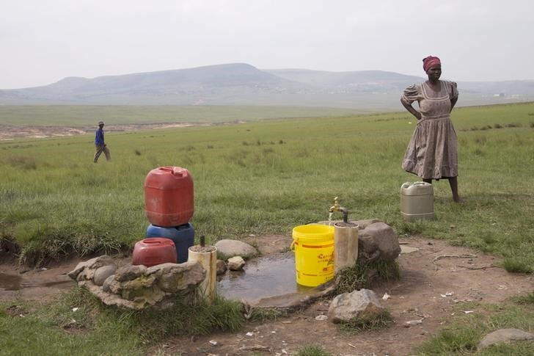
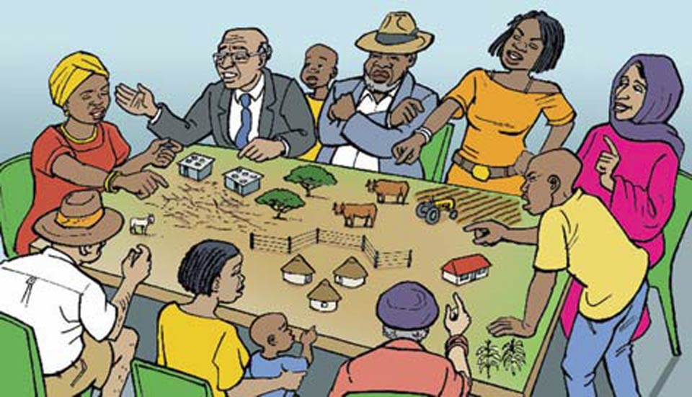
Strategies to encourage people to stay in rural areas
Social Justice Issues
WHAT IS SOCIAL JUSTICE?
Ensuring that people are treated equally and that all their socials needs are provided for.
Land Reform
AGENDA 21 – is a broad strategy to develop rural areas.
In SA land is a highly contested resource.
The current South African government aims to alleviate poverty especially in rural areas by transferring landownership to South Africans who have been denied access to this economic resource.
This objective will be achieved through land reform programmes. What are these programs?
Access to land
Poverty and the lack of access to resources hinder access to social justice.
Basic needs(Food,shelter,clothing and clean running water must be satisfied before any development can happen.
Improve services eg Electricity and roads

Slide 7
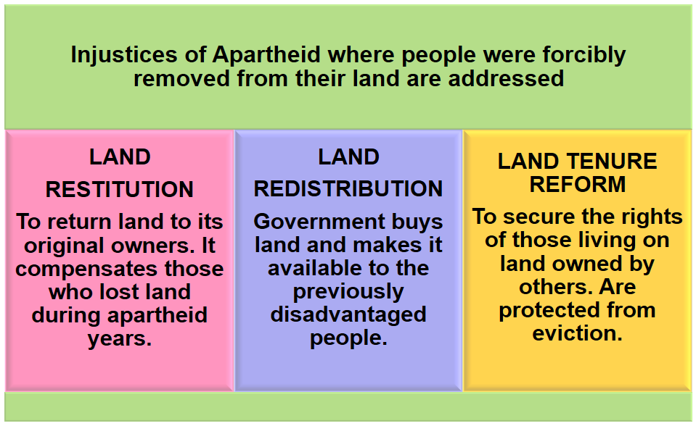
LAND REFORM

Slide 8
SOCIAL JUSTICE ISSUES IN RURAL AREAS
CASE STUDY: TELLING THE STORY ABOUT SOUTH AFRICA'S RURAL POOR
TELLING THE STORY ABOUT SOUTH AFRICA'S RURAL POOR
by Gara LaMarche
This is a story about the Skhosanas, interviewed by Social Surveys Africa:
Until 2001, they survived relatively well on the farm. They had a tap for water; they had firewood. Then the farm was sold to a new owner who wanted the Skhosanas off the land. For two years, they fought eviction. After all, this was the 'new' South Africa, and, for the first time, they had rights. But the farm owner shut down their water tap and ordered them to stop gathering wood on his land. Finally, the owner came early one morning when the children were still asleep, broke down the door, and threw the family's furniture and belongings onto the road. The children were afraid they would have nowhere to sleep. Mr Skhosana was ill and could not work anymore. Mrs Skhosana says she will never forget the experience of 'being thrown out like rubbish'.

Slide 9
Assessment – Social Justice Issues
Read the article below on a social justice issue in South Africa
1.1.1 Explain what is meant by the term social justice. (1 x 1) (1)
1.1.2 Name the social justice issue that the story captures. (1 x 1) (1)
1.1.3 Why is the word 'new' emphasised in the article? (1 x 2) (2)
1.1.4 Name the law that secures the rights of people who live under insecure conditions on land owned by others. (1 x 2) (2)
1.1.5 Excluding the social justice issue mentioned in QUESTION 1.1.2 discuss TWO other social justice issues experienced in rural areas. (2 x 2) (4)
1.1.6 Discuss any TWO problems that the government experiences with land reform. (2 x 2) (4)
Total (13)

Slide 10
Memorandum to Assessment
1.1.1 Ensuring that people are treated fairly and that all their socials needs are provided for [CONCEPT] (1 x 1) (1)
1.1.2 Being denied access to a home . (1 x 1) (1)
1.1.3 It shows that although we are living in a democratic country some
things have not changed (2) (1 x 2) (2)
1.1.4 Land tenure reform (2) (1 x 2) (2)
1.1.5 No access to piped water (2)
No electricity (2)
No access to basic services such as clinics, schools, proper infrastructure (2)
Insufficient job opportunities, underpaid (2)
[Any TWO. Accept other reasonable answers] (2 x 2) (4)

Slide 11
Memorandum to Assessment cont…..
1.1.6 The willing buyer/seller principle takes time to settle (2)
It takes time to mediate disputes and resolve issues (2)
Huge costs are involved (2)
Political interference (2)
Distrust in government's reasoning (2)
Eviction of farm workers despite the new land tenure laws (2)
Lack of support from government (2)
Disagreement between government and traditional leaders about the
extent of land to be restored (2)
People having no interest in farming or agricultural knowledge and therefore not
utilising the redistributed land (2)
[Any TWO. Accept other reasonable answers] 2 x 2) (4) Total (13)

Slide 12
Worksheets and answer sheets on the website
In conclusion I would like you to access the following on the department website :
PowerPoint slides on Rural settlements, rural settlement issues.
Worksheets on Rural and Urban Settlements
Answer sheets to the worksheets.
KEEP SAFE AND SPEND AT LEAST ONE HOUR REVISING YOU WORK.

