Slide 1


GENETICS AND INHERITANCE
MONOHYBRID CROSSES

Slide 2
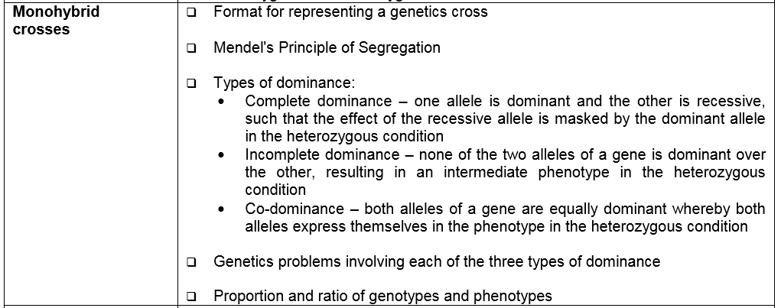
EXAMINATION GUIDELINES

Slide 3

MONOHYBRID CROSSES
Based on Mendel’s experiments conducted with pea plants
Pure (true) breeding pea plants were crossed to study the inheritance of one characteristic at a time e.g. tall pea plants were crossed with dwarf/short plants.
QUESTION?
STATE THE CHARACTERISTIC THAT WAS BEING INVESTIGATED IN THIS EXPERIMENT?
ANSWER:HEIGHT
All offspring in the first (F1) generation were tall , none were dwarf. He allowed the offspring of the F1 generation to self fertilise and the offspring of the second generation came out in the ratio
3 Tall plants : 1 short Plant

Slide 4
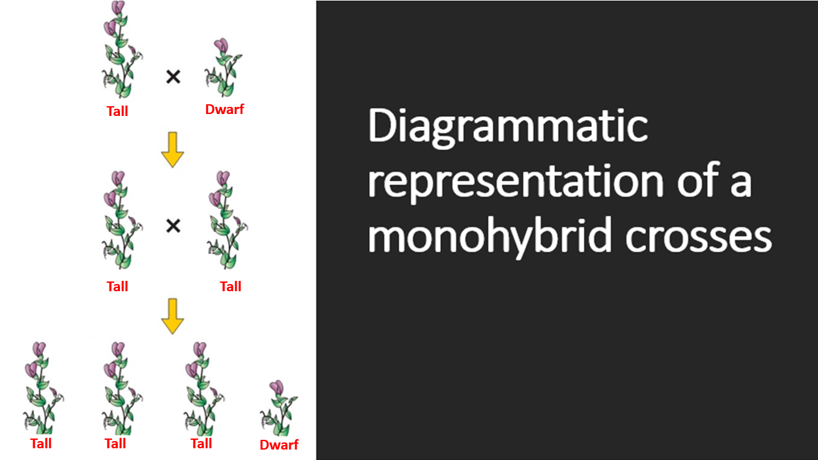

Slide 5

TEMPLATE FOR A GENETIC CROSS
P1 phenotype
genotype
meiosis
gametes
fertilization
F1 genotype
phenotype
Tall X Dwarf
TT X tt
T, T X t, t
Tt Tt Tt Tt
All Tall

Slide 6
USING A PUNNET SQUARE IN A GENETIC CROSS
P2 phenotype
genotype
meiosis
gametes
fertilization
F2 genotype TT, Tt, Tt, tt
phenotype 3 Tall: 1 dwarf
Tall X Tall
Tt X Tt
T, t X T, t
 | T | t
T | TT | Tt
t | Tt | tt

Slide 7
MENDEL’S PRINCIPLE OF SEGREGATION
States that the two alleles for a characteristic separate or segregate during gamete formation (meiosis) so that each gamete contains only one allele for that characteristic.

Slide 8
MENDEL’S LAW OF DOMINANCE
States that if homozygous individuals with contrasting characteristics are interbred, the F1 generation will show the dominant characteristic

Slide 9

ACTIVITY 1
In pea plants round (R) seed shape is dominant over wrinkled (r) seed shape. Use a genetic cross to determine the genotypic ratio of the offspring that result from crossing two heterozygous pea plants.

Slide 10
TEMPLATE FOR A GENETIC CROSS
P1 phenotype
genotype
meiosis
gametes
fertilization
F1 genotype
genotypic
ratio
phenotype
Round X Round
Rr X Rr
R, r X R, r
RR Rr Rr rr
1RR: 2 Rr: 1 rr
3 Round, 1 wrinkled

Slide 11
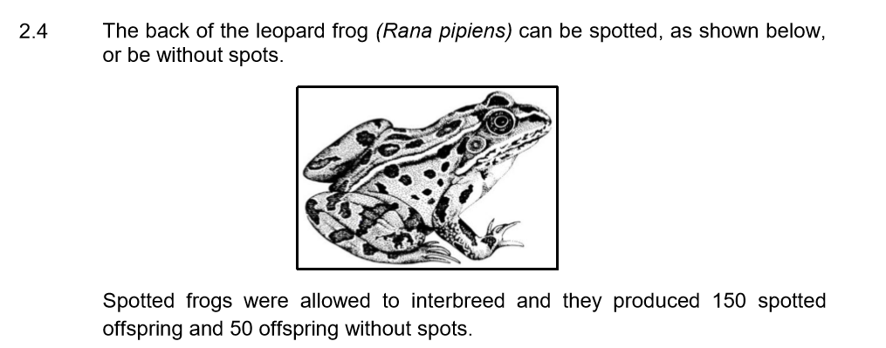
ACTIVITY 2 – Q2.4 P2 NOV 2019

Slide 12
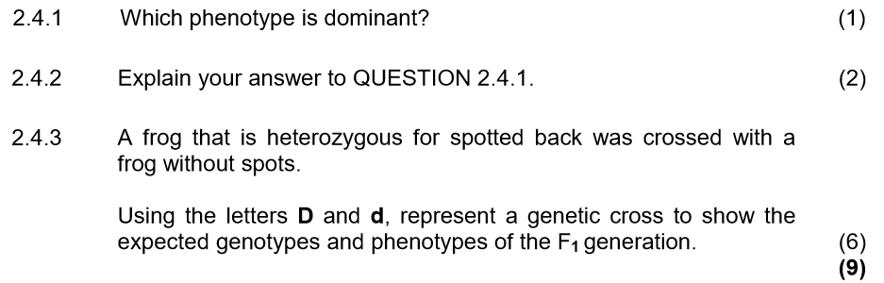
QUESTIONS
Spotted back
Spotted frogs produced offspring without spots/ The spotted offspring were three times more than offspring without spots/ ratio of spotted offspring to offspring without spots is 3:1

Slide 13
TEMPLATE FOR A GENETIC CROSS
P₁ | Phenotype | Spotted |  |  | x | Without spots
 | Genotype | Dd |  |  | x | dd
Meiosis
 | G/gametes | D , d |  |  | x | d , d 
Fertilisation
F₁ | Genotype | DD ; Dd ; dd ; dd*
 | Phenotype | (2) spotted ; (2) without spots*
P₁ and F₁
Meiosis and fertilisation |  |  |  | 2 compulsory + any 4
Can do a cross using Punnet square if you prefer

Slide 14
TYPES OF DOMINANCE: COMPLETE DOMINANCE
T x t
A genetic cross where the dominant allele masks (blocks) the expression of a recessive allele in the heterozygous condition
E.g. In Pea plants tall is dominant (T), dwarf is recessive (t)
Tt
Tall

Slide 15




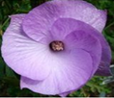
INCOMPLETE DOMINANCE
A genetic cross between two phenotypically different parents produces offspring different from both parents but with an intermediate phenotype
None of the two alleles of a gene is dominant
Both alleles are represented with a capital letter but different letters are used
Red flower
White flower
Pink flower
X
RR
WW
RW
X

Slide 16
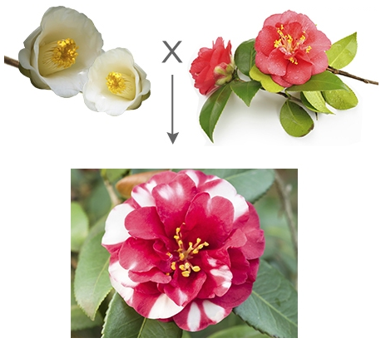
CO-DOMINANCE
Red camellia
White camellia
WW
RR
A genetic cross in which both alleles are equally dominant and are expressed equally in the phenotype of offspring in the heterozygous state
Red and White camellia
RW
https://biologywise.com/codominance-explained-with-examples

Slide 17
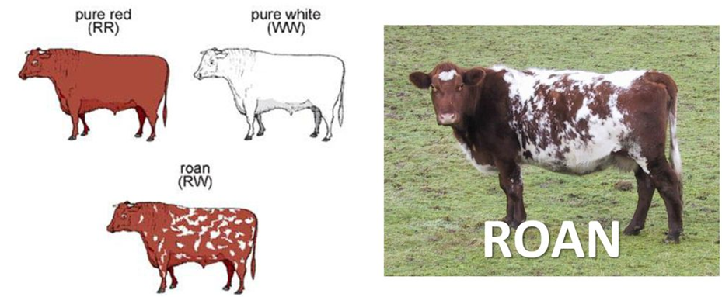
CO-DOMINANCE IN ANIMALS
Other examples: Blood groups in humans e.g. AB blood group (SEE LATER)

Slide 18
ACTIVITY: GENETICS WORKSHEET 2

