Slide 1

How to shorten a link
Take long URLs and shrink them into much smaller ones

Slide 2
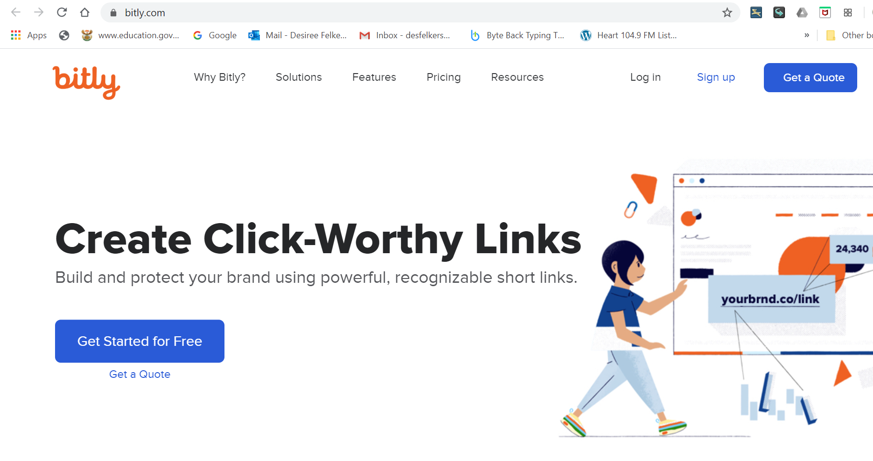
In your web browser, go to https://bitly.com
Click Sign up

Slide 3
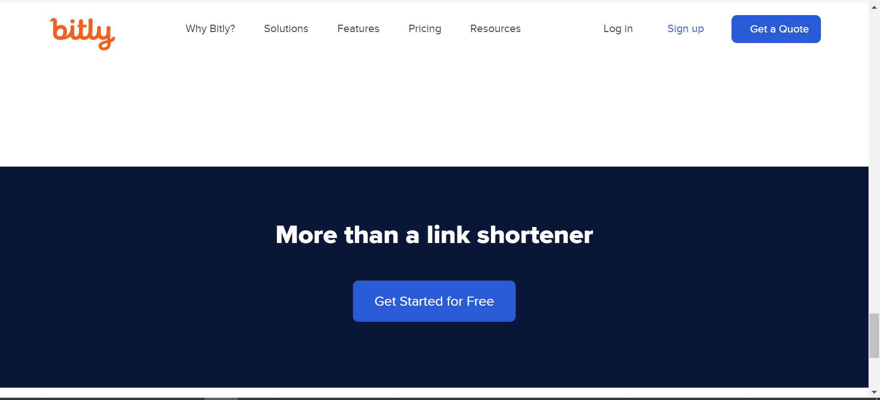
Scroll down and click on Get Started for Free

Slide 4
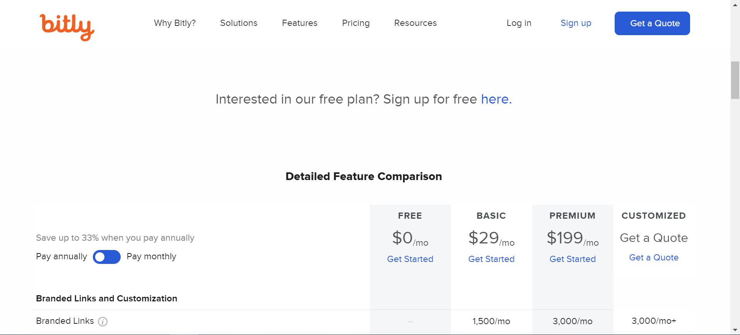
Scroll down and click on the link to Sign up for free here

Slide 5
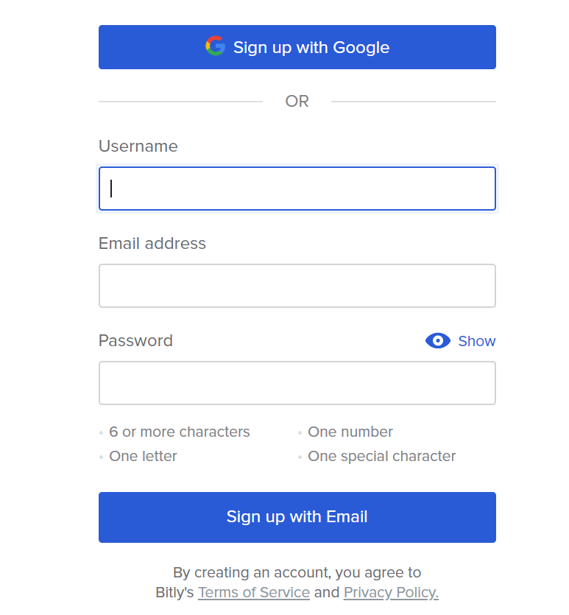
Choose to sign up with Google or with an Email account (Gmail will work well)

Slide 6
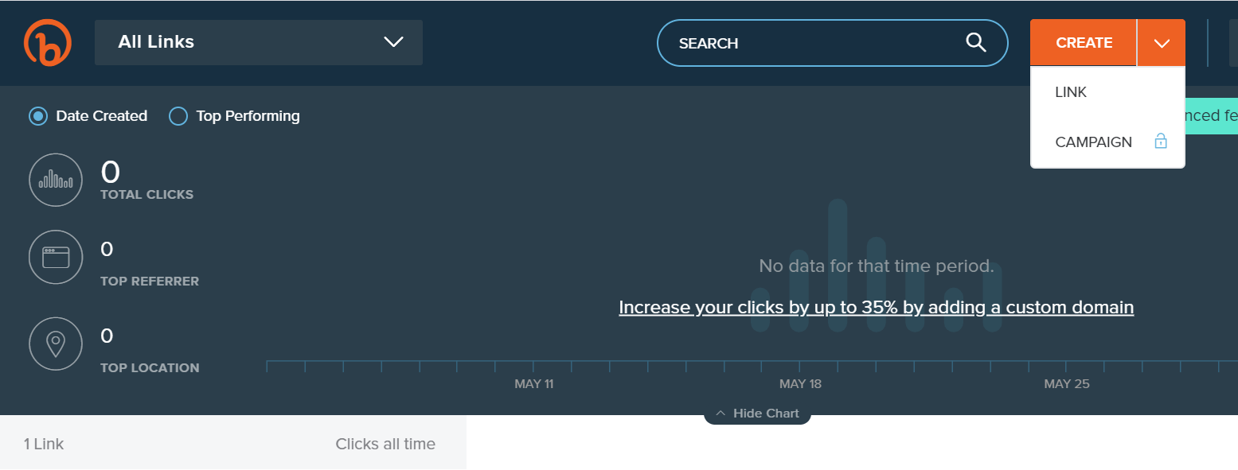
Click on the arrow next to Create and select Link

Slide 7
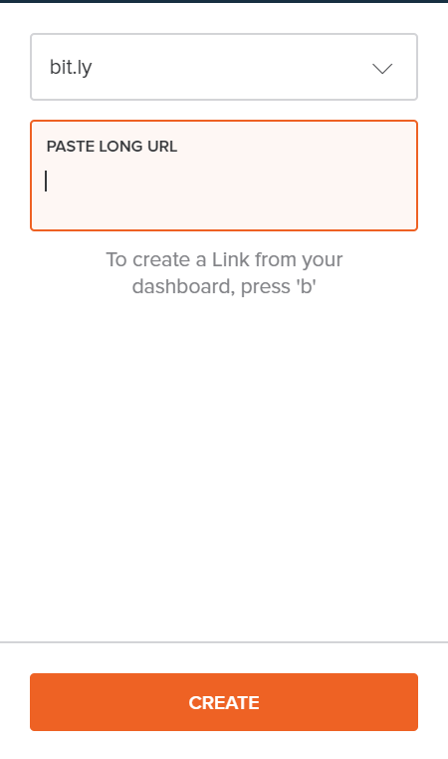
Enter the full URL in the box
Click Create

Slide 8
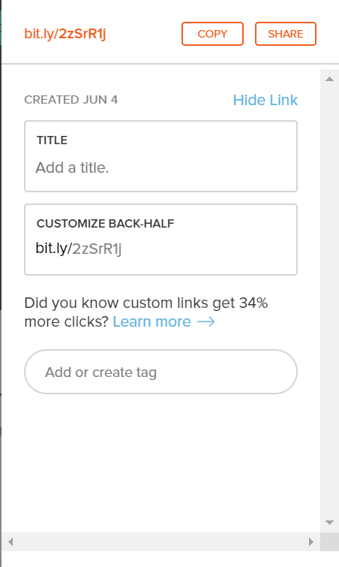
Shortened link
Click the Copy button and then go to wherever you want to use it and paste it.
When you click on the shortened link or enter it into your web browser, it gets converted back to is full length.

Slide 9
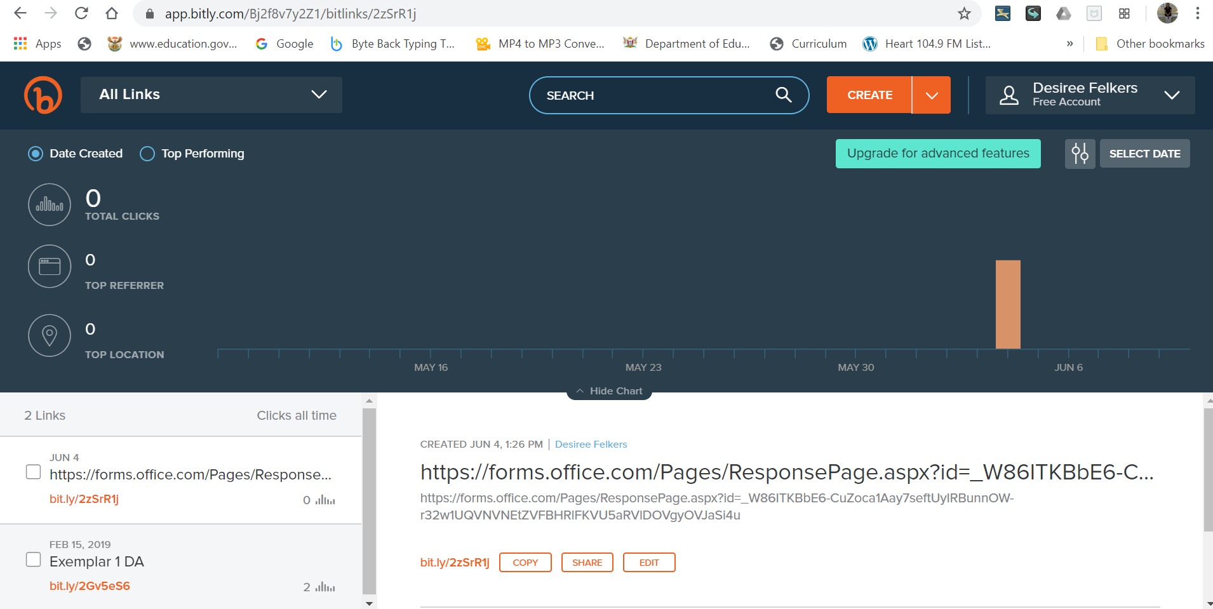
Stay signed in. The next time you go to https://bitly.com this will be your landing page.

