Slide 1
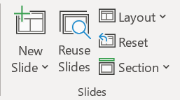
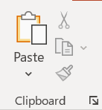

PowerPoint
Lesson 2

Slide 2

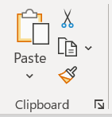

4. In the Clipboard Group, click Paste
3. Click on the place in the presentation where you want to paste the text
2. On the Home tab, in the Clipboard Group, click Copy
1. Select the text you want to copy
Copy and Paste within
the presentation

Slide 3
4. In the Clipboard Group, click Paste
3. Click on the place in the presentation where you want to paste the text
2. On the Home tab, in the Clipboard Group, click Cut
1. Select the text you want to move (cut)
Cut and Paste within
the presentation

Slide 4

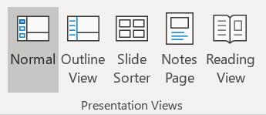
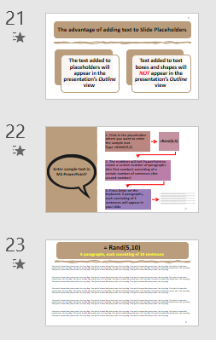
1. When you copy slides, you can specify the theme that you want the new slides to adopt
2. Click View, and then in the Presentation Views group, click Normal.
3. In the slide thumbnails on the left side, click the slide(s) that you want to copy
4. On the Home tab, in the Clipboard Group, click Copy
To paste an item, using
a SPECIFIC FORMAT,
use the Paste Special
Command

Slide 5
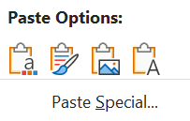


7. To take the theme of the destination presentation, click Use Destination Theme This will adapt the copied slide to match the destination theme
5. To paste the slides into the new location: On the Home Tab, in the Clipboard group, click the down-pointing arrow under Paste
6. The Paste Special Dialogue box opens
8. To maintain the theme of the presentation you are copying from, click Keep Source Formatting. This implies that the slide will keep its original theme format and not the theme of the destination presentation
To paste an item, using
a SPECIFIC FORMAT,
use the Paste Special
Command (Cont’d)

Slide 6
How to select multiple slides
To select multiple sequential slides, click the first slide, press SHIFT, and then click the last slide that you want. Alternatively, you can click on the first slide, press SHIFT and then press the CURSOR DOWN button until you get to the last slide
To select multiple non-sequential slides, press CTRL, and then click each slide that you want

Slide 7


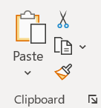
1. If you have written text in PowerPoint, and have it formatted using a specific font type, colour, and font size, you could copy that formatting to another slide by using the Format Painter tool
6. If you double-clicked the Format Painter after selecting the text, you can use it multiple times
2. Select the text with the formatting you want to copy
3. On the Home tab, in the Clipboard Group, click Format Painter
4. The pointer changes to a paintbrush
5. Click and drag to select the text that you want to format and release the mouse button
7. Click it once more or press the Esc key to deactivate it
Copy formatting from
one item to another
using the Format Painter

Slide 8
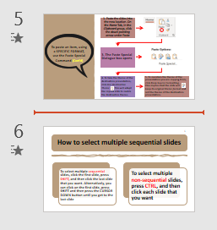
1. When you reuse / import a slide from one presentation to another, it is simply a copy of the original
3. Open the Presentation that you want to add a slide to
2. Changes you make to the copy do not affect the original slide in the other presentation
4. In the left pane where you see thumbnail images of your slides, click in-between the slides where you want to add the imported slide
How to Import / Reuse
Slides from another
Presentation
5. A red line will appear between the slides

Slide 9

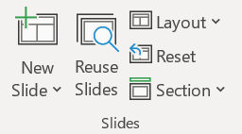
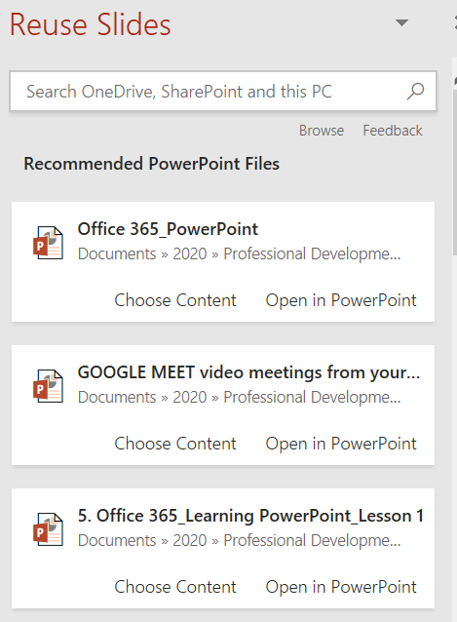
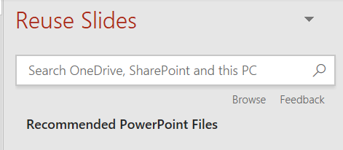
6. On the Home tab, in the Slides group, click on Reuse Slides
7. A new pane will appear on the right, which will ask you to locate the file you want to obtain the new slides from
8. Click Browse
How to Import / Reuse
Slides from another
Presentation (Cont’d)

Slide 10
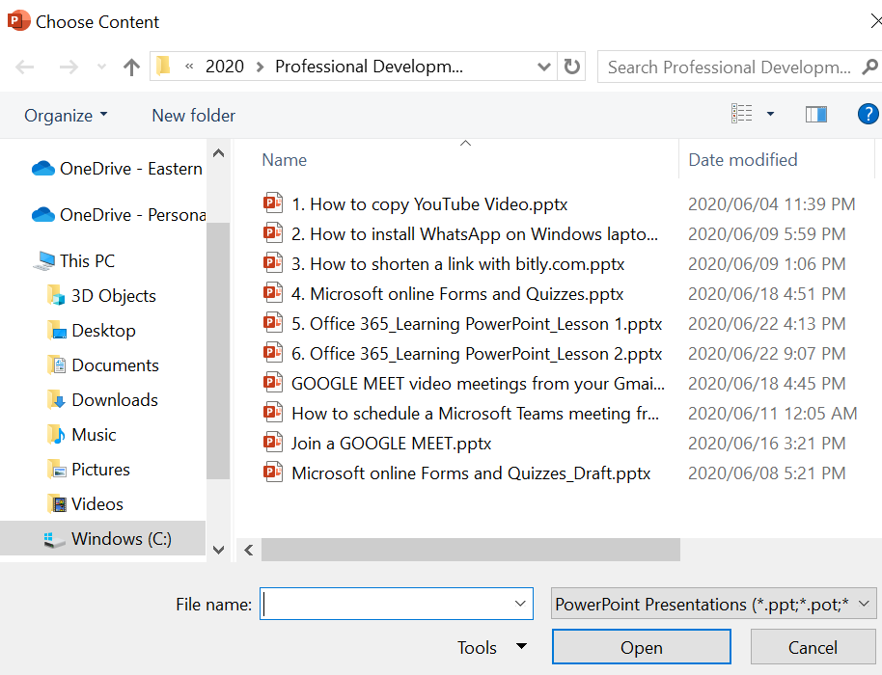
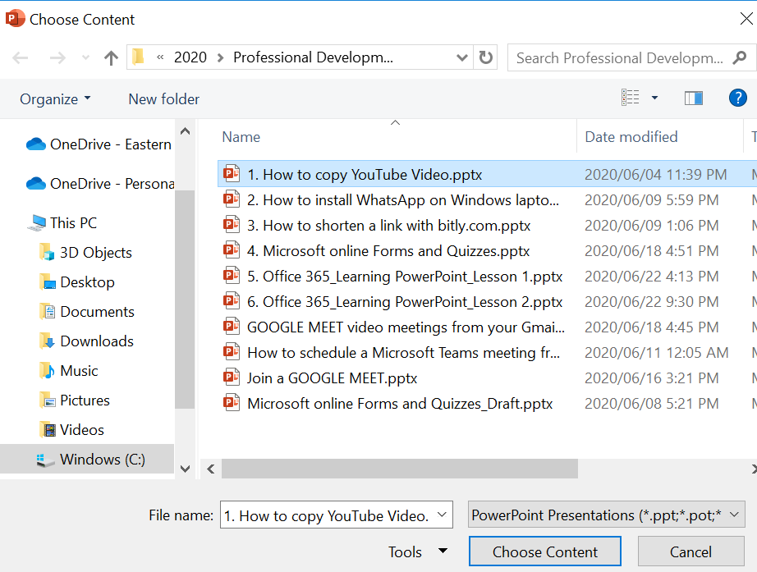
9. This summons a Browse dialog box
10. Locate the file that you wish to import slides from and click Choose Content
11. The slides from the presentation you selected are displayed in the Reuse Slides task pane on the right
12. If you want the slide that you are adding to the destination presentation to maintain the formatting of the original presentation, select the Use source formatting check box before you add the slide to the destination presentation
How to Import / Reuse
Slides from another
Presentation (Cont’d)

Slide 11
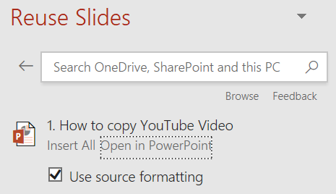

14. To insert a slide, click the slide or click Insert Slide
15. When you’re done, click the X at the top right of the Reuse Slides task pane to dismiss it
13. With the Use source formatting option deselected, the slide assumes the theme of the presentation it is inserted into
16. If you accidentally import an unwanted slide, right-click the slide IN THE LEFT PANE and select Delete Slide
How to Import / Reuse
Slides from another
Presentation (Cont’d)

Slide 12
1. If you edit a slide layout too much, you might find that you cannot quite get it into the layout you want, and that you would like to start over
3. On the Home tab, in the Slides group, click Reset
4. Notice how it resets the text on the slide to its default settings
2. You can reset a slide, which will restore the position, size, and formatting of your slide to its default state
Reset a PowerPoint Slide
to its original
(default) Settings

Slide 13
1. If you have edited the formatting of a PowerPoint slide individually you may have detached it from its slide master
3. Also, if you change the formatting on the slide master, the changes may not be carried through to this slide
4. When you reset a PowerPoint slide to its Slide Master Settings, ensure that you are on the slide that has been detached from its master
2. This means that it will be inconsistent with other slides
Reset a PowerPoint
Slide to its
Slide Master Settings

Slide 14
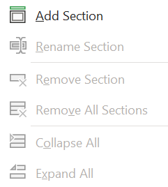
1. If you have a lot of slides, you can organize them into Sections to make your presentation easier to navigate
3. From the Home tab, in the Slides group, click the Section command
4. Choose Add Section from the drop-down menu
2. To create a new section in your presentation, select the First Slide that you want in the New Section
How to create a
new Section in
your PowerPoint
Presentation

Slide 15
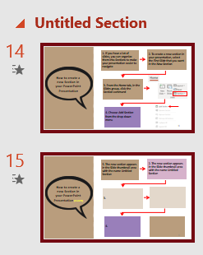
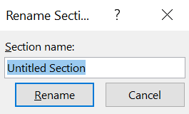
5. The new section appears in the Slide thumbnail area with the name Untitled Section
6. Type the new Section name in the dialog box, then click Rename
7. Repeat to add as many sections as you need
8. To collapse or expand a section, click the triangle next to the section name
How to create a
new Section in
your PowerPoint
Presentation (Cont’d)

Slide 16
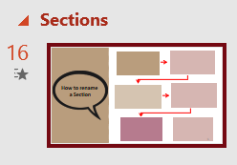
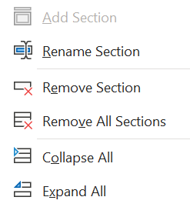
1. In the left pane where you see thumbnail images of your slides, click on the Section name
2. On the Home tab, in the Slides group, click the Section command
3. Click Rename Section and give it a different name. During a slide show, you can select the section you want to go to
How to rename
a Section

Slide 17
1. In the left pane where you see thumbnail images of your slides, click on the Section name
2. On the Home tab, in the Slides group, click the Section command
3. Click Remove Section. When you remove a Section, you are not removing the slides, you are only removing the Section
How to remove
a Section

